Slide 1
Closing the GAP: Improving the Accuracy of gem5’s GPU Models
Vishnu Ramadas, Daniel Kouchekinia, Ndubuisi Osuji, Matthew D. Sinclair
University of Wisconsin-Madison, AMD Research
Notes:
Good morning! I'm Daniel Kouchekinia, a 5th year undergrad presenting here on behalf of the University of Wisconsin-Madison’s heterogenous architectures lab. I'll be presenting our work on improving the accuracy of gem5's GPU models so that the optimizations we make in gem5 yield results that are grounded in reality
This work has been done under the guidance of Professor Matt Sinclair and in collaboration with Vishnu Ramadas and (In-doo-boo-see Ooh-su-ji).

Slide 2

Prior CPU-GPU SE Mode Support in gem5
Execution-driven, cycle-level
Models complex CPUs & GPUs
Rapid prototyping of new features
Simulates HIP (AMD’s GPGPU language) applications
UW HAL Group
Creating, validating and releasing docker image to run GPU models with updated versions of ROCm
Released support for several GPU workloads in gem5-resources, enabled CI testing
Publicly-available support focuses on Carrizo- and Vega-Class
Do not always provide high accuracy relative to equivalent real GPUs (hazardous)
[Gutierrez et al., HPCA ‘18]
2
Notes:
The existing gem5 GPU support was introduced by AMD Research at HPCA 2018. They introduced a new cycle-level, execution-driven GPU model that uses AMD’s ROCm stack to run HIP applications.
Our group has been enhancing this to run CPU-GPU experiments in gem5. Prior work our group has done includes creating, validating, and releasing a docker image to run GPU models that include updated versions of ROCm. Additionally, we’ve updated gem5 to make it easier to reproduce results, released support for a number of GPU workloads in gem5-resources, as well as enabled continuous-integration testing for many of these.
One major area for improvement in gem5s GPU support is the accuracy of its models when compared to real GPUs (at least in the public models). This mismatch in accuracy has the potential to be hazardous, with gem5 users prototyping new optimizations being at risk of drawing incorrect conclusions as to the efficacy of their optimizations.

Slide 3
Improving Register Allocation Support
Simple register allocation – only 1 wavefront/CU at a time
Even if sufficient registers are available for more WFs
Issue: unrealistic relative to real GPUs
Solution: add dynamic register allocator [Bruce et al. ISPASS ‘20]
If enough registers available, schedule additional WFs concurrently/CU
Potentially can utilize all WF slots depending on register requirements
More complex, higher performance designs possible
Intuition: Dynamic allocator significantly improves accuracy
3
Notes:
In the process of our work, one of the things we noticed was that we weren’t getting enough parallelization in some cases. Investigating this, we saw that gem5’s GPU model had a very simple register allocator that led to only 1 wavefront being assigned per compute unit at a given time. This is unrealistic, as a real GPU will run many wavefronts in parallel provided enough resources are available.
To increase the number of wavefronts that could be run at once to take advantage of all the available resources, we decided to add support for a dynamic register allocator that could allocate multiple wavefronts per CU.
(Click)
Intuitively, this should significantly improve accuracy relative to real systems.

Slide 4
Dynamic Register Allocator Performance
Reality: dynamic register allocator 6% worse than simple – why?
4
Notes:
We tested both allocators on a variety of testbenches and we've plotted the results here. The test benches are along the bottom here, with speedup of the simple allocator in blue and with the dynamic allocator in orange.
(Click)
Counter to our intuition, these results show that the dynamic register allocator is actually slightly worse than the simple one.

Slide 5
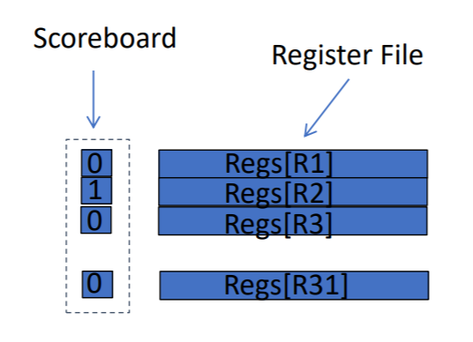
Issue: Dependence Tracking
GPU model did not track dependencies well → many stalls
Result: optimizing register allocation in isolation was insufficient
Issue: Proprietary GPU dependence checking sols unknown
Solution: simple, in-order scoreboard
Bit per register to track use status
Cleared on instruction completion
Checks for RAW/WAW hazards
Result: up to 44% reduction in stalls
5
Notes:
In investigating why this was the case, we realized that the GPU model wasn't tracking dependencies well, which led to stalls that ultimately hurt performance. Optimizing the register allocations alone was therefore not sufficient. But there was a problem with improving dependency tracking to be more realistic: the solutions actually used in hardware are proprietary and not publicly available. It was only through digging into literature and patents that we were able to determine that using a simple in-order scoreboard to keep track of register dependencies could help.
(Click)
And it did, resulting in up to a 44% reduction in stalls, improving accuracy relative to the equivalent real GPU.

Slide 6
Issue: Unknowns in Proprietary Solutions
Point solution (not scalable)
Need for examining GPU behavior at a finer granularity
Goal: Isolate behavior of different components to attack inaccuracies at a more digestible level
Targeting specific corresponding statistics in gem5 and the ROC profiler
6
Notes:
However, this example was ultimately a point-based solution; We found an inaccuracy at a high level and had to dig in deep to understand and rectify the underlying cause. For broader improvements to gem5's GPU accuracy, this approach just isn't scalable.
To have a more systematic approach, we need to be able to examine GPU behavior at a finer granularity, isolating individual components. By testing these individual components, we could then directly compare isolated statistics between the simulator and the real GPU, making analysis more digestible.

Slide 7
Microbenchmarks
Hand-tuned HIP assembly kernel μBenches
Atomic operations latency & bandwidth (with and without conflicts)
L1 I$ size & latency
L1 scalar and vector D$ size, latency, & bandwidth
LDS (scratchpad) latency & bandwidth
L2 $ latency & bandwidth
Main memory latency & bandwidth
TLB/Page Table latency & bandwidth
Max FLOPs, Arithmetic latency for various operations, …
Compare μBench output and GAP script [Jamieson gem5 Workshop ‘22] analysis to identify underlying inaccuracies
7
Notes:
So, we set out to do exactly this by writing a set of microbenchmarks to exercise specific components. These are hand-tuned HIP assembly kernels that measure metrics such as the latency and bandwidths of atomic instructions, different levels of the cache, memory, and LDS, as well as max FLOPS.
The output of these microbenchmarks from gem5 and the real GPU can then be compared to help identify underlying sources of inaccuracy.
Additionally, GAP (the gem5 GPU Accuracy Profiler), a script developed by our group and which we presented at last year’s gem5 workshop, can then be used to compare corresponding statistics between the ROC profiler and gem5's stats to lend further insight.

Slide 8
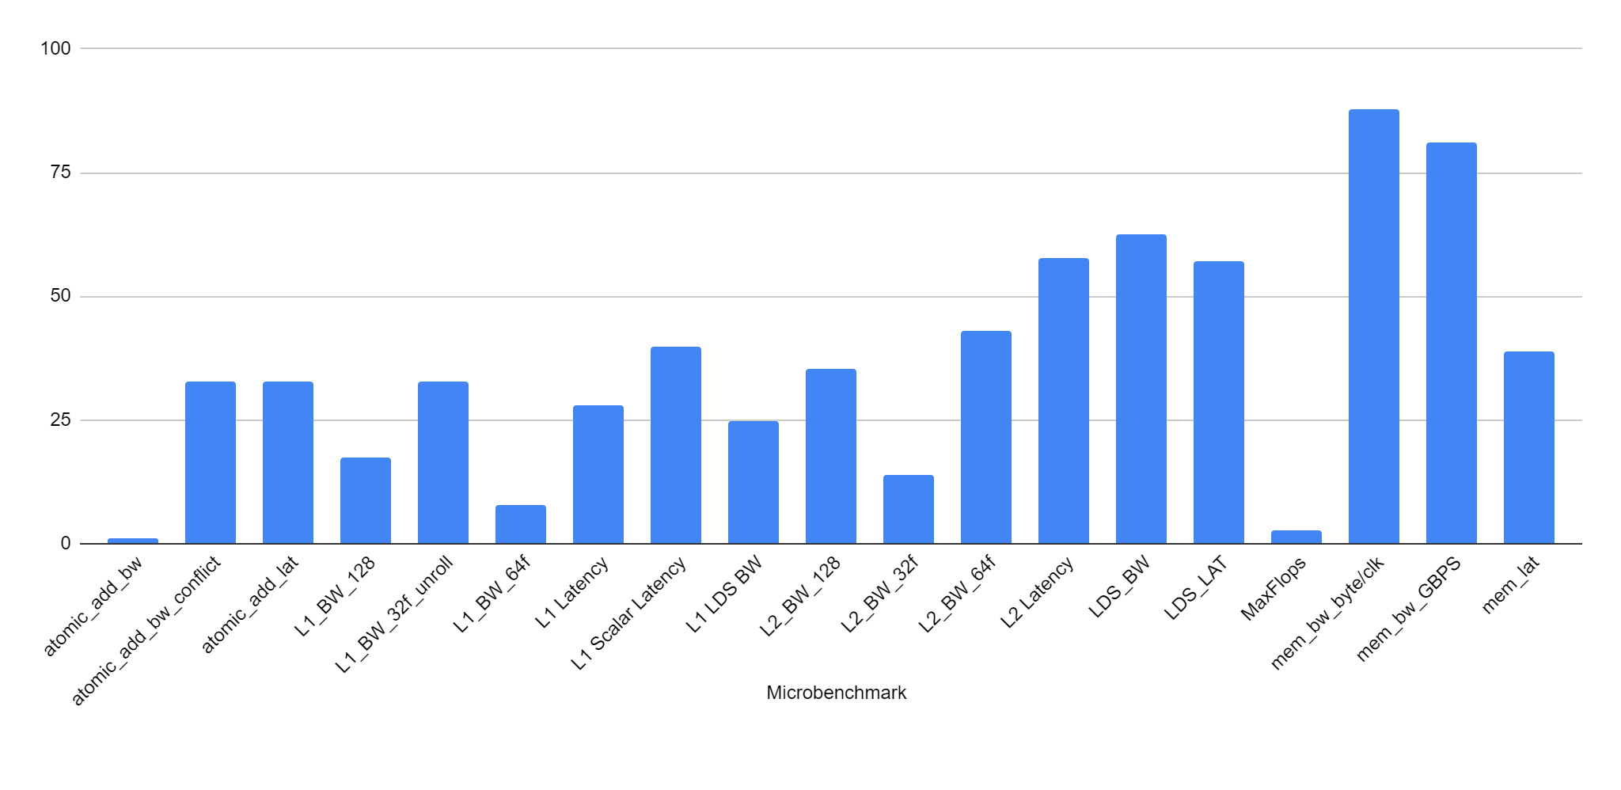

μBench Results Before Tuning (Vega 20)
Most microbenchmarks see significant error when compared with real GPU.
8
Notes:
Here’s a plot that captures the comparison of our microbenchmarks’ output, showing the absolute error of gem5’s results when compared to the real GPU. The model was configured to represent an AMD Vega 20. The different microbenchmarks we ran are displayed along the bottom.
(Click)
As is readily apparent, there’s significant error in most of the micro benches. But by laying it out like this, we’re able to focus our efforts at one area at a time. As can be observed on the right, the highest errors were associated with accessing memory.
However, since memory accesses ultimately go through the cache system, we decided to tackle L1, L2, and LDS latencies first.

Slide 9
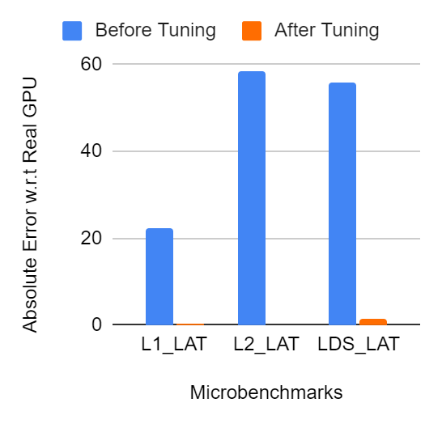
μBench Discrepancy: L1, L2, & LDS Latency
Issue: L1, L2, & LDS clocked twice as fast as they should be
Result: Lower latencies than actual GPU
Refinement of cache parameters including latency and size
9
Notes:
On looking into what gem5 parameters might cause these deviations, we observed that the caches were being clocked twice as fast as cores by default in gem5. This caused latencies to be much lower than what was expected as the caches were effectively operating twice as fast. Additional error resulted from cache parameters being poorly tuned to the microarchitecture. Making these adjustments in the model’s configuration yielded significant improvements that reduced the model error associated with these microbenchmarks down to a fraction of a percent.

Slide 10
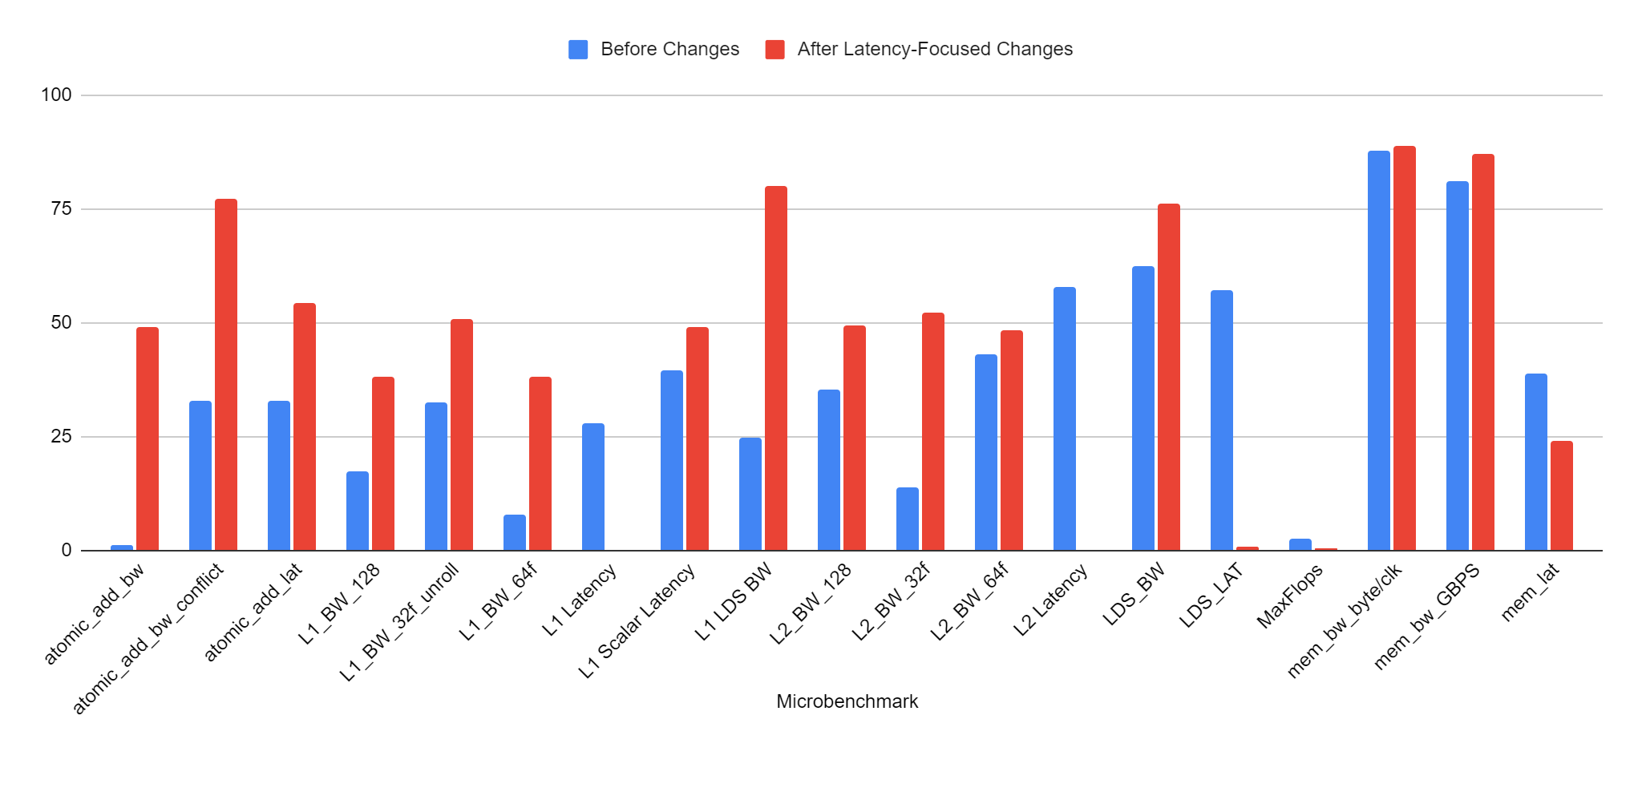
μBench Results After Clock Fixes
L1, L2, LDS latency errors reduced, accurate but others (especially BWs) increased
Points to need to iteratively refine
10
Notes:
However, as much as we would like these benchmarks to be independently addressable, tuning aspects of the model for these latencies affected the other benchmarks as well. Here’s a plot showing that difference, with errors before the tuning in blue and the new errors in red.
Bandwidths error (Click) increased the most significantly, averaging around 47%. These changes can be attributed to the cache clock correction; The previously high clock frequencies were doubling bandwidth, which happened to bring the numbers closer to their actual values. Since we know the clock changes are representative of the real GPU, this just means that the underlying bandwidth inaccuracies were worse than we originally thought.
(Click) However, the fact that addressing one set of microbenchmarks impacted the rest points to the need to iteratively refine and take a step back after each set of changes to see how we might need to compensate elsewhere.

Slide 11
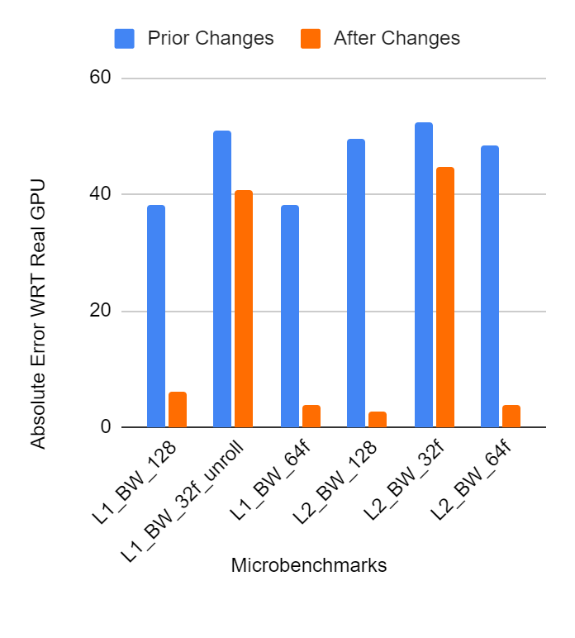
μBench Discrepancy: L1 & L2 Bandwidths
Tuned coalescer, number of banks, and L1 latency parameters
Issue: Lack of cache bypassing for GLC and SLC loads and stores
GLC*-set instructions should not cache in L1
SLC**-set instructions should not cache in L1 or L2
* Global-Level Coherence
** System-Level Coherence
11
Notes:
With the bandwidths so affected by our changes, we turned to L1 and L2 bandwidths.
In this regard we were able to significantly reduce error by tuning coalescer parameters, the number of banks, and the L1 latency.
However, a more fundamental issue with the model we ran into was the lack of cache bypassing for loads and stores. Flags set for system level coherence and global level coherence were being ignored, meaning caches weren't being bypassed as appropriate. GLC loads and stores were erroneously being cached in L1 and SLC loads and stores being cached in L1 and L2. By modifying the SLICC to pass and store those bits as appropriate and by adding additional states, we were able to implement this behavior, greatly increasing accuracy. There is, however, still work to be done on 32-bit accesses.

Slide 12
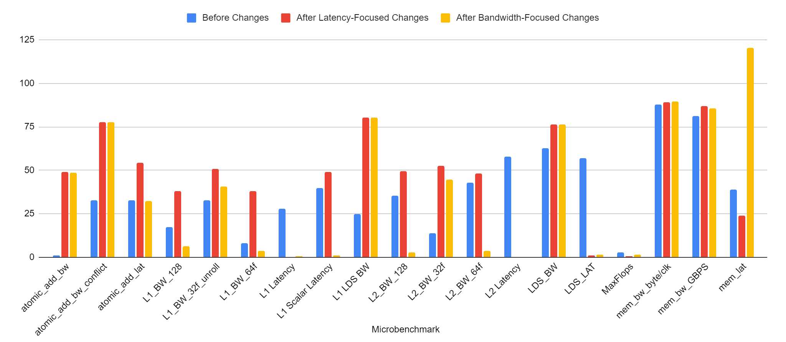
μBench Results After BW-Related Changes
Improvements to L1 and L2 bandwidths, with no impact elsewhere
12
Notes:
Here’s that same chart again, showing results before our changes and now the results after these bandwidth-related changes in orange. (Click)
The effect of these changes seemed to be mostly limited to the bandwidth micro benches. Clearly, there's still work to be done.

Slide 13
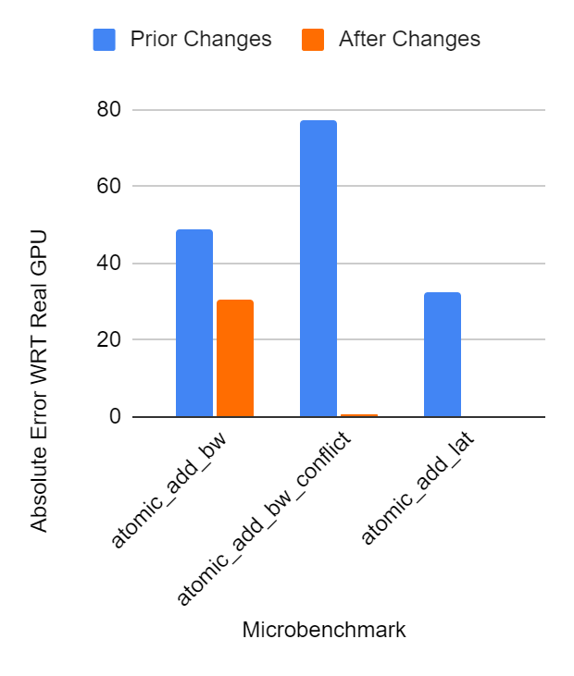
μBench Discrepancy: Atomics
Issue: No GLC atomic support
Consequence: all atomics treated as system-scope atomics
Added GLC atomic handling into VIPER coherence protocol
GLC atomics now performed at L2
Additional fixes for GPU WB L2 caches
13
Notes:
Next, we shifted our focus to atomic operations. Through investigating why the latency was higher than expected, we discovered a lack of global level coherence support as a major culprit. Up to this point all atomics were treated as system-scope, and weren’t being performed in the L2 when appropriate. This meant that non-SLC requests were incurring the additional latencies and bandwidth limitations associated with going to the directory.
We were able to go in and add this support in the VIPER coherence protocol, but in the process had to make additional changes to the protocol to allow for a write-back L2 (which previously hadn't been working) that is more representative of the real GPU. These modifications made significant improvement to atomic accuracy, but we believe that we can further reduce inaccuracies by improving our modeling cache atomic ALU resource constraints with a free-list of available ALUs.

Slide 14
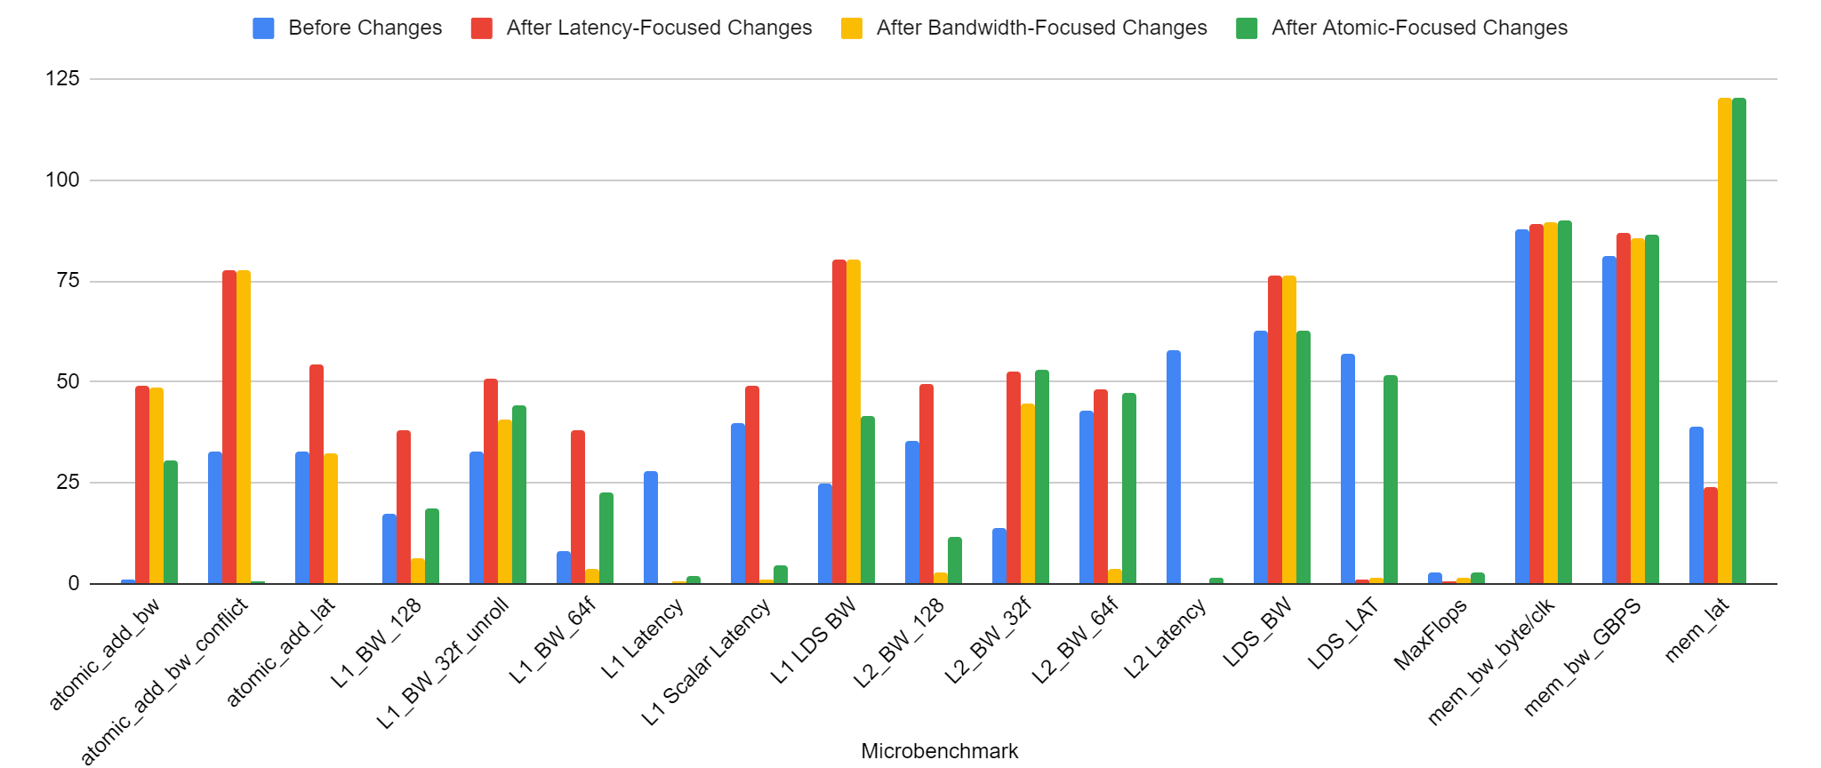
μBench Results After Atomic Changes
+ WB l2
Atomics improved, but increased inaccuracies of other bandwidths
14
Notes:
Again, going back to that high level overview we can compare the previous sets of changes against what we have now in green. In making these changes targeting atomics, we observed increases to some bandwidth inaccuracies (click), which are highlighted here. Some of these can likely be attributed to a now writeback L2, but further targeted investigation is required.

Slide 15
Next Steps: Further Iterative Refinement
Continue to use μBenches to guide iterative improvements
Continue to improve accuracy with additional microbenchmarks
Update model to provide additional features
Update main memory HBM model to use multiple channels
Atomic ALU constraints, TLB and I$ refinement
Add additional support and HW features as uncovered by tests
After μBenches obtain high fidelity:
Validate larger benchmarks
Add known good models for this and other GPUs
15
Notes:
From here our path set: continued iterative refinement with the goal of minimizing the error from all microbenchmarks. Beyond working on improving the results of existing benchmarks, we also intend to add additional benchmarks for more specific GPU functionalities, such as differentiating between atomic instructions that do or do not return a value.
To address bandwidths, which are still a major source of inaccuracy, we intend to update the GPUs model’s main memory to an HBM model with multiple channels.
Other areas we’ve targeting include refinements related to the TLB and I-Cache, which we have additional benchmarks to exercise.
Looking even further in advance, when we’ve been able to satisfactorily reduce errors in our micro benches, we intend to validate these in larger benchmarks and add known-good models to gem5 for the Vega 20 and other GPUs.

Slide 16
Conclusions
Having validated gem5 models is important
Existing GPU model does not always behave intuitively
Point solutions insufficient
Solution: Iterative refinement through μBenches
Use microbenchmarks to tune for minimum absolute error in GPU model
Validate and release model improvements publicly
We’ve already released some patches!
Integrate performance regression testing into gem5
16
Notes:
Our end goal is to improve and validate the accuracy of gem5 GPU models. Having validated models in our systems is important in ensuring that effect of optimizations made in gem5 are representative of what their effect would be on a real GPU.
Previous refinements have relied on point solutions, which are inefficient and hard to scale. By developing microbenchmarks where we can compare outputs and statistics between gem5 and a real GPU, we can systematically target individual components to iteratively identify and resolve sources of inaccuracy.
As a result of this iterative refinement, we hope to validate and release accurate models of real GPUs, as well as to integrate performance regression testing into gem5 to ensure these models would stay accurate going forward.
Thank you.

