Slide 1
Improving gem5’s GPUFS Support
Vishnu Ramadas*, Matthew Poremba^, Bradford M. Beckmann^, and Matthew D. Sinclair*^
*University of Wisconsin-Madison, ^AMD Research
vramadas@wisc.edu

Slide 2
Outline
Introduction
Proposal
Progress
Conclusion and Future Work
Improving gem5’s GPUFS Support
Notes:
I will briefly talk a few shortcomings that gem5’s GPU models have when executing certain classes of large-scale workloads. I will then propose a few solutions to tackle these shortcomings and walk through the progress we’ve made on this so far. I will then wrap up the presentation by offering a glimpse at what we’ve planned to achieve over the coming months

Slide 3
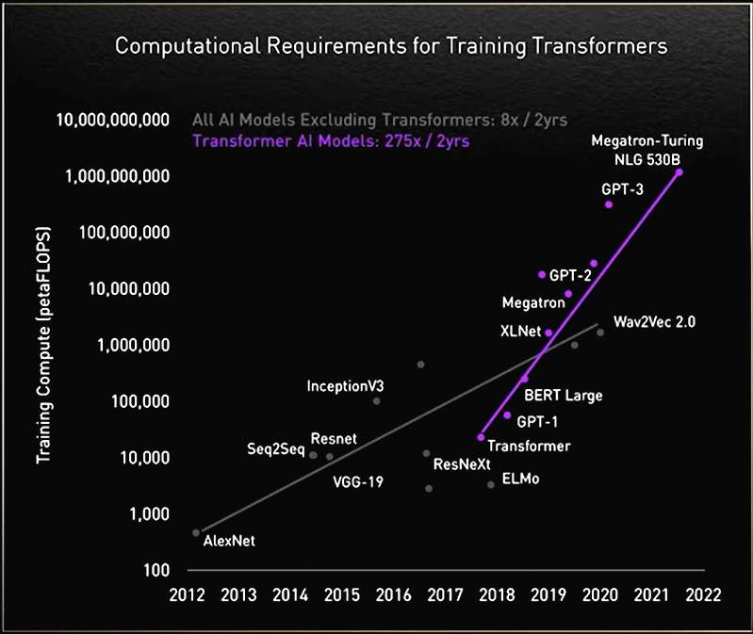
Introduction : Challenges in Application Scaling
Simulating entire workloads would take months (or years) in modern gem5
How do we make it faster?
Source:
1. https://developer.nvidia.com/blog/using-deepspeed-and-megatron-to-train-megatron-turing-nlg-530b-the-worlds-largest-and-most-powerful-generative-language-model/ 2. https://blogs.nvidia.com/blog/2022/03/25/what-is-a-transformer-model/
Improving gem5’s GPUFS Support
Notes:
Language models are a class of workloads that heavily rely on GPUs. Transformer-based language models have made significant strides in natural language processing over the past few years. Each new language model comes with more parameters than its predecessor. GPT-4 has around a trillion parameters, while GPT-3 has only 175 billion. The rate of growth in parameter size is almost exponential and is estimated to be around 16 trillion in 2024. This means that the computational requirements for training these transformers will also scale exponentially, needing atleast a billion petaFLOPS for future models. Simulating these workloads in its entirety would take months, if not years, in gem5. This simulation speed is unacceptable and presents a barrier to adopting gem5. How do we make such simulations faster?

Slide 4
Introduction : Prior CPU-GPU Support in gem5
Execution-driven, cycle-level
Models complex CPUs & GPUs
Rapid prototyping of new features
Validate simulation with execute-in-execute
Prior work [Gutierrez et al. HPCA '18]
Runs unmodified ROCm 1.6 user stack
Simulates HIP and HCC applications
HCC/HIP are AMD’s GPGPU languages
Solid foundation, but does not support ML workloads
Improving gem5’s GPUFS Support
Notes:
What does the GPU support in gem5 look like? My colleague, Daniel, spoke extensively about the nature of GPU models in gem5 in an earlier talk. This provides a very solid foundation, but does not support ML workloads

Slide 5
Introduction : ML Support in gem5 CPU-GPU system
We have started to add this support
[Alsop IISWC ‘19], [Roarty gem5 Workshop ‘21]
Improving gem5’s GPUFS Support
Notes:
Several changes have to made before ML applications can be run on gem5. We added the libraries that we need to the gem5 environment are were able to run a few workloads ML workloads natively. Support for frameworks like PyTorch and Tensorflow are in the pipeline.

Slide 6
Introduction : GPUFS Support
Introduced in gem5 v22.0
Previously only supported SE mode with ROCm 4.0
FS mode supports ROCm 4.2
Running in SE mode required either a specific host environment containing the ROCm stack or a Docker container that encapsulated this environment
GPUFS removes all host requirements
Improves simulation speed by functionally simulating memory copies
Adds KVM CPU-GPU support
Improving gem5’s GPUFS Support
Notes:
As an aside, the last couple of gem5 releases introduced and enhanced GPU-FS support. Those who have run the SE mode will recollect that running simulations required either a very specific host environment that contains all the necessary libraries along with the ROCm stack or a Docker that encapsulated this environment. This docker GPU-FS removes this requirement since the disk-image it boots already contains this. The latest release also adds KVM CPU-GPU support which can be utilized to speed up simulations

Slide 7
Introduction : What is KVM CPU
Kernel-based Virtual Machine (KVM):
Open-source virtualization technology built into Linux. Turns Linux into a hypervisor that allows the host machine to run a virtual machine
KVM CPU allows simulation to fast-forward by running the CPU instructions directly on the virtual machine, instead of timing CPU models
Requires the application binary to be compiled for the host machine architecture
Can be used in CPU-GPU systems to fast forward through CPU code
Improving gem5’s GPUFS Support
Notes:
KVM is an open-source virtualization technology built into Linux which allows the host machine to run a virtual machine on it. KVM allows the simulation to fast-forward through the application by running the instructions directly on the virtual machine. This can be utilized in CPU-GPU simulations to fast forward through CPU code and only simulate the kernels running on the GPU on a timing model

Slide 8
Outline
Introduction
Proposal
Progress
Conclusion and Future Work
Improving gem5’s GPUFS Support
Notes:
We plan to use this feature as a base for our work to speed up CPU-GPU simulations

Slide 9
Our Vision to Run Large-Scale Workloads
Not all parts of the application are equally interesting
Some functions/code blocks are “more important” to its behavior
Applications are simulated multiple times when evaluating new ideas
Key Insight – some regions of the application can be run with low fidelity without affecting the way the other parts interact with the underlying hardware
Can use KVM CPU support in GPUFS to do this
Improving gem5’s GPUFS Support
Notes:
Two main observations drive our proposal. First, not all parts of the application are equally interesting. Usually, some code regions of a workload are of more interest to the architect than the others. Second, applications are simulated multiple times when evaluating new ideas. The key insight from this that our proposal makes use of is that the less interesting regions of an application can be run with low fidelity and the more important regions can be run with high fidelity without affecting the quality of the simulation results. And the KVM CPU support can come in handy

Slide 10
Mixed Fidelity for Less Important Application Phases
May not want to fully simulate certain phases of applications
Solution: leverage gem5’s KVM CPU to functionally simulate these phases
Simulated system
CPU
GPU
kernel
launch
kernel
completion
kernel
launch
Time
kernel
launch
kernel
comp.
functional only
simulation
kernel
launch
CPU
functional+timing
simulation
GPU
Wall Clock
Improving gem5’s GPUFS Support
Notes:
Our goal, therefore, is to utilize the KVM CPU to functionally simulate CPU code first, and less important GPU kernels later. In doing so, we hope to sacrifice some of the fidelity to reap huge benefits simulation time wise. As the diagram here shows, simulating only some kernels on a timing model reduces the wall clock significantly

Slide 11
Outline
Introduction
Proposal
Progress
Conclusion and Future Work
Improving gem5’s GPUFS Support
Notes:
We made significant progress in achieving this too.

Slide 12
Using KVM CPUs : How Much Does This Help?
First Step : Utilized KVM support to fast forward through CPU code
Simulated system
CPU
GPU
kernel
launch
kernel
completion
kernel
launch
Time
kernel
launch
kernel
comp.
functional only
simulation
kernel
launch
CPU
functional+timing
simulation
GPU
Wall Clock
Improving gem5’s GPUFS Support
Notes:
First, we were able to utilize the KVM support to fast forward through the CPU regions. This made us reduce the overall simulation time to roughly equal the kernel execution time.

Slide 13
Using KVM CPUs : How Much Does This Help?
Cycle Level GPU Simulation : 10-50 KIPS
Functional KVM Simulation : 100s MIPS
KVM CPU emulating GPU : 10s MIPS
Conservative speedup for a kernel containing 2B SIMD instructions:
11 hours of cycle-level GPU simulation
3 minutes to execute on KVM CPU – single threaded
On-going Work: full set of results for GPU workloads
Improving gem5’s GPUFS Support
Notes:
In doing so, we gained overall speedups of around 200x. A complete timing simulation would have needed a peak of 10-50 KiPS while fast-forwarding through CPU code gave us a peak around 10MIPS. A kernel with 2B SIMD instructions took around 3 minutes on a KVM CPU-GPU system, a significant reduction from the 11 hours it takes otherwise, These are still early results and we are evaluating more workloads to fully understand the scope of speedup available.

Slide 14
Further Refinement : Checkpoints
Users often simulate the same application many times
Can speedup the execution by not redoing the less important parts
Solution: create checkpoints (ala CPU SimPoints)
Capture the state of the execution when a checkpoint is taken
Restore this state the next time the application is run
Resume execution from the next instruction after restoration
Previously only possible for CPUs
Added support in GPUs, leveraging gem5’s FS mode and m5 operations
Improving gem5’s GPUFS Support
Notes:
Users also simulate the same application multiple times while evaluate new architectural ideas. While KVM CPUs do help speedup simulation, running certain kernels again and again adds avoidable overhead. Runtime can be reduced further by simply not redoing these less important regions. This is achieved by using checkpoints. When running an application for the first time, a checkpoint can be taken just before the first region of interest in the code. This captures the state of the simulation at that point during runtime. Subsequent runs resume from the instruction after the checkpoint.
This was previously possible only for CPUs. We have added support for GPUs, leveraging m5 operations and gem5’s FS mode.
Add numbers for this?

Slide 15
Can We Do Even Better (Faster)?
Current Task: convert less-important GPU kernels into CPU code
Update LLVM GPU backend to emit CPU code for kernels
Use KVM CPU (low fidelity) or another CPU model (medium fidelity)
Most important phases get max fidelity, others get less fidelity
Improving gem5’s GPUFS Support
Notes:
Can we speed things up even better? We are currently working on converting less important GPU kernels into CPU code. We plan to use the LLVM GPU backend to emit CPU versions of kernels that we will run on the KVM CPU. This way, only the most important regions of the code get highest fidelity and reduce the overall runtime while preserving the quality of the run stats generated

Slide 16
Can We Do Even Better (Faster)?
Functionally simulate GPU kernels on CPU
Preliminary results : only 1.58x – 3x slower on KVM vs bare metal (1 thread)
Simulated system
CPU
GPU
kernel
launch
kernel
completion
kernel
launch
Time
kernel
launch
kernel
comp.
functional only
simulation
kernel
launch
CPU
functional+timing
simulation
GPU
Wall Clock
Mixed Fidelity makes gem5 much closer to real HW
Improving gem5’s GPUFS Support
Notes:
Having this capability brings the gem5 GPU models as close as possible to what we envision in our proposal. Only the most important kernels get to execute on the timing models while the others are simulated only functionally. Preliminary results show that this leads to the application only needing 1.58x-3x the time it would take on bare metal and it bring gem5 much closer to real HW in terms of execution times!

Slide 17
Outline
Introduction
Proposal
Progress
Conclusion and Future Work
Improving gem5’s GPUFS Support
Notes:
To conclude,

Slide 18
Conclusion and Future Work
Large-scale applications that run on the GPU models take extremely large simulation times
Our updates are the first in a series to significantly reduce runtime for such workloads
Significantly improves usability and reduce barriers to entry for simulation
Future Work
Profile ML workloads to find regions that can be annotated for checkpointing
Integrate other accelerators into mainline gem5
Support accelerator fast-forwarding and checkpointing
Additional publicly available applications and resources
Improving gem5’s GPUFS Support
Notes:
Our updates are the first in a series of updates that aim to signficantly reduce runtime for large-scale ML workloads by allowing fast-forwarding and checkpointing. This significantly improves usablitiy of gem5 in simulating such workloads and also reduces barriers to entry for gem5’s adoption.
We also have a few tasks planned for the fugure . We would like to profie ML workloads to find regions that can be annotated for checkpointing. This removes the burden of finding such regions from the user.
We also plan to integrate other HW accelerators into mainline gem5 and support fast-forwding and checkpointing in them. We also wish to add more workloads and resources to the public repository to reduce efforts users might otherwise go through to port them to gem5.

