Slide 1



Modern Front-end Support in gem5
Bhargav Reddy Godala, Nayana Prasad Nagendra, Ishita Chaturvedi, Simone Campanoni, David I. August
PRINCETON
UNIVERSITY
Liberty Research Group
Arcana Research Group

Slide 2
Introduction
We have seen that aggressive Out-of-Order CPUs tolerate data miss latency.
Modern CPUs employ decoupled front-end to tolerate instruction miss latency.
What is a decoupled front-end?

Slide 3
State-of-Art Front-end
Branch Re-steer Address
Back-end
NIP
BPU
Fetch Engine
Decode
IAG
I-Cache
IFU
Front-end
Traditional Front-end
FTQ: Fetch Target Queue
IFU: Instruction Fetch Unit
BPU: Branch Prediction Unit
IAG: Instruction Address Generation
NIP: Next Instruction Pointer
3
EMISSARY, Nagendra and Godala, et al.
Notes:
To tolerate instruction cache miss latency modern processors implement decoupled front-end. What is a decoupled frontend? I’m going to show it by modifying a traditional front-end. Here is a traditional frontend pipeline. In this design address generation unit is inside Instruction Fetch Unit. Which feeds fetch engine with a PC of next instruction to fetch from I-Cache. In a decoupled front-end address generation unit is decoupled from Instruction Fetch Unit. <click>.

Slide 4
State-of-Art Front-end
Branch Re-steer Address
Back-end
FTQ
IFU
NIP
BPU
Fetch Engine
Decode
IAG
Prefetch
I-Cache
Front-end
Fetch Directed Instruction Prefetching Pipeline (FDIP) [Glenn Reinman et al., MICRO’99]
FTQ: Fetch Target Queue
IFU: Instruction Fetch Unit
BPU: Branch Prediction Unit
IAG: Instruction Address Generation
NIP: Next Instruction Pointer
Key Idea: Prefetch in the predicted path
3
EMISSARY, Nagendra and Godala, et al.
Notes:
Now, a Fetch Target Queue is inserted in between IAG and IFU. Each entry of FTQ represents a basic block. Prefetch engine takes entries from FTQ and issues prefetch requests to Instruction Cache. Even fetch is stalling Address generation unit keeps feeding FTQ with addresses in the predicted path. If we have perfect prediction front-end would never stall. Unfortunately that is not the case. Due to this design I-Cache misses have unequal costs.

Slide 5
Design

Slide 6
Challenges in Implementing FDIP in gem5
Fetch stage is already complex.
Dynamic Instruction objects are constructed before BPU is invoked.
Branch Instruction is needed to invoke BPU.
Sequence numbers are used to squash mis-speculated instructions.

Slide 7
Branch Sequence Numbers
Unique sequence number to identify branch.
Every dynamic instruction contains:
A sequence number
Branch Sequence of prior branch
BrSeq Seq | Seq | Instruction
10 | 100 | Br
10 | 101 | I0
10 | 102 | I1
10 | 103 | I2
11 | 104 | Br
11 | 105 | I3
11 | 106 | I4
11 | 107 | I5
Notes:
Talk about how squash works.

Slide 8
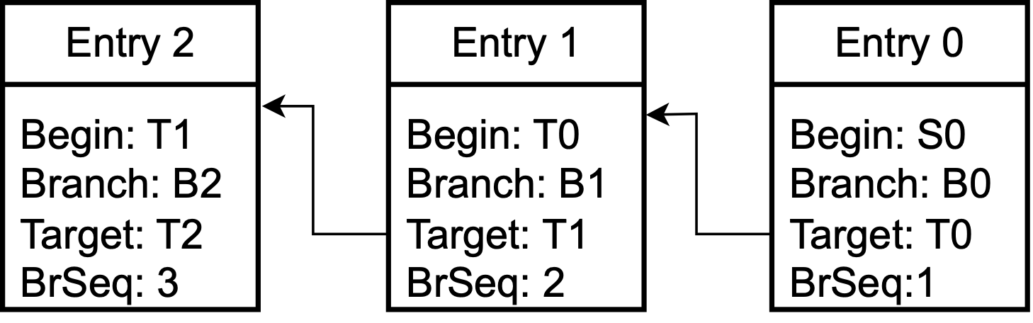
Fetch Target Queue (FTQ)
Each entry consists of:
A begin address (target of prior branch)
End address (branch PC)
Target address
Branch Sequence number

Slide 9
Prefetch Engine
Prefetch Buffer:
Address to prefetch
Issue one prefetch and insert into Fetch Buffer
FTQ
F2
F1
F0
F3
F1
F0
Prefetch Buffer
L6
L5
L4
L3
L2
L1
L0
Fetch Buffer
L3
L2
L1
L0
Prefetch request issued
Pending
Ready

Slide 10
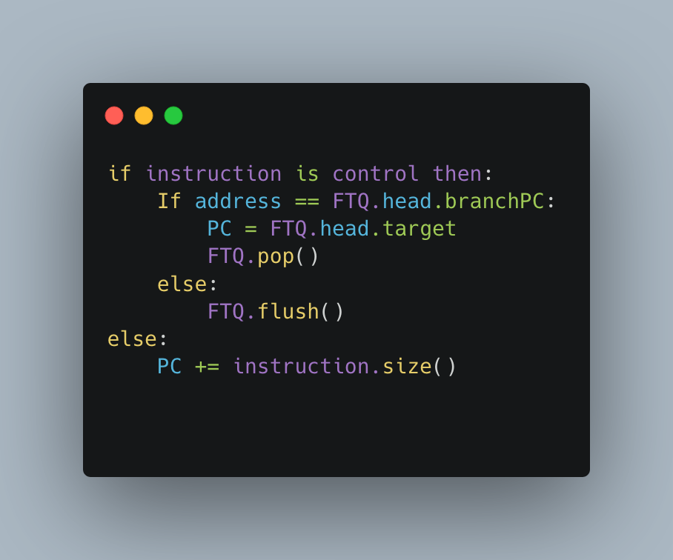
Modified Fetch Stage

Slide 11
Optimizations

Slide 12
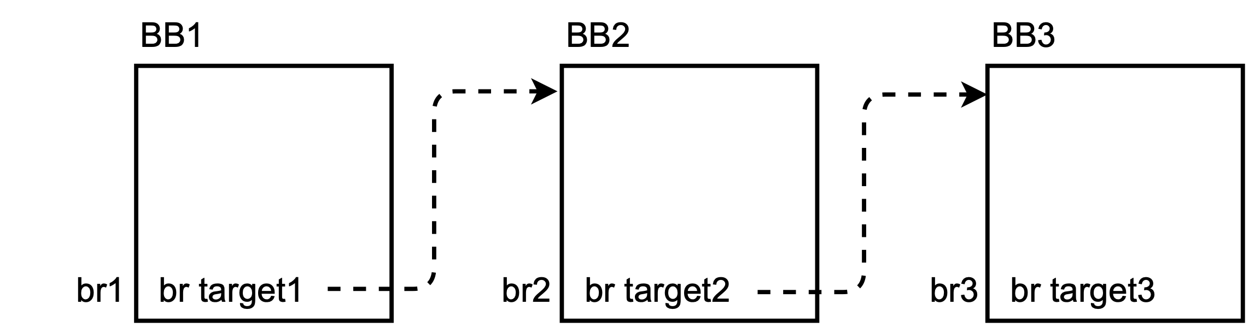
Basic Block Based BTB
Index | Traget
br1 | target1
br2 | target2
br3 | Target3
Index | Target | Branch
target1 | target2 | br2
target2 | target3 | br3
PC based BTB
BBL based BTB

Slide 13
Pre-decode And Early Correction
BBL BTB are indexed using beginning of a basic block.
Beginning of a basic block is identified:
Using the next instruction following a branch instruction.
Early Correction:
When an unconditional branch is predicted not taken.
Flush FTQ and restart by using the pre-decoded target.

Slide 14
Branch Predictor Changes
BBL Based Branch Predictor lookup.
Branch Sequence numbers.
ITTAGE indirect predictor support.

Slide 15
X86 vs ARM
X86:
Variable width instructions
Pre-decoding is very expensive
Micro Sequenced Ops
Exception handling using ROM
ARM:
Fixed width instructions
Pre-decoding is not expensive

Slide 16
Micro Branches in X86
In X86 there are instructions which are dynamically decoded to loops.
Example: String copy
These branches are not inserted into BTB.
This is handled as a special case:
These are not seen by the FDIP pipeline.
At the time of fetch; a back edge is predicted taken.
FTQ will not be flushed till a squash from later stages is received.

Slide 17
Performance Bug Fixes
Perfect recovery of branch history.
TAGE Bimodal table roll back.

Slide 18
Evaluation

Slide 19
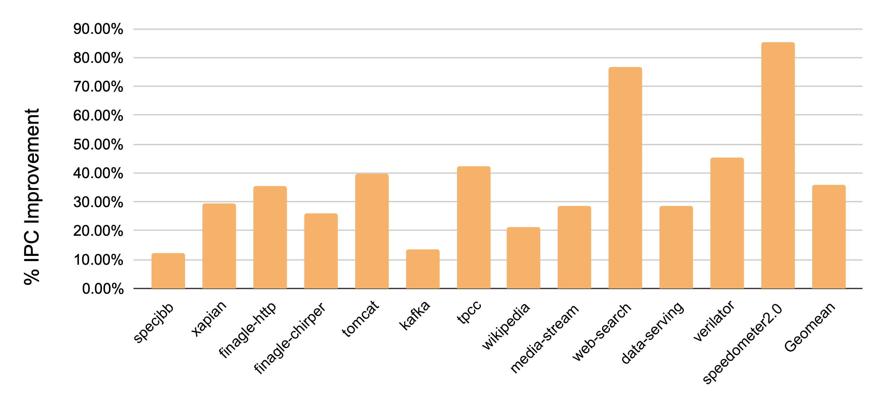
Performance of ARM workloads with FDIP
Field | Alderlake like
ISA | ARM 64-bit
L1I | 32KB
L1D | 64KB
L2 | 1MB (16-way)
L3 | 2MB
FTQ | 24 entry 192 inst
Width | 8-wide
ROB Size | 512 entries
IQ/LQ/SQ | 240/128/72
BPU | TAGE, ITTAGE
BTB | 16K entries
gem5 O3 CPU simulation parameters
IPC Performance improvement of ARM workloads in % over No FDIP baseline

Slide 20
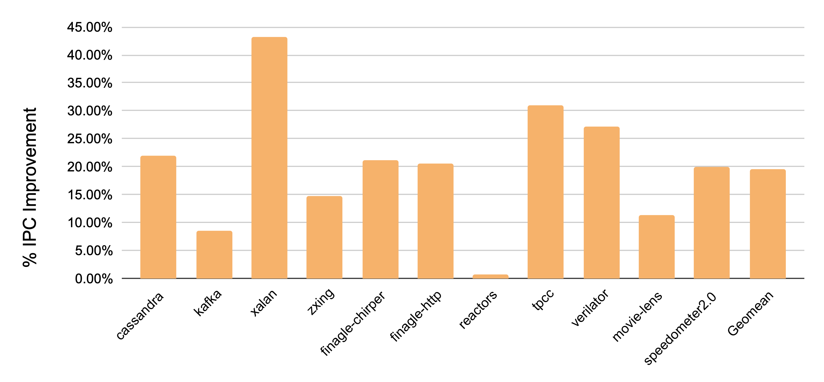
Performance of X86 workloads with FDIP
Field | Alderlake like
ISA | X86 64-bit
L1I | 32KB
L1D | 64KB
L2 | 1MB (16-way)
L3 | 2MB
FTQ | 24 entry 192 inst
Width | 8-wide
ROB Size | 512 entries
IQ/LQ/SQ | 240/128/72
BPU | TAGE, ITTAGE
BTB | 16K entries
gem5 O3 CPU simulation parameters
IPC Performance improvement of X86 workloads in % over No FDIP baseline

Slide 21
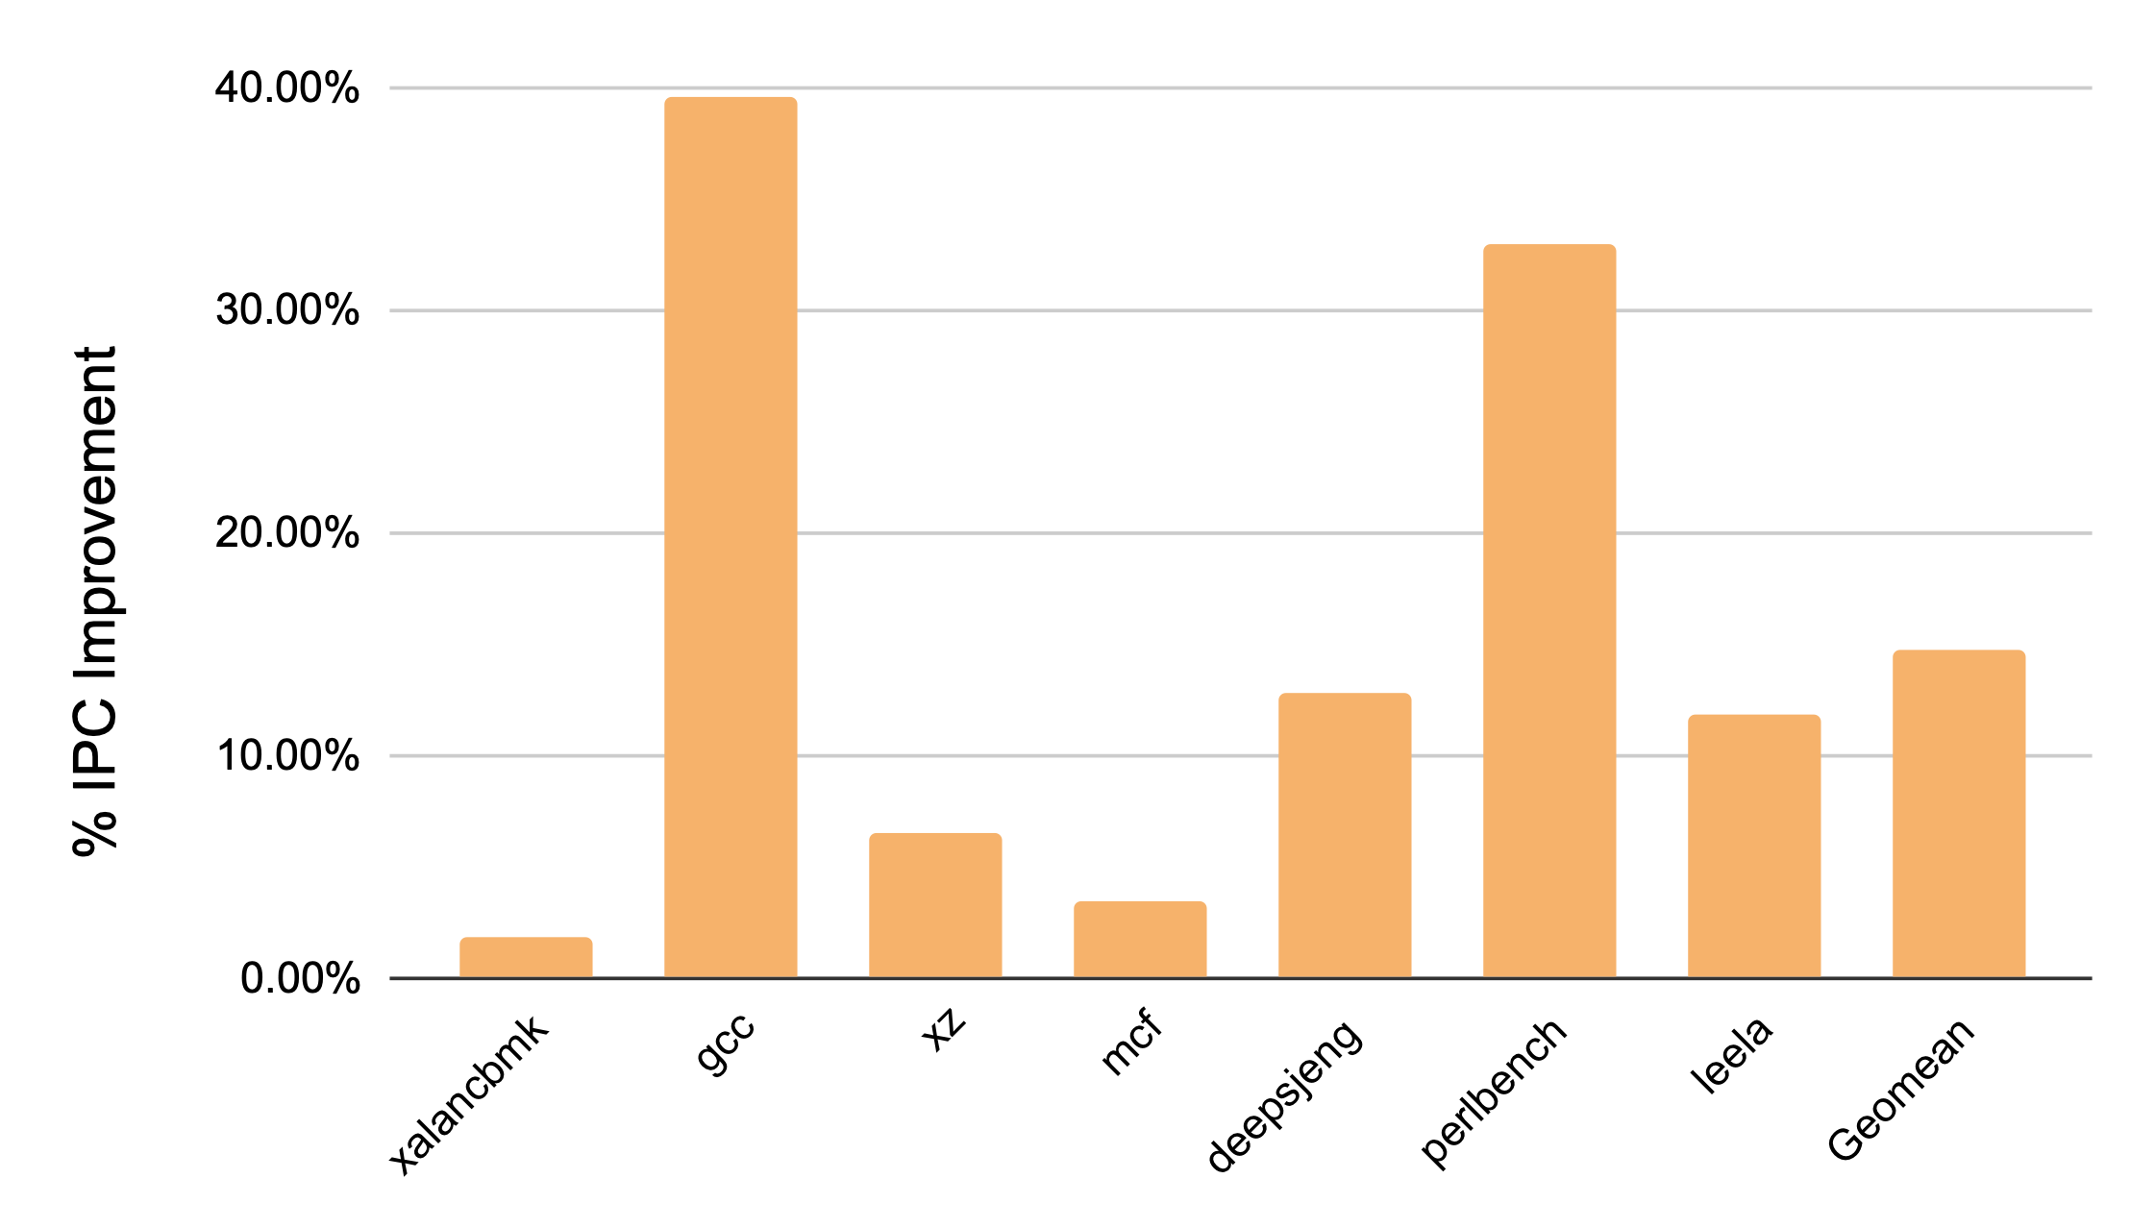
Performance of X86 SPEC17 workloads with FDIP
Field | Alderlake like
ISA | X86 64-bit
L1I | 32KB
L1D | 64KB
L2 | 1MB (16-way)
L3 | 2MB
FTQ | 24 entry 192 inst
Width | 8-wide
ROB Size | 512 entries
IQ/LQ/SQ | 240/128/72
BPU | TAGE, ITTAGE
BTB | 16K entries
gem5 O3 CPU simulation parameters
IPC Performance improvement of X86 SPEC17 workloads in % over No FDIP baseline

Slide 22
Published Works
EMISSARY: Enhanced Miss Awareness Replacement Policy for L2 Instruction Caching at ISCA’23
Session 2B

Slide 23


Conclusion
We implemented FDIP in gem5.
A significant speedup over baseline.
This work was used in EMISSARY [ISCA’23].
Available at https://github.com/PrincetonUniversity/gem5_FDIP
Workloads: https://tinyurl.com/yjsc2aw4
gem5 + FDIP
Workloads

Slide 24
Thank you
Questions?

