Slide 1

Genetic improvement of GPU code
Jhe-Yu (Jerry) Liou, Stephanie Forrest, Carole-Jean Wu
Computer Science and Engineering
Biodesign institute
Arizona State University, Tempe, AZ
Notes:
Thanks for introduction
Thanks for coming. My name is Jhe-Yu Liou. A PhD students from Arizona statue university. This work is under collaboration with Professor Forrest and, my advisor, Professor Wu.

Slide 2

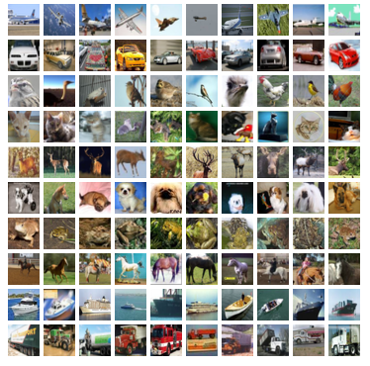
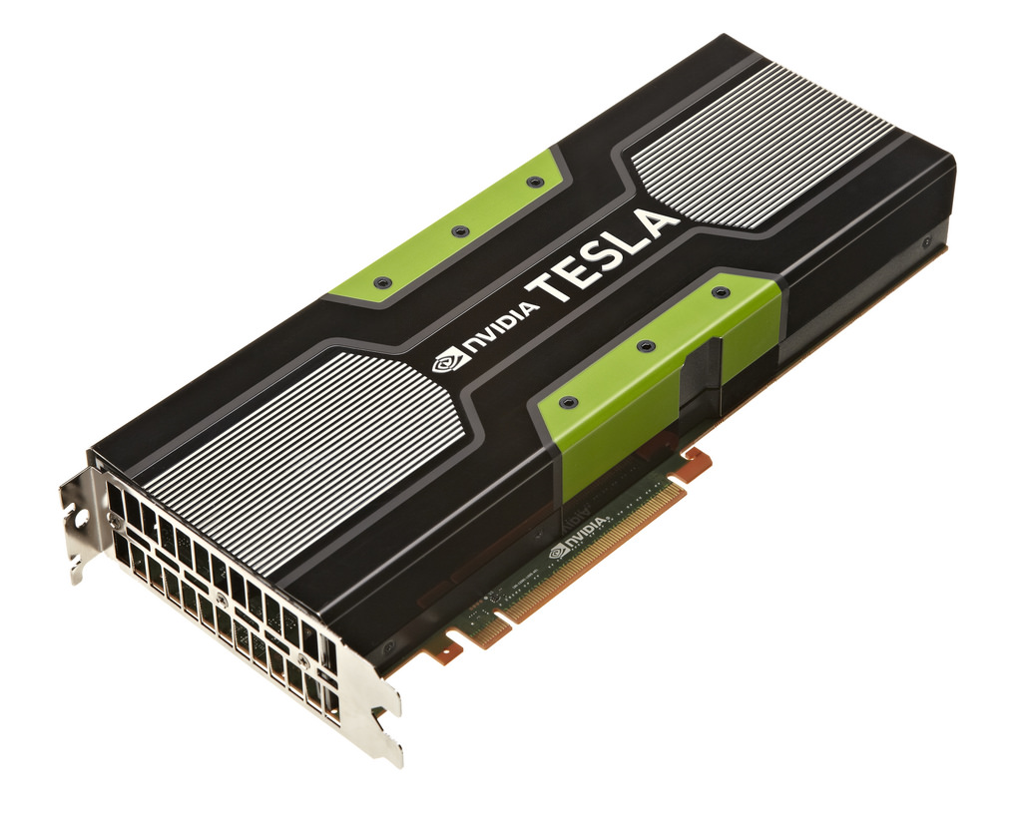
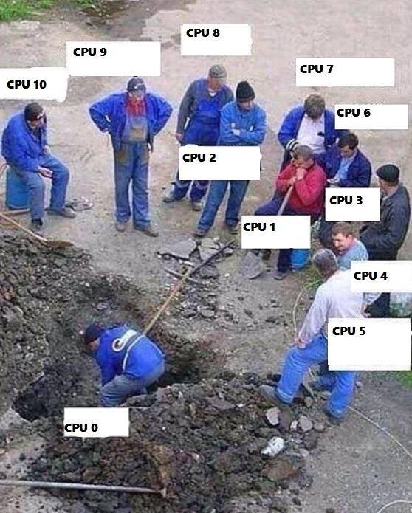
Motivation
GPU is the de-facto co-processor for computation-intensive applications
Deep learning
Image processing
Protein folding…
GPU programs are often poorly optimized
Optimization requires both architecture/domain expertise
C++-like programming interface encourages novice programmers
Core
Core
Core
Core
Core
Core
Core
Core
Core
Core
Core
Notes:
GPUs have been largely used in computation-intensive applications such as, because of its abundant computational power
However, GPU programs are often poorly optimized, which result in low utilization. It is commonly seen in GPU programs that only few GPU cores are used while the others are idle.
To optimize the GPU programs, you will need not only architecture expertise, but also domain expertise, so that you know how to map your workload into thousand GPU cores.
Another reason why it is poorly optimized is because of its C++ like programming interface. Any novice programmers can program it without knowing the underlying architecture.

Slide 3
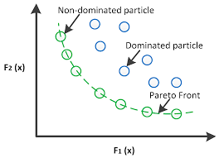
Approach: Use Genetic Programming to find optimizations
GPU programs are usually small, but critical to performance
Search space is smaller
Any improvement can be significant
Many GPU applications are error-tolerant
More resilient to the program transformation from GP
Error can be co-optimized along with performance (multi-objective)
Error
Runtime
Notes:
We consider using GP because, first, GPU programs are usually smaller but critical to performance. It means the search space is smaller, while any found improvement can be significant.
Secondly, many GPU applications can tolerate error. It means the programs can be more likely to survive from the mutation. Furthermore, we can include error in our fitness function and turn the search problem into a multi-objective optimization.

Slide 4
Outline
Motivation
Proposed Design – GEVO
Experimental Setup
Result and Analysis
Conclusion
Notes:
In the following slides, I will show you our proposed design, experimental setup, and result and mutation analysis, and t

Slide 5
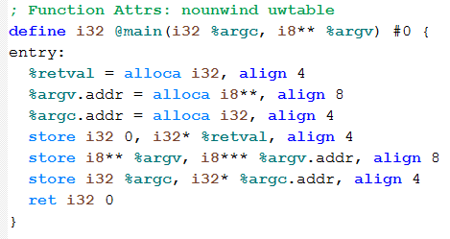
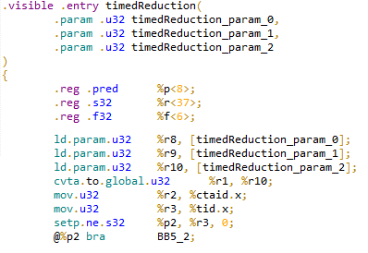
Compilation flow of GPU programs
Device code
Device LLVM IR
Nvidia PTX
CUDA source file – mixed with host and device code
__global__ kernel(){
id = threadId.x;
…
}
__global__ kernel(){
id = threadId.x;
…
}
int main() {
cudaInit()
float *a;
float *b;
…
cudaMemoryCopy()
kernel<<<…>>>(a,b)
cudaMemoryCopy()
}
GEVO – Gpu EVOlve
Host code (Pure C/C++)
int main() {
cudaInit()
float *a;
float *b;
cudaMemoryCopy()
…
cudaKernelLaunch()
cudaMemoryCopy
}
Application
Binary
Notes:
We need to first understand how GPU (CUDA) program is compiled, and where we are going to apply the genetic programming.

Slide 6
Overview of Gpu EVOlution (GEVO)
INPUT
Population
Application
GPU Kernel Code
Evaluation
Selection
GEVO
Fitness Function
Test Cases
Mutation
Crossover
Notes:
Here is the overview of our design using genetic programming, GEVO takes 3 things as input, a GPU program, a fitness function, which in the talk is kernel runtime and error, and test cases to evaluate and validate modified program
Then it go through the standard genetic programming procedure, where the most important process are selection, crossover, and mutation. We will explainer in the next few slides.

Slide 7
Selection
Multi-objective selection: (runtime, error)
NSGA-II : Non-dominated Sorting Genetic Algorithm [1]
Combine dominance and crowding distance for ranking
A
Rank
Error
High
Low
A
C
B
B
C
Runtime
[1] Deb et al., "A fast and elitist multiobjective genetic algorithm: NSGA-II,“IEEE Transactions on Evolutionary Computation, 2002
Notes:
Since we defined our fitness function to be runtime and error, we need a multi-objective selection. We chose to adopt NSGA-II as our selection opertions. Essentionally, what NSGA-II is doing is that it combine the pareto dominance together with crowding distance for ranking, and use this rank for tournament selection.

Slide 8
Mutation
Copy, delete, move, replace, swap instructions/operands
Often breaks LLVM syntax: requires repairs
Function(int %0)
%1 = load int, %0
%4i = mul float, %3, 1.0
%2 = add int, %1, %1
%3 = conv float int %2
%4 = mul float, %3, 1.0
Function(int %0)
%1 = load int, %0
%4i = mul float, %3, 1.0
%2 = add int, %1, %1
%3 = conv float int %2
%4 = mul float, %3, 1.0
Copy an instruction
1.0
Connect the input
%4i
Apply the output

Slide 9
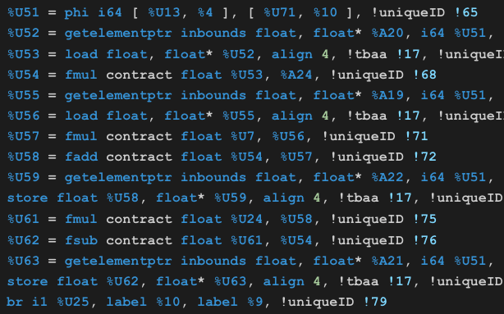
Individual representation LLVM-IR + Patch(mutation)
Individual
LLVM-IR
Patch
Copy 3, 4
Move 9, 3
Del 4
Mutation
Crossover
Notes:
Mutation and crossover

Slide 10
Crossover
Uses patch-based representation
Individual 1
Combine & Shuffle
Random Point Separation
Reorder
Reapply
Patches
New Individual 1
Kernel Variant 1
Patch
New Kernel Variant 1
Patch
CP
CP
CP
CP
CP
SWP
CP
CP
DEL
CP
CP
CP
CP
Original kernel
Individual 2
DEL
DEL
New Individual 2
Kernel Variant 2
Patch
MV
MV
New Kernel Variant 2
Patch
CP
SWP
SWP
DEL
MV
MV
MV
MV
SWP
SWP
SWP
DEL
DEL

Slide 11
Outline
Motivation
Proposed Design – GEVO
Experimental Setup
Results and Analysis
Conclusion

Slide 12
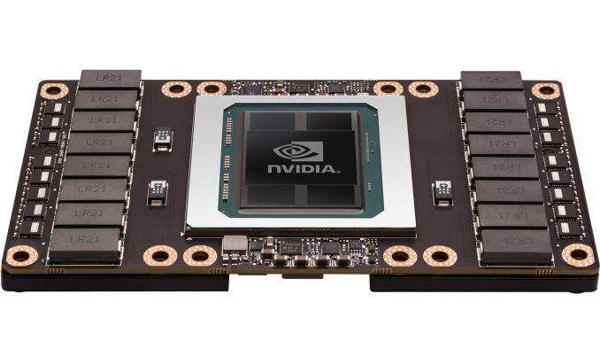
Experimental Setup
Platform
GPU: Nvidia P100
Driver: CUDA 9.2 with Nvidia driver 410
CUDA kernel Compiler: Clang/LLVM-8.0
GEVO Parameters
Population size: 256
Cross rate: 80%
Mutation rate: 30%
Search time: 48 hours (20 – 100 generations)

Slide 13
Benchmarks
 | Applications | Error metric | Test suites | Post-optimization validation
Rodinia benchmark suites [2] (GPGPU) | Bfs B+tree … Particle filter Stream cluster (13 applications) | Max raw output difference | Built-in data generator | Held-out tests
ML workloads trained using ThunderSVM [3] | MNIST a9a | Model training error | Training datasets | Testing datasets MNIST large dataset
[2] S. Che et al., "Rodinia: A benchmark suite for heterogeneous computing,“ IISWC 2009
[3] W. Zei et al., “ThunderSVM: A Fast SVM Library on GPUs and CPUs”, JMLS 2018
Notes:
Make table

Slide 14
Outline
Motivation
Proposed Design – GEVO
Experimental Setup
Results and Analysis
Rodinia benchmark suite
ML workloads trained under ThunderSVM
Conclusion

Slide 15
GEVO results – Rodinia
Notes:
Using percentage

Slide 16
Temporal analysis – hotspot (epistasis)
Sub-optimal individual can be served as the stepping stone for better optimization combination
This implies error tolerance can be used for circumventing and reaching other program spaces.
Observed 3 key mutations, introducing 0.3 error rate individually, but only incurring 0.1 error rate when combined.
Notes:
Blue bar is the normalized runtime to the left y-axis, orange dash line is the error rate to the right y-axis

Slide 17
Optimization analysis – remove redundant store (LU decomposition)
(a) Unmodified
(b) Post-Compilation
(c) GEVO Optimized
1 __shared__ s[BLOCK];
2 int c = CONST;
3 int tid = ThreadId.x;
4 for(i=0; i < 16; i++) 5 s[tid] = init(tid);
6 __syncthread();
7
8
9 for(i=0; i < 16; i++) 10 s[tid] = s[tid] - s[i]*s[i];
11 12 s[tid] = s[tid] / c;
13 __syncthread();
1 __shared__ s[BLOCK];
2 int c = CONST;
3 int tid = ThreadId.x;
4 for(i=0; i < 16; i++) 5 s[tid] = init(tid);
6 __syncthread();
7
8 float temp = s[tid];
9 for(i=0; i < 16; i++) { 10 temp = temp - s[i]*s[i];
11 s[tid] = temp; } 12 s[tid] = temp / c;
13 __syncthread();
1 __shared__ s[BLOCK];
2 int c = CONST;
3 int tid = ThreadId.x;
4 for(i=0; i < 16; i++) 5 s[tid] = init(tid);
6 __syncthread();
7
8 float temp = s[tid];
9 for(i=0; i < 16; i++) 10 temp = temp - s[i]*s[i];
11 s[tid] = temp; 12 s[tid] = temp / c;
13 __syncthread();
Interpretation: The GPU executes the load instruction without waiting for the outstanding store instruction to be finished, and renders the store instruction redundant.

Slide 18
Representative Rodinia optimizations
Architecture-specific | Application-specific
Removing redundant synchronization primitives Hotspot LU decomposition Needleman-Wunch | Removing conditional execution Hotspot LU decomposition Particle filter
Removing redundant stores LU decomposition | Loop perforation Stream cluster LU decomposition Hotspot
 | Memoization Hotspot

Slide 19
GEVO results – ML workloads in ThunderSVM
3.24x faster, 0.17% more accurate
2.93x faster, 0.04% more accurate
MNIST
a9a
Supersede the baseline in both objectives!
Same prediction error trend on testing dataset
10x training time reduction on the MNIST large dataset (1182 mins to 121 mins)
with nearly the same training accuracy (100% to 99.997%)
Notes:
Remove the blue dots

Slide 20
Optimization analysis – Terminate the loop earlier (MNIST)
...
00 While (1)
01 // select f Up
02 if (is_I_up(…))
03 f_val_reduce[tid] = f;
04 up_val = f_val_reduce[…];
05
06 // select f Low
07 if (is_I_low(…))
08 // f_val_reduce[tid] = -f;
09 f_val_reduce[tid] = 1 – f;
10 down_val = f_val_reduce[…];
11
12 if (up_val – down_val < epsilon)
13 break;
Sequential minimal optimization
Iteratively optimizes solution until the progress being slow down.
GEVO changes the terminal condition, to exit the loop earlier
The accuracy isn’t affected by this change.
This might only be applicable for particular type of dataset

Slide 21
Conclusion
GEVO finds 3 classes of optimization:
Architecture-specific
Application-specific
Dataset-specific
Machine learning is a promising GEVO target
Error tolerant
Expensive training times
Currently experimenting with deep learning frameworks
Multi-objective search allows GEVO to find stepping stones to explore larger program space.

Slide 22
Genetic improvement of GPU code
Thanks for Yours Attention!
Jhe-Yu (Jerry) Liou, Stephanie Forrest, Carole-Jean Wu
Computer Science and Engineering
Biodesign institute
Arizona State University, Tempe, AZ
Notes:
Thanks for introduction
Thanks for coming. My name is Jhe-Yu Liou. A PhD students from Arizona statue university. This work is under collaboration with Professor Forrest and, my advisor, Professor Wu.

Slide 23
Main loop of GEVO
pop = Initialization(POP_SIZE, PROGRAM)
for all individual from pop
Mutate(individual) * 3
rank = NonDominateSorting(pop)
while
offspring = SelTournment(pop, rank, POP_SIZE)
elites = SelBest(pop, rank, POP_SIZE/4)
for every 2 individuals (ind1,ind2) from Offspring
if random(0,1) < CROSS_RATE
Crossover(ind1, ind2)
for every ind from Offspring
if random(0,1) < MUTATE_RATE
Mutate(ind)
rank = NonDominateSorting(elites + offspring)
pop = SelBest(elites + offspring, rank, POP_SIZE)
POP_SIZE = 256
CROSS_RATE = 0.8
MUTATE_RATE = 0.3
Initialization
Selection
Crossover & Mutation
Elitism

Slide 24
Mutation
Copy, delete, move, replace, swap instructions/operands
Often breaks syntax: requires repairs
Function(int %0)
%1 = load int, %0
%4i = mul float, %3, 1.0
%2 = add int, %1, %1
%3 = conv float int %2
%4 = mul float, %3, 1.0
Function(int %0)
%1 = load int, %0
%4i = mul float, 1.0, 1.0
%2 = add int, %1, %1
%3 = conv float int, %2
%4 = mul float, %4i, 1.0
Copy an instruction
Connect the input
Apply the output
Function(int %0)
%1 = load int, %0
%2 = add int, %1, %1
%3 = conv float int %2
%4 = mul float, %3, 1.0
Function(int %0)
%1 = load int, %0
%2 = add int, %0, %0
%3 = conv float int, %2
%4 = mul float, %3, 1.0
delete an instruction
Connect the broken dependence chain

Slide 25
Optimization analysis – Removing conditional branch (Particle filter)
Use inner if statement to exit loop
It is guaranteed by the application algorithm
This single mutation results in 6% speedup over the baseline
1 // CDF and u are both global
2 // memory with size of N
3 int tid = ThreadId.x …;
4
5 for (x=0; x<N; x++) {
6 if (CDF[x] >= u[tid]) {
7 index = x;
8 break;
9 }
10 }

Slide 26
Optimization analysis – Removing redundant barrier (Needleman-Wunch)
1 __shared__ int temp[...][...];
2 __shared__ int ref[...];
3 int tid = threadId.x;
4
5 ref[tid] = referrence[...];
6 __syncthreads();
7 temp[tid +1][0] = matrix_cuda[...];
8 __syncthreads();
9 temp[0][tid+1] = matrix_cuda[...];
10 __syncthreads();
11
12 for (int i=0; i<BLOCK_SIZE; i++)
13 temp[tid][tid] =
14 temp[i][0] + temp[0][i] + ref[i];
The 1st and 2nd syncthreads() are not needed

