Slide 1


Democratizing computer science simulation with a components library
Presented by Bobby R. Bruce

Slide 2
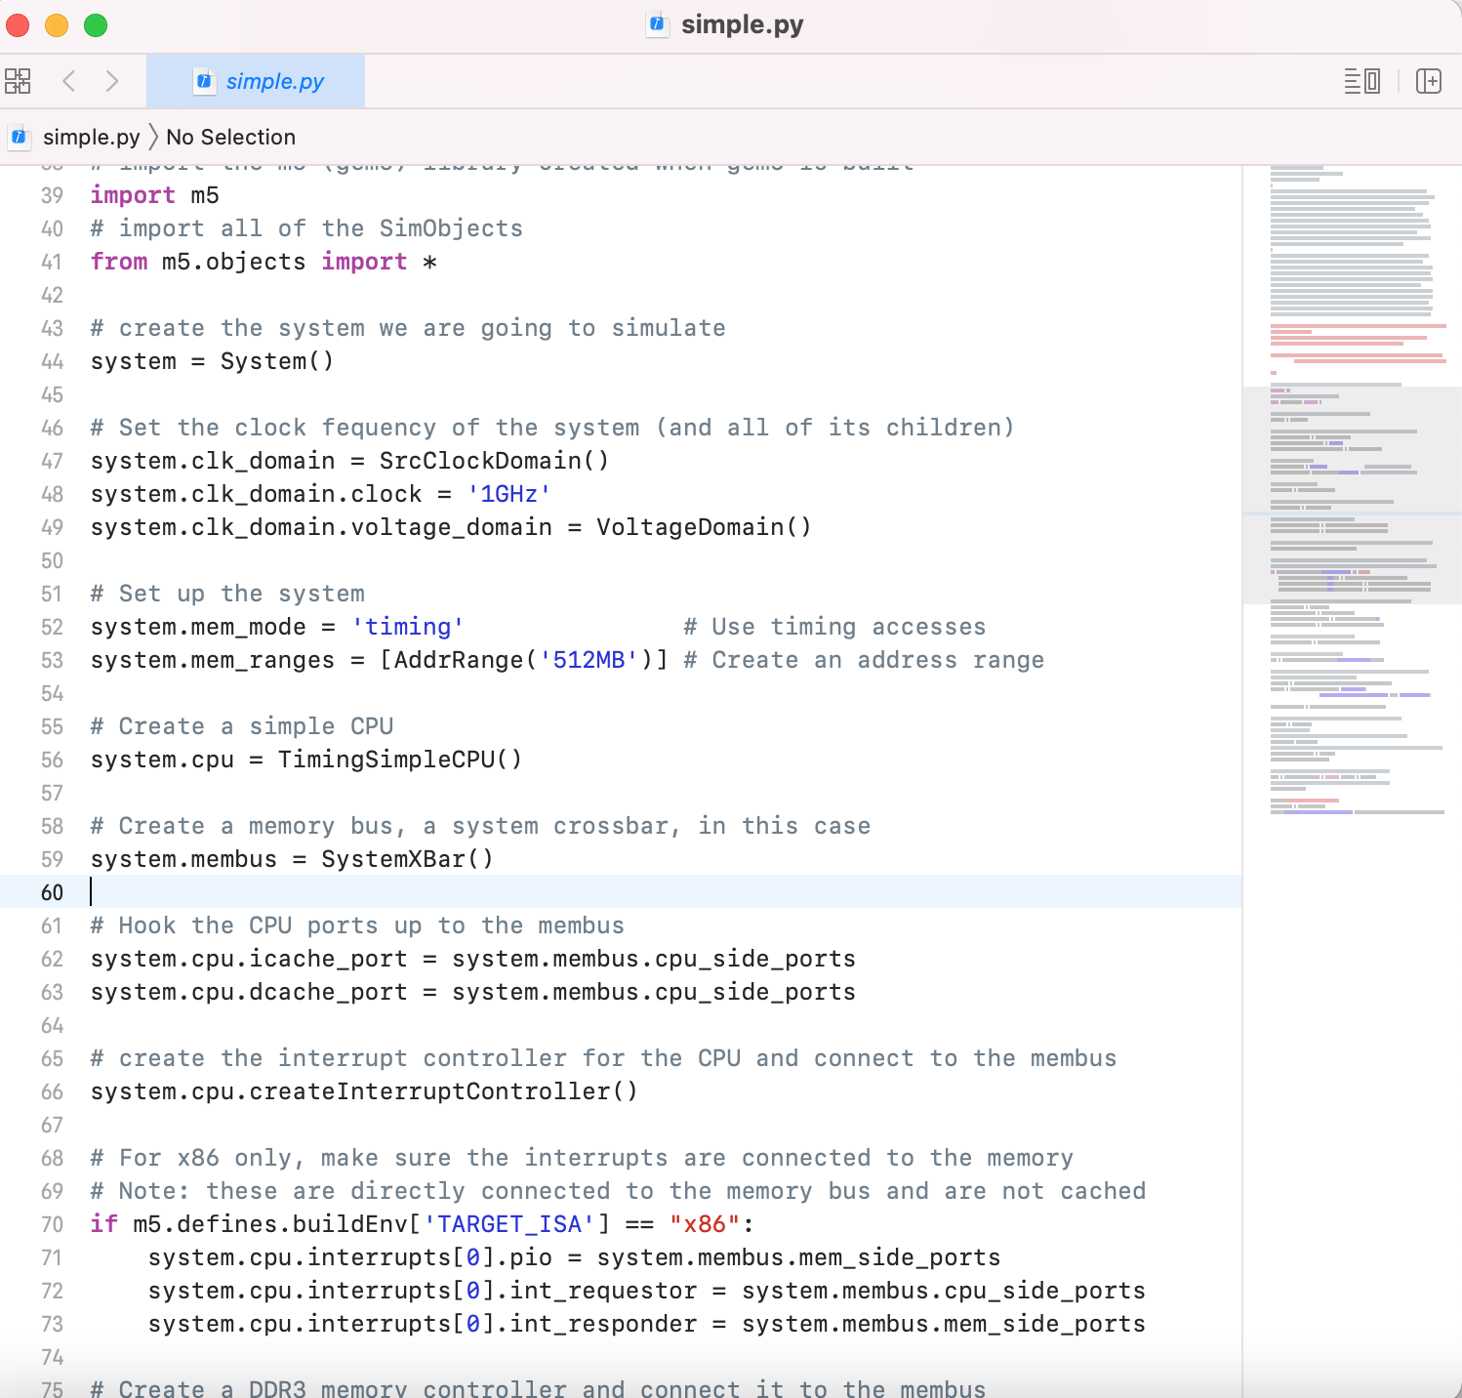
"hello World" in gem5: Plenty of boilerplate
A single core setup connected directly to main memory, with no cache, requires 36 lines of Python!
Many hundreds are required for a system capable of booting a modern OS.
Unsupported scripts and examples are circulated in the community as many configurations do not vary between simulations.

Slide 3
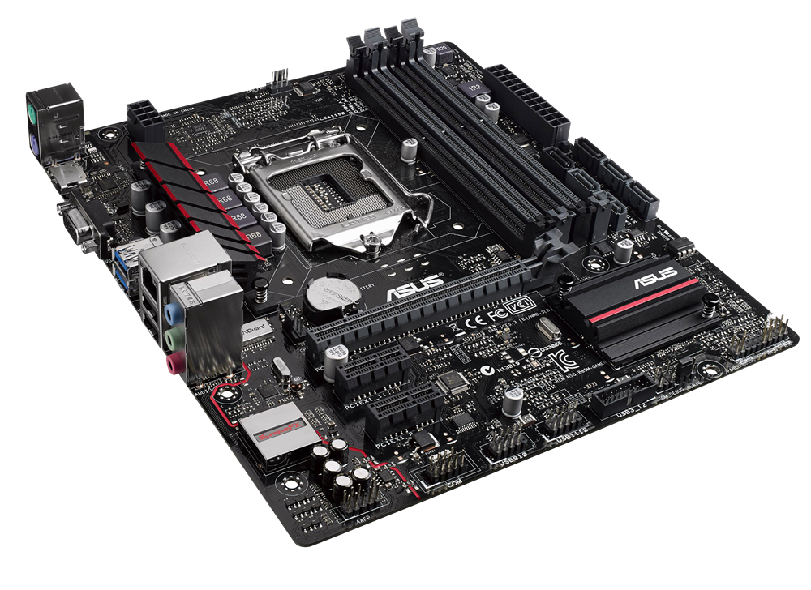
Solution: Gem5 Components
Processor
Memory
Simple Processor
Cache Hierarchy
SingleChannelDDR3_1600
No Cache
SwitchableProcessor
PrivateL1PrivateL2
...
SingleChannelDDR4_2400
MesiTwoLevel
Board
...
...

Slide 4
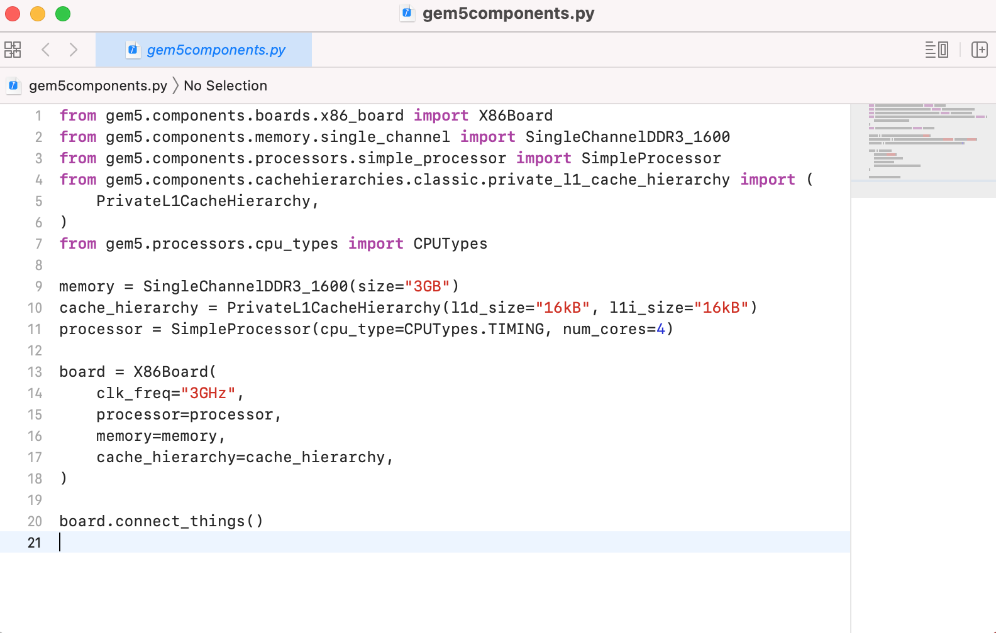
Gem5 components

Slide 5
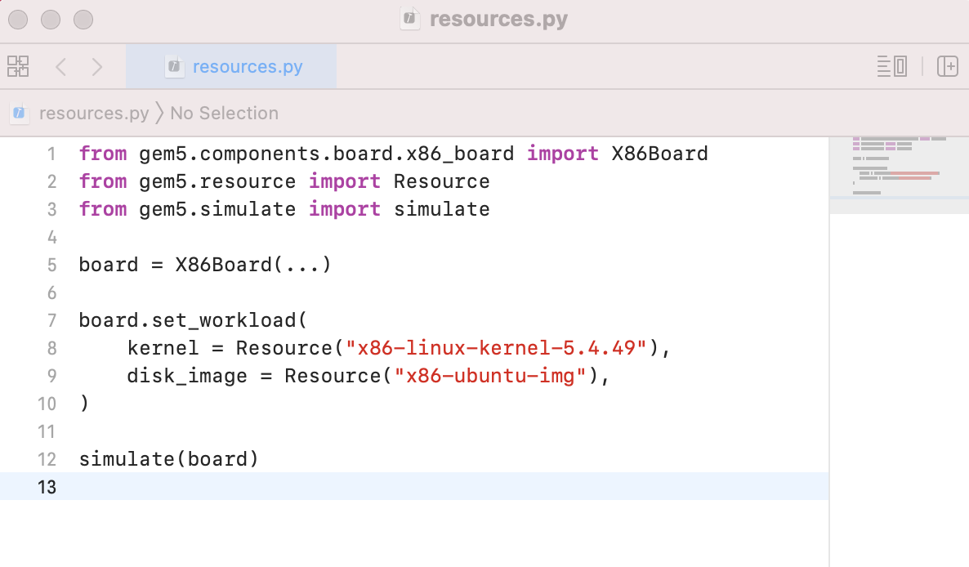
And, gem5 Resources!
Uses
Kernel
Applications
gem5 Simulation
Uses
Disk Image
Benchmarks
Tests
gem5 resources contains pre-built resources for gem5 simulations.
They may be automatically obtained via configuration scripts.
Resources

Slide 6

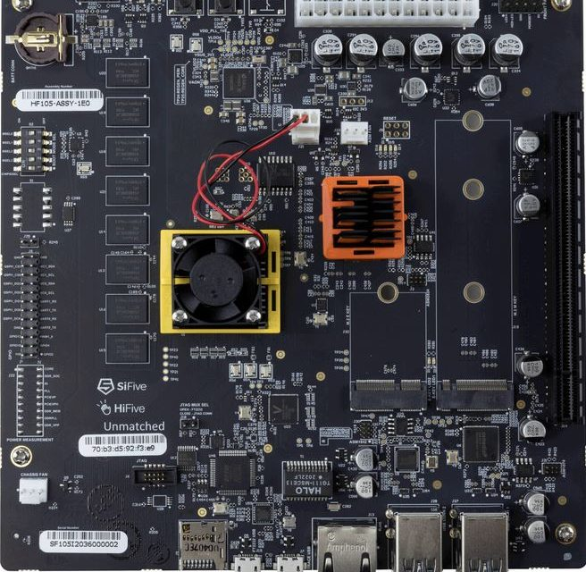
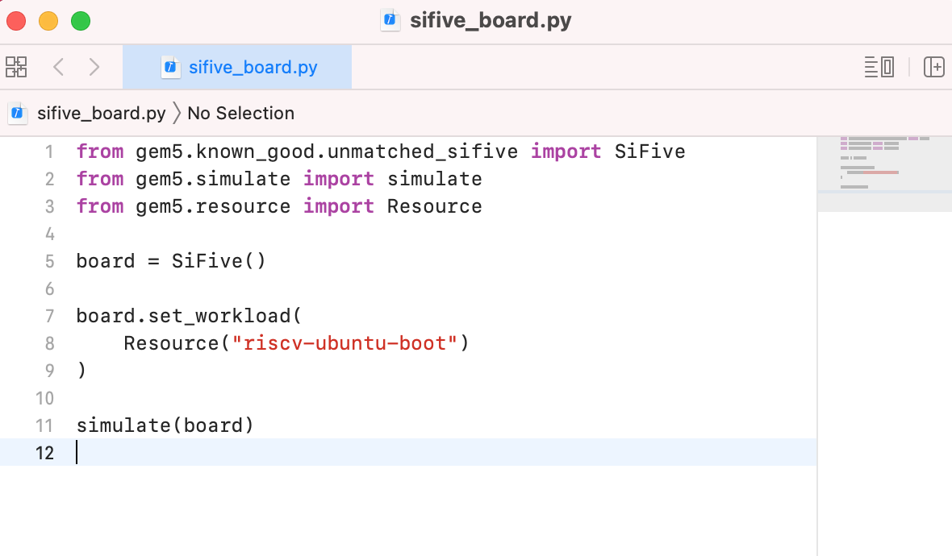
Coming soon! "Known Good Configurations"
Known Good Configurations

