Slide 1
Price and reception on Steam
Which genres should an investment fund prioritise for due diligence?
Portfolio case study — Data Analyst · July 28, 2026
Notes:
Welcome. Framing: a portfolio case that simulates the work of a data analyst for an investment fund evaluating the video game sector. Expected total duration: ~30 minutes.

Slide 2
Context
The business problem
An investment fund is evaluating entry into the video game sector and has no data-driven basis for deciding which genre to prioritise for its investment thesis in the PC/Steam market.
The question we answer
Which genre and price-band combinations show the most consistent pattern of high reception (% positive reviews), controlling for game age?
The decision this enables
Recommend 2-3 genres where the committee should prioritise investment due diligence.
117,430
games published on Steam analysed
10
real video game genres evaluated
8,998
paid games with ≥500 reviews (analysis base)
Out of scope: PC/Steam only; does not establish causality; does not allocate investment budget.
Notes:
Fictional client: investment fund. Steam as a proxy for the PC/digital market. The question was defined and approved in Phase 1 (Ask) of the case.

Slide 3
Method
1
Sources
Steam Games Dataset (fronkongames, Kaggle, CC BY 4.0) + CPI-U inflation index (BLS, US) to adjust prices across years.
2
Cleaning
Fixed a header bug in the raw CSV, excluded duplicates and 8,423 games with no genre assigned. Count reconciliation verified with an assert.
3
Analysis filter
Paid games (Price > 0) with ≥500 reviews — the minimum volume for the % positive reviews to be statistically reliable.
4
Price bands
Inflation-adjusted price quartiles, calculated on the data itself (not arbitrary bands).
Full, reproducible detail in notebooks/caso_steam_precio_recepcion.ipynb
Notes:
This is a summary; the full technical detail (ROCCC, biases, cleaning log) is in the notebook and in CASO.md. For this audience (investment committee) only the essentials are shown.

Slide 4
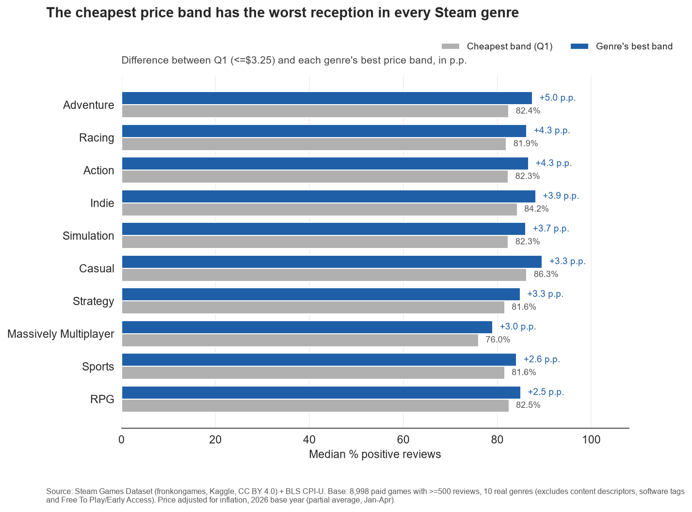
Finding 1
The cheapest band has the worst reception, across all 10 genres without exception
In each of the 10 real game genres, the cheapest price band (≤$3.25 adjusted) gets the lowest median % of positive reviews. The improvement moving to the best band ranges from +2.5 to +5.0 percentage points.
Source: Steam Games Dataset (fronkongames, CC BY 4.0) + BLS CPI-U.
Notes:
Three-part filter: the practical question is which price band suits each genre; the data shows Q1 is systematically lowest; the chart confirms it visually, bar by bar.

Slide 5
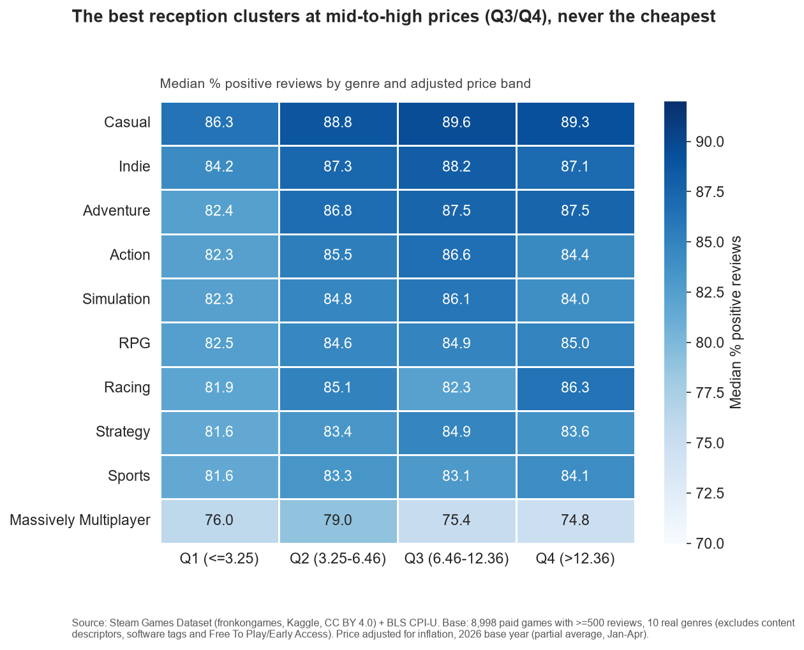
Finding 2
The best reception clusters at mid-to-high prices, not at the expensive extreme
The heatmap shows the reception peak is at Q3 ($6.46-$12.36) or Q4, depending on genre — never Q1 or Q2. There is no simple linear "more expensive is always better" relationship.
Source: Steam Games Dataset (fronkongames, CC BY 4.0) + BLS CPI-U.
Notes:
Recalculated via an alternate path (pivot_table) and matches groupby.agg. This rules out a calculation error behind the pattern.

Slide 6
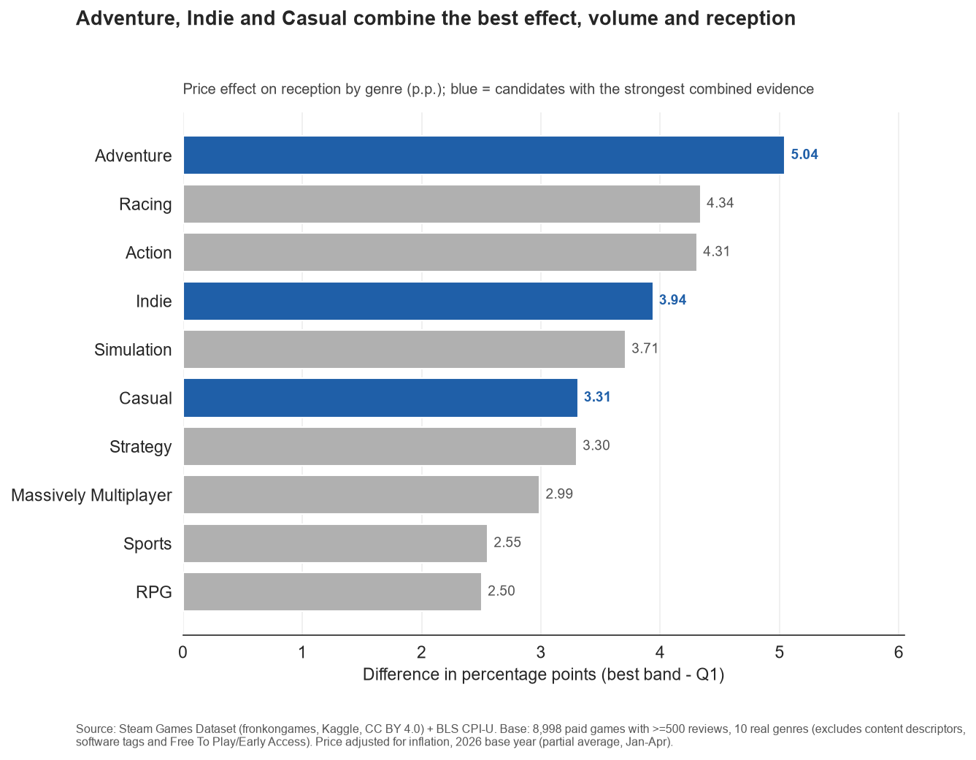
Finding 3
Adventure, Indie and Casual: the candidates with the best combined evidence
Ranking genres by effect size (the difference between Q1 and its best band), Adventure leads with +5.04 p.p. Together with Indie (+3.94 p.p., largest volume: 5,561 games) and Casual (+3.31 p.p., highest absolute reception: 89.6%), they combine the strongest evidence.
Source: Steam Games Dataset (fronkongames, CC BY 4.0) + BLS CPI-U.
Notes:
Massively Multiplayer is left out: worst reception across all 4 bands and only 176 games of evidence.

Slide 7
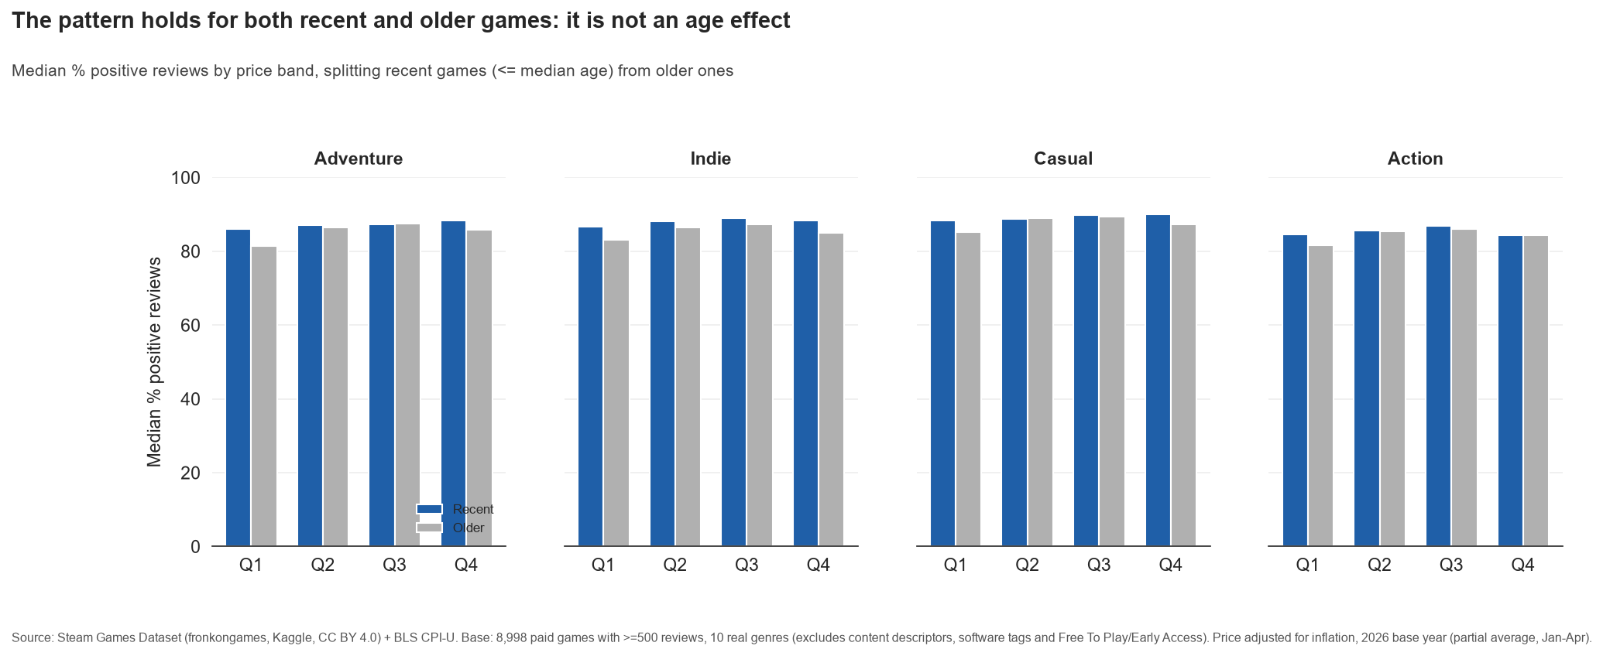
Finding 4
The pattern is not an artefact of the game's age
We split recent games from older ones: across the four reference genres, Q1 remains the weakest band in both groups. The correlation between age and % positive reviews is just -0.087.
Source: Steam Games Dataset (fronkongames, CC BY 4.0) + BLS CPI-U.
Notes:
This is the key check against the most obvious alternative interpretation: that cheap games have simply been on the market longer and accumulated more negative reviews because of that.

Slide 8
Candidates with the best evidence for due diligence
Adventure
Indie
Casual
+5.04 p.p.
5,561
89.6%
largest price effect on reception
games — the largest volume of evidence
the highest absolute reception of the 10 genres
4,030 games of evidence
+3.94 p.p. effect
+3.31 p.p. effect
Massively Multiplayer is left off this list: insufficient evidence (176 games) and worst reception across all 4 bands.
Notes:
These three feed into the formal recommendations of Phase 6 (Act), not yet closed — this presents the evidence, not the final investment decision.

Slide 9
What this analysis doesn't answer
Causality
The pattern is a descriptive correlation. It may reflect selection (studios who charge more also invest more in quality), not that raising the price improves reception.
Long tail
34.1% of the catalogue has no reviews and is excluded from the analysis for statistical reliability — not because the opportunity was dismissed.
Evolution over time
There are no dated individual reviews; game age is used as a proxy, not the real evolution of reception.
Scope of the recommendation
Prioritises genres, doesn't allocate budget or replace studio-or-publisher-specific due diligence.
Notes:
These limitations are stated explicitly, not hidden in an appendix, following Phase 5's exit gate.

Slide 10
Next step: Phase 6 — Act
This presentation closes the analysis and visualisation phases (Phases 4-5 of the case). Phase 6 will translate this evidence into:
• A formal prioritisation recommendation between Adventure, Indie and Casual
• The consolidated limitations for the investment committee
• Desirable additional data before committing capital (e.g. studio size, marketing budget, the <500-review long tail)
Notes:
Make clear to the audience that the formal investment decision is not being made in this meeting — this is the evidence that will support it.

Slide 11
Appendix — Methodology and checks
Adjusted price quartiles (base: 8,998 paid games with ≥500 reviews)
Q1 ≤ $3.25 · Q2 $3.25-$6.46 · Q3 $6.46-$12.36 · Q4 > $12.36
Checks applied before accepting the result
1. Sanity check: adjusted quartiles vs. raw unadjusted list price, same order of magnitude.
2. Recalculation via an alternate path (pivot_table vs. groupby.agg) — matches point for point.
3. Age ruled out as a confounder: correlation ≈ -0.087.
4. Control by age band (recent vs. older): the pattern holds.
5. Effect size quantified (2.50-5.04 p.p.), not just direction.
6. Manual recalculation of % positive reviews on a random sample — matches exactly.
7. Sample robustness reviewed by genre (n = 176 to 5,561); genres with n<350 flagged.
Full technical notebook: notebooks/caso_steam_precio_recepcion.ipynb
Notes:
Appendix for the senior analyst / technical audience who wants to audit the method.

Slide 12
Appendix — Prepared questions and answers
Q: Isn't this just that expensive games come from bigger studios with better marketing?
A: We don't rule it out: it's the case's most important causality limitation. The dataset has no studio size or marketing budget — recommended as additional data for Phase 6.
Q: Why exclude the 34% of games with no reviews? Aren't opportunities lost there?
A: They are excluded for statistical reliability (with <500 reviews the % is noise), not because the opportunity is dismissed. Documented as pending additional analysis.
Q: How sensitive is the result to how the price bands were defined?
A: The quartiles were recalculated via an alternate path and compared against raw unadjusted price — same order of magnitude. A sensitivity test with fixed bands is a reasonable next step.
Q: Why trust a third-party dataset instead of direct data from Valve?
A: This is a declared failure in the ROCCC assessment (partial failure on "Original"). It's used as the best public source that combines price, genre and reviews; `estimated_owners` is not used as the main metric for this reason.
Q: What's the exact number behind "Adventure is the best candidate"?
A: Adventure: 4,030 games, +5.04 p.p. effect, peak median 87.48% in Q4. All calculations are reproducible in the technical notebook.
Notes:
The five toughest questions, prepared in writing, following Phase 5's exit gate.

Slide 13
Thank you
Source: Steam Games Dataset (fronkongames, Kaggle, CC BY 4.0) + BLS CPI-U (public domain).
Portfolio case study — Data Analyst · contact: juanesa2002@gmail.com
Notes:
Close. Open the floor for questions using the prepared Q&A appendix.

