Slide 1

Unit 6 Sunshine for all
Grammar

Slide 2
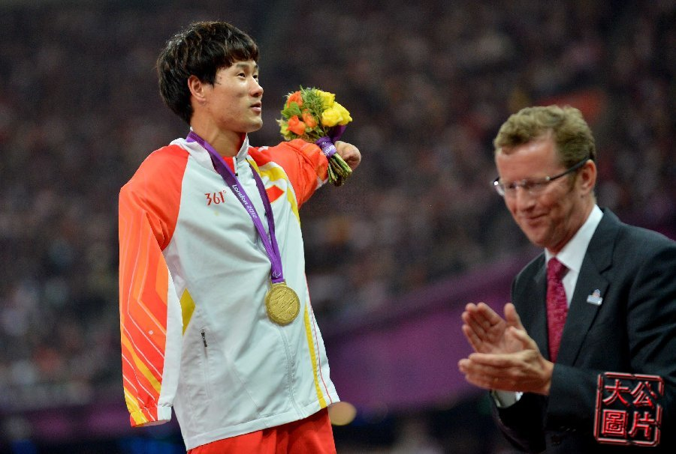
It’s meaningful to join the competition.

Slide 3
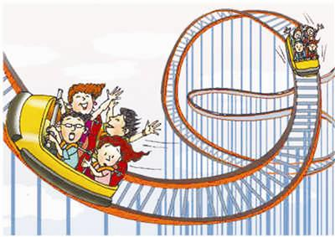
It’s exciting to ride the roller coaster.

Slide 4
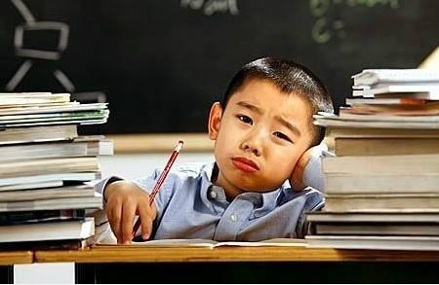
It’s boring to do so much homework.

Slide 5
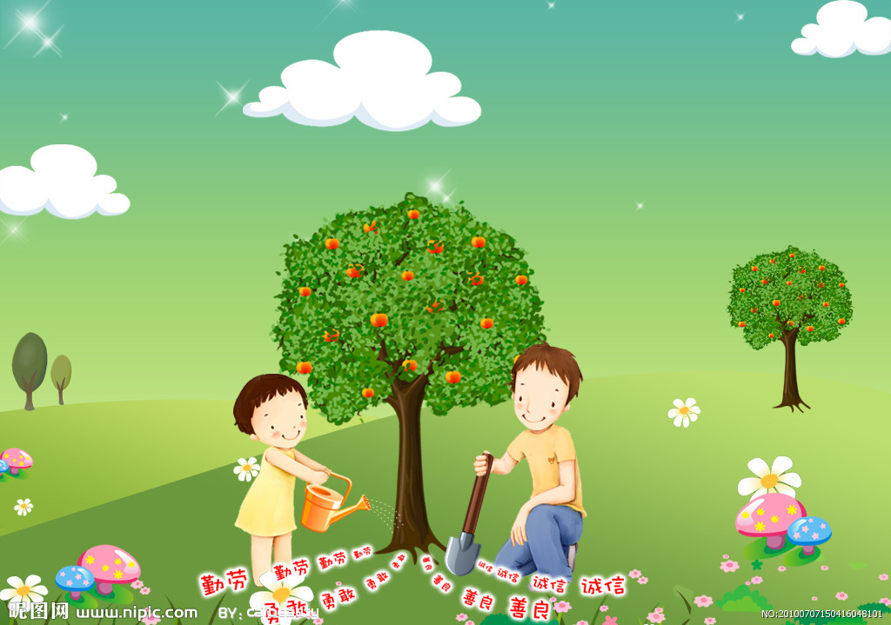
It’s meaningful to plant trees.

Slide 6
Work out the rule
It is | adjective | to-infinitive
It is | meaningful | to join the competition.
 | exciting | to ride the roller coaster.
 | boring | to do so much homework.
 | meaningful | to plant trees.
We use It is + adjective + to-infinitive to express what we think about something.
谈论做某事的感受，意为：做某事是......的

Slide 7
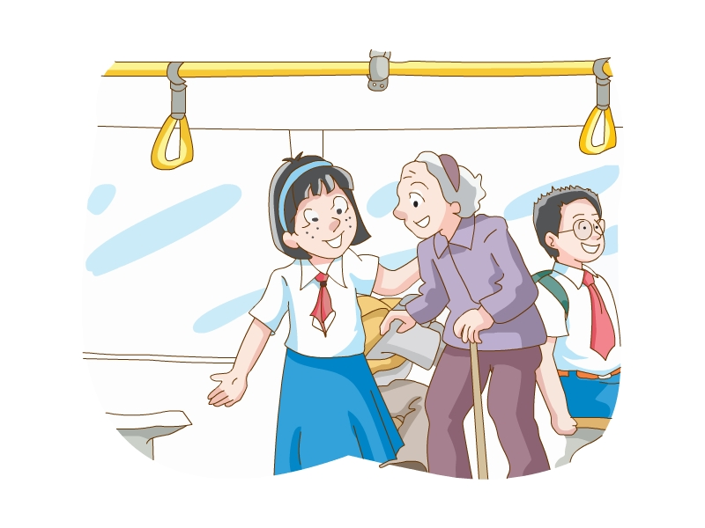
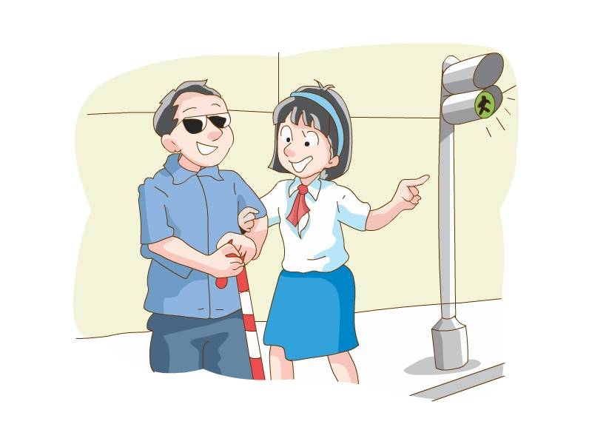
Amy is thinking about what she can do to help society. Help her use the words in brackets and those in the box to make sentences.
It is right to give seats to the elderly.
It is good to help blind people cross the road.

Slide 8
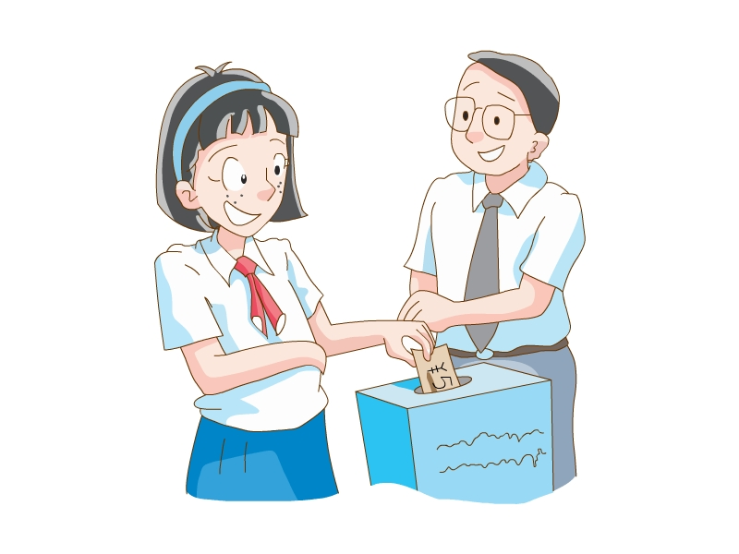
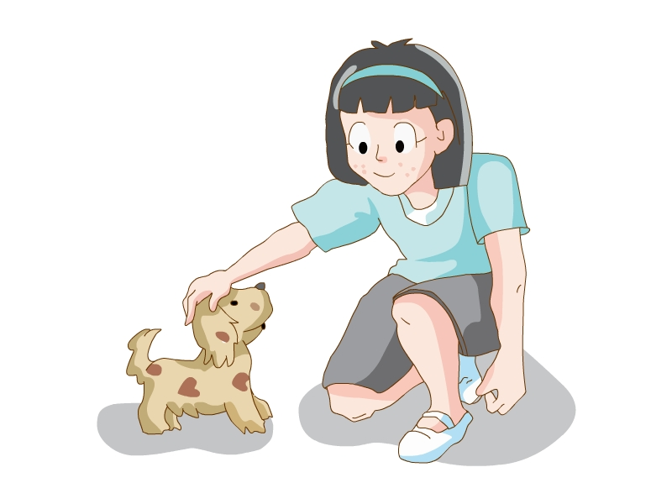
It is helpful to donate money to charities.
It is proper to take care of a lost pet.

Slide 9
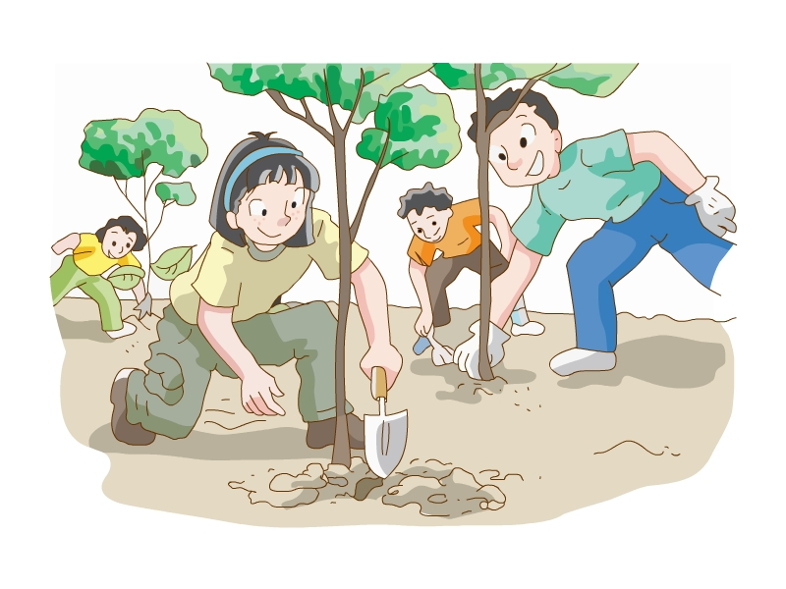
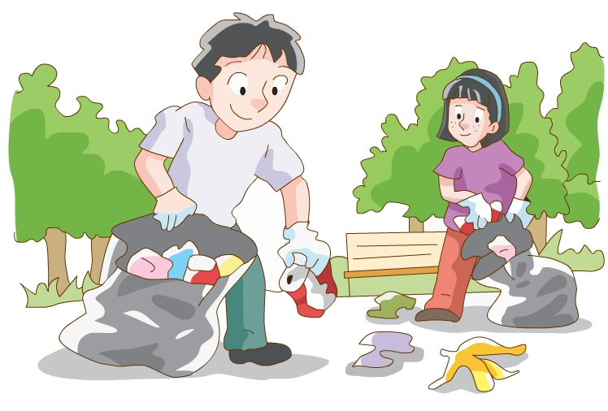
It is important to plant more trees.
It is necessary to keep parks clean.

Slide 10

To help others is meaningful for Amy.
It is meaningful for Amy to help others.
It is proper for Amy to take care of a lost pets.
It is necessary for Amy to keep parks clean.
It is important for Amy to plant more trees.

Slide 11
Work out the rule
It is | adjective | for | someone | to-infinitive
It is | important | for | people | to learn good manners.
 | difficult |  | Li Hai | to win the competition.
 | possible |  | her | to work for the charity.
We can add for someone to specify who we are talking about. 谈论某人做某事的感受
We can use _________________ (subject pronouns, object pronouns) after for.
object pronouns

Slide 12
Simon is a volunteer now. He works for people with intellectual disabilities. Amy is asking him about his work. Complete their conversation with the phrases in the box.
Amy: Why do you want to be a volunteer?
Simon: Because any help would mean a lot. Many
organizations provide help for people with
intellectual disabilities, but it’s (1)
___________________ to do their work one-to-
one without the help of volunteers.
Amy: It’s (2) __________________ to be a volunteer.
Do you need experience?
impossible for them
wonderful for you

Slide 13
Simon: No. It’s not (3) ____________________ to have
any experience, but it’s very (4) _____________
to be kind and friendly.
Amy: What are your tasks?
Simon: I’m in the sports group. I chat with them, help
them practise and make sure they’re safe. I
think it’s (5) ______________ to work with
these special people.
Amy: Do you have any trouble talking to people with
intellectual disabilities?
Simon: Yes, a little. We need to be more patient.
However, it’s very (6) _______________ to make
friends with them.
necessary for volunteers
important for us
fantastic for me
easy for people

Slide 14
Practice
1. 多说英语对我们来说很重要.
_____________________________________________
2. 你们参加这个俱乐部是很有意义的.
_____________________________________________
3. 对你来说一个人穿过森林很危险。
_____________________________________________
4. 对于他们来说按时到那是不可能的。
_____________________________________________
It’s important for us to speak more English.
It’s meaningful for you to join this club.
It’s dangerous for you to walk through the forest alone.
It’s impossible for them to get there on time.

Slide 15
Amy is kind. She gives her seat to the elderly.
It is kind of Amy to give seats to the elderly.

Slide 16
Amy is helpful. She donates money to charities.
It is helpful of Amy to donate money to charities.

Slide 17
Work out the rule
It is | adjective | of | someone | to-infinitive
It is | kind | of | Amy | to give seats to the elderly.
 | helpful |  | Amy | to donate money to charities.
We can use It is + adjective + of... + to-infinitive to express what we think of someone’s actions. 表达我们对他人行为的看法

Slide 18
Mr Wu wants to know what the Class 1, Grade 8 students think about the actions below. Help them organize their thoughts by rearranging the words below to form sentences.
1. carless/the tap/the boy/to/it is/running/leave/of
________________________________________________
2. the girl/it is/bad/of/pick flowers/in the park/to
________________________________________________
3. wrong/it is/of/drop litter/to/the people/everywhere
________________________________________________
4. of/kind/it is/to/donate blood/the young man/to people in need
________________________________________________
5. smoke/to/not right/it is/the man/of /in public places
________________________________________________
It is careless of the boy to leave the tap running.
It is bad of the girl to pick flowers in the park.
It is wrong of the people to drop litter everywhere.
It is kind of the young man to donate blood to people in need.
It is not right of the man to smoke in public places.

Slide 19

Difficult points
It is + adjective + of sb. to do sth.
It is + adjective + for sb. to do sth.
如何区别？

Slide 20
It is + adj. + for sb. + to do sth.
对某人来说，做某事是…
= Doing/ To do sth. is + adj.
= It is + adj. + that-clause
e.g. It is important for us to learn English well.
= To learn English well is important for us.
= It is important that we learn English well.
常用形容词有：
hard, difficult, easy, important, interesting, necessary, unnecessary, possible, impossible, useful, useless, boring, exciting……
形容词表示不定式所具备的特征或客观情况，是对所做的事的好坏等性质的修饰、说明。

Slide 21
It is + adj. + of sb. + to do sth.
某人做某事是…
= sb. is +adj. enough to do sth.
e.g. It’s helpful of her to help me with English.
= She is helpful enough to help me with my English.
常用形容词有：
brave, careless, clever, foolish, generous, good, helpful, honest, kind, nice, polite, silly, stupid, wrong, right, bad, strong, unkind, nice, wise, selfish, generous, careful, careless……
形容词描述的是人的特征、品质等，即句中 sb. 和 adj. 构成的主谓关系合乎逻辑。

Slide 22

Language points
1. It is helpful to donate money to charities.
donate ... to ... 捐……给……
donate money to charities 给慈善机构捐钱
donate blood to people in need 给有需要的人献血
e.g. It’s kind of you to donate these clothes to Project Hope.
Practice:
1. Michel has _________ all his pocket money _____ the local charity to help people in need.
A. given; for B. raised; to
C. donated; to D. bought; for

Slide 23
2. Do you have any trouble talking to people with intellectual disabilities?
have trouble (in) doing sth. 做某事有困难
= have difficulty (in) doing sth.
= have problems (in) doing sth.
e.g. Do you have trouble in learning English?
Practice:
1. Do you have any trouble _________ (win) the game?
2. She is very shy. She has difficulty __________ (chat) with others.
winning
chatting

Slide 24
Useful phrases and expressions
1. give seats to the elderly 给老人让座
2. help blind people cross the road 帮盲人过马路
3. take care of a lost pet 照看一只迷路的宠物
4. in one’s spare time 在某人空闲的时间里
5. people in need 需要帮助的人

Slide 25
Exercises
I. 用介词of或者for填空。
1. It is meaningful _____ us to help the elderly.
2. It is helpful _____ Millie to organize the charity show.
3. It is bad _____our students to play too much computer games.
4. It’s dangerous ______ children to play with fire.
5. It is polite _____ Lucy to greet her teacher every day.
6. It is difficult _____ us to learn English well.
7. It is impossible ______ him to finish it in 2 hours.
8. It is unkind _____ you to break the glass.
9. It is clever _____ her not to take the gift.
10. It was careful _____ him to make no mistakes at all.
for
of
for
for
of
for
for
of
of
of

Slide 26
II. 单项选择。
1. It’s very nice_______ you to give me such a chance.
A. to B. for C. of D. at
2. It’s necessary _______ us to keep the classroom _______ every day.
A. for; cleans B. of; clean
C. for; clean D. of; cleaning
3. It is _______ of the people to _______ money to the poor people.
A. important; donating B. generous; raising
C. meaningful; raise D. helpful; donate
4. ---I like my Chinese teacher. He is very kind _____ us.
---That is very kind _____ him.
A. of; to B. to; of C. to; to D. of; of

Slide 27
Thank you!

