Slide 1
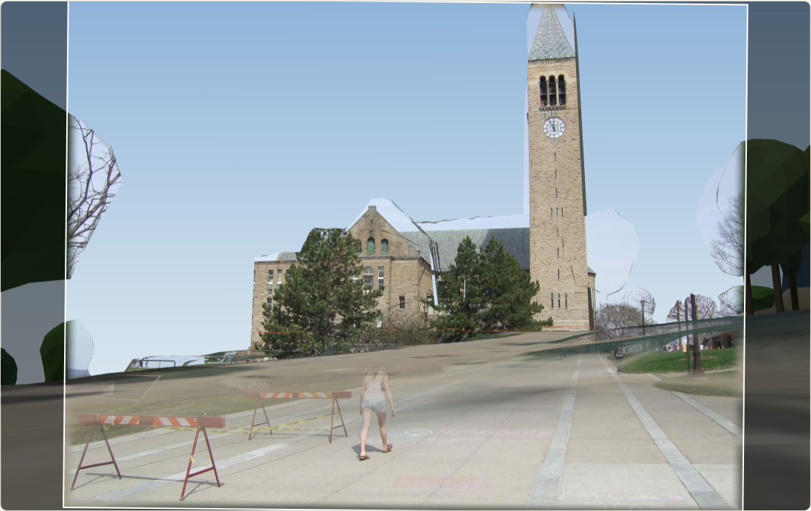
GhostMap
CS 6672 · COLMAP HACKER PROJECT
Putting COLMAP reconstructions into the real world, without GPS
A photograph painted onto the lidar model of Cornell from where it was taken. Photograph: joebeone, CC BY 2.0 (Flickr).
Public data only: USGS 3DEP lidar · OpenStreetMap footprints · New York State aerial imagery · licensed photographs from Wikimedia Commons and Flickr
Notes:
SHOW / 操作: the title slide. / 标题页。
EN: Hi, I'm [your name]. This is GhostMap, my COLMAP hacker project. In one sentence: COLMAP gives you a 3D
中文: 大家好，我是［名字］。这是 GhostMap，我的 COLMAP hacker project。一句话：COLMAP 给你的 3D 模型在一个没有意义的

Slide 2
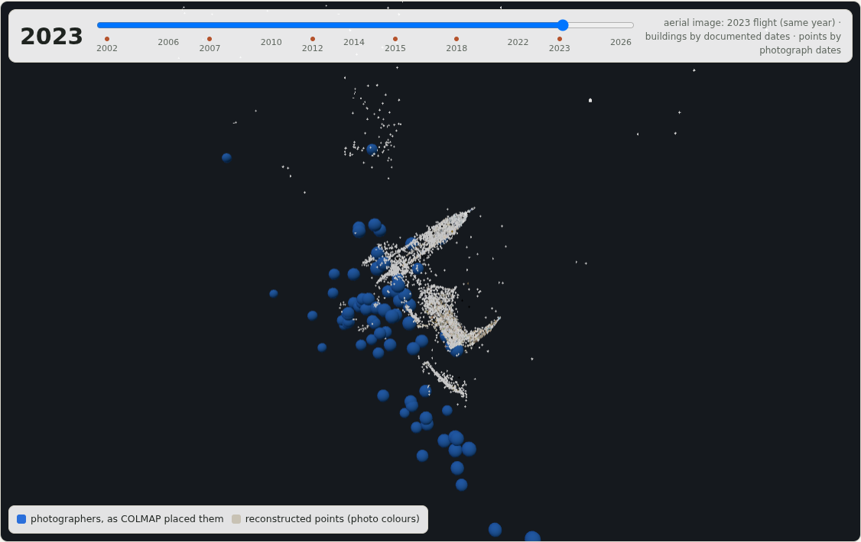
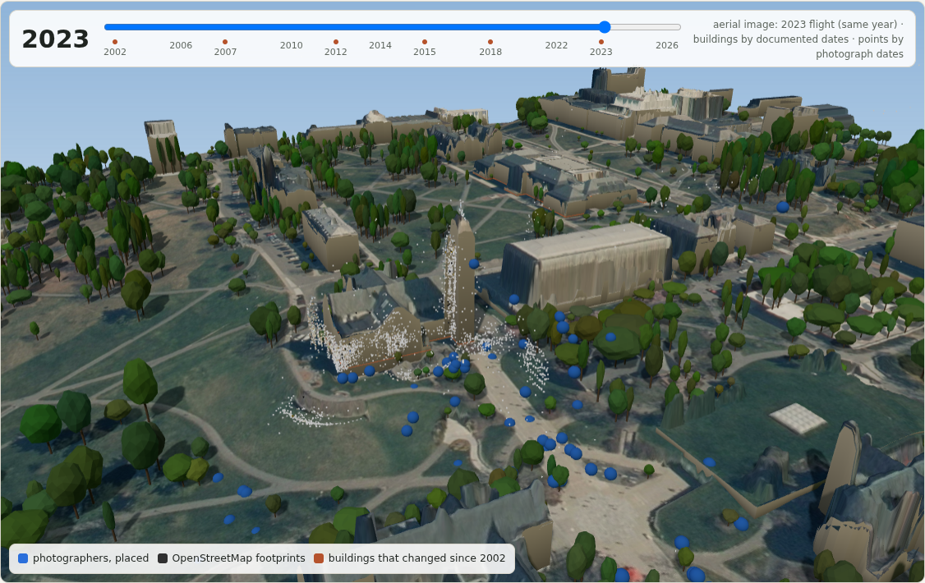
What GhostMap does
COLMAP's output: 88 internet photographs of McGraw Tower as a model in a frame of its own. No metres, no north, no up, no place on Earth.
1
Places a COLMAP reconstruction in the real world, without GPS
USGS lidar and OpenStreetMap footprints fix the seven numbers COLMAP leaves free; the certificate names the cue behind each (scale here: ±3.9 %, three independent ways)
2
Refuses when the geometry can't
all 7 campus fragments refused, each with its reason; the 3 that GPS could check were 64 m to 845 m off, and all 3 had been refused
The same model placed in metres on the campus, without GPS, from public lidar and map footprints, with a certificate that says which cue fixed which number.
3
Places a new photograph in about two seconds
53 of 76 within a median 0.7 m when taken out and placed again; painted back onto the lidar city from where it was taken
Built on pycolmap and hloc, public data only; a live demo page; then the lidar as referee and teacher for the splats.
Notes:
SHOW / 操作: the two pictures on the left, top to bottom, then the three points. / 左边两张图从上到下，再讲右边三点。
EN: What GhostMap does, in one picture. Top: what COLMAP gives you from 88 internet photographs of McGraw Tower,
中文: 一张图讲清 GhostMap 做什么。上面：COLMAP 从 88 张钟楼的网络照片给你的东西，一个在自己坐标系里的模型，没有米、没有北、
NEXT / 过渡: It didn't start here. / 一开始不是这个。

Slide 3
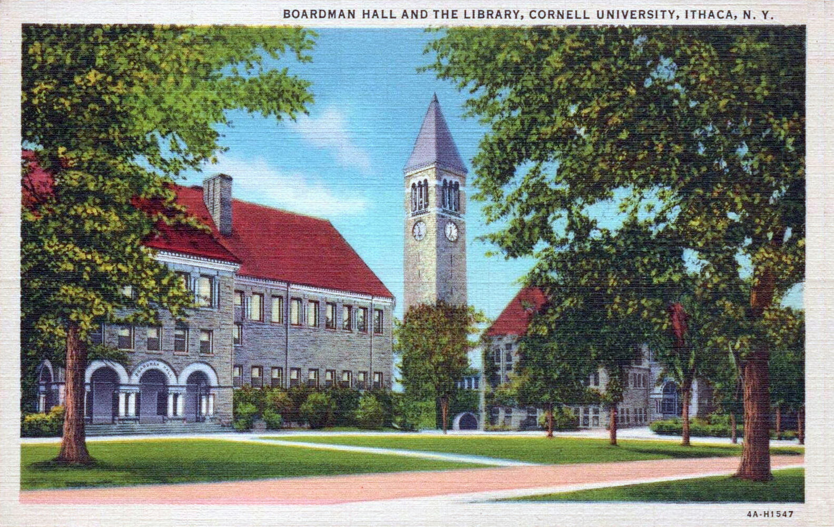
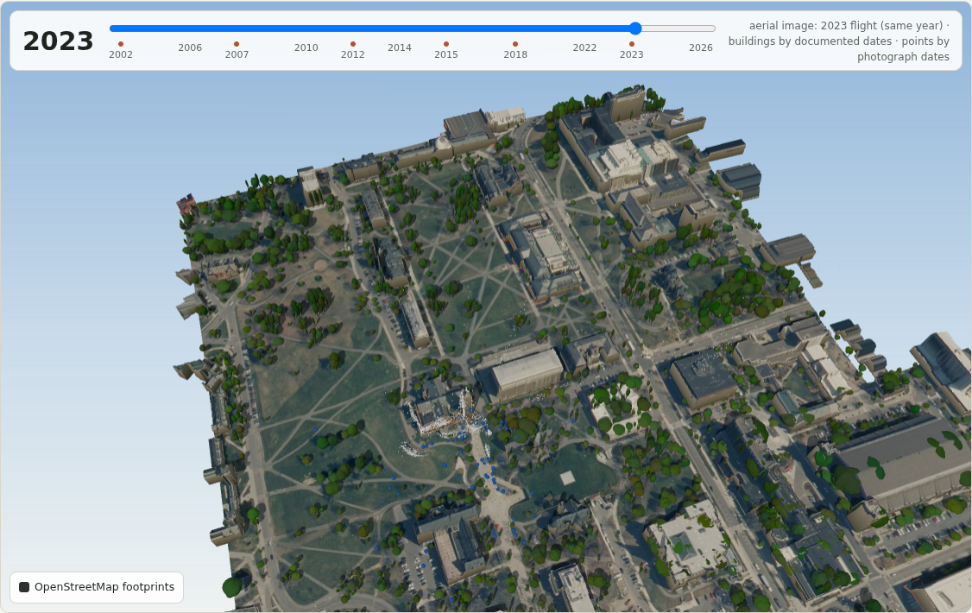
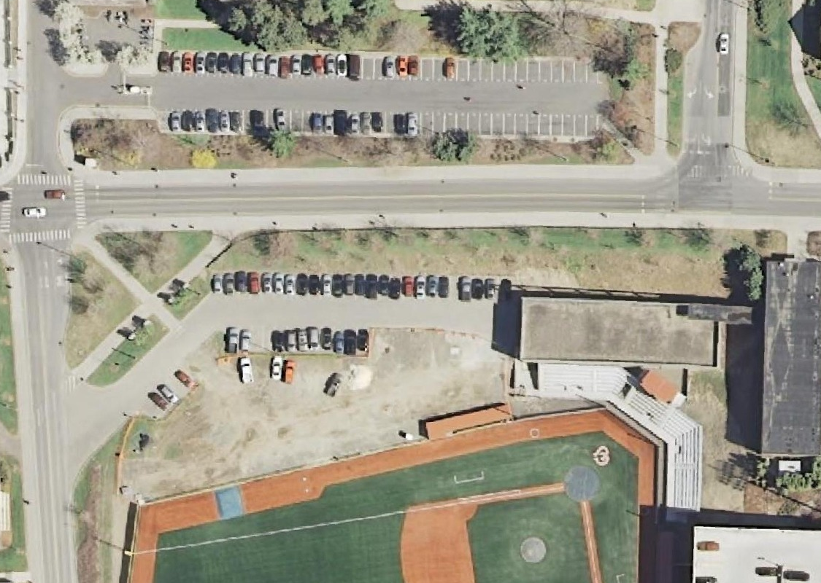
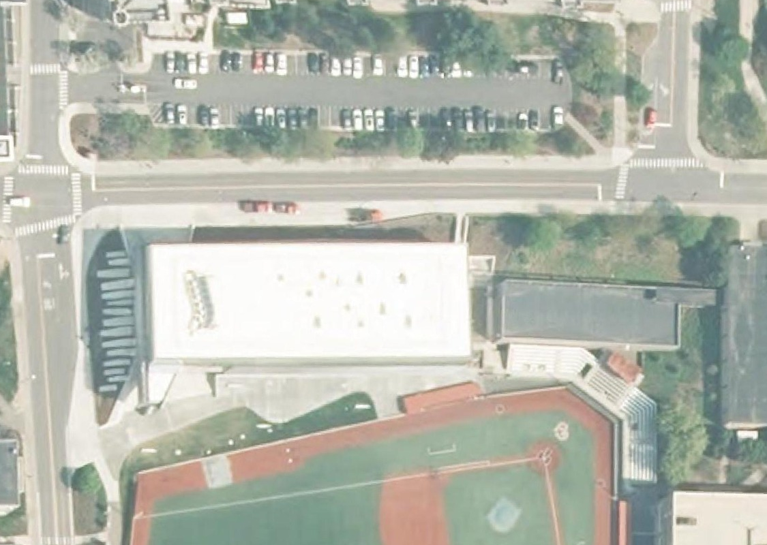
Three things we tried first
2007: a parking lot
2015: Gates Hall
A 1934 postcard (public domain).
The campus fragments, refused (demo, chapter 3).
1
Bring back a demolished building from old postcards
2
One 3D model of the whole Arts Quad
3
Watch the campus change in 3D, 2002 to 2026
mirror images
29 pieces
0 photographs
Each placed view fits the tower to a few pixels, from the wrong side: the tower's four faces look alike, and nobody photographed it from the postcards' side.
339 photographs reconstructed at once come out as 29 separate fragments: people photograph landmarks, not the walls between them.
Not one licensed photograph of any construction site before its building went up; the "before" exists only from the air.
stopped by the record and the geometry
stopped by coverage
stopped by the record; the mechanism dates from 2014
All three needed the same thing: a COLMAP model that knows where it is.
Notes:
SHOW / 操作: the three columns, left to right. / 三列，从左到右。
EN: Before this project there were three. The first is where the name comes from: Boardman Hall, Cornell's old
中文: 做这个项目之前，先试过三个方向。第一个是名字的来历：Boardman Hall，康奈尔以前的法学院楼，位置就是现在的 Olin
NEXT / 过渡: So what does COLMAP actually give you? / 那 COLMAP 到底给了你什么？

Slide 4
Seven free numbers, and why GPS can't fix them here
COLMAP's own fix: model_aligner, from known camera positions, usually GPS
1 tag
GPS among the 88 photographs, and it is 1.7 km off: it points to downtown Ithaca
63
of the 88 are Flickr web copies downloaded without any metadata, so their GPS is unknown
≈11 m
GPS fit error at Gates Hall, the one fragment with 6 tags: where it puts a held-out camera
COLMAP's cameras (blue) and points, at their native size and orientation (live demo, chapter 1).
88 licensed photographs · 32 photographers · 5,901 points · dated 2003–2025
seven numbers COLMAP leaves free: 1 scale, 3 rotations, 3 translations
A similarity needs at least three good, well-spread positions per fragment; 129 of 393 Commons photographs carry GPS, just not where it matters, and a wrong tag never announces itself.
tilt
tilt
heading
scale
east
north
height
Notes:
SHOW / 操作: the floating model and the seven dots, then the GPS numbers on the right. / 漂着的模型和七个点，然后是
EN: This is what COLMAP gives you: 88 licensed photographs of the tower and the library, 32 photographers, 5,901
中文: 这是 COLMAP 给你的：88 张钟楼和图书馆的授权照片，32 位摄影者，5,901 个点。看起来没问题，但 SfM 只能把场景恢复到一个

Slide 5
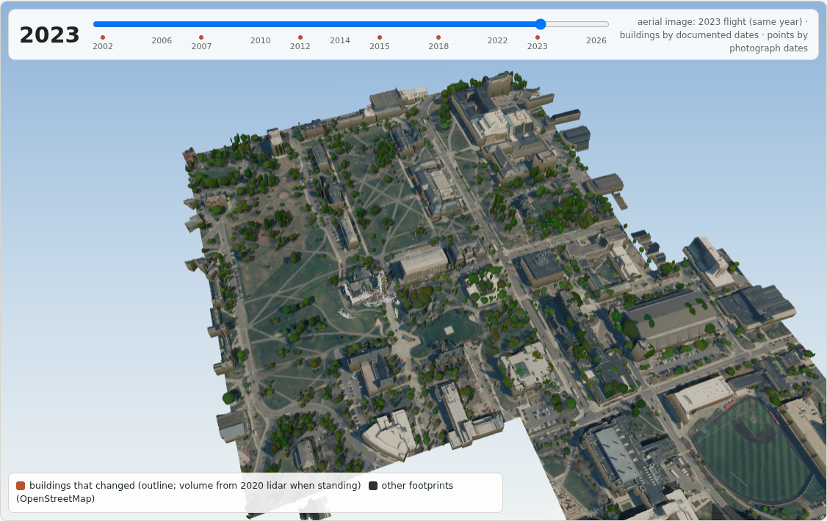
The world already has a 3D model
USGS 3DEP airborne lidar
public domain, in metres, most of the US
OpenStreetMap footprints
every building's outline, raised to its lidar roof
New York State aerial imagery
six flights, 2002 to 2023, draped on the terrain
Can public measurements fix COLMAP's seven free numbers instead of GPS, and say so when they can't?
Cornell from USGS lidar, OpenStreetMap footprints and the 2023 New York State flight (live demo, chapter 6).
Notes:
SHOW / 操作: the lidar campus. / lidar 校园。
EN: But the United States already has a 3D model of itself: USGS airborne lidar, public domain, in metres,
中文: 但美国本来就有一个自己的 3D 模型：USGS 的机载 lidar，公共领域，以米为单位，覆盖美国大部分地区。再加上
NEXT / 过渡: Here is the whole pipeline. / 下面是完整的流程。

Slide 6
The pipeline
COLMAP · PYCOLMAP · HLOC
THE PUBLIC WORLD
Licensed photographs
Features and matches
Incremental mapping
USGS 3DEP lidar
OpenStreetMap footprints
The city
Wikimedia Commons and Flickr; licence and duplicate checks
NetVLAD pairs, SuperPoint keypoints, LightGlue matches
pycolmap: 88 cameras, 5,901 points, in a frame of its own
a 640 m box as two rasters, the surface and the bare ground, 0.5 m cells, UTM 18N
1,078 outlines: wall distance fields, roof edges, inside masks
each footprint raised from the lidar ground to the lidar roof; what the page draws
GHOSTMAP
Cues
Search
Certificate
Apply
walls · roof edges · photographers' heights · tower top · free space · cameras outside
over the seven numbers: a heading × scale grid, position by descent, refinement, levelling; every score kept
bands, runner-up heading, per-cue ablation, cue profiles: usable, or refused with the reason
Reconstruction.transform(Sim3d): the fragment in metres on the campus
A new photograph
Splats refereed and taught
Time
retrieve · match · RANSAC pose · placed, distance open, or refused; painted onto the city
every Gaussian scored against lidar free space; one lidar rule in training
6 aerial flights 2002–2023, dated buildings, years per point
Notes:
SHOW / 操作: the grey lane, the green lane, then the orange one and the three uses. / 先灰色，再绿色，然后橙色和下面
EN: Grey is COLMAP: licensed photographs, hloc features and matches, pycolmap's incremental mapper; out comes a
中文: 灰色是 COLMAP：授权照片，hloc 提特征和匹配，pycolmap 增量建图，出来一个在自己坐标系里的片段。绿色是公开的世界：

Slide 7
Step 1 · the two inputs
The fragment, from COLMAP
The world, from public data
88 photographs
640 m box, 0.5 m cells
licensed, 32 photographers, the dated ones 2003–2025
USGS 3DEP lidar in UTM 18N as two rasters: the surface and the bare ground
NetVLAD · SuperPoint · LightGlue
1,078 footprints
pairs, keypoints and matches (hloc), then pycolmap's incremental mapper
OpenStreetMap outlines: wall distance fields, roof edges read from the lidar just inside each wall, inside masks
5,901 points
the city
and 88 cameras, with the facade normals and the photographers' positions the cues read
each footprint raised from the lidar ground to the lidar roof; the model the page draws and paints on
Notes:
SHOW / 操作: left the fragment, right the world. / 左边片段，右边世界。
EN: The two inputs. The fragment: 88 licensed photographs; NetVLAD picks the pairs, SuperPoint and LightGlue
中文: 两个输入。片段：88 张授权照片，NetVLAD 选配对，SuperPoint 和 LightGlue 匹配，pycolmap 建图，得到 88 个相机、5,901 个

Slide 8
Step 2 · each cue fixes some of the seven numbers
tilt
tilt
heading
scale
east
north
height
Facade normals
walls are vertical: the up direction, before the search
Photographers' heights
people stand 1.6 ± 0.3 m above the lidar ground
OpenStreetMap walls
points on the walls: precision over every wall, recall over the named building's
Lidar roof edges
a facade's top meets the lidar roof just inside it, ± 3 m
Parallel walls
their spacing is known in metres
McGraw Tower top
the tower's axis on its footprint, its top at the lidar top
Free space
32 samples per camera-to-point ray, none inside a building (after Kaminsky 2009)
Filled: the cue fixes that number. Free space fixes none on its own; it rules out placements that put a line of sight through a building. The objective is the weighted sum of the bounded cue scores: walls 1 · roof edges 0.5 · camera height 0.3 · landmark 1 · free space 0.5 · outside 0.5.
Notes:
SHOW / 操作: the cue table, row by row. / 线索表，逐行。
EN: No single cue fixes everything, so each one fixes part. Facade normals give the two tilts: walls are
中文: 没有哪条线索能定所有的数，所以每条定一部分。立面法向定两个倾斜：墙是竖直的。摄影者的高度再微调：人站在 lidar 地面

Slide 9
Step 3 · the search keeps everything it looks at
1
Vertical first
2
Landmark
3
Grid
from the facade normals; a fragment with one facade falls back to the cameras' own up, and the certificate records which rule was used
pins the position: when the photographs name a tower and the model holds a tower-like cluster, its axis goes onto the footprint centre; the walls then decide the heading, the top the scale
heading every 3°, scale from a third to three times a prior from the facade's height; in each cell the position descends along the wall distance field
4
Refine
5
Level
6
Keep every score
the best cells, at least 5° apart, refined jointly with an explicit simplex; then a 0.5° heading scan around the winner
a robust plane through the well-observed photographers' heights proposes the remaining tilt; fits turned by ⅓, ⅔ and all of it compete with the facade vertical on the joint objective
each cue's score is stored per cell, so the profile of any cue subset over scale or heading is read off afterwards, without a second search
The output of the search is not one similarity but the objective over the whole grid; the certificate is read from that.
Notes:
SHOW / 操作: the six steps. / 六步。
EN: The search keeps everything it looks at. The vertical comes from the facade normals first. If a tower is in
中文: 搜索把看过的东西都留着。竖直方向先从立面法向来。范围里有塔、而且照片点了它的名，塔轴就钉住位置。然后是网格：朝向每

Slide 10
Step 4 · the certificate
Bands
how far each number can move before the objective drops by 10 % of its range
Runner-up heading
the best heading more than 20° away must score under 80 % of the winner
Ablation
each cue removed in turn and the fit repeated: how far the optimum moves
Cue profiles
the walls alone, the roof edges and the tower each imply a scale; more than 25 % apart is "cues disagree"
In metres among the lidar buildings (live demo, chapter 2).
certificate: usable
Structural rules
a roof-edge score under 0.25 with no landmark: no facade was seen; more than 10 % of the photographers inside a building: refused
±3.9 %
scale, fixed 3 independent ways: tower top, parallel walls, roof edges
72 %
the best other heading's score against the winner
Verdict
usable, or a named failure mode, with the scale uncertainty the fixing cue implies
3.7°
levelled by the photographers' heights
83 %
of COLMAP's points within 2.5 m of a lidar surface
Notes:
SHOW / 操作: the list on the left, then the placed fragment and its numbers; optionally demo chapter 2 for the snap. /
EN: The certificate is what the search writes down. Bands: how far each number can move before the objective
中文: 证书就是搜索写下来的东西。区间：每个数能动多远，目标函数才掉它量程的十分之一。第二名：离最优 20 度以外的最好朝向，

Slide 11
The certificate's numbers, explained
Number | What it measures | The rule | Why it matters
±3.9 % | the tower top fixes the scale to about 2 m over the tower's height; the walls alone and the roof edges of 4 walls land inside that band | scale fixed by at least one cue, and the cues that measure it must agree | three independent measurements give the same 17.8 m per COLMAP unit
72 % | the best heading more than 20° away scores this much of the winner (the quadrants: 12 %, 4 %, 68 %) | under 80 %, or the heading is ambiguous; a square tower alone gives about 95 % | the heading is unique, not one of four look-alike faces
3.7° | the facade vertical was tilted; the photographers' heights over the lidar ground proposed 5.5°, and two thirds of it won on the joint objective | camera height corrects tilt only as far as the other cues agree | 18 of 88 photographers end at eye height; the rest are far away and poorly placed along their rays
83 % | of COLMAP's own points within 2.5 m of a lidar surface; 43 % within 1 m of a footprint wall | a structural check, not a fit term | the noise floor every splat is later compared with
1.00 · 0.85 · 0.25 | cue scores at the optimum: tower 1.00, free space 0.85, cameras outside 0.97, roof edges 0.42, walls 0.25, camera height 0.12 | each bounded 0 to 1 with a stated noise model | who did the work: the tower, confirmed by the walls and the roof edges
Notes:
SHOW / 操作: the table, row by row. / 表格，逐行。
EN: Each number on the certificate means something physical. Plus or minus 3.9 percent: the tower top fixes the
中文: 证书上每个数都对应一件物理上的事。±3.9%：塔顶把尺度定到塔高上下约 2 米，只用墙和四条屋檐定出的尺度都落在这个区间里，

Slide 12
How the scale is read: every cue's own profile
Take one cue away and refit
without | heading | scale | position
walls | 0.03° | ×1.000 | 0.05 m
roof edges | 0.16° | ×0.999 | 0.30 m
camera height | 0.00° | ×1.000 | 0.00 m
tower | 0.73° | ×0.977 | 0.98 m
free space | 0.00° | ×1.000 | 0.00 m
cameras outside | 0.00° | ×1.000 | 0.00 m
Removing the tower moves the optimum 1.0 m and 0.7°; removing any other cue moves it under 0.3 m. The tower does the work; the walls and the roof edges confirm it, and the certificate says so.
Every cue that measures scale peaks at the same place, 17.8 m per unit; the certificate reads "fixed three independent ways" off these curves.
Notes:
SHOW / 操作: the curves, then the ablation table. / 曲线，然后右边的消融表。
EN: Here is why "three independent ways" is not a figure of speech. The objective over scale, each cue on its
中文: 这就是为什么"三种独立方式"不是一句修辞。目标函数在尺度上的曲线，每条线索单独画：只用墙、只用屋檐、只用塔、只用摄影者

Slide 13
Watch it snap
Recorded from the demo page (chapter 2): the fragment in COLMAP's frame, then the placement applied; it lands among the lidar buildings and the certificate appears. Click to play; the live demo does the same.
Notes:
SHOW / 操作: click the clip (or demo chapter 2). / 点视频（或切到演示第 2 章）。
EN: The fragment floating in COLMAP's frame, then the placement applied: it lands among the lidar buildings and the
中文: 片段漂在 COLMAP 的坐标系里，然后把变换应用上去：它落到 lidar 建筑之间，证书出现。模型本身没有变，变的只是那七个数。

Slide 14
When it refuses, and why
Fragment (named by its photographs) | Photos | Certificate | Checked by GPS
Uris Library | 54 | refused: no facade seen | no usable GPS
Morrill Hall | 18 | refused: cameras inside buildings | 845 m off
McGraw Tower | 27 | refused: cues disagree | no usable GPS
Goldwin Smith Hall | 13 | refused: scale undetermined | no usable GPS
McGraw Tower | 22 | refused: cameras inside buildings | no usable GPS
Olive Tjaden Hall | 8 | refused: scale undetermined | 64 m off
Gates Hall | 8 | refused: scale undetermined | 325 m off
Why: geometry, on a synthetic hall with a known answer
One facade
scale undetermined
scale ×0.970 · heading 2.0° off
Two parallel facades
position undetermined
scale ×0.999 · heading 2.2° off
A corner
The whole campus collection reconstructed at once: 339 photographs, 29 fragments; the 7 with eight or more cameras are listed.
usable
scale ×0.993 · heading 0.12° off
3 of 3
placements GPS could check were 64 m to 845 m off, and all were refused: none certified and then found wrong.
Three facades
usable
scale ×1.003 · heading 0.10° off
red = not fixed · layouts: backup slide
Notes:
SHOW / 操作: the table, then the four layouts on the right. / 表格，然后右边四种布局。
EN: The more useful half is the refusals. The whole campus at once: 339 photographs, 29 fragments, seven big
中文: 更有用的一半是拒绝。整个校园一次重建：339 张照片，29 个片段，7 个够大可以试。7 个全被拒绝，每个有原因：没看到立面、

Slide 15
The synthetic hall, all sixteen cases
With exact roof edges
every placement is within 3 % in scale (the one-facade case is refused anyway: nothing in it fixes the scale) and the verdicts are right.
With a 3 m roof-edge error
the corner comes out 23 % too large and is still certified usable: nothing else in a corner fragment measures scale, so the certificate cannot see it. Where the walls do measure scale (parallel walls, three facades) the same error is caught as "cues disagree".
verdict | one facade | two parallel | a corner | three facades
exact roof edges | scale undetermined | position undetermined | usable | usable
3 m roof-edge error | scale undetermined | cues disagree | usable | cues disagree
So
the certificate's known hole is a map error it has no second opinion on; measuring that false-acceptance rate is on the plan.
Notes:
SHOW / 操作: the chart, then the right-hand reading. / 图表，然后右边的解读。
EN: The full synthetic sweep. With exact lidar roof edges, every placement is within 3 percent in scale and the
中文: 完整的合成实验。lidar 屋檐准确时，每个放置的尺度误差都在 3% 以内，结论也都对。给 lidar 一个 3 米的屋檐误差，墙角那个

Slide 16
The same building through two fragments
Building | Fragment | against | Verdicts | Median | 90th pct
McGraw Tower | Uris Library, 88 photos (certified) | Uris Library, 54 photos | usable / not usable | 0.6 m | 1.5 m
Uris Library | Uris Library, 88 photos (certified) | Uris Library, 54 photos | usable / not usable | 22.6 m | 37.3 m
McGraw Tower | Uris Library, 88 photos (certified) | McGraw Tower, 27 photos | usable / not usable | 1.1 m | 1.7 m
Uris Library | Uris Library, 88 photos (certified) | McGraw Tower, 27 photos | usable / not usable | 1.5 m | 6.4 m
McGraw Tower | Uris Library, 88 photos (certified) | McGraw Tower, 22 photos | usable / not usable | 1.2 m | 2.7 m
Uris Library | Uris Library, 88 photos (certified) | McGraw Tower, 22 photos | usable / not usable | 12.9 m | 27.2 m
A check that needs no ground truth. The same building reconstructed in two fragments, each placed on its own: McGraw Tower agrees within 1.2 m against every campus fragment (the landmark pins it); Uris Library is 2–23 m apart where the campus fragment's heading was refused. Refused frames disagree by tens of metres; nothing certified disagrees.
Notes:
SHOW / 操作: the table, then the reading below. / 表格，然后下面的解读。
EN: A check that needs no ground truth: the same building reconstructed in two fragments, each placed on its own.
中文: 一个不需要真值的检验：同一栋楼在两个片段里各自重建、各自放置。钟楼对每个校园片段都在约 1 米内一致，因为地标把它钉住了。

Slide 17
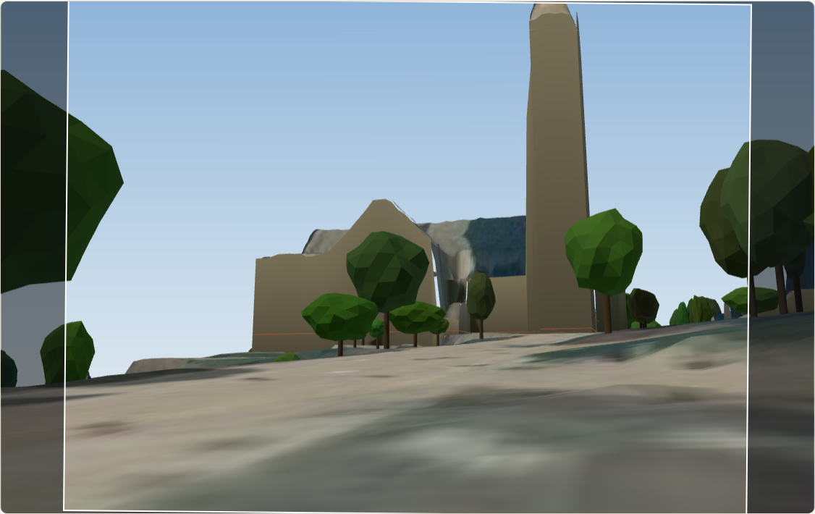
Step 5 · a photograph it has never seen
1 · Retrieve
2 · Match
3 · Pose
4 · Distance
5 · Paint
NetVLAD: the 10 most similar of the 88
SuperPoint (4,096 keypoints at 1,200 px) + LightGlue
pycolmap RANSAC (12 px) from the EXIF focal length and 4 guesses, then refined with the focal free; most inliers wins, at least 40
poses from the other guesses keeping 70 % of the inliers form a segment; longer than 25 m: the distance stays open
the photograph projected onto the lidar city from that pose, with a depth test
From where it was placed: the photograph painted onto the lidar city (inside the white frame).
The same spot, the bare lidar city: the tower is where the photograph says. Photograph: joebeone, CC BY 2.0 (Flickr).
Tested by taking each of the 88 photographs out and placing it again (76 with a trustworthy reference pose):
53 placed
21 distance open
2 refused
120 of 120 refused
median 0.7 m from the reconstruction's own pose
the true spot a median 3.3 m from the stated line
each would have been about 115 m wrong
Mapillary photographs from the Arts Quad side
Notes:
SHOW / 操作: the five steps, the two pictures, the four numbers; then demo chapter 11: a long-lens photograph in
EN: Back to the photograph from the start. COLMAP can register a new image, but into its own frame; here the
中文: 回到开头那张照片。COLMAP 能注册新照片，但只能进它自己的坐标系；这里的参考是放好的片段，所以同样的注册直接落在地图上。

Slide 18
Placing a photograph, live
Recorded from the demo page (chapter 11): a photograph from the tray, placed in about two seconds without GPS; the camera moves to where the photographer stood and the photograph is painted onto the city; then all 88 photographs painted back. Click to play; or do it live with your own phone photograph.
Notes:
SHOW / 操作: click the clip, or do it live on chapter 11 with your own phone photograph. / 点视频，或者在第 11 章用自己
EN: A photograph from the tray, placed in about two seconds without GPS; the camera moves to where the photographer
中文: 托盘里的一张照片，不用 GPS 大约两秒放好；镜头移到摄影者站的位置，照片投影到城市上；然后 88 张照片各自从自己的位姿

Slide 19
Tested by taking each photograph out
0.7 m
median error of the 53 placed: half of them land within a footstep of where the reconstruction had them; 90th percentile 5.6 m, worst 20 m
3.3 m
for the 21 long-lens shots the direction is right and the distance is the open part: the true spot lies this far from the stated line
≈115 m
what a wrong acceptance would have cost: the 2 refused would each have been this far off
Each of the 88 photographs taken out of the reconstruction and placed again from scratch, scored where COLMAP's own pose of it is trustworthy (12 are not: COLMAP had put one 37 km away).
120 / 120
street photographs from the Arts Quad side refused as a block: a whole side of the tower nobody online photographed
Notes:
SHOW / 操作: the chart, then the four numbers with their meaning. / 图表，然后四个数字和它们的意思。
EN: The test: each of the 88 photographs taken out of the reconstruction and placed again from scratch, scored on
中文: 检验：88 张照片每张拿出重建、从头再放，在 76 张参考位姿本身可信的照片上打分。0.7 米：一半的放置落在离重建位姿一步之内；

Slide 20
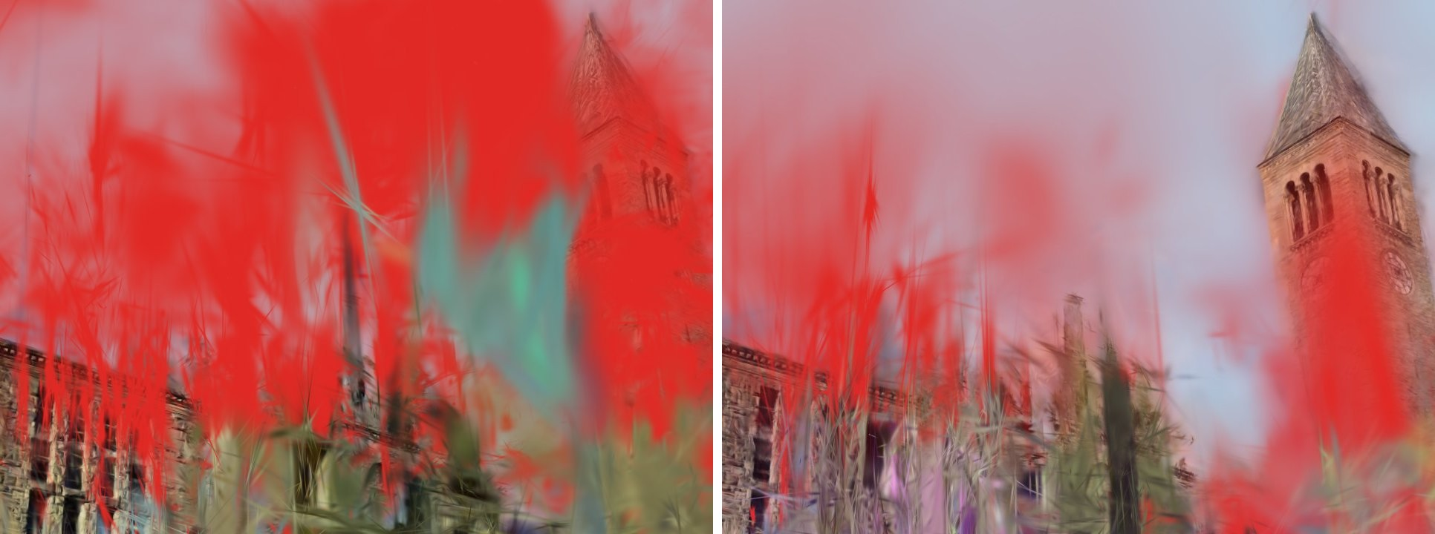
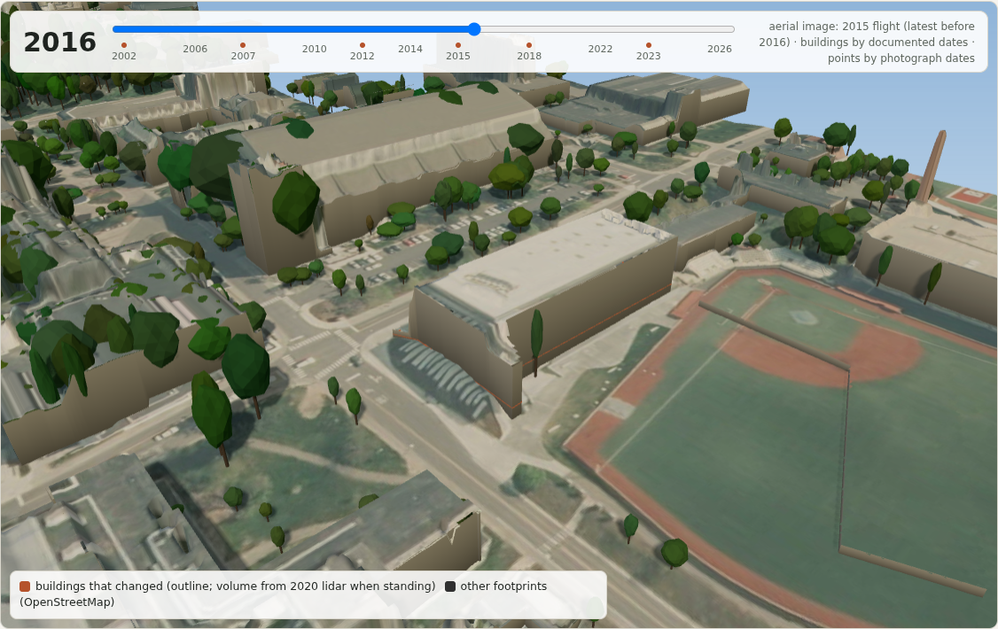
What a world frame buys you
The lidar as referee and teacher
Time, for free
A view no photographer took; every Gaussian painted by the lidar: red in measured-empty air, purple underground. Plain splat left, lidar-taught right.
41 % → 5 %
41 % → 88 %
14.4 → 14.5
of Gaussians under the bare ground
on lidar surfaces
dB on held-out photos: no worse
Gates Hall in the 2016 flight: a parking lot until 2012. 6 aerial flights, 2002–2023, on the same terrain (live demo, chapter 7).
Notes:
SHOW / 操作: the two panels; optionally demo chapter 5 (the fly-through, tick "paint each Gaussian by the lidar's
EN: Once the model is in metres, the lidar becomes a referee. I trained Gaussian splats from the same
中文: 模型一旦以米为单位，lidar 就成了裁判。我用同样的照片训练 Gaussian splat。普通的 splat 有 41% 的高斯埋在地面以下。加上

Slide 21
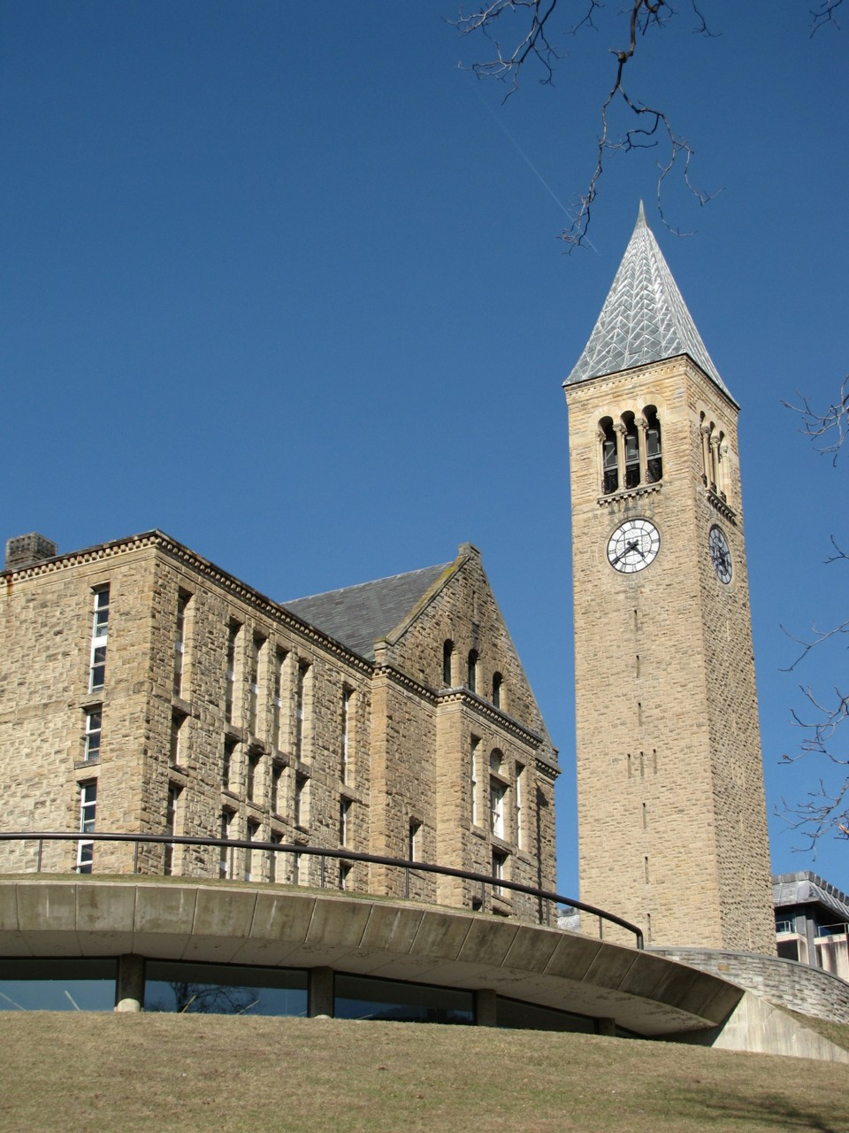
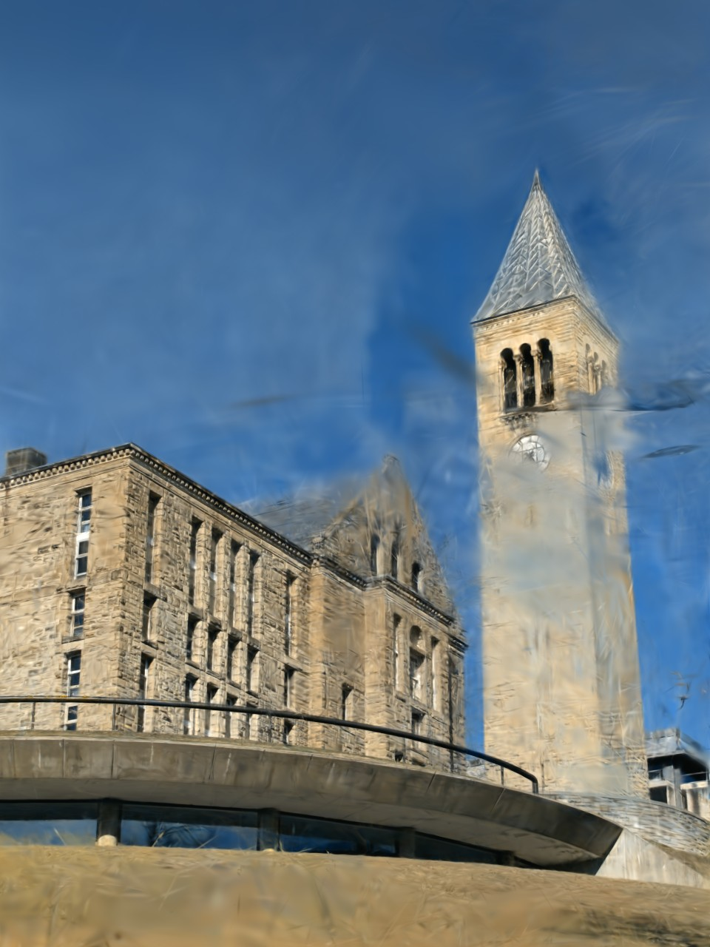
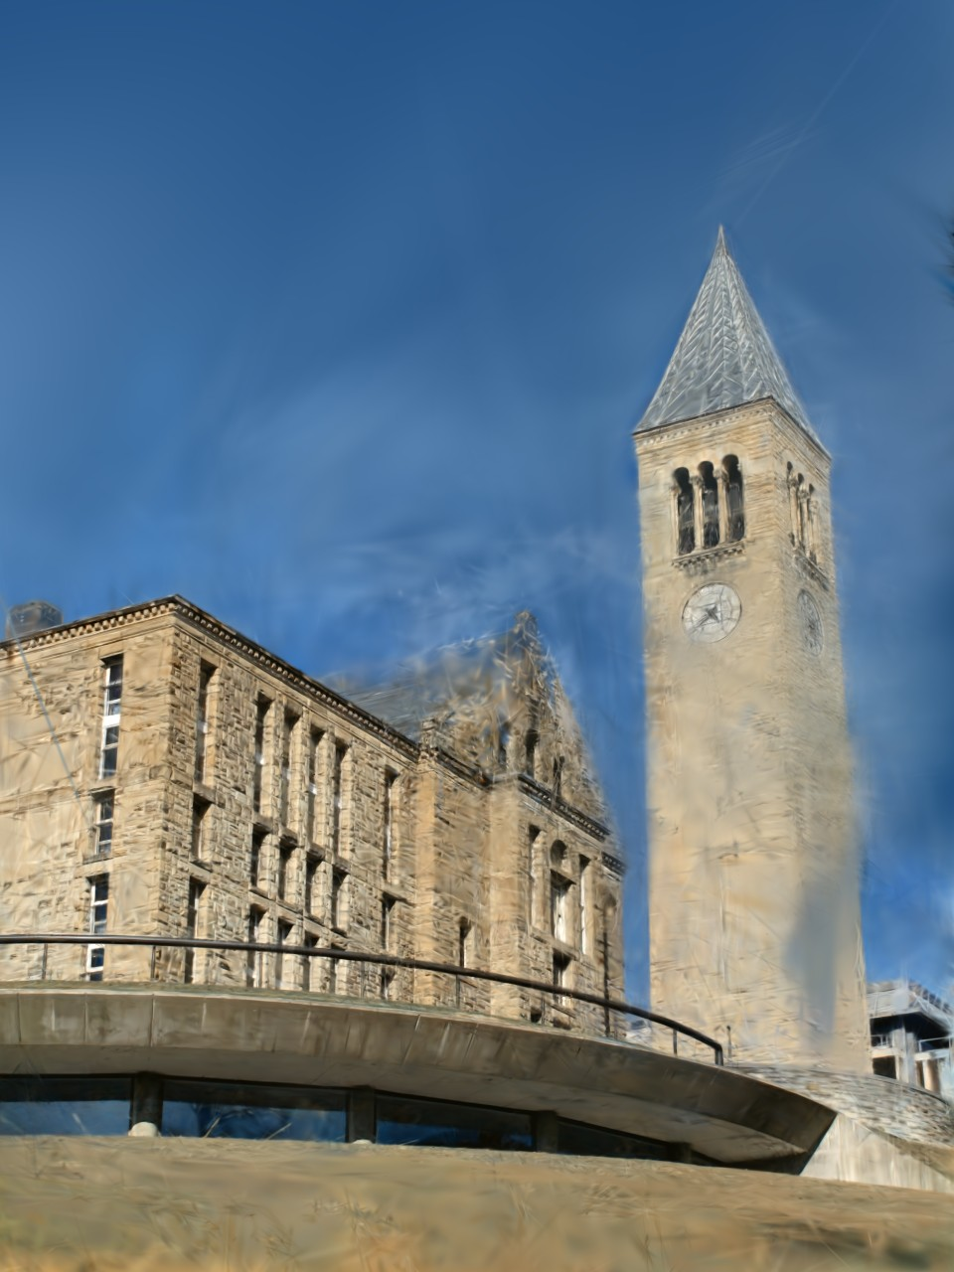
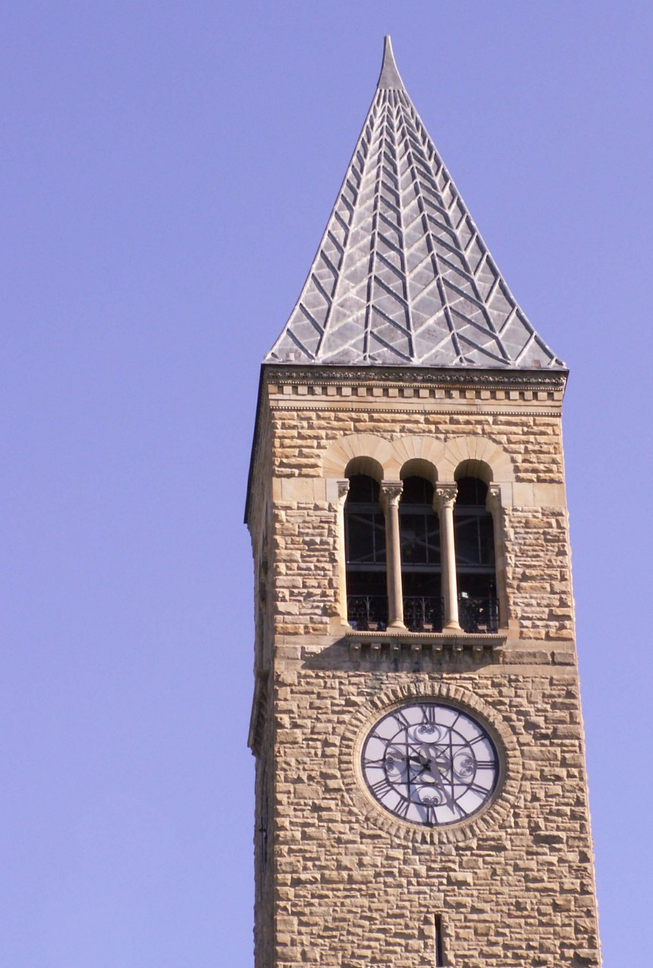
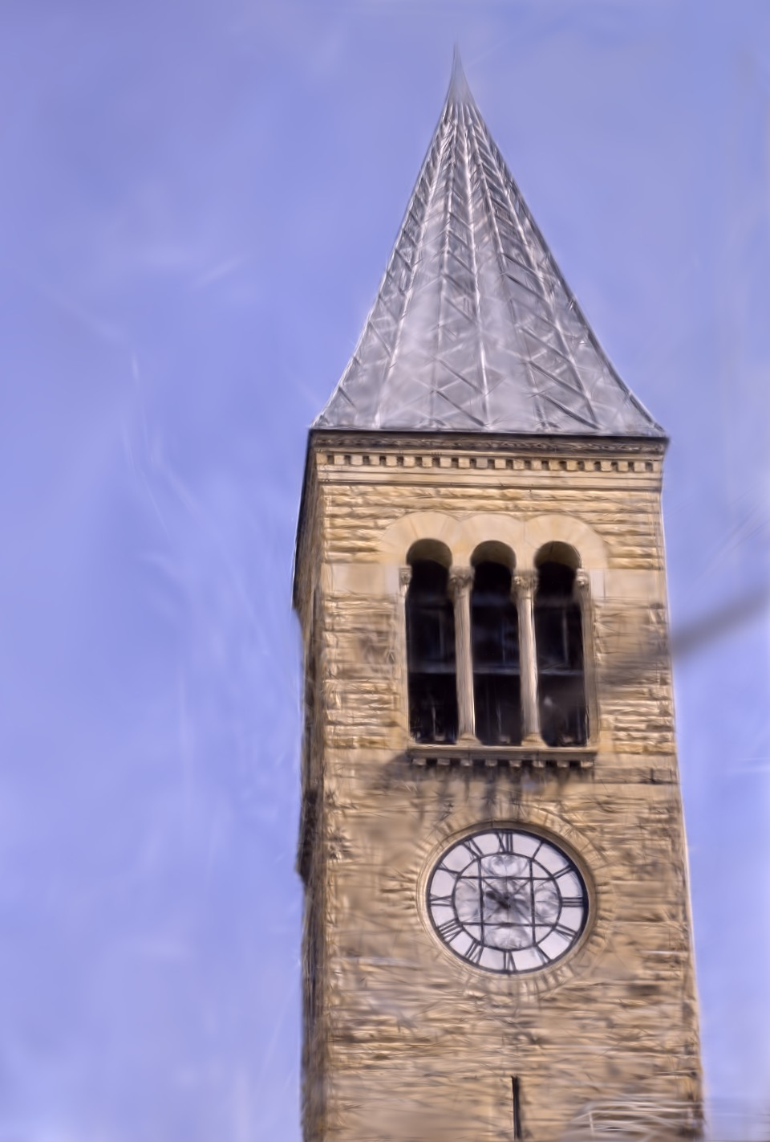
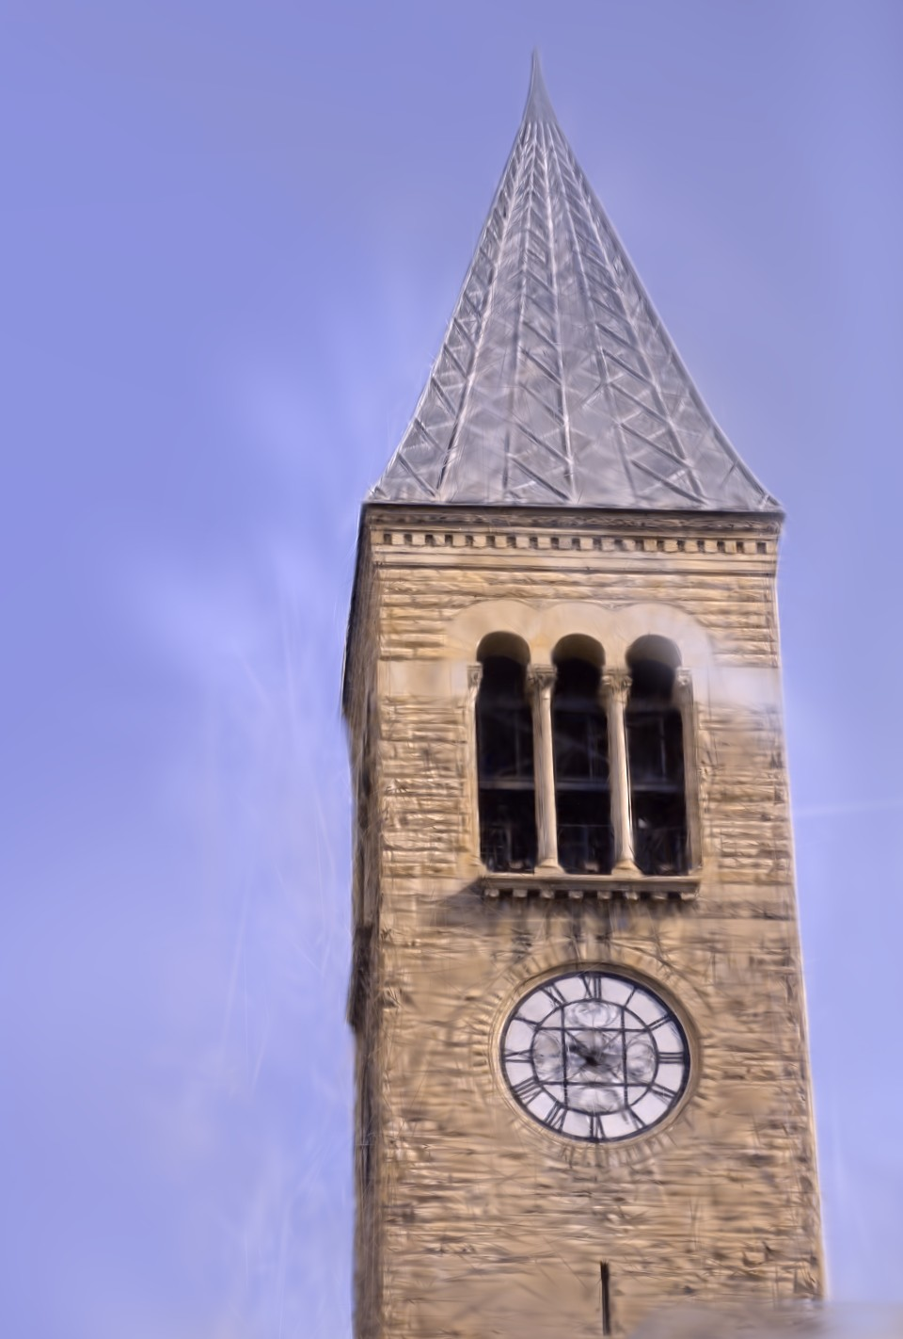
Held-out photographs, rendered by both splats
the photograph
the plain splat, from its placed pose
the lidar-taught splat, same pose
23.7 dB
24.1 dB
22.3 dB
22.1 dB
Two photographs never used in training, rendered by each splat from the pose the placement gave them; dB is PSNR against the photograph after a per-image colour fit. They look alike: the lidar rule costs no image quality. The difference is where the paint is, which the next clip shows.
Notes:
SHOW / 操作: the two rows. / 两行图。
EN: Two photographs never used in training, rendered by each splat from the pose the placement gave them; the
中文: 两张训练时没用过的照片，由两个 splat 各自从放置给出的位姿渲染；数字是对照片的 PSNR。看起来差不多：lidar 规则不损失画质。

Slide 22
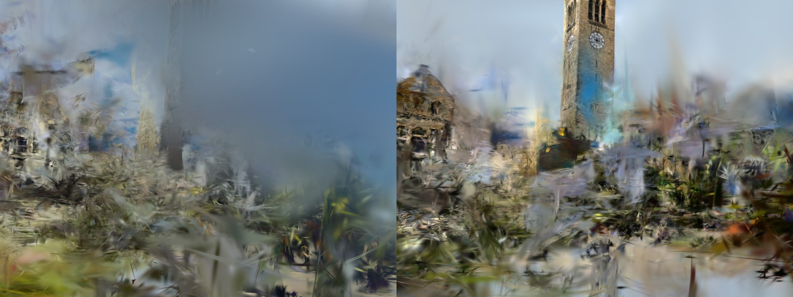
Between the photographers
41 % → 88 %
of opaque Gaussians inside the measured volume sit on a lidar surface
41 % → 5 %
under the bare ground: the plain splat buries almost half its paint
18 % → 8 %
in air the lidar measured empty: floaters
A camera path no photographer took (240 frames between them): left plain, right lidar-taught. Red: paint in air the lidar measured empty; purple: under the bare ground. Click to play; the live demo is chapter 5.
20 % → 4 %
One rule in training: opacity times metres into measured-empty air or under the bare ground; same photographs, same 15,000 steps.
of the pixels along this path are paint the lidar refutes
14.4 → 14.5 dB
Plain → lidar-taught is the same training with one added term; the "verdict" colouring is the referee score, computed for every Gaussian against the lidar rasters.
on held-out photographs (best-covered view 22.4 → 22.5 dB): no worse
Notes:
SHOW / 操作: click the clip (or demo chapter 5 with "paint each Gaussian by the lidar's verdict"). / 点视频（或演示第 5
EN: A camera path no photographer took; left the plain splat, right the lidar-taught one, every Gaussian painted by
中文: 一条没有摄影者走过的路径；左边普通 splat，右边 lidar 教过的，每个高斯按 lidar 的判定上色：红是 lidar 测到为空的空气里的

Slide 23
What is new here, honestly
Work | What it does | What differs here
Kaminsky, Snavely, Seitz, Szeliski · CVPR Workshops 2009 | SfM to an overhead image: points on its edges, free space; a 2D search | lidar heights, explicit metric cues, a diagnosis per number
Wang, Wilson, Snavely · 3DV 2013 | georegistration from Flickr geotags and Google Earth models | no geotags; public lidar and OpenStreetMap only
Zhang et al. · Remote Sensing 2019 | ground SfM to airborne lidar through building outlines, GPS-initialised | no GPS to start from; refusal when the geometry cannot fix a number
Degeneracy-aware registration (Zhang, Kaess, Singh · ICRA 2016; X-ICP · 2023) | which directions a scan-to-map fit leaves undetermined | an SfM fragment of unknown scale, several heading candidates, cues from public maps
Lidar-constrained Gaussian splatting (several, 2024–25) | lidar geometry as a training constraint | a per-Gaussian referee score, from public airborne lidar, in the placed frame
The claim: cue-based grounding of sparse internet fragments without any GPS, against public lidar and footprints, with a per-number diagnosis that can refuse. A method-and-system claim.
Not shown yet: that it beats a fair baseline; that the diagnosis cuts wrong acceptances; a second site.
Notes:
SHOW / 操作: the table, then the claim box. / 表格，然后下面的主张。
EN: What is new here, honestly. Aligning reconstructions to maps goes back to Kaminsky and colleagues in 2009;
中文: 诚实地说什么是新的。把重建对到地图上，2009 年 Kaminsky 等人就做过；Wang、Wilson 和 Snavely 2013 年用地理标签做；

Slide 24
Still working on, as the final project
The gap | The work | The hoped end
One certified fragment of 8, no independent truth | my own phone photographs with GPS; held-out geotags that no fit ever reads | placement error measured, not inferred
No fair baseline yet | footprint-only alignment; a Kaminsky-style edge-and-free-space fit; scale-aware point-cloud registration; this method without its diagnosis | the cues and the diagnosis shown to add capability, or shown not to
The certificate is a heuristic: a 3 m roof-edge error passed with the scale 23 % off | acceptance coverage against false acceptances, on the synthetic hall and the real fragments; calibrate the bands | a certificate with a measured false-acceptance rate
One campus; the Arts Quad side blind; splats blurry | more buildings here; a second campus that USGS 3DEP covers; photographs of the tower from the Arts Quad side | reproducible wherever USGS lidar and OpenStreetMap exist
From a working pipeline to a tested method: the evaluation above, written up as a workshop paper. A method that places what can be placed and refuses what cannot, measured on two campuses.
Notes:
SHOW / 操作: the four rows: gap, work, hoped end. / 四行：缺口、要做的、希望的终点。
EN: So this is the work still open, and I'd like to continue it as the final project. Independent truth: my own
中文: 这就是还开着的工作，我想作为 final project 继续做。独立真值：我自己带 GPS 的手机照片，以及任何拟合都不读的留出地理

Slide 25
COLMAP's frame is arbitrary. The world's isn't.
Placed with public lidar and footprints, no GPS
Refused, with the reason, when geometry can't fix it
New photographs placed in seconds
The tower-and-library fragment, placed.
Questions? The demo stays open. github.com/BobbyZbp/CS-6672
Notes:
SHOW / 操作: the closing slide; leave the demo open for questions. / 结束页；演示页面开着答问。
EN: COLMAP's frame is arbitrary; the world's isn't. With public data only and no GPS, a reconstruction can be
中文: COLMAP 的坐标系是随便定的，真实世界的不是。只用公开数据、不用 GPS，重建可以被放进世界，放不了的时候它也会说。

Slide 26
Backup · the synthetic hall
One facade
Two parallel facades
A corner
Three facades
scale undetermined
position undetermined
usable
usable
scale ×0.970
heading 2.0° off
scale ×0.999
heading 2.2° off
scale ×0.993
heading 0.12° off
scale ×1.003
heading 0.10° off
A synthetic hall with a known answer, seen from above; cameras in black, the facades they see in colour. Exact lidar roof edges, every cue on. Dots: tilt · tilt · heading · scale · east · north · height; red outline = not fixed.
Notes:
SHOW / 操作: for questions on the refusal reasons. / 有人问拒绝原因时用。
EN: A synthetic hall with a known answer, seen from above; cameras in black, the facades they see in colour. One
中文: 一个答案已知的合成建筑，从上往下看；相机是黑点，看到的立面是彩色。一面墙尺度自由；两面平行墙沿墙的位置自由；一个墙角或

