Slide 1
COM 212: Data Structures
Stephen Douglass

Slide 2
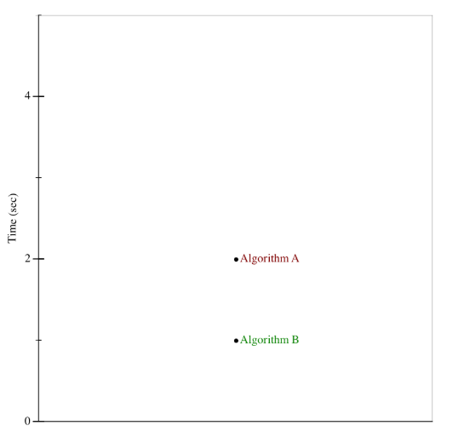
Which is faster?

Slide 3
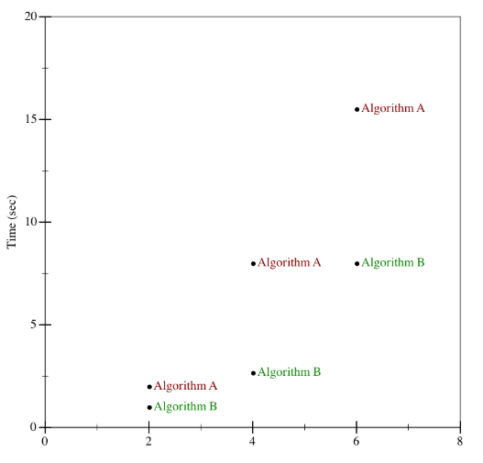
Which is faster?

Slide 4
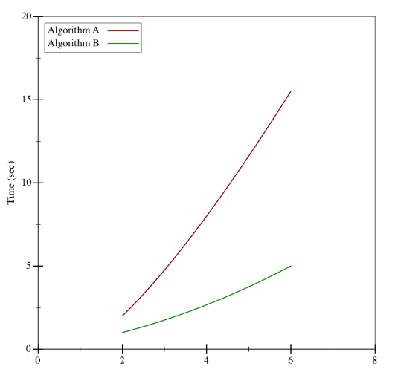
Which is faster?

Slide 5
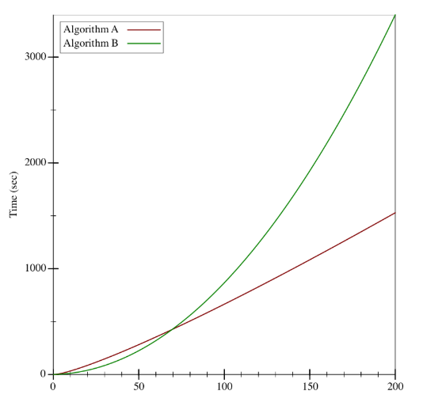
Which is faster?

Slide 6
Runtime
Measure efficiency of Algorithm
Efficiency: Time and Space
Runtime does not refer to how much time (in seconds) it takes to run
Differs from machine to machine
Think runtime in terms of input size (n)
Therefore, runtime is a function of n

Slide 7
7 Functions
The constant function 1
The logarithm function log n
The linear n
The N-Log-N function n log n
The quadratic function n²
The cubic function and polynomials n³
The exponential function a^{n}

Slide 8
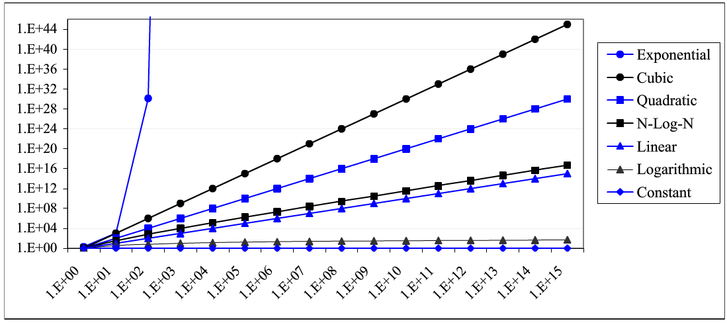
Growth Rate
1 < log n < n < n log n < n² < n³ < a^{n}
Image source: GT textbook

Slide 9
Runtime Review
Array element access operator [ ]
Array findMax()
allDistinct() for two arrays
Insertion Sort
Binary Search

Slide 10
Big-Oh/Big-O
Linear functions are said to have “O of n” or O(n)
Quadratic functions are said to have “O of n squared” or O(n²)
…

