Slide 1
Design public or employee health programs. overview
Nursing • Professional Practice • Design public or employee health programs.
Explain the scope and priority focus for Design public or employee health programs..
Orient the learner to the lesson sequence and the highest-priority thinking for Design public or employee health programs..
Use the right panel as the learner-facing summary. Keep narration in the script, not on the slide.
Key points
Instruct individuals - families - or other groups on topics such as health education - di…
includes a recognition phase, a priority decision phase, and an evaluation phase.
The first safe action should be linked to the highest-risk cue pattern in Instruct indivi…
Lesson scope includes: Instruct individuals - families - or other groups on topics such a…
1

Slide 2
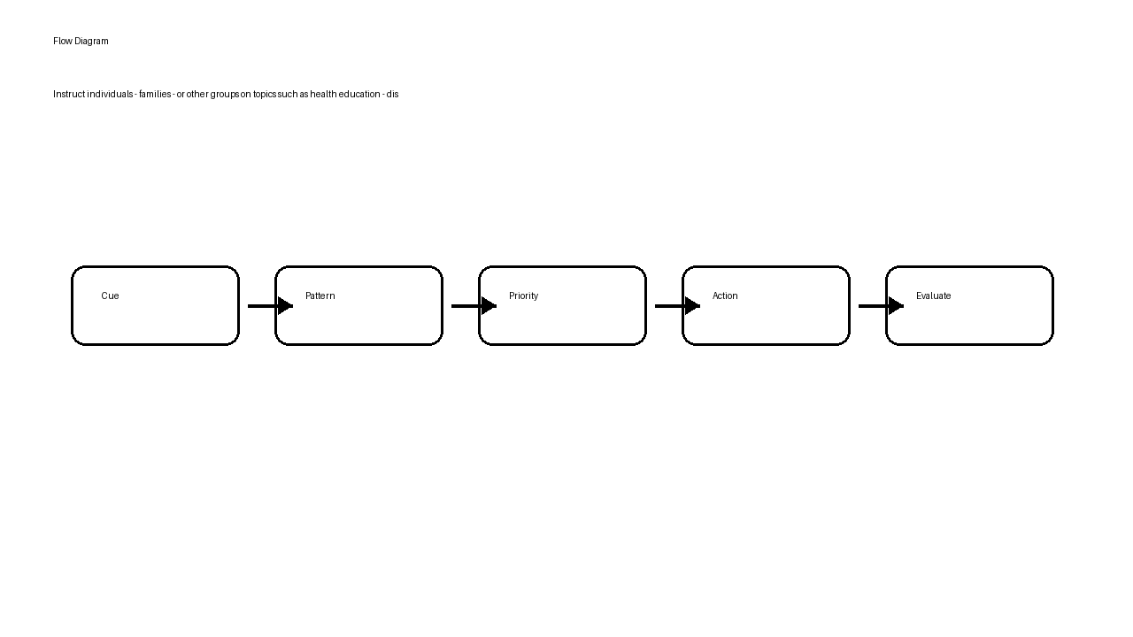
Instruct individuals - families - or other groups on topics such as health education - disease prevention - or childbirth and develop health improvement programs.
Nursing • Professional Practice • Design public or employee health programs.
Learner summary
Instruct individuals - families - or other groups on topics such as health education - di…
includes a recognition phase, a priority decision phase, and an evaluation phase.
The first safe action should be linked to the highest-risk cue pattern in Instruct indivi…
Instruct individuals - families - or other groups on topics such as health education - disease prevention - or childbirth and develop health improvement programs.
2

Slide 3
Clinical judgment case: Instruct individuals - families - or other groups on topics such as health education - disease prevention - or childbirth and develop health improvement programs.
Nursing • Professional Practice • Design public or employee health programs.
Practice scenario
A learner reviews a scenario related to Instruct individuals - families - or other groups on topics such as health education - disease prevention - or childbirth and develop health improvement programs. within Design public or employee health programs.. Use the cue set to identify the first safe action and the expected response.
Which action should occur first, and what outcome would show improvement?
Decision cues
Instruct individuals - families - or other groups on topics such as health education - di…
includes a recognition phase, a priority decision phase, and an evaluation phase.
The first safe action should be linked to the highest-risk cue pattern in Instruct indivi…
3

Slide 4
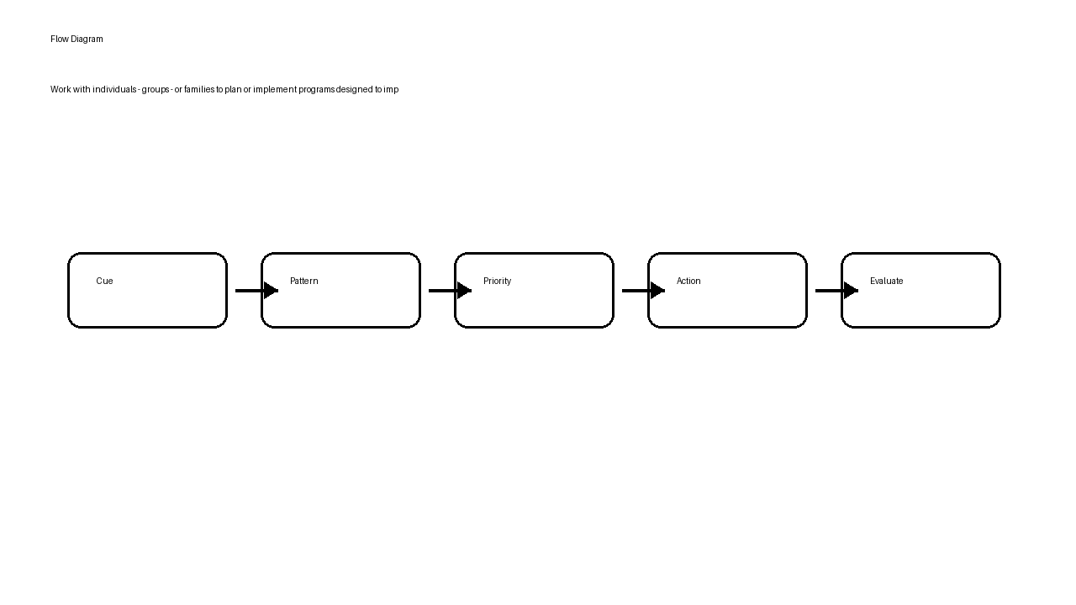
Work with individuals - groups - or families to plan or implement programs designed to improve the overall health of communities.
Nursing • Professional Practice • Design public or employee health programs.
Learner summary
Work with individuals - groups - or families to plan or implement programs designed to im…
includes a recognition phase, a priority decision phase, and an evaluation phase.
The first safe action should be linked to the highest-risk cue pattern in Work with indiv…
Work with individuals - groups - or families to plan or implement programs designed to improve the overall health of communities.
4

Slide 5
Clinical judgment case: Work with individuals - groups - or families to plan or implement programs designed to improve the overall health of communities.
Nursing • Professional Practice • Design public or employee health programs.
Practice scenario
A learner reviews a scenario related to Work with individuals - groups - or families to plan or implement programs designed to improve the overall health of communities. within Design public or employee health programs.. Use the cue set to identify the first safe action and the expected response.
Which action should occur first, and what outcome would show improvement?
Decision cues
Work with individuals - groups - or families to plan or implement programs designed to im…
includes a recognition phase, a priority decision phase, and an evaluation phase.
The first safe action should be linked to the highest-risk cue pattern in Work with indiv…
5

Slide 6
Design public or employee health programs. comparison guide
Nursing • Professional Practice • Design public or employee health programs.
Subtopic | Key cue pattern | First safe action
Instruct individuals - families - or other groups on topics such as health education - disease prevention - or childbirth and develop health improvement programs. | Instruct individuals - families - or other groups on topics such as health education - di… | Address the highest-risk cue first for Instruct individuals - families - or other groups on topics such as health education - disease prevention - or childbirth and develop health improvement programs..
Work with individuals - groups - or families to plan or implement programs designed to improve the overall health of communities. | Work with individuals - groups - or families to plan or implement programs designed to im… | Address the highest-risk cue first for Work with individuals - groups - or families to plan or implement programs designed to improve the overall health of communities..
6

Slide 7
Design public or employee health programs. summary and remediation
Nursing • Professional Practice • Design public or employee health programs.
State the review and remediation steps for Design public or employee health programs..
Close the lesson and direct the learner to the next practice step.
Use the right panel as the learner-facing summary. Keep narration in the script, not on the slide.
Key points
Review high-risk cues for: Instruct individuals - families - or other groups on topics su…
Rehearse one case before moving into assessment or question-bank work.
Use the objective table to confirm lesson-to-assessment alignment.
Follow the remediation map for weak areas and repeat the decision cycle.
7

