Slide 1
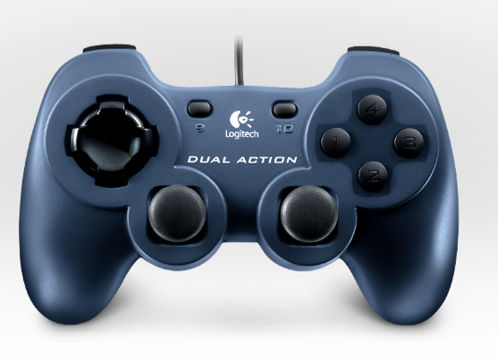

Shooter Up
Shooter Feed Test
PTO Test
Shooter Off
Shooter High Speed (Long Shot)
Shooter Low Speed (Pyramid Shot)
Shooter Down
Climb
Climber Test
Shoot
Climber Deploy
Shooter Test
Stiff Arm

