Slide 1
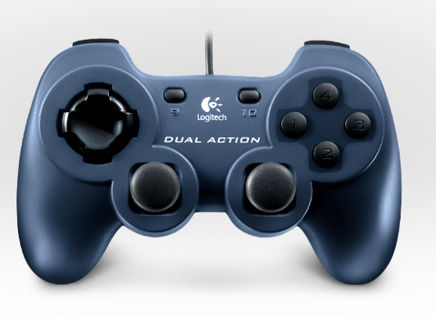

Shooter Up
Shooter Feed Test
PTO Test
Shooter Off
Shooter High Speed
Shooter Low Speed
Shooter Down
Climb
Climber Test
Shoot
Climber Deploy
Shooter Test

