Slide 1
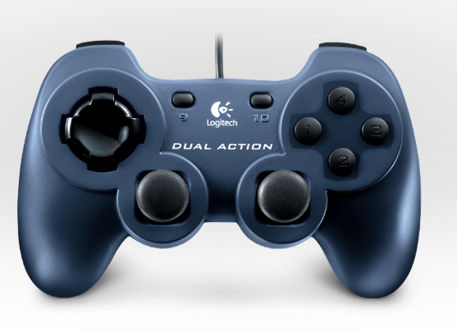

Shooter Up
PTO Test
Shooter Feed Test
Shooter Down
Climb
Climber Test
Shoot
Climber Deploy
Shooter Test

