Slide 1
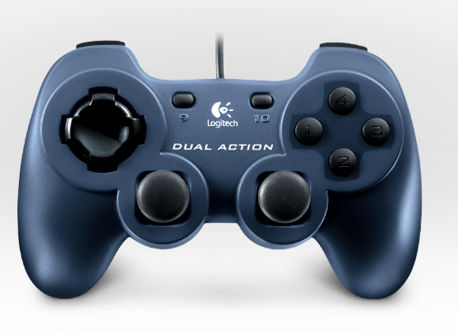

Shooter Up
Shooter Feed Test
PTO Test
Shooter Off
Shooter High Speed (Long Shot)
Shooter Low Speed (Pyramid Shot)
Shooter Down
Climb
Climber Test
Shoot
Climber Deploy
Shooter Test

