Slide 1
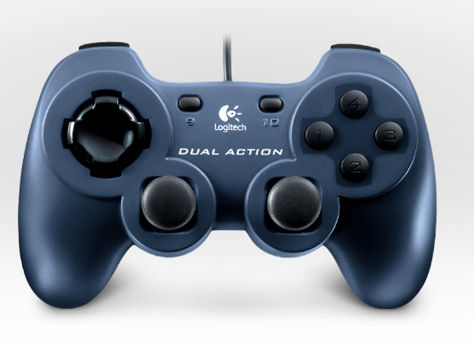
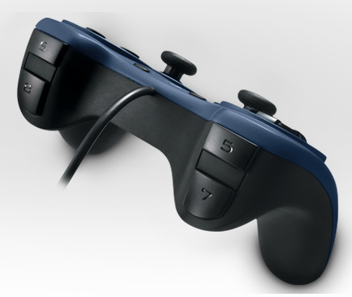
Inclination Up
Auto Mode
Clearing
Mode
Toggle Camera
Fender Mode
Turret Left
Turret Right
Key Mode
Inclination Down
Ramp
Stage 1 & Fin Up/Down
Stage 2 Up/Down
Shoot
Pickup
Shooter Test
Fin Toggle

Slide 2
Auto Mode
Clearing
Mode
Toggle Camera
Fender Mode
Turret Left
Turret Right
Key Mode
Ramp
Stage 1 & Fin Up/Down
Stage 2 Up/Down
Shoot
Pickup
Shooter Test
Fin Toggle

