Slide 1
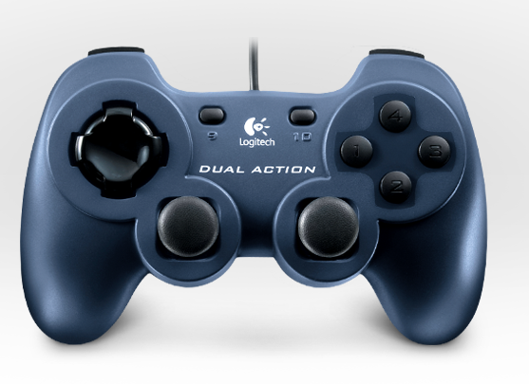
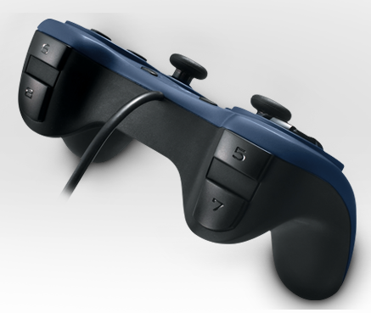
Winch
Test*
Retract to full
Toggle Wall
Winch External Ratchet*
Pickup
Winch
Override*
Toggle Pickup
Fire
Missile Switch must be set for these to be active
Toggle Transfer
Lobe

