Slide 1
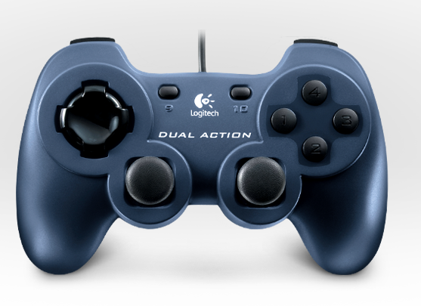
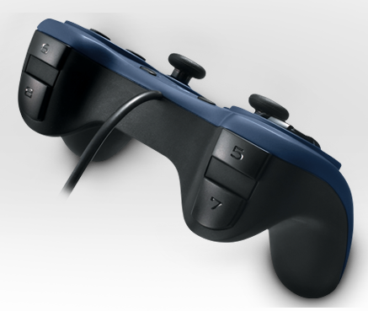
Low Arms
High Box
Pickup Motor
Stacker Lift
Window Forward
*Missile Switch must be set for these to be active
Window Backward
Notes:
‹#›
‹#›

Slide 2
Notes:
‹#›
‹#›

