Slide 1

Data Modelling Many to Many
Charles Severance
www.dj4e.com

Slide 2


Browser
Linux
D
O
M
N
G
I
N X
WGSIConfig
settings.py
Django
Routing
urls.py
views.py
Parse
Response
Views
Templates
forms.py
Javascript
Database
Shell
Models
model.py
/admin
admin.py

Slide 3
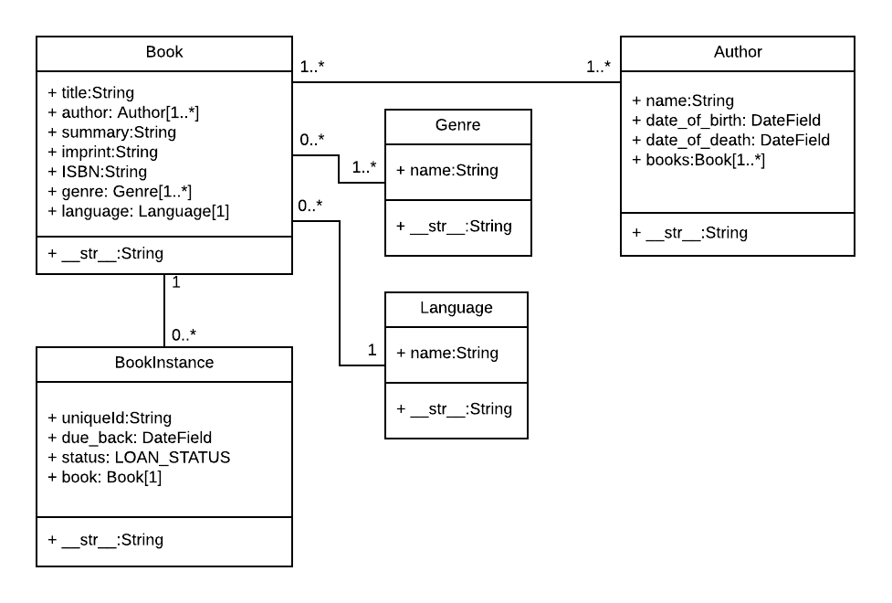
Many-to-Many
"The relationships between Book / Genre and Book / Author are many-to-many"
https://developer.mozilla.org/en-US/docs/Learn/Server-side/Django/Models

Slide 4
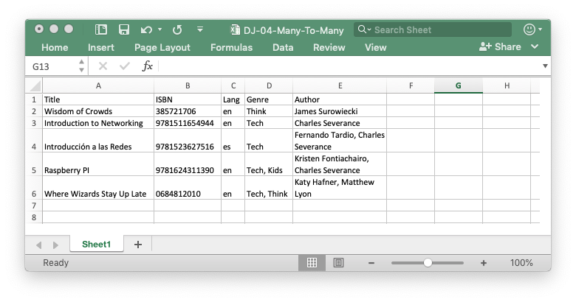

Slide 5
Many-To-Many
Title | ISBN | Genre | Author
Wisdom of Crowds | 385721706 | Think | James Surowiecki
Introduction to Networking | 9781511654944 | Tech | Charles Severance
Introducción a las Redes | 9781523627516 | Tech | Fernando Tardio, Charles Severance
Raspberry PI | 9781624311390 | Tech, Kids | Kristen Fontichiaro, Charles Severance
Where Wizards Stay Up Late | 0684812010 | Tech, Think | Katy Hafner, Matthew Lyon

Slide 6
One-To-One?
Genre
Book
Genre
Book
id
id
name
title
genre

Slide 7
Book
3
Wisdom of Crowds
Genre
genre_id
41
Think
Book
Genre
5
43
Networking
Tech
genre_id

Slide 8
Multiple Genre Columns?
Book
4
Raspberry Pi
Genre
genre_id_01
42
genre_id_02
Kids
Book
Genre
5
43
Networking
Tech
genre_id_01
genre_id_02

Slide 9
Multiple Genre Columns?
Book
NO!!!!!!!
4
Raspberry Pi
Genre
genre_id_01
42
genre_id_02
Kids
Book
Genre
5
43
Networking
Tech
genre_id_01
genre_id_02

Slide 10
Many-To-Many
one_to_many + one_to_many = many_to_many

Slide 11
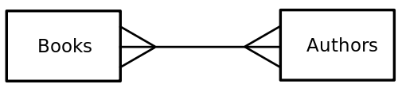
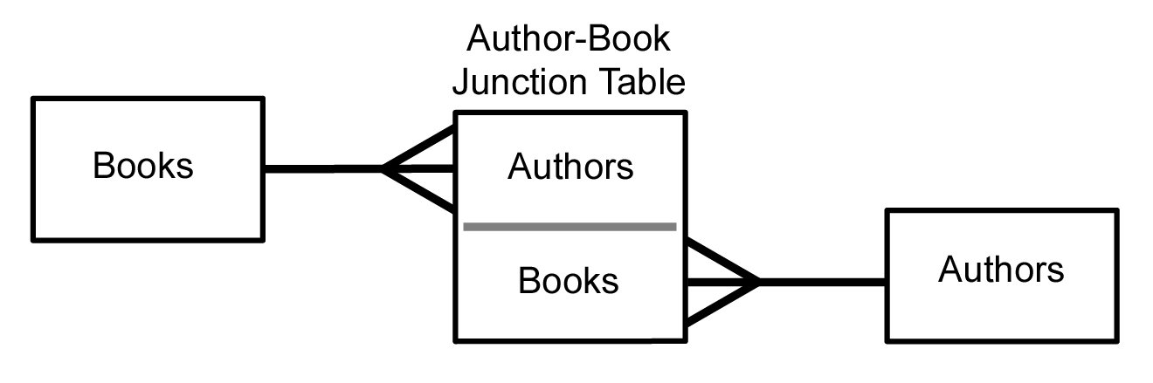
Many to Many
Sometimes we need to model a relationship that is many to many.
We need to add a “connection” table with two foreign keys.
There is usually no separate primary key.
We need two one-to-many relationships to capture a many-to-many
https://en.wikipedia.org/wiki/Many-to-many_(data_model)

Slide 12
Many-to-Many in Locallibrary
Legend:
1..* Many with a minimum of 1
0..* Many with a minimum of 0

Slide 13
Author
Book
title
Many
name
Many
Authored
Author
Book
id
id
id
Many
book
One
name
title
One
author
Many
books
authors
Django calls this the "through" table

Slide 14
from django.db import models
class Book(models.Model):
title = models.CharField(max_length=200)
authors = models.ManyToManyField('Author', through='Authored')
class Author(models.Model):
name = models.CharField(max_length=200)
books = models.ManyToManyField('Book', through='Authored')
class Authored(models.Model):
book = models.ForeignKey(Book, on_delete=models.CASCADE)
author = models.ForeignKey(Author, on_delete=models.CASCADE)
https://github.com/csev/dj4e-samples/blob/master/samples/bookmany/models.py

Slide 15
dj4e-samples$ python3 manage.py makemigrations
Migrations for 'bookmany':
bookmany/migrations/0001_initial.py
- Create model Author
- Create model Authored
- Create model Book
- Add field book to authored
- Add field books to author
dj4e-samples$ python3 manage.py migrate
Operations to perform:
Apply all migrations: admin, auth, autos, bookmany, bookone, contenttypes, favs, favsql, forums, gview, many, myarts, pics, rest, sessions, social_django, tracks, users
Running migrations:
Applying bookmany.0001_initial... OK
dj4e-samples$
Remember that makemigrations only "does something" when you create or alter a models.py file. The migrate only "does something" when there are migrations that are not yet applied to the database. Also an application must be added to settings.py before these commands see the models.py file for an application.

Slide 16
dj4e-samples$ python3 manage.py shell
>>> from bookmany.models import Book, Author, Authored
>>> b1 = Book(title='Networking')
>>> b1.save()
>>> b2 = Book(title='Raspberry')
>>> b2.save()
>>> a1 = Author(name='Fontichiaro')
>>> a1.save()
>>> a2 = Author(name='Severance')
>>> a2.save()
>>> Authored(book=b1, author=a2).save()
>>> Authored(book=b2, author=a1).save()
>>> Authored(book=b2, author=a2).save()
>>> b1.authors.values()
<QuerySet [{'id': 2, 'name': 'Severance'}]>
>>> b2.authors.values()
<QuerySet [{'id': 1, 'name': 'Fontichiaro'}, {'id': 2, 'name': 'Severance'}]>
>>> a1.books.values()
<QuerySet [{'id': 2, 'title': 'Raspberry'}]>
>>> a2.books.values()
<QuerySet [{'id': 1, 'title': 'Networking'}, {'id': 2, 'title': 'Raspberry'}]>
>>> quit()
dj4e-samples$
Book
authors
Authored
Author
books

Slide 17
Another Example of Many-Many
Educational Technology

Slide 18
member-of
Person
Course
title
Many
Many
email
name
Member
Person
Course
id
id
id
Many
person
One
email
title
One
course
Many
name
members
role
courses
https://en.wikipedia.org/wiki/Many-to-many_(data_model)

Slide 19
from django.db import models
class Person(models.Model):
email = models.CharField(max_length=128, unique=True)
name = models.CharField(max_length=128, null=True)
def __str__(self):
return self.email
class Course(models.Model):
title = models.CharField(max_length=128, unique=True)
members = models.ManyToManyField(Person,
through='Membership', related_name='courses')
def __str__(self):
return self.title
https://github.com/csev/dj4e-samples/blob/master/samples/many/models.py
https://docs.djangoproject.com/en/2.1/ref/models/fields/#choices

Slide 20
class Membership(models.Model):
person = models.ForeignKey(Person, on_delete=models.CASCADE)
course = models.ForeignKey(Course, on_delete=models.CASCADE)
created_at = models.DateTimeField(auto_now_add=True)
updated_at = models.DateTimeField(auto_now=True)
LEARNER = 1
IA = 1000
GSI = 2000
INSTRUCTOR = 5000
ADMIN = 10000
MEMBER_CHOICES = (
( LEARNER, 'Learner'),
( IA, 'Instructional Assistant' ),
( GSI, 'Grad Student Instructor' ),
( INSTRUCTOR, 'Instructor' ),
( ADMIN, 'Administrator' ),
)
role = models.IntegerField(
choices=MEMBER_CHOICES,
default=LEARNER,
)
def __str__(self):
return "Person "+ str(self.person.id) + " <--> Course " + str(self.course.id)

Slide 21
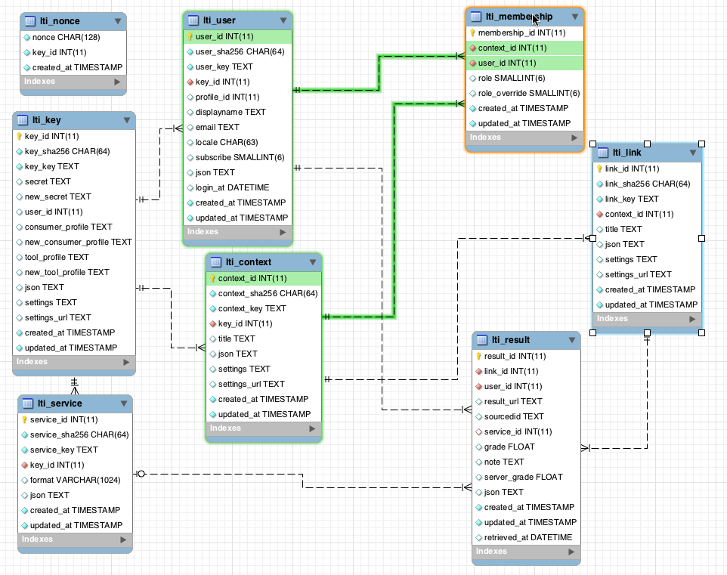
www.tsugi.org

Slide 22
>>> from many.models import Person, Course, Membership
>>> p = Person(email='ted@umich.edu')
>>> p.save()
>>> c = Course(title='Woodcraft')
>>> c.save()
>>> c.id
6
>>> c.members.values()
<QuerySet []>
>>> m = Membership(role=Membership.INSTRUCTOR, course=c, person=p)
>>> m.save()
>>> m.id
15
>>> m.course_id
6
>>> c.members.values()
<QuerySet [{'id': 3, 'email': 'ted@umich.edu', 'name': None}]>
>>> p.courses.values()
<QuerySet [{'id': 6, 'title': 'Woodcraft'}]>
Course
Member
Person
1
M
M
1

Slide 23
Demo Batch Loading from CSV
https://github.com/csev/dj4e-samples/tree/master/samples/scripts
https://django-extensions.readthedocs.io/en/latest/runscript.html

Slide 24
Loading Data From A File
Sometimes we need to pre-load data into our Django database
This data might come from an API or file
We need to write a Python program to function like the Django shell
many/load.csv
jane@tsugi.org,I,Python
ed@tsugi.org,L,Python
sue@tsugi.org,L,Python
ed@tsugi.org,I,Django
sue@tsugi.org,L,Django
ed@tsugi.org,I,SQL
jane@tsugi.org,L,SQL
scripts/many_load.py
db.sqlite
many/models.py
https://github.com/csev/dj4e-samples

Slide 25
Installing django-extensions
dj4e-samples$ pip3 install django-extensions
Requirement already satisfied: django-extensions in /Library/Frameworks/Python.framework/Versions/3.6/lib/python3.6/site-packages
Requirement already satisfied: six>=1.2 in /Library/Frameworks/Python.framework/Versions/3.6/lib/python3.6/site-packages
dj4e-samples$
Note that this is installed already in dj4e-samples but for a new project you will need to install it yourself and edit settings.py
https://django-extensions.readthedocs.io/en/latest/runscript.html

Slide 26
Include Extensions in Project Settings
INSTALLED_APPS = [
'django.contrib.admin',
'django.contrib.auth',
[ ... ]
# Extensions - see requirements.txt
'django_extensions',
'crispy_forms',
[ ... ]
'home.apps.HomeConfig',
# Sample Applications - don't copy
'hello.apps.HelloConfig',
'getpost.apps.GetpostConfig',
'users.apps.UsersConfig',
[ ... ]
]
dj4e-samples/settings.py

Slide 27
Make a scripts folder
dj4e-samples$ mkdir scripts
dj4e-samples$ touch scripts/__init__.py
We place empty __init__.py files in folders to indicate to Python that they contain files that hold modules and as such are suitable for importing into a Python application.
http://effbot.org/pyfaq/what-is-init-py-used-for.htm

Slide 28
The Data File
dj4e-samples$ cat many/load.csv
jane@tsugi.org,I,Python
ed@tsugi.org,L,Python
sue@tsugi.org,L,Python
ed@tsugi.org,I,Django
sue@tsugi.org,L,Django
ed@tsugi.org,I,SQL
jane@tsugi.org,L,SQL
dj4e-samples$
https://en.wikipedia.org/wiki/Cat_(Unix)

Slide 29
import csv # https://docs.python.org/3/library/csv.html
from many.models import Person, Course, Membership
def run():
fhand = open('many/load.csv')
reader = csv.reader(fhand)
Person.objects.all().delete()
Course.objects.all().delete()
Membership.objects.all().delete()
for row in reader:
print(row)
p, created = Person.objects.get_or_create(email=row[0])
c, created = Course.objects.get_or_create(title=row[2])
r = Membership.LEARNER
if row[1] == 'I' : r = Membership.INSTRUCTOR
m = Membership(role=r,person=p, course=c)
m.save()
scripts/many_load.py

Slide 30
class Membership(models.Model):
person = models.ForeignKey(Person, on_delete=models.CASCADE)
course = models.ForeignKey(Course, on_delete=models.CASCADE)
created_at = models.DateTimeField(auto_now_add=True)
updated_at = models.DateTimeField(auto_now=True)
LEARNER = 1
IA = 1000
GSI = 2000
INSTRUCTOR = 5000
ADMIN = 10000
MEMBER_CHOICES = (
( LEARNER, 'Learner'),
( IA, 'Instructional Assistant' ),
( GSI, 'Grad Student Instructor' ),
( INSTRUCTOR, 'Instructor' ),
( ADMIN, 'Administrator' ),
)
role = models.IntegerField(
choices=MEMBER_CHOICES,
default=LEARNER,
)
def __str__(self):
return "Person "+ str(self.person.id) + " <--> Course " + str(self.course.id)

Slide 31
dj4e-samples$ python3 manage.py runscript many_load
['jane@tsugi.org', 'I', 'Python']
['ed@tsugi.org', 'L', 'Python']
['sue@tsugi.org', 'L', 'Python']
['ed@tsugi.org', 'I', 'Django']
['sue@tsugi.org', 'L', 'Django']
['ed@tsugi.org', 'I', 'SQL']
['jane@tsugi.org', 'L', 'SQL']
dj4e-samples$
for row in reader:
print(row)
p, created = Person.objects.get_or_create(email=row[0])
c, created = Course.objects.get_or_create(title=row[2])
r = Membership.LEARNER
if row[1] == 'I' : r = Membership.INSTRUCTOR
m = Membership(role=r,person=p, course=c)
m.save()

Slide 32
Many-to-Many in the Django Shell
dj4e-samples$ python3 manage.py shell
>>> from many.models import Person, Course, Membership
>>> Person.objects.values()
<QuerySet [{'id': 1, 'email': 'jane@tsugi.org', 'name': None},
{'id': 2, 'email': 'ed@tsugi.org', 'name': None},
{'id': 3, 'email': 'sue@tsugi.org', 'name': None}]>
>>> x = Person.objects.get(pk=1)
>>> x.email
jane@tsugi.org
>>> x.courses.values()
<QuerySet [{'id': 1, 'title': 'Python'},
{'id': 3, 'title': 'SQL'}]>
>>> y = Course.objects.get(pk=2)
>>> y.title
'Django'
>>> y.members.values()
<QuerySet [{'id': 2, 'email': 'ed@tsugi.org', 'name': None},
{'id': 3, 'email': 'sue@tsugi.org', 'name': None}]>
>>>

Slide 33
Looking at the "through" table
>>> y = Course.objects.get(pk=2)
>>> y.membership_set.all().values()
<QuerySet [
{'id': 4, 'person_id': 2, 'course_id': 2, 'created_at':
datetime.datetime(2019, 9, 19, 11, 23, 25, 539243, tzinfo=<UTC>),
'updated_at': datetime.datetime(2019, 9, 19, 11, 23, 25, 539267,
tzinfo=<UTC>), 'role': 5000},
{'id': 5, 'person_id': 3, 'course_id': 2, 'created_at':
datetime.datetime(2019, 9, 19, 11, 23, 25, 541351, tzinfo=<UTC>),
'updated_at': datetime.datetime(2019, 9, 19, 11, 23, 25, 541373,
tzinfo=<UTC>), 'role': 1}
]>
>>>
https://stackoverflow.com/questions/2005953/access-fields-in-django-intermediate-model

Slide 34
Summary
Data modelling is both simple and complex
"Don't allow string data to be replicated"
We use keys and relationships
Primary key
Foreign key
Relationships
One-to-Many
Many-to-Many

Slide 35
Acknowledgements / Contributions
These slides are Copyright 2019- Charles R. Severance (www.dr-chuck.com) as part of www.dj4e.com and made available under a Creative Commons Attribution 4.0 License. Please maintain this last slide in all copies of the document to comply with the attribution requirements of the license. If you make a change, feel free to add your name and organization to the list of contributors on this page as you republish the materials.
Initial Development: Charles Severance, University of Michigan School of Information
Insert new Contributors and Translators here including names and dates
Continue new Contributors and Translators here

