Slide 1

Django Owned Rows
Charles Severance
www.dj4e.com

Slide 2
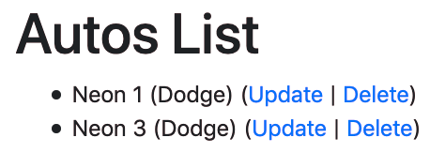
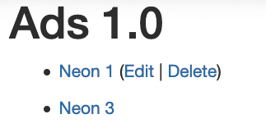
Who Can Edit Which Row?
In our Autos CRUD assignment, any user could edit any row. But in real systems, different users own each row in a data model and we only allow a user to edit /modify the row(s) that "belong to them".

Slide 3
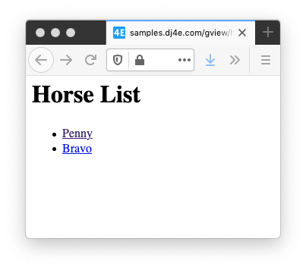
dj4e-samples/gview/views.py
from django.views import generic
from gview.models import Horse
class HorseListView(generic.ListView):
model = Horse
https://samples.dj4e.com/gview/horses
dj4e-samples/gview/templates/gview/horse_list.html
<h1>Horse List</h1>
<p>
{% if horse_list %}
<ul>
{% for horse in horse_list %}
<li>
<a href="{% url 'gview:horse' horse.id %}">
{{ horse.name }}</a>
</li>
{% endfor %}
</ul>
{% else %}
<p>There are no horses in the database.</p>
{% endif %}
</p>

Slide 4
dj4e-samples/gview/views.py
from django.views import generic
from gview.models import Horse
class HorseListView(generic.ListView):
model = Horse
gview.views.HorseListView
model = gviews.models.Horse
dj4e-samples/gview/templates/gview/horse_list.html
django.views.generic.ListView
<h1>Horse List</h1>
<p>
{% if horse_list %}
<ul>
{% for horse in horse_list %}
<li>
<a href="{% url 'gview:horse' horse.id %}">
{{ horse.name }}</a>
</li>
{% endfor %}
</ul>
{% else %}
<p>There are no horses in the database.</p>
{% endif %}
</p>

Slide 5
dj4e-samples/myarts/views.py
from myarts.models import Article
from myarts.owner import OwnerListView
class ArticleListView(OwnerListView):
model = Article
myarts.views..ArticleListView
model = myarts.models.Article
dj4e-samples/myarts/templates/myarts/article_list.html
myarts.owner.ListView
<ul>
{% for article in article_list %}
<li>
<a href="{% url 'myarts:article_detail' article.id %}">
{{ article.title }}</a>
{% if article.owner == user %}
(<a href="{% url 'myarts:article_update' article.id %}">
Edit</a> |
<a href="{% url 'myarts:article_delete' article.id %}">
Delete</a>)
{% endif %}
</li>
{% endfor %}
</ul>
django.views.generic.ListView

Slide 6
Inheritance (Review)
When we make a new class - we can reuse an existing class and inherit all the capabilities of an existing class and then add our own little bit to make our new class
Another form of store and reuse
Write once - reuse many times
The new class (child) has all the capabilities of the old class (parent) - and then some more

Slide 7
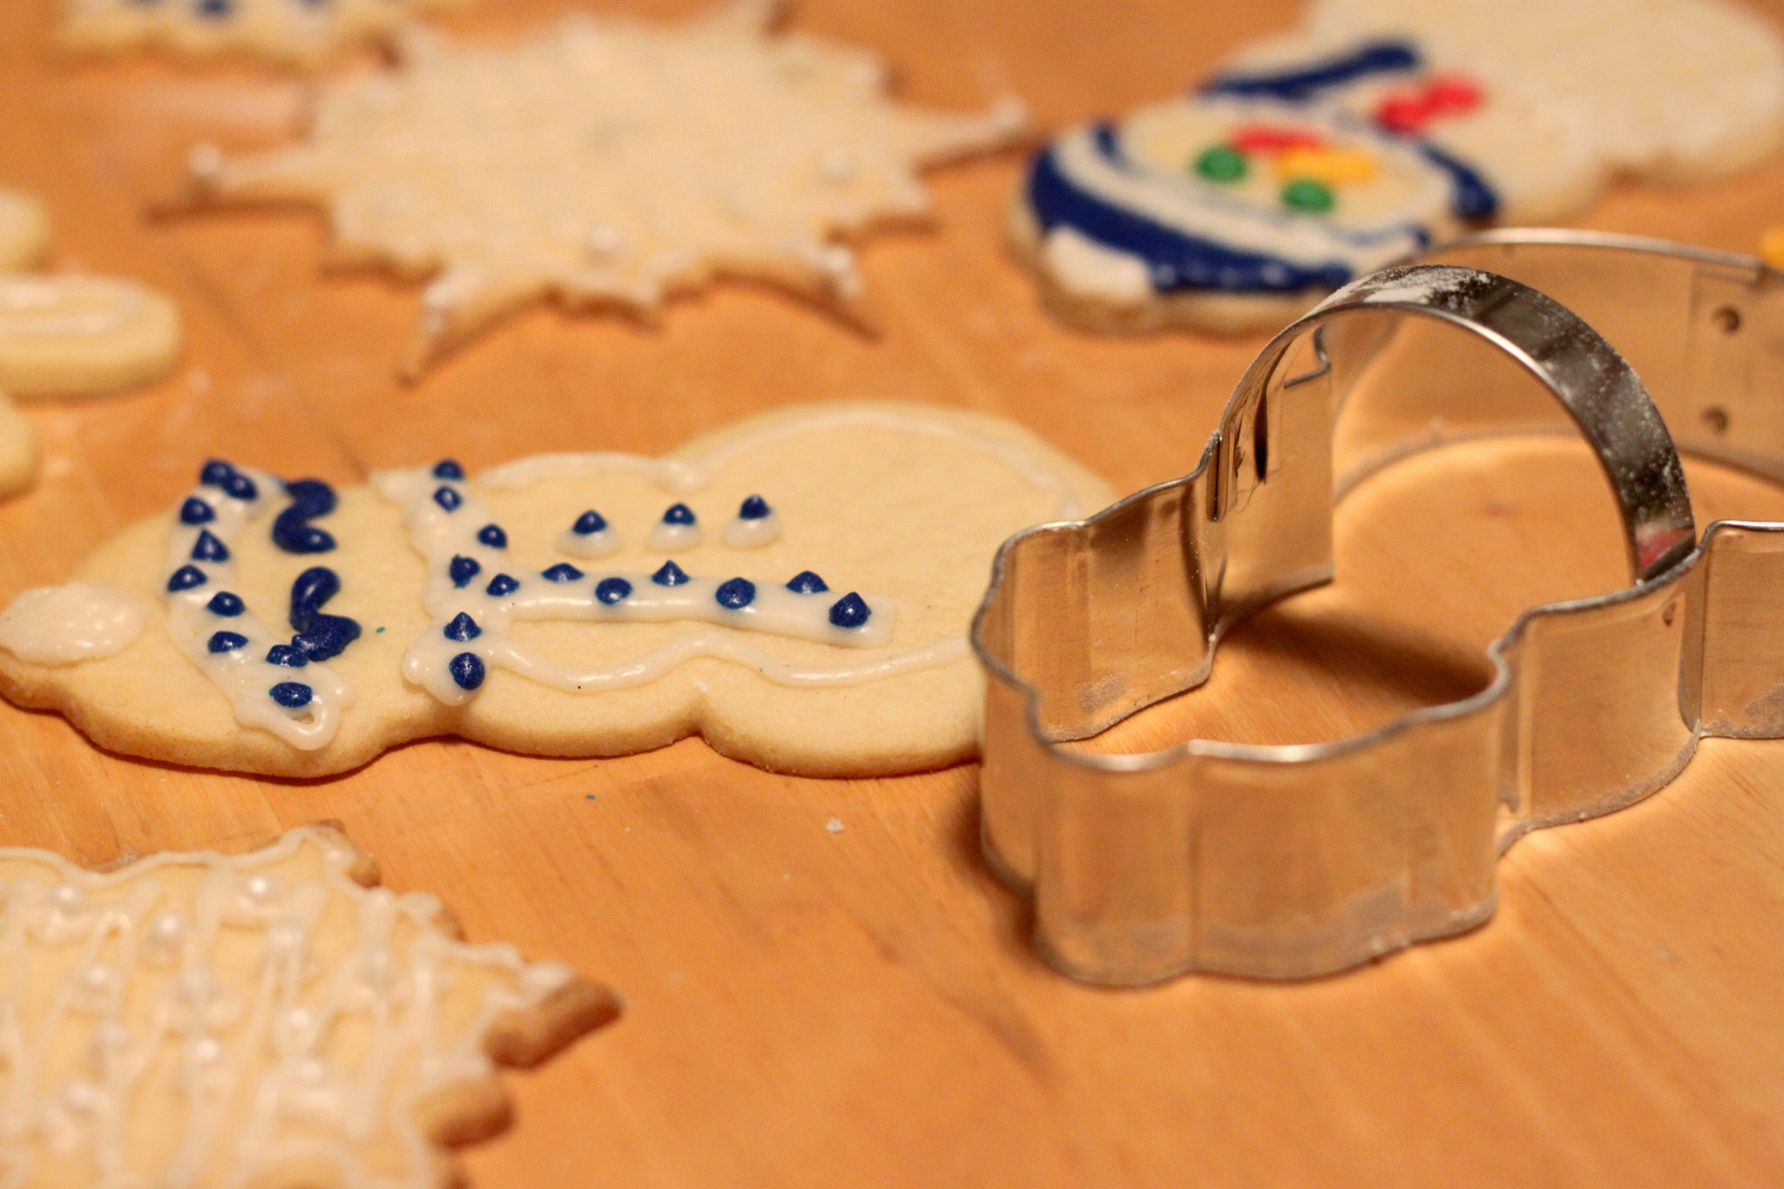
Terminology: Inheritance
‘Subclasses’ are more specialized versions of a class, which inherit attributes and behaviors from their parent classes, and can introduce their own.
http://en.wikipedia.org/wiki/Object-oriented_programming

Slide 8
class django.views.generic.list.ListView
A page representing a list of objects. While this view is executing, self.object_list will contain the list of objects (usually, but not necessarily a queryset) that the view is operating upon.
Method Flowchart
setup()
dispatch()
http_method_not_allowed()
get_template_names()
get_queryset()
get_context_object_name()
get_context_data()
get()
render_to_response()
https://docs.djangoproject.com/en/3.0/ref/class-based-views/generic-display/#django.views.generic.list.ListView

Slide 9
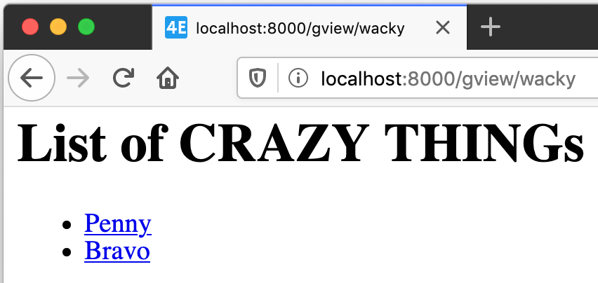
dj4e-samples/gview/views.py
https://samples.dj4e.com/gview/wacky
# Lets explore how (badly) we can override things...
class WackyEquinesView(generic.ListView):
model = Car
template_name = 'gview/wacky.html'
def get_queryset(self, **kwargs):
crazy = Horse.objects.all() # Convention: Car
return crazy
def get_context_data(self, **kwargs):
context = super().get_context_data(**kwargs)
context['crazy_thing'] = 'CRAZY THING'
return context
dj4e-samples/gview/templates/gview/wacky.html
<h1>List of {{ crazy_thing }}s</h1>
<p>
{% if horse_list %}
<ul>
{% for xyz in horse_list %}
<li>
<a href="{% url 'gview:horse' xyz.id %}">{{ xyz.name }}</a>
</li>
{% endfor %}
...

Slide 10
Summary
Generic views allow us to produce lots of similar pages without cutting, pasting and editing boiler plate
Quicker development
Consistent User Experience
Less lines of code means fewer mistakes

Slide 11
Acknowledgements / Contributions
These slides are Copyright 2019- Charles R. Severance (www.dr-chuck.com) as part of www.dj4e.com and made available under a Creative Commons Attribution 4.0 License. Please maintain this last slide in all copies of the document to comply with the attribution requirements of the license. If you make a change, feel free to add your name and organization to the list of contributors on this page as you republish the materials.
Initial Development: Charles Severance, University of Michigan School of Information
Insert new Contributors and Translators here including names and dates
Continue new Contributors and Translators here

Slide 12
Additional Source Information
Snowman Cookie Cutter" by Didriks is licensed under CC BY https://www.flickr.com/photos/dinnerseries/23570475099

