Slide 1

Views and Templates
Charles Severance
www.dj4e.com

Slide 2
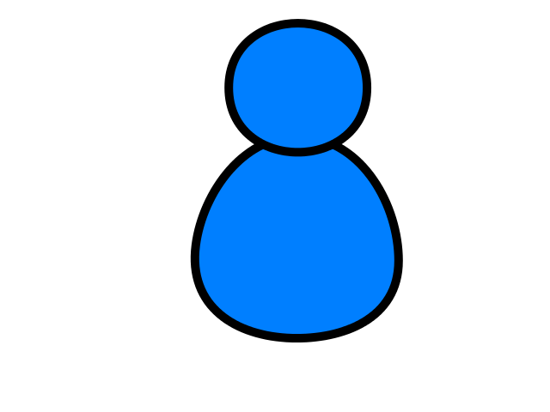
Browser
Linux
D
O
M
N
G
I
N X
WGSIConfig
settings.py
DJango
Routing
Click
urls.py
views.py
Parse
Response
Views
Templates
forms.py
Javascript
Database
Shell
Models
models.py
/admin
admin.py

Slide 3
Views are the core of our application
Django looks at the incoming request URL and uses urls.py to select a view
The view from views.py
Handle any incoming data in the request and copy it to the database through the model
Retrieve data to put on the page from the database though the model
Produce the HTML that will become the response and return it to the browser
https://samples.dj4e.com/

Slide 4
Reading the URL
When Django receives an HTTP request it parses it, uses some of the URL for routing purposes and passes parts of the URL to your code
Django Application (also folder)
View within application
https://samples.dj4e.com/views/funky
https://samples.dj4e.com/views/danger?guess=42
https://samples.dj4e.com/views/rest/24
Key / value parameter (GET)
URL Path Parameter

Slide 5
URL Dispatcher
A clean, elegant URL scheme is an important detail in a high-quality Web application. Django lets you design URLs however you want, with no framework limitations.
To design URLs for an app, you create a Python module informally called a URLconf (URL configuration). This module is pure Python code and is a mapping between URL path expressions to Python functions (your views).
This mapping can be as short or as long as needed. It can reference other mappings. And, because it’s pure Python code, it can be constructed dynamically.
https://docs.djangoproject.com/en/2.2/topics/http/urls/

Slide 6
Three patterns for views (in urls.py)
Requests are routed to a pre-defined class from Django itself
Requests are routed to a function in views.py that takes the http request as a parameter and returns a response
Requests are routed to a class in views.py that has get() and post() methods that take the http request as a parameter and return a response

Slide 7
from django.urls import path
from . import views
from django.views.generic import TemplateView
# https://docs.djangoproject.com/en/2.1/topics/http/urls/
app_name='views'
urlpatterns = [
# pre-defined class from Django
path('', TemplateView.as_view(template_name='views/main.html')),
# function from views.py
path('funky', views.funky),
path('danger', views.danger),
path('game', views.game),
path('rest/<int:guess>', views.rest),
path('bounce', views.bounce),
# our class from views.py
path('main', views.MainView.as_view()),
path('remain/<slug:guess>', views.RestMainView.as_view()),
]
views/urls.py

Slide 8
path('', TemplateView.as_view(template_name='views/main.html'))
views/urls.py
views/templates/views/main.html
<html><body><p>This is the views main.html sample</p>
<p>
<ul>
<li>This page is coming from a file in views/templates/main.html</li>
<li><a href="funky">Use a view function</a></li>
...
</ul>
</p>
<p>This sample code is available at
<a href="https://github.com/csev/dj4e-samples" target="_blank">
https://github.com/csev/dj4e-samples</a>
</p>
</body></html>

Slide 9
Request and Response Objects
Django uses request and response objects to pass information throughout your Django application.
When a page is requested by a browser, Django creates an HttpRequest object that contains metadata about the request.
Then Django loads the appropriate view, passing the HttpRequest as the first argument to the view function. Each view is responsible for returning an HttpResponse object.
The Application Programming Interfaces (APIs) for HttpRequest and HttpResponse objects, are defined in the django.http module.
https://docs.djangoproject.com/en/2.2/ref/request-response/

Slide 10
class HttpRequest
Attributes
All attributes should be considered read-only, unless stated otherwise.
HttpRequest.scheme
A string representing the scheme of the request (http or https usually).
HttpRequest.body
The raw HTTP request body as a bytestring. This is useful for processing data in different ways than conventional HTML forms: binary images, XML payload etc. For processing conventional form data, use HttpRequest.POST.
https://docs.djangoproject.com/en/2.2/ref/request-response/#django.http.HttpRequest

Slide 11
class HttpResponse
In contrast to HttpRequest objects, which are created automatically by Django, HttpResponse objects are your responsibility.
Each view you write is responsible for instantiating, populating, and returning an HttpResponse.
Passing strings
Typical usage is to pass the contents of the page, as a string or bytestring, to the HttpResponse constructor.
https://docs.djangoproject.com/en/2.2/ref/request-response/#django.http.HttpResponse

Slide 12
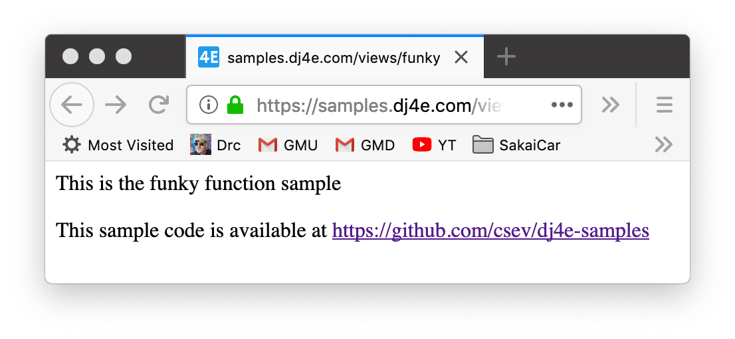
https://samples.dj4e.com/views/funky
path('funky', views.funky),
from django.http import HttpResponse
from django.http import HttpResponseRedirect
# Create your views here.
def funky(request):
response = """<html><body><p>This is the funky function sample</p>
<p>This sample code is available at
<a href="https://github.com/csev/dj4e-samples">
https://github.com/csev/dj4e-samples</a></p>
</body></html>"""
return HttpResponse(response)

Slide 13
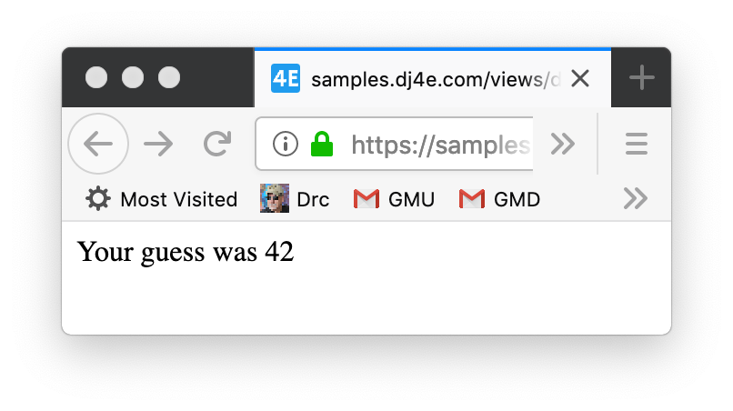
https://samples.dj4e.com/views/danger?guess=42
path('danger', views.danger),
views/urls.py
from django.http import HttpResponse
from django.http import HttpResponseRedirect
# Create your views here.
def danger(request) :
response = """<html><body>
<p>Your guess was """+request.GET['guess']+"""</p>
</body></html>"""
return HttpResponse(response)
views/views.py

Slide 14
Danger? Why is it named danger?
It is dangerous to take data from the user and include it in the HTTP Response without "escaping" the output.
HTML + JavaScript is a programming language and you don't want your users "sending code" to other user's browsers
Cross-Site Scripting (XSS)
https://en.wikipedia.org/wiki/Cross-site_scripting

Slide 15
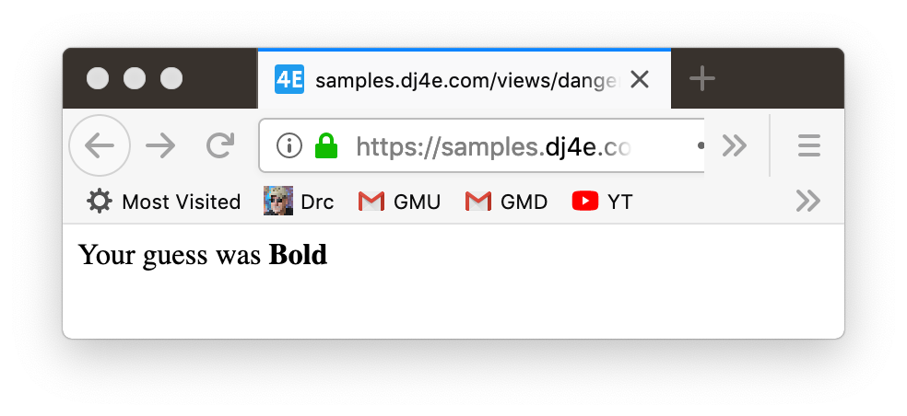
https://samples.dj4e.com/views/danger?guess=%3Cb%3EBold%3C%2Fb%3E
def danger(request) :
response = """<html><body>
<p>Your guess was """+request.GET['guess']+"""</p>
</body></html>"""
return HttpResponse(response)
Response Source
<html><body>
<p>Your guess was <b>Bold</b></p>
</body></html>

Slide 16
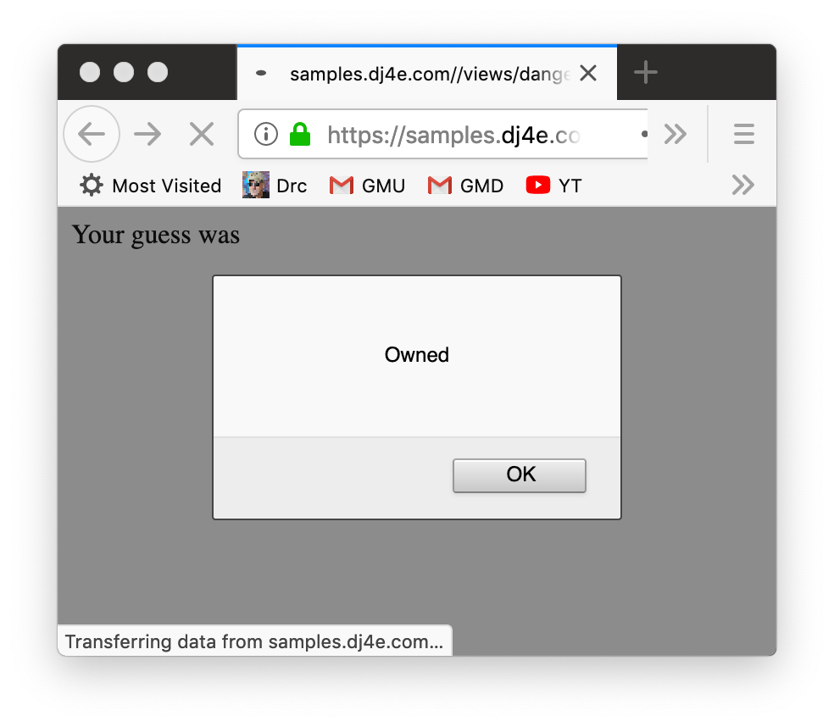
https://samples.dj4e.com/views/danger?guess=%3Cscript%3Ealert%28%27Owned%27%29%3B%3C%2Fscript%3E
Response Source
<html><body>
<p>Your guess was <script>alert('Owned');</script></p>
</body></html>

Slide 17
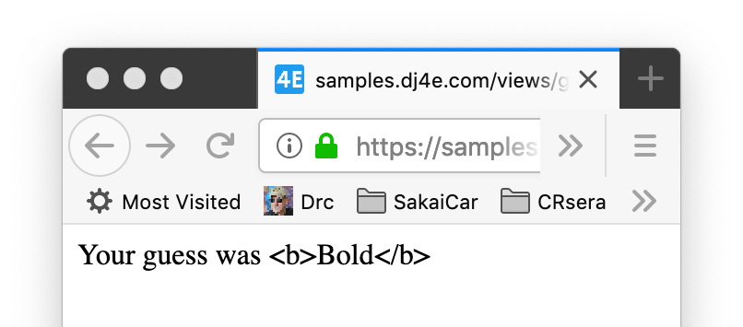
Safe HTML ecaping
https://samples.dj4e.com/views/game?guess=%3Cb%3EBold%3C%2Fb%3E
def danger(request) :
response = """<html><body>
<p>Your guess was """+request.GET['guess']+"""</p>
</body></html>"""
return HttpResponse(response)
def game(request) :
response = """<html><body>
<p>Your guess was """+escape(request.GET['guess'])+"""</p>
</body></html>"""
return HttpResponse(response)
<html><body>
<p>Your guess was &lt;b&gt;Bold&lt;/b&gt;</p>
</body></html>

Slide 18
Passing URL Path Values to the View
https://samples.dj4e.com/views/rest/41
urlpatterns = [
path('rest/<int:guess>', views.rest),
]
<type:parameter-name>
from django.http import HttpResponse
from django.utils.html import escape
def rest(request, guess) :
response = """<html><body>
<p>Your guess was """+escape(guess)+"""</p>
</body></html>"""
return HttpResponse(response)

Slide 19
Class Views – Inheritance
path('main', views.MainView.as_view()),
from django.http import HttpResponse
from django.utils.html import escape
from django.views import View
class MainView(View) :
def get(self, request):
response = """<html><body><p>Hello world MainView in HTML</p>
<p>This sample code is available at
<a href="https://github.com/csev/dj4e-samples">
https://github.com/csev/dj4e-samples</a></p>
</body></html>"""
return HttpResponse(response)
https://www.py4e.com/lessons/Objects

Slide 20
Parameters to Class Views
https://samples.dj4e.com/views/remain/abc123-42-xyzzy
path('remain/<slug:guess>', views.RestMainView.as_view()),
from django.http import HttpResponse
from django.utils.html import escape
from django.views import View
class RestMainView(View) :
def get(self, request, guess):
response = """<html><body>
<p>Your guess was """+escape(guess)+"""</p>
</body></html>"""
return HttpResponse(response)
https://www.py4e.com/lessons/Objects

Slide 21
HTTP Status Codes
http://www.dr-chuck.com/page1.htm - 200 OK
http://www.dj4e.com/nowhere.htm - 404 Not Found
http://www.drchuck.com/ - 302 Found / Moved
Also known as “redirect”
https://en.wikipedia.org/wiki/List_of_HTTP_status_codes

Slide 22
HTTP Location Header
If your application has not yet sent any data, it can send a special header as part of the HTTP Response.
The redirect header includes a URL that the browser is supposed to forward itself to.
It was originally used for web sites that moved from one URL to another.
http://en.wikipedia.org/wiki/URL_redirection

Slide 23
Sending a Redirect from a View
https://samples.dj4e.com/views/bounce
path('bounce', views.bounce)
from django.http import HttpResponse
from django.http import HttpResponseRedirect
# This is a command to the browser
def bounce(request) :
return HttpResponseRedirect('https://www.dj4e.com/lessons')
https://docs.djangoproject.com/en/2.2/ref/request-response/#django.http.HttpResponseRedirect

Slide 24
Demo / Walkthrough
https://github.com/csev/dj4e-samples/tree/master/views

Slide 25
Templates to Organize HTML
https://github.com/csev/dj4e-samples/tree/master/tmpl

Slide 26
Templates Organize Our HTML
Concatenation and escaping can get tiresome and lead to very obtuse looking code.
from django.http import HttpResponse
from django.utils.html import escape
from django.views import View
class RestMainView(View) :
def get(self, request, guess):
response = """<html><body>
<p>Your guess was """+escape(guess)+"""</p>
</body></html>"""
return HttpResponse(response)
https://github.com/csev/dj4e-samples/tree/master/tmpl

Slide 27
Template Render Process
Render Data
Template
Render
Engine
Rendered
Output

Slide 28
Template Render Process
<h1>Hi!</h1>
<pre>
{{ dat }}
</pre>
{ 'dat' : 'Fun Stuff' }
Render
Engine
<h1>Hi!</h1>
<pre>
Fun Stuff
</pre>

Slide 29
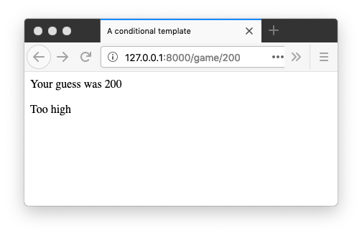
From the URL to the Template
urlpatterns = [
path('game/<slug:guess>', views.GameView.as_view()),
]
from django.views import View
class GameView(View) :
def get(self, request, guess) :
x = {'guess' : int(guess) }
return render(request, 'cond.html', x)

Slide 30
View Using a Template to make HTML
from django.views import View
class GameView(View) :
def get(self, request, guess) :
x = {'guess' : int(guess) }
return render(request, 'cond.html', x)
<html>
<head>
<title>A conditional template</title>
</head>
<body>
<p>Your guess was {{ guess }}</p>
{% if guess < 42 %}
<p>Too low</p>
{% elif guess > 42 %}
<p>Too high</p>
{% else %}
<p>Just right</p>
{% endif %}
</body>
</html>

Slide 31
Template Tags
{{ zap }}
{{ zap|safe }}
{% url 'cat-detail' cat.id %}
{% author.get_absolute_url %}
{% if zap > 100 %}
{% endif %}
{% block content %}
{% endblock %}
Substitution
Calling code
Logic
Blocks

Slide 32
Template "coding"
<html>
<head>
<title>A simple page</title>
</head>
<body>
<p>Your guess was {{ zap }}</p>
<p>Escaped {{ txt }}</p>
<p>Escaped not! {{ txt|safe }}</p>
</body>
</html>
<body>
<ul>
{% for x in fruits %}
<li>{{ x }}</li>
{% endfor %}
</ul>
{% if nuts %}
<p>Number of nuts: {{ nuts|length }}</p>
{% else %}
<p>No nuts.</p>
{% endif %}
</body>

Slide 33
Template Inheritance
Base
Template
Render
Data
Template
Render
Engine
Rendered
Output

Slide 34
Template Inheritance
base.html
<html>
<head>
<title>A template</title>
</head>
<body>
{% block content %}{% endblock %}
</body>
</html>
cond.html
<html>
<head>
<title>A conditional template</title>
</head>
<body>
<p>Your guess was {{ guess }}</p>
{% if guess < 42 %}
<p>Too low</p>
{% elif guess > 42 %}
<p>Too high</p>
{% else %}
<p>Just right</p>
{% endif %}
</body>
</html>
cond2.html
{% extends "base.html" %}
{% block content %}
<p>Your guess was {{ guess }}</p>
{% if guess < 42 %}
<p>Too low</p>
{% elif guess > 42 %}
<p>Too high</p>
{% else %}
<p>Just right</p>
{% endif %}
{% endblock %}

Slide 35
Demo / Walkthrough
https://github.com/csev/dj4e-samples/tree/master/templates

Slide 36
Summary
Views are where we bring the application components together to handle requests from browsers and produce responses for the browsers
Templates take a context and merge it into a template to produce HTML
Values can be substituted without without "escaping"
Conditional
Looping
Inheritance between templates

Slide 37
Acknowledgements / Contributions
These slides are Copyright 2019- Charles R. Severance (www.dr-chuck.com) as part of www.dj4e.com and made available under a Creative Commons Attribution 4.0 License. Please maintain this last slide in all copies of the document to comply with the attribution requirements of the license. If you make a change, feel free to add your name and organization to the list of contributors on this page as you republish the materials.
Initial Development: Charles Severance, University of Michigan School of Information
Insert new Contributors and Translators here including names and dates
Continue new Contributors and Translators here

