Slide 1


Form Processing
Charles Severance
www.dj4e.com

Slide 2
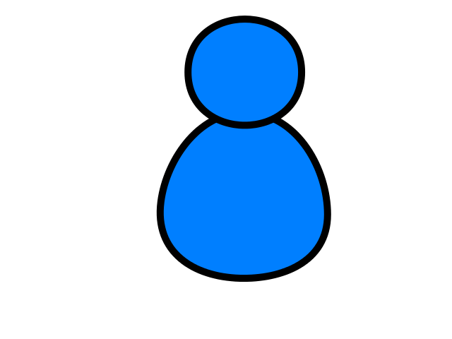
Browser
Linux
D
O
M
N
G
I
N X
WGSIConfig
settings.py
DJango
Routing
Click
urls.py
views.py
Parse
Response
Views
Templates
forms.py
Javascript
Database
Shell
Models
model.py
/admin
admin.py

Slide 3
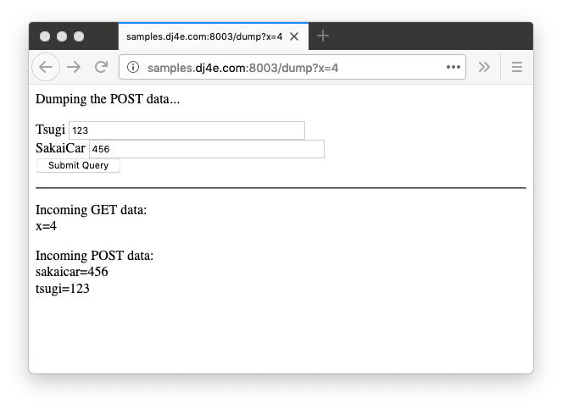
Forms gather data and send it to the server

Slide 4
GET and POST with Forms

Slide 5
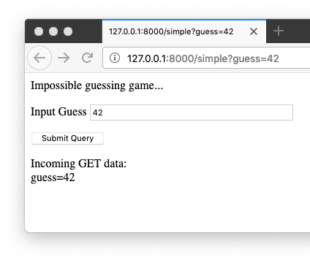
def simple(request):
response = '<p>Impossible guessing game...</p>'
response += '''<form>
<p><label for="guess">Input Guess</label>
<input type="text" name="guess" size="40" id="guess"/></p>
<input type="submit"/>
</form>
'''
if len(request.GET) > 0 :
response += '<p>Incoming GET data:<br/>\n'
for key, value in request.GET.items():
response += html.escape(key) + '=' +
html.escape(value) + '</br>\n'
response += '</p>\n'
return HttpResponse(response)

Slide 6
<form method="post">
<p><label for="abc123">Tsugi</label>
<input type="text" name="tsugi" size="40" id="abc123"/><br/>
<label for="xyzzy">SakaiCar</label>
<input type="text" name="sakaicar" size="40" id="xyzzy"/><br/>
<input type="submit"/></p>
</form><hr/>

Slide 7
Forms GET vs. POST
Two ways the browser can send parameters to the web server
GET - Parameters are placed on the URL which is retrieved.
POST - The URL is retrieved and parameters are appended to the request in the the HTTP connection.

Slide 8
Passing Parameters to The Server
GET /simple?guess=42
Accept: text/html
User-Agent: Lynx/2.4 libwww/2.14
Web Server
HTTP
Request
POST /guess
Accept: text/html
User-Agent: Lynx/2.4 libwww/2.14
Content-type: application/x-www-form-urlencoded
Content-length: 13
guess=42
Browser
<input type="text" name="guess" id="yourid" />

Slide 9
Rules of the POST/GET Choice
POST is used when data is being created or modified.
GET is used when your are reading or searching things.
Web search spiders will follow GET URLs but generally not POST URLs.
GET URLs should be “idempotent” - the same URL should give the “same thing” each time you access it.
GET has an upper limit of the number of bytes of parameters and values (think about 2K).

Slide 10
POST-REDIRECT-GET

Slide 11
HTTP Status Codes
http://www.dr-chuck.com/page1.htm - 200 OK
http://www.wa4e.com/nowhere.htm - 404 Not Found
http://www.drchuck.com/ - 302 Found / Moved
Also known as “redirect”
https://en.wikipedia.org/wiki/List_of_HTTP_status_codes

Slide 12
HTTP Location Header
If your application has not yet sent any data, it can send a special header as part of the HTTP Response.
The redirect header includes a URL that the browser is supposed to forward itself to.
It was originally used for web sites that moved from one URL to another.
http://en.wikipedia.org/wiki/URL_redirection

Slide 13
POST / Redirect / GET

Slide 14
POST / Refresh / ☹
Once you do a POST, if you refresh, the browser will re-send the POST data a second time.
The user gets a pop-up that tries to explain what is about to happen.

Slide 15
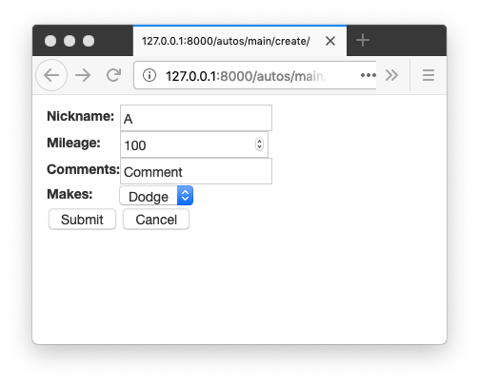
Press Submit then Refresh

Slide 16
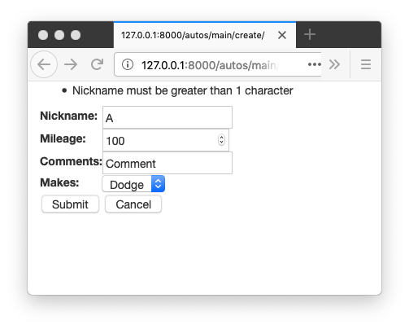
Press Submit then Refresh

Slide 17
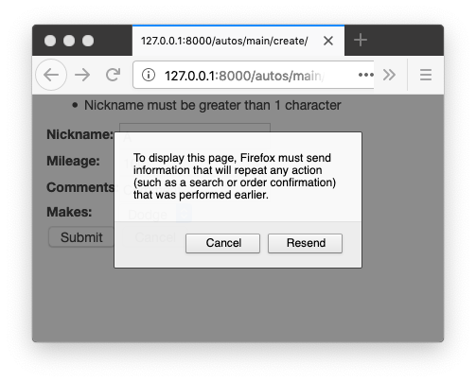
Press Submit then Refresh

Slide 18
No Double Posts
Typically POST requests are adding or modifying data whilst GET requests view data
It may be dangerous to do the same POST twice (say withdrawing funds from a bank account)
So the browser insists on asking the user (out of your control)
Kind of an ugly UX / bad usability

Slide 19
POST Redirect Rule
The simple rule for pages intended for a browser is to never generate a page with HTML content when the app receives POST data
Must redirect somewhere - even to the same script - forcing the browser to make a GET after the POST

Slide 20
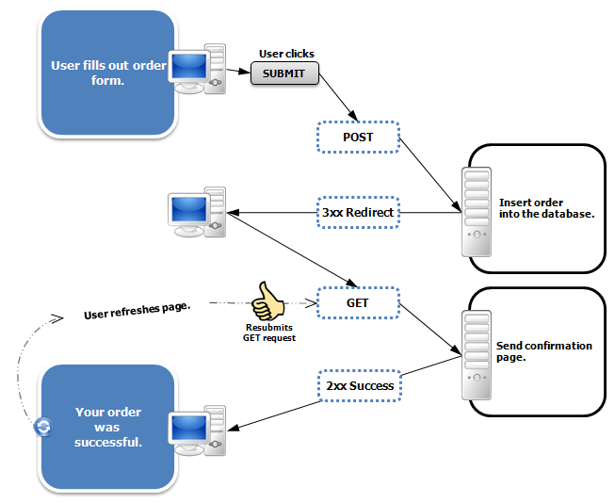
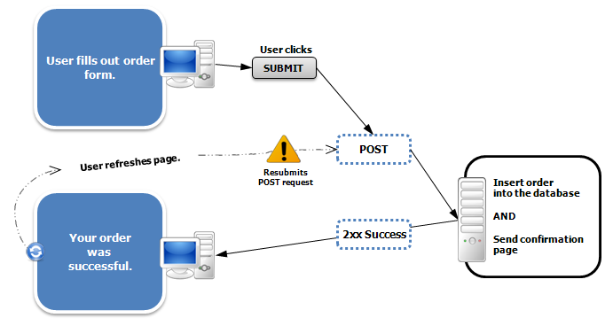
https://en.wikipedia.org/wiki/Post/Redirect/Get

Slide 21
Demo

Slide 22
Summary
HTML for Forms
GET versus POST
POST Redirect GET

Slide 23
Acknowledgements / Contributions
These slides are Copyright 2019- Charles R. Severance (www.dr-chuck.com) as part of www.dj4e.com and made available under a Creative Commons Attribution 4.0 License. Please maintain this last slide in all copies of the document to comply with the attribution requirements of the license. If you make a change, feel free to add your name and organization to the list of contributors on this page as you republish the materials.
Initial Development: Charles Severance, University of Michigan School of Information
Insert new Contributors and Translators here including names and dates
Continue new Contributors and Translators here

