Slide 1

Login and Logout
Charles Severance
www.dj4e.com
https://samples.dj4e.com/authz/
https://github.com/csev/dj4e-samples/tree/master/authz

Slide 2
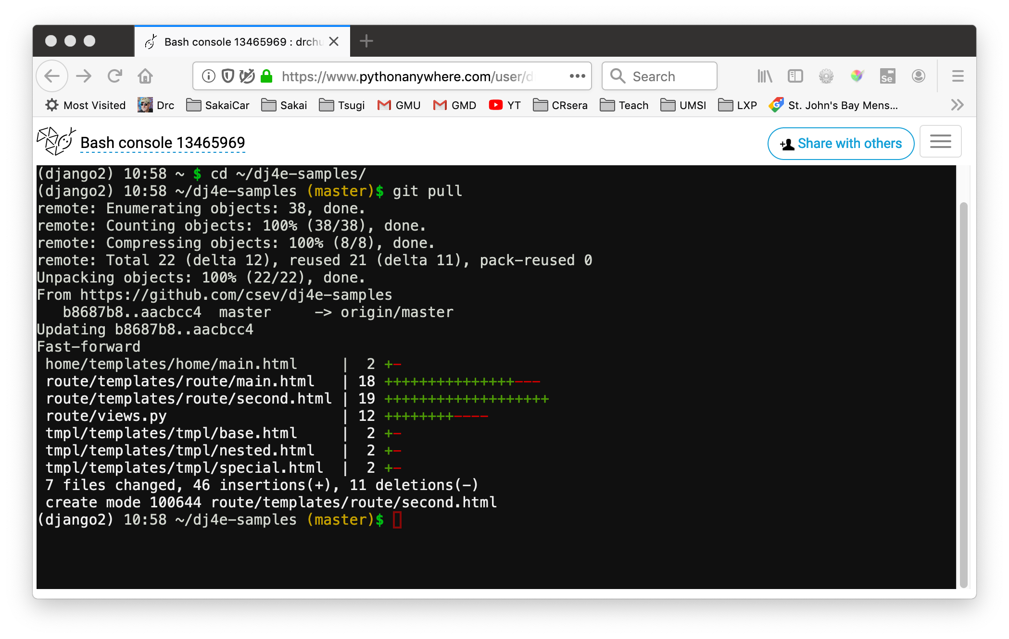
Update your dj4e-samples
cd ~/dj4e-samples
git pull

Slide 3
User authentication in Django
Django comes with a user authentication system. It handles user accounts, groups, permissions and cookie-based user sessions. The authentication system consists of:
Users
Permissions: Binary (yes/no) flags designating whether a user may perform a certain task.
Groups: A generic way of applying labels and permissions to more than one user.
A configurable password hashing system
Forms and view tools for logging in users, or restricting content
A pluggable backend system
Authentication support is bundled as a Django contrib module in django.contrib.auth. By default, the required configuration is already included in settings.py.
https://docs.djangoproject.com/en/2.2/topics/auth/

Slide 4
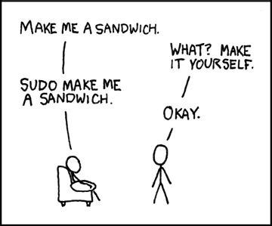
Making the super user
We need to "bootstrap" our system and make a user that can log into the admin page and make more users
dj4e-samples$ python3 manage.py createsuperuser
Username: dj4e-samples
Email address: csev@umich.edu
Password:
Password (again):
Superuser created successfully.
https://xkcd.com/149/

Slide 5
Wiping out your database
Sometimes you want to clear out and re-initialize your db.sqlite3 file
The super users and users are stored in the database so when you remove it, you need to re-create the super users.
dj4e-samples$ rm db.sqlite3
dj4e-samples$ python3 manage.py migrate
dj4e-samples$ python3 manage.py createsuperuser
Username: dj4e-samples
Email address: csev@umich.edu
Password:
Password (again):
Superuser created successfully.

Slide 6
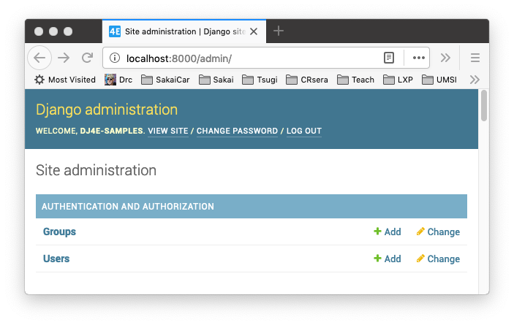
Additional Users and Permissions
Once you have a super user you can log into your application and create additional new users, associate them with groups, and give them permissions in the "/admin" user interface
Many applications don’t need to use the groups or permissions features of Django

Slide 7
Logging Users into Our Application

Slide 8
Sessions are not "logging in"
A session is a way of marking a browser and storing data on the server which can be stored and retrieved across multiple request-response-cycles
Sessions exist irrespective of whether or not the user is logged in
When the user passes the login check, the server adds data to the session identifying the user
When the user logs out, that information in the session is removed
Sessions are required to implement login

Slide 9
Sessions, Users, Login, and Django
Login functionality is built into Django and included in your settings.py by default
dj4e-samples/dj4e-samples/settings.py
INSTALLED_APPS = [
'django.contrib.admin',
'django.contrib.auth',
'django.contrib.contenttypes',
...
https://docs.djangoproject.com/en/2.2/topics/auth/default

Slide 10
Sessions, Users, Login, and Django
We need to add a path to the code that gives us login and logout urls
We can reverse lookup these urls using the 'login' and 'logout' view names
dj4e-samples/dj4e-samples/urls.py
urlpatterns = [
path('', include('home.urls')),
path('admin/', admin.site.urls),
path('accounts/', include('django.contrib.auth.urls')),
...
https://docs.djangoproject.com/en/2.2/topics/auth/default

Slide 11
dj4e-samples/authz/views.py
from django.urls import reverse
class DumpPython(View) :
def get(self, req):
resp = "<pre>\nUser Data in Python:\n\n"
resp += "Login url: " + reverse('login') + "\n"
resp += "Logout url: " + reverse('logout') + "\n\n"
https://samples.dj4e.com/authz/python
You can get the login and logout urls using reverse()
User Data in Python:
Login url: /accounts/login/
Logout url: /accounts/logout/

Slide 12
Where to go after login / logout completion
We want to transfer the user to a login page from many pages in our application and when they successfully log in, we want to bring them back to our page or some other page
The "next=" parameter tells login or logout where to redirect the user after login

Slide 13
dj4e-samples/authz/templates/main.html
urlpatterns = [
path('', TemplateView.as_view(template_name='authz/main.html')),
path('open', views.OpenView.as_view(), name='open'),
path('apereo', views.ApereoView.as_view(), name='apereo'),
path('manual', views.ManualProtect.as_view(), name='manual'),
path('protect', views.ProtectView.as_view(), name='protect'),
path('python', views.DumpPython.as_view(), name='python'),
]

Slide 14
dj4e-samples/authz/templates/authz/main.html
<h1>Current request.path {{ request.path }}</h1>
{% if user.is_authenticated %}
<p>Authenticated as
<pre>
Name: {{ user.get_full_name }}
Email: {{ user.email }}
Id: {{ user.id }}
</pre>
</p>
<p>You can <a href="{% url 'logout' %}?next={% url 'authz:open' %}">Logout</a></p>
{% else %}
<p>You are not logged in</p>
<p>You can <a href="{% url 'login' %}?next={{ request.path }}">Login</a> if you like.</p>
{% endif %}

Slide 15
<ul>
<li>
Go to <a href="{% url 'authz:open' %}">{% url 'authz:open' %}</a>
(no login required)
</li>
<li>
Go to <a href="{% url 'authz:apereo' %}">{% url 'authz:apereo' %}</a>
(no login required)
</li>
<li>
Go to <a href="{% url 'authz:manual' %}">{% url 'authz:manual' %}</a>
(protected by user.is_authenticated)
</li>
<li>
Go to <a href="{% url 'authz:protect' %}">{% url 'authz:protect' %}</a>
(protected by LoginRequiredMixin)
</li>
<li>
Go to <a href="{% url 'authz:python' %}">{% url 'authz:python' %}</a>
dump request.user data in python
</li>
</ul>

Slide 16
dj4e-samples/authz/templates/authz/main.html
<p>You can <a href="{% url 'login' %}?next={{ request.path }}">
Login</a> if you like.</p>
https://samples.dj4e.com/authz/open
Current request.path /authz/open
You are not logged in
You can Login if you like.
Go to /authz/open (no login required)
Go to /authz/apereo (no login required)
Go to /authz/manual (protected by user.is_authenticated)
Go to /authz/protect (protected by LoginRequiredMixin)
Go to /authz/python dump request.user data in python
<p>You can <a href="/accounts/login/?next=/authz/open">Login</a> if you like.</p>

Slide 17
<p>You can <a href="{% url 'logout' %}?next={% url 'authz:open' %}">
Logout</a></p>
Current request.path /authz/open
Authenticated as
Name:
Email: csev@umich.edu
Id: 1
You can Logout
Go to /authz/open (no login required)
Go to /authz/apereo (no login required)
Go to /authz/manual (protected by user.is_authenticated)
Go to /authz/protect (protected by LoginRequiredMixin)
Go to /authz/python dump request.user data in python
https://samples.dj4e.com/authz/open
When logging out, make sure to set next to a url that does not require login. If you do – the user will be in a frustrating logout / login loop.
<p>You can <a href="/accounts/logout/?next=/authz/open">Logout</a></p>

Slide 18
The Login Page

Slide 19
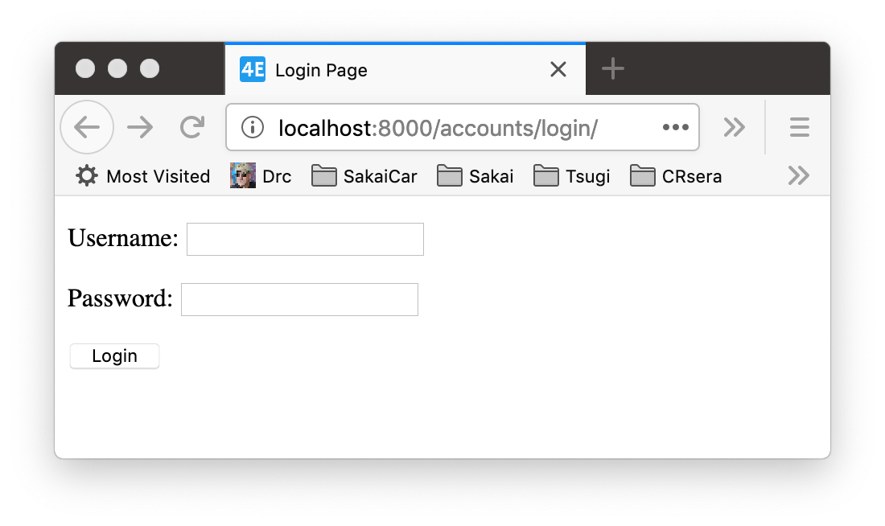
Look and Feel - Login Template
https://samples.dj4e.com/accounts/login
To allow us to control the look and feel of the login page we must provide a template called "registration/login.html"
Django describes what needs to be in this template
We can put this in any of our application templates folders
https://docs.djangoproject.com/en/2.2/topics/auth/default/#django.contrib.auth.views.LoginView

Slide 20
dj4e-samples/home/templates/registration/login.html
<html>
<title>Login Page</title>
</head>
<body>
{% if form.errors %}
<p>Your username and password didn't match. Please try again.</p>
{% endif %}
{% if next %}
{% if user.is_authenticated %}
<p>Your account doesn't have access to this page. To proceed,
please login with an account that has access.</p>
{% else %}
<p>Please login to see this site.</p>
{% endif %}
{% endif %}
<form method="post" action="{% url 'login' %}">
{% csrf_token %}
{{ form.as_p }}
<input type="submit" class="btn btn-primary" value="Login" />
<input type="hidden" name="next" value="{{ next }}" />
</form>
</body>

Slide 21
Data for the logged in user
https://samples.dj4e.com/authz/open
{% if user.is_authenticated %}
<p>Authenticated as
<pre>
Name: {{ user.get_full_name }}
Email: {{ user.email }}
Id: {{ user.id }}
</pre>
</p>
{% else %}
<p>You are not logged in</p>
{% endif %}
Current request.path /authz/open
Authenticated as
Name:
Email: csev@umich.edu
Id: 1
You can Logout
Go to /authz/open (no login required)
Go to /authz/apereo (no login required)
Go to /authz/manual (protected by user.is_authenticated)
Go to /authz/protect (protected by LoginRequiredMixin)
Go to /authz/python dump request.user data in python
dj4e-samples/authz/templates/authz/main.html

Slide 22
Accessing user data in Python
https://samples.dj4e.com/authz/python
User Data in Python:
Login url: /accounts/login/
Logout url: /accounts/logout/
User: dj4e-samples
Email: csev@umich.edu
dj4e-samples/authz/views.py
class DumpPython(View) :
def get(self, req):
resp = "<pre>\nUser Data in Python:\n\n"
resp += "Login url: " + reverse('login') + "\n"
resp += "Logout url: " + reverse('logout') + "\n\n"
if req.user.is_authenticated:
resp += "User: " + req.user.username + "\n"
resp += "Email: " + req.user.email + "\n"
else:
resp += "User is not logged in\n"
resp += "\n"
resp += "</pre>\n"
resp += """<a href="/authz">Go back</a>"""
return HttpResponse(resp)

Slide 23
Views that require a logged in user
Many of your views need to make sure that someone is logged in before performing some operation that depends on the request.user data being set
request.user.id
request.user.email
You could check user.is_authenticated at the beginning of each view and if the user is not logged, redirect them to reverse('login') with the appropriate next= parameter
https://docs.djangoproject.com/en/2.2/topics/auth/default/#the-loginrequired-mixin

Slide 24
dj4e-samples/authz/views.py
from django.utils.http import urlencode
class ManualProtect(View) :
def get(self, request):
if request.user.is_authenticated :
return render(request, 'authz/main.html')
loginurl = reverse('login')+'?'+urlencode({'next': request.path})
return redirect(loginurl)
from django.contrib.auth.mixins import LoginRequiredMixin
class ProtectView(LoginRequiredMixin, View) :
def get(self, request):
return render(request, 'authz/main.html')
https://docs.djangoproject.com/en/2.2/topics/auth/default/#the-loginrequired-mixin

Slide 25
dj4e-samples/authz/templates/authz/main.html
<h1>Current request.path {{ request.path }}</h1>
{% if user.is_authenticated %}
<p>Authenticated as
<pre>
Name: {{ user.get_full_name }}
Email: {{ user.email }}
Id: {{ user.id }}
</pre>
</p>
<p>You can <a href="{% url 'logout' %}?next={% url 'authz:open' %}">Logout</a></p>
{% else %}
<p>You are not logged in</p>
<p>You can <a href="{% url 'login' %}?next={{ request.path }}">Login</a> if you like.</p>
{% endif %}

Slide 26
Summary - Setting up login
Add django.contrib.auth entries to INSTALLED_APPS and urlpatterns
Create a template named 'registration/login.html'
Get urls for login and logout using reverse, reverse_lazy, or the url template tag
Add the "next=" parameter to those URLs to bring the user back to a page after successful login or logout
Add LoginRequiredMixin to views that can only be accessed by a logged in user

Slide 27
Acknowledgements / Contributions
These slides are Copyright 2019- Charles R. Severance (www.dr-chuck.com) as part of www.dj4e.com and made available under a Creative Commons Attribution 4.0 License. Please maintain this last slide in all copies of the document to comply with the attribution requirements of the license. If you make a change, feel free to add your name and organization to the list of contributors on this page as you republish the materials.
Initial Development: Charles Severance, University of Michigan School of Information
Insert new Contributors and Translators here including names and dates
Continue new Contributors and Translators here

