Slide 1


Single Table SQL
Charles Severance
www.dj4e.com

Slide 2
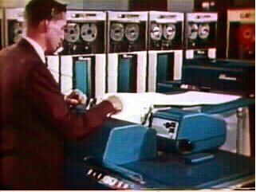

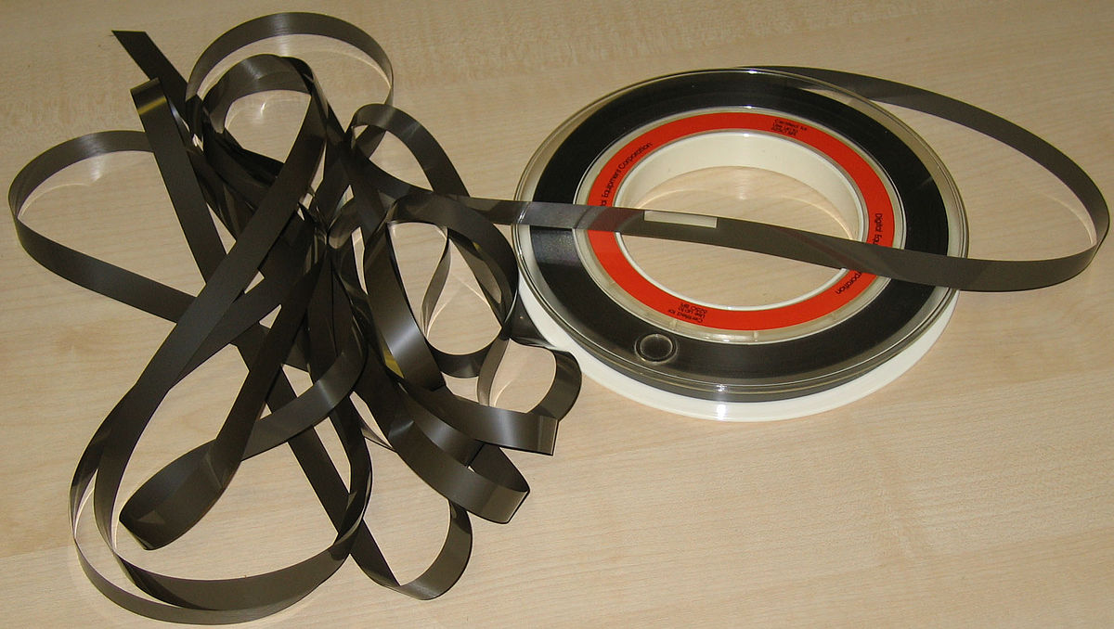
OLD
Sorted
Sequential
Master
Update
1970s
NEW
Sorted
Merge
Transactions
Sorted
https://en.wikipedia.org/wiki/IBM_729

Slide 3
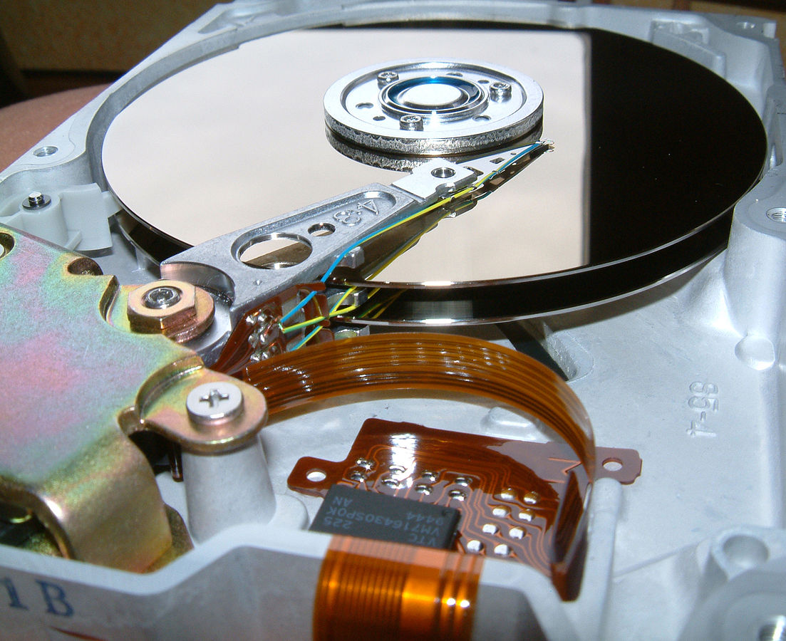
Random Access
When you can randomly access data...
How can you layout data to be most efficient?
Sorting might not be the best idea
https://en.wikipedia.org/wiki/Hard_disk_drive_platter

Slide 4
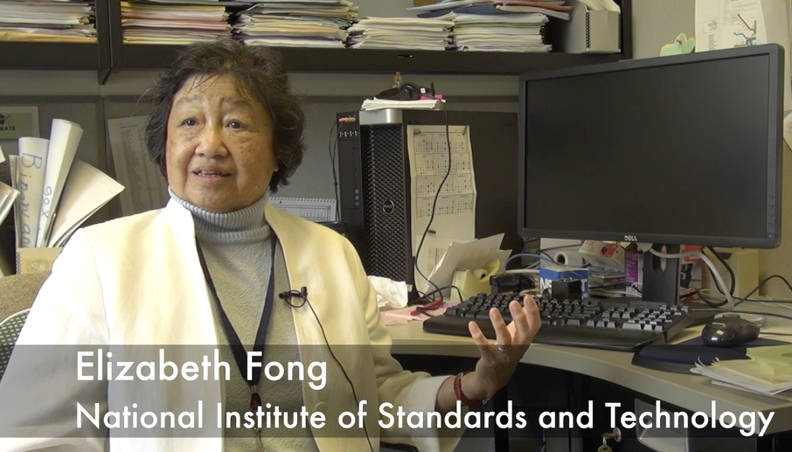
Structured Query Language
Structured Query Language (SQL) came out of a government / industry partnership
National Institute of Standards and Technology (NIST)
https://youtu.be/rLUm3vst87g

Slide 5
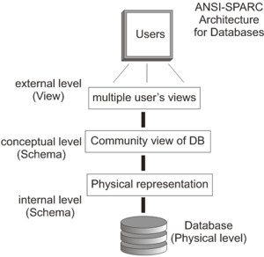
SQL
Structured Query Language is the language we use to issue commands to the database
- Create/Insert data
- Read/Select some data
- Update data
- Delete data
http://en.wikipedia.org/wiki/SQL
https://en.wikipedia.org/wiki/ANSI-SPARC_Architecture

Slide 6
Relational Databases
Relational databases model data by storing rows and columns in tables. The power of the relational database lies in its ability to efficiently retrieve data from those tables and in particular where there are multiple tables and the relationships between those tables involved in the query.
http://en.wikipedia.org/wiki/Relational_database

Slide 7
Common Database Systems
Three major Database Management Systems in wide use
- Oracle - Large, commercial, enterprise-scale, very very tweakable
- MySql - Simpler but very fast and scalable - commercial open source
- SqlServer - Very nice - from Microsoft (also Access)
Many other smaller projects, free and open source
- HSQL, SQLite, Postgres, ...

Slide 8
Database Model
A database model or database schema is the structure or format of a database, described in a formal language supported by the database management system. In other words, a “database model” is the application of a data model when used in conjunction with a database management system.
http://en.wikipedia.org/wiki/Database_model

Slide 9
SQL
Structured Query Language is the language we use to issue commands to the database
- Create data (a.k.a Insert)
- Retrieve data
- Update data
- Delete data
http://en.wikipedia.org/wiki/SQL

Slide 10
Lets Make a Database
https://www.dj4e.com/lectures/SQL-01-Basics.txt

Slide 11
Start Simple - A Single Table
$ sqlite3 zip.sqlite3
SQLite version 3.11.0 2016-02-15 17:29:24
Enter ".help" for usage hints.
sqlite> .tables
sqlite> CREATE TABLE Users(
...> id INTEGER NOT NULL
...> PRIMARY KEY AUTOINCREMENT,
...> name VARCHAR(128),
...> email VARCHAR(128)
...> ) ;
sqlite> .tables
Users
sqlite> .schema Users
CREATE TABLE Users(
id INTEGER NOT NULL
PRIMARY KEY AUTOINCREMENT,
name VARCHAR(128),
email VARCHAR(128)
);
sqlite>
CREATE TABLE Users(
id integer NOT NULL
PRIMARY KEY
AUTOINCREMENT,
name VARCHAR(128),
email VARCHAR(128)
);
https://www.dj4e.com/lectures/SQL-01-Basics.txt

Slide 12
SQL: Insert
The Insert statement inserts a row into a table
INSERT INTO Users (name, email) VALUES ('Kristin', 'kf@umich.edu')

Slide 13
SQL: Delete
Deletes a row in a table based on selection criteria
DELETE FROM Users WHERE email='ted@umich.edu'

Slide 14
SQL: Update
Allows the updating of a field with a where clause
UPDATE Users SET name='Charles' WHERE email='csev@umich.edu'

Slide 15
Retrieving Records: Select
The select statement retrieves a group of records - you can either retrieve all the records or a subset of the records with a WHERE clause
SELECT * FROM Users
SELECT * FROM Users WHERE email='csev@umich.edu'

Slide 16
Sorting with ORDER BY
You can add an ORDER BY clause to SELECT statements to get the results sorted in ascending or descending order
SELECT * FROM Users ORDER BY email
SELECT * FROM Users ORDER BY name DESC

Slide 17
SQL Summary
INSERT INTO Users (name, email) VALUES ('Kristin', 'kf@umich.edu')
DELETE FROM Users WHERE email='ted@umich.edu'
UPDATE Users SET name="Charles" WHERE email='csev@umich.edu'
SELECT * FROM Users
SELECT * FROM Users WHERE email='csev@umich.edu'
SELECT * FROM Users ORDER BY email

Slide 18
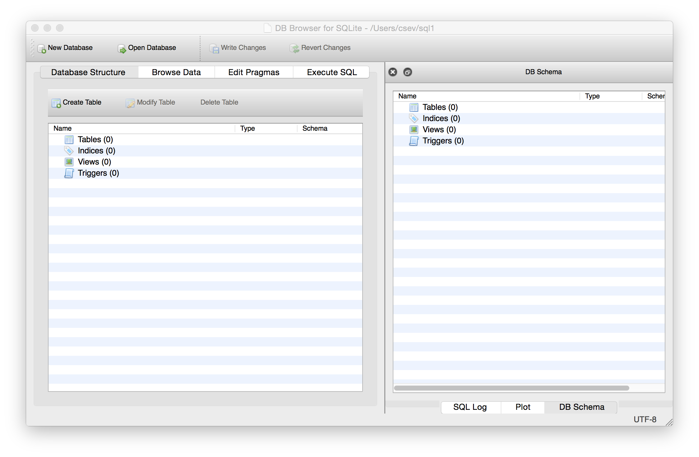
http://sqlitebrowser.org/

Slide 19
Acknowledgements / Contributions
These slides are Copyright 2019- Charles R. Severance (www.dr-chuck.com) as part of www.dj4e.com and made available under a Creative Commons Attribution 4.0 License. Please maintain this last slide in all copies of the document to comply with the attribution requirements of the license. If you make a change, feel free to add your name and organization to the list of contributors on this page as you republish the materials.
Initial Development: Charles Severance, University of Michigan School of Information
Insert new Contributors and Translators here including names and dates
Continue new Contributors and Translators here

