Slide 1


Data Modelling One to Many
Charles Severance
www.dj4e.com

Slide 2

Browser
Linux
D
O
M
N
G
I
N X
WGSIConfig
settings.py
Django
Routing
urls.py
views.py
Parse
Response
Views
Templates
forms.py
Javascript
Database
Shell
Models
model.py
/admin
admin.py

Slide 3
Model Design
Model design is an art form of its own with particular skills and experience
Our goal is to avoid the really bad mistakes and design clean and easily understood models
Model design starts with a sample data set and draws a picture

Slide 4
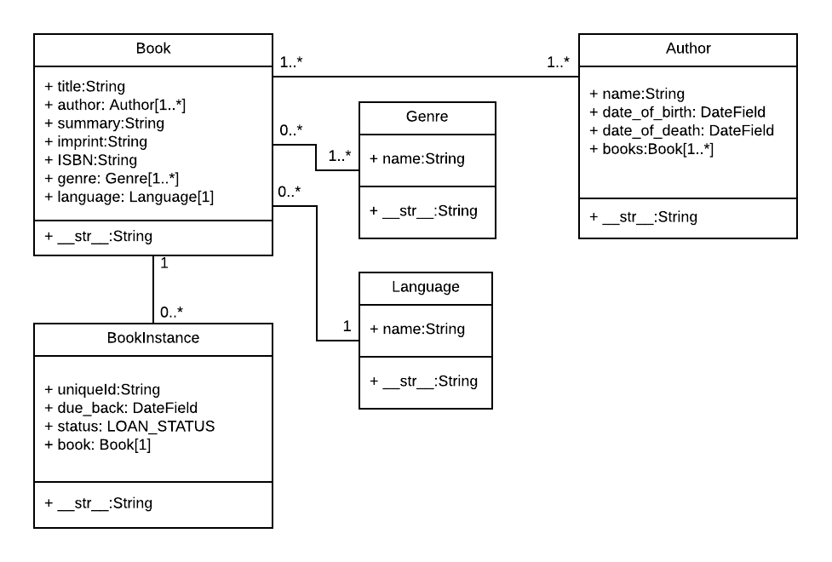
Table
Field
Method
"One Book can between zero and infinite number of BookInstances"
https://developer.mozilla.org/en-US/docs/Learn/Server-side/Django/Models

Slide 5
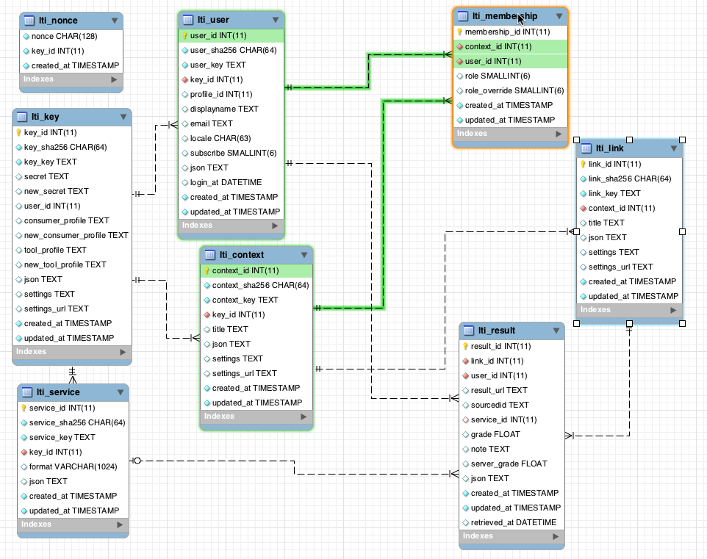
www.tsugi.org

Slide 6
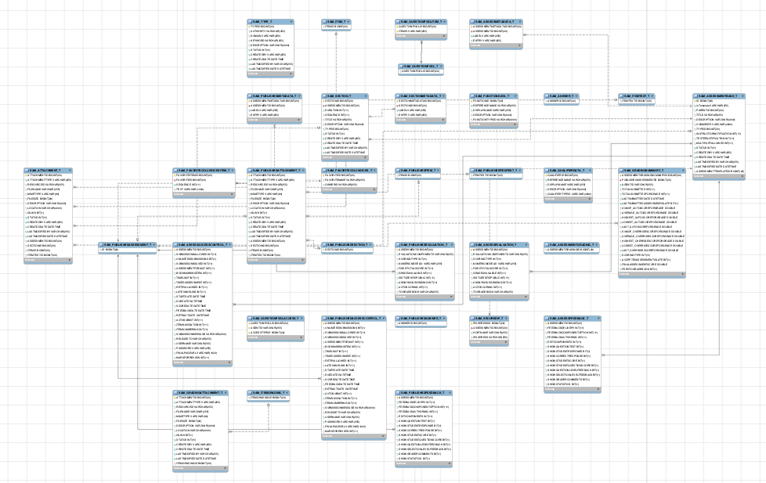
www.sakaiproject.org

Slide 7
Building a Data Model
Drawing a picture of the data objects given a data set and then figuring out how to represent the objects and their relationships
Basic Rule: Don’t put the same string data in twice - use an additional table and a foreign key instead
When there is one thing in the “real world” there should be one copy of that thing in the database

Slide 8
Database Normalization (3NF)
There is *tons* of database theory - way too much to understand without excessive predicate calculus
Do not replicate data - reference data - point at data
Use integers for keys and for references
Add a special “key” column to each table which we will make references to. By convention, many programmers and frameworks call this column “id”
http://en.wikipedia.org/wiki/Database_normalization

Slide 9
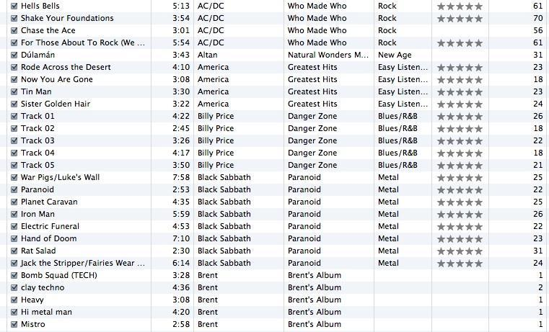
A "Data Set"
Track
Len
Artist
Album
Genre
Rating
Count

Slide 10
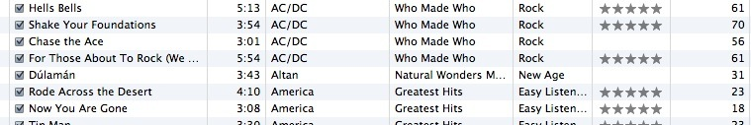
For each “piece of info”...
Is the column an object or an attribute of another object?
Once we define objects, we need to define the relationships between objects
Len
Album
Genre
Artist
Rating
Track
Count

Slide 11
Track
Album
Artist
Genre
Rating
Len
Count

Slide 12
Track
Rating
Len
Count
Track
Artist
Album
belongs-to
Artist
Album
Genre
belongs-to
Rating
Len
Genre
belongs-to
Count

Slide 13
Track
Rating
Len
Count
Artist
belongs-to
Album
belongs-to
Genre
belongs-to

Slide 14
Connecting Data With Keys

Slide 15
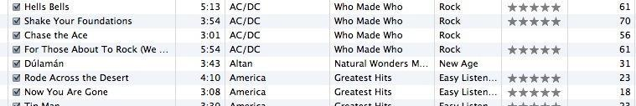
We want to keep track of which band is the “creator” of each music track...
What album does this song “belong to”??
Which album is this song related to?

Slide 16
Three Kinds of Keys
Primary key - generally an integer auto-increment field – added automatically by django
Logical key - What the outside world uses for lookup
Foreign key - generally an integer key pointing to a row in another table
Album
id
title
artist
...

Slide 17
Key Rules
Best practices
Never use your logical key as the primary key
Logical keys can and do change, albeit slowly
Relationships that are based on matching string fields are less efficient than integers
User
id
login
password
name
email
created_at
modified_at
login_at

Slide 18
Foreign Keys
A foreign key is when a table has a column that contains a key which points to the primary key of another table.
Best practice is having all primary keys and foreign keys integers – Django does this automatically
Album
id
title
artist
...
Artist
id
name
...

Slide 19
Defining and Connecting Models

Slide 20
Model Field Types
AutoField
BigAutoField
BigIntegerField
BinaryField
BooleanField
CharField
DateField
DateTimeField
DecimalField
DurationField
EmailField
FileField
FilePathField
FloatField
ImageField
IntegerField
GenericIPAddressField
NullBooleanField
PositiveIntegerField
PositiveSmallIntegerField
SlugField
SmallIntegerField
TextFIeld
TimeField
URLField
ForeignKey
ManyToManyField
OneToOneField
https://docs.djangoproject.com/en/2.1/ref/models/fields/#field-types

Slide 21
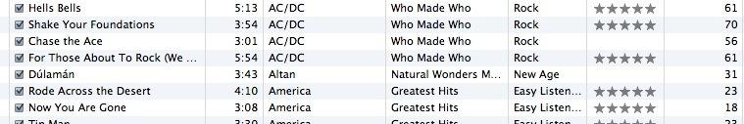
Artist
Track
Rating
Len
Count
belongs-to
Album
belongs-to
Genre
belongs-to

Slide 22
belongs-to
Album
title
Artist
Table
Primary key
Logical key
Foreign key
Artist
Album
id
id
name
title
album
Django automatically adds a primary key to all models and names it "id".

Slide 23
Artist
Track
id
Album
id
name
id
title
title
rating
Table
Primary key
Logical key
Foreign key
artist
length
count
album
Genre
genre
id
name

Slide 24
class Artist(models.Model):
name = models.CharField(max_length=200, db_index=True, help_text='Artist name')
def __str__(self):
"""String for representing the Model object."""
return self.name
class Album(models.Model):
title = models.CharField(max_length=200, db_index=True, help_text='Album title')
artist = models.ForeignKey('Artist', on_delete=models.SET_NULL, null=True)
def __str__(self):
"""String for representing the Model object."""
return self.title
https://github.com/csev/dj4e-samples/blob/master/samples/tracks/models.py
https://docs.djangoproject.com/en/2.1/topics/db/models/

Slide 25
class Genre(models.Model):
name = models.CharField(max_length=200, db_index=True, help_text='Genre of music')
def __str__(self):
"""String for representing the Model object."""
return self.name
class Track(models.Model):
title = models.CharField(max_length=200, db_index=True, help_text='Track title')
rating = models.IntegerField(null=True)
length = models.IntegerField(null=True)
count = models.IntegerField(null=True)
album = models.ForeignKey('Album', on_delete=models.CASCADE)
genre = models.ForeignKey('Genre', on_delete=models.SET_NULL, null=True)
def __str__(self):
"""String for representing the Model object."""
return self.title
https://github.com/csev/dj4e-samples/blob/master/samples/tracks/models.py
https://docs.djangoproject.com/en/2.1/topics/db/models/

Slide 26
One-To-Many in the ORM
>>> from tracks.models import Artist, Genre, Album, Track;
>>> Artist.objects.values()
<QuerySet [{'id': 1, 'name': 'Led Zepplin'},
{'id': 2, 'name': 'ACDC'}]>
>>> Album.objects.values()
<QuerySet [{'id': 1, 'title': 'Who Made Who', 'artist_id': 2},
{'id': 2, 'title': 'IV', 'artist_id': 1}]>
>>> alb = Album.objects.get(pk=1)
>>> alb
<Album: Who Made Who>
>>> alb.artist
<Artist: ACDC>
>>> art = Artist.objects.get(pk=1)
>>> art
<Artist: Led Zepplin>
>>> art.album_set.values()
<QuerySet [{'id': 2, 'title': 'IV', 'artist_id': 1}]>
Artist
Album
1
M

Slide 27
Demo
https://www.dj4e.com/lectures/DJ-03-One-To-Many.txt

Slide 28
Coming Up Many-to-Many
www.tsugi.org

Slide 29
"The relationship between Book and Genre is many-to-many"
https://developer.mozilla.org/en-US/docs/Learn/Server-side/Django/Models

Slide 30
Acknowledgements / Contributions
These slides are Copyright 2019- Charles R. Severance (www.dr-chuck.com) as part of www.dj4e.com and made available under a Creative Commons Attribution 4.0 License. Please maintain this last slide in all copies of the document to comply with the attribution requirements of the license. If you make a change, feel free to add your name and organization to the list of contributors on this page as you republish the materials.
Initial Development: Charles Severance, University of Michigan School of Information
Insert new Contributors and Translators here including names and dates
Continue new Contributors and Translators here

