Slide 1

Data Modelling Many to Many
Charles Severance
www.dj4e.com

Slide 2


Browser
Linux
D
O
M
N
G
I
N X
WGSIConfig
settings.py
Django
Routing
urls.py
views.py
Parse
Response
Views
Templates
forms.py
Javascript
Database
Shell
Models
model.py
/admin
admin.py

Slide 3
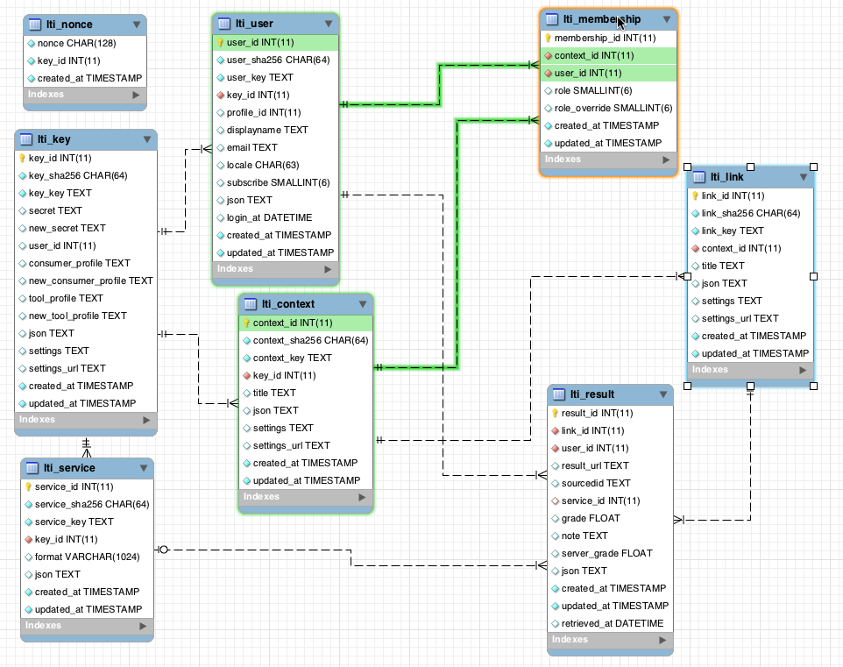
www.tsugi.org

Slide 4
belongs-to
Album
Track
Album
Track
id
id
name
title
album

Slide 5
One Album to Many Tracks ☺
Track
4
Immigrant Song
album_id 9
Track
Album
5
9
Tangerine
Led Zeppelin III
album_id 9

Slide 6
Track
4
????
Immigrant Song
Album
album_id 9
2003
School of Rock
Track
Album
5
9
Tangerine
Led Zeppelin III
album_id 9
https://www.youtube.com/watch?v=SFDMyiUjoWU

Slide 7
Track
4
Immigrant Song
Album
album_id_01 2003
2003
album_id_02 9
School of Rock
Track
Album
5
9
Tangerine
Led Zeppelin III
album_id_01 9
album_id_02
https://www.youtube.com/watch?v=SFDMyiUjoWU

Slide 8
Track
NO!!!!!!!
4
Immigrant Song
Album
album_id_01 2003
2003
album_id_02 9
School of Rock
Track
Album
5
9
Tangerine
Led Zeppelin III
album_id_01 9
album_id_02
https://www.youtube.com/watch?v=SFDMyiUjoWU

Slide 9
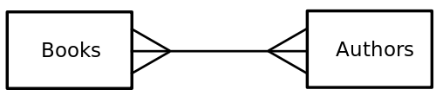
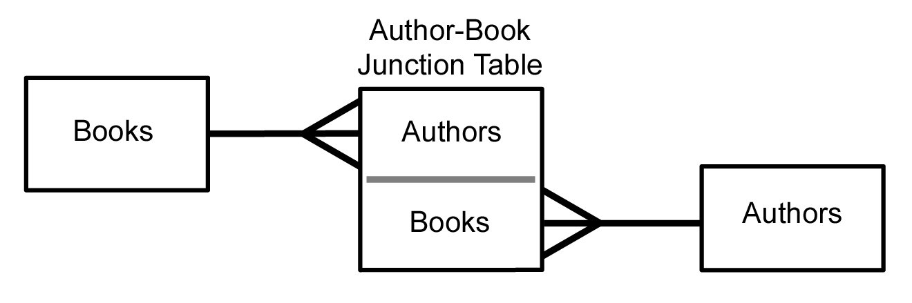
Many to Many
Sometimes we need to model a relationship that is many to many.
We need to add a “connection” table with two foreign keys.
There is usually no separate primary key.

Slide 10
member-of
Person
Course
title
Many
Many
email
name
Member
Person
Course
id
id
id
Many
person
One
email
title
One
course
Many
name
members
role
courses
https://en.wikipedia.org/wiki/Many-to-many_(data_model)

Slide 11
from django.db import models
class Person(models.Model):
email = models.CharField(max_length=128, unique=True)
name = models.CharField(max_length=128, null=True)
def __str__(self):
return self.email
class Course(models.Model):
title = models.CharField(max_length=128, unique=True)
members = models.ManyToManyField(Person,
through='Membership', related_name='courses')
def __str__(self):
return self.title
https://github.com/csev/dj4e-samples/blob/master/samples/many/models.py
https://docs.djangoproject.com/en/2.1/ref/models/fields/#choices

Slide 12
class Membership(models.Model):
person = models.ForeignKey(Person, on_delete=models.CASCADE)
course = models.ForeignKey(Course, on_delete=models.CASCADE)
created_at = models.DateTimeField(auto_now_add=True)
updated_at = models.DateTimeField(auto_now=True)
LEARNER = 1
IA = 1000
GSI = 2000
INSTRUCTOR = 5000
ADMIN = 10000
MEMBER_CHOICES = (
( LEARNER, 'Learner'),
( IA, 'Instructional Assistant' ),
( GSI, 'Grad Student Instructor' ),
( INSTRUCTOR, 'Instructor' ),
( ADMIN, 'Administrator' ),
)
role = models.IntegerField(
choices=MEMBER_CHOICES,
default=LEARNER,
)
def __str__(self):
return "Person "+ str(self.person.id) + " <--> Course " + str(self.course.id)

Slide 13
www.tsugi.org

Slide 14
Many-To-Many in the ORM
>>> from many.models import Person, Course, Membership
>>> p = Person(email='ted@umich.edu').save()
>>> c = Course(title='Woodcraft').save()
>>> c.id
6
>>> c.members.values()
<QuerySet []>
>>> m = Membership(role=Membership.INSTRUCTOR, course=c, person=p)
>>> m.save()
>>> m.id
15
>>> m.course_id
6
>>> c.members.values()
<QuerySet [{'id': 3, 'email': 'ted@umich.edu', 'name': None}]>
>>> p.courses.values()
<QuerySet [{'id': 6, 'title': 'Woodcraft'}]>
Course
Member
Person
1
M
M
1

Slide 15
Demo Batch Loading from CSV
https://github.com/csev/dj4e-samples/tree/master/samples/many

Slide 16
Many-To-Many In LocalLibrary
https://github.com/csev/dj4e-samples/tree/master/samples/many

Slide 17
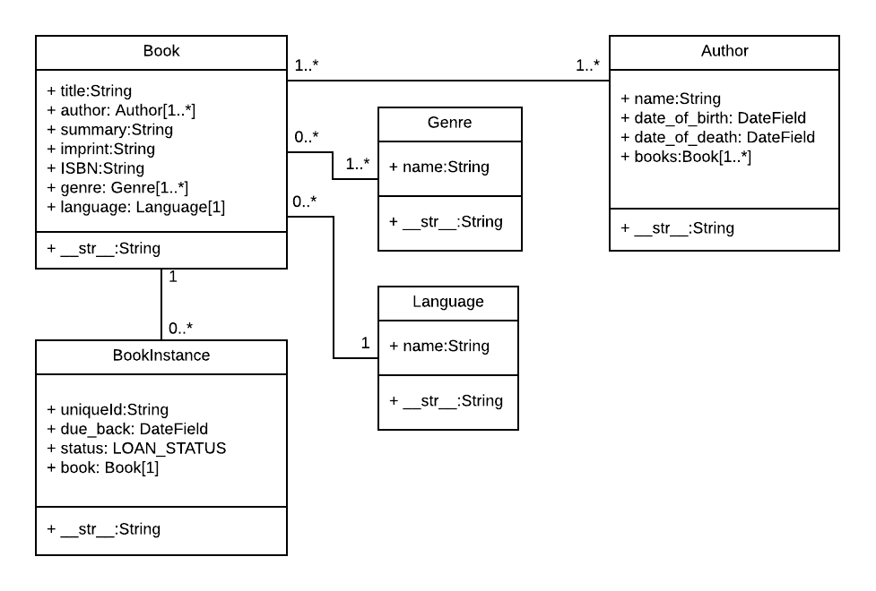
"The relationship between Book and Genre is many-to-many"
https://developer.mozilla.org/en-US/docs/Learn/Server-side/Django/Models

Slide 18
Acknowledgements / Contributions
These slides are Copyright 2019- Charles R. Severance (www.dr-chuck.com) as part of www.dj4e.com and made available under a Creative Commons Attribution 4.0 License. Please maintain this last slide in all copies of the document to comply with the attribution requirements of the license. If you make a change, feel free to add your name and organization to the list of contributors on this page as you republish the materials.
Initial Development: Charles Severance, University of Michigan School of Information
Insert new Contributors and Translators here including names and dates
Continue new Contributors and Translators here

