Slide 1

Form Processing
Charles Severance
www.dj4e.com
https://samples.dj4e.com/getpost/
https://samples.dj4e.com/form/

Slide 2

Browser
Linux
D
O
M
N
G
I
N X
WGSIConfig
settings.py
Django
Routing
Click
urls.py
views.py
Parse
Response
Views
Templates
forms.py
Javascript
Database
Shell
Models
models.py
/admin
admin.py

Slide 3
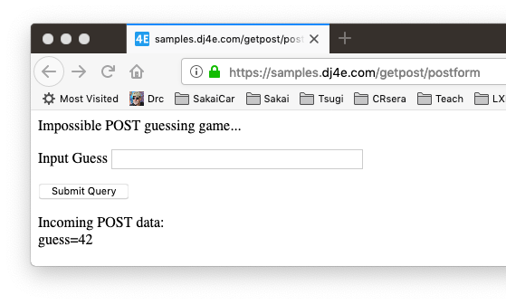
Forms gather data and send it to the server

Slide 4
FORMS in HTML

Slide 5
Utility Code – Dump a Dictionary
# Call as dumpdata('GET', request.GET)
def dumpdata(place, data) :
retval = ""
if len(data) > 0 :
retval += '<p>Incoming '+place+' data:<br/>\n'
for key, value in data.items():
retval += html.escape(key) + '=' + html.escape(value) + '</br>\n'
retval += '</p>\n'
return retval
dj4e-samples/getpost/views.py

Slide 6
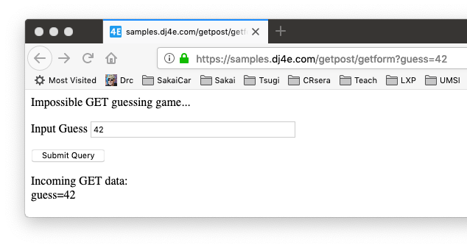
def getform(request):
response = """<p>Impossible GET guessing game...</p>
<form>
<p><label for="guess">Input Guess</label>
<input type="text" name="guess" size="40" id="guess"/></p>
<input type="submit"/>
</form>"""
response += dumpdata('GET', request.GET)
return HttpResponse(response)
dj4e-samples/getpost/views.py
https://samples.dj4e.com/getpost/getform

Slide 7

@csrf_exempt
def postform(request):
response = """<p>Impossible POST guessing game...</p>
<form method="POST">
<p><label for="guess">Input Guess</label>
<input type="text" name="guess" size="40" id="guess"/></p>
<input type="submit"/>
</form>"""
response += dumpdata('POST', request.POST)
return HttpResponse(response)
dj4e-samples/getpost/views.py
https://samples.dj4e.com/getpost/postform

Slide 8
FORMS in HTTP

Slide 9
Forms GET vs. POST
Two ways the browser can send parameters to the web server
GET - Parameters are placed on the URL which is retrieved.
POST - The URL is retrieved and parameters are appended to the request in the the HTTP connection.

Slide 10
Passing Parameters to The Server
GET /form/getform?guess=42
Accept: text/html
User-Agent: Lynx/2.4 libwww/2.14
Web Server
HTTP
Request
POST /form/postform
Accept: text/html
User-Agent: Lynx/2.4 libwww/2.14
Content-type: application/x-www-form-urlencoded
Content-length: 13
guess=42
Browser
<input type="text" name="guess" id="yourid" />

Slide 11
Rules of the POST/GET Choice
POST is used when data is being created or modified.
GET is used when your are reading or searching things.
GET should never be used to insert, modify or delete data.
Web search spiders will follow GET URLs but generally not POST URLs.
GET URLs should be “idempotent” - the same URL should give the “same thing” each time you access it.
GET has an upper limit of the number of bytes of parameters and values (think about 2K).

Slide 12
Cross-Site-Request-Forgery (CSRF)
Security

Slide 13
Remember…..
dj4e-samples/getpost/views.py
@csrf_exempt
def postform(request):
response = """<p>Impossible POST guessing game...</p>
<form method="POST">
<p><label for="guess">Input Guess</label>
<input type="text" name="guess" size="40" id="guess"/></p>
<input type="submit"/>
</form>"""
response += dumpdata('POST', request.POST)
return HttpResponse(response)

Slide 14
CSRF Attack
A rogue site generates a page that includes form that posts data to a legitimate site where the user is logged in via a session cookie
The form is submitted to the legitimate site and the cookie is included
The legitimate site accepts the request because of the cookie value
Note that the rogue site does not need to know the cookie value – it just knows that the cookie will be sent on requests to the legitimate site
https://en.wikipedia.org/wiki/Cross-site_request_forgery

Slide 15
CSRF Defense
The legitimate site chooses a large random number (the CSRF Token) and puts it in the session
When the legitimate site generates a POST form, it includes the CSRF Token as a hidden input field
When the form is submitted the CSRF Token is sent as well as the cookie
The site looks up the session and rejects the request if the incoming CSRF Token does not match the session's CSRF Token
https://en.wikipedia.org/wiki/Cross-site_request_forgery

Slide 16
Scenario: Time to Change a Student Grade
www.dj4e.com
Browser
Page produced by legit server.
<form method="post"
action="https://www.dj4e.com/grades/123">
<input type="text" name="new-grade"
value="0.5">
<input type="submit">
</form>
user: csev
instructor: true
42
POST /grades/123
cookie: sessid=42
new-grade=0.5
cookies
www.dj4e.com
sessid: 42
Student | Grade
123 | 0.5
456 | 1.0

Slide 17
Attack (without CSRF)
www.csrf.com
Browser
Page produced by rogue server.
<form method="post"
action="https://www.dj4e.com/grades/123">
<input type="text" name="new-grade"
value="1.0">
<input type="submit">
</form>
user: csev
instructor: true
42
www.dj4e.com
POST /grades/123
cookie: sessid=42
new-grade=1.0
cookies
www.dj4e.com
sessid: 42
Student | Grade
123 | 1.0
456 | 1.0

Slide 18
With CSRF
www.dj4e.com
Browser
Page produced by legit server.
<form method="post"
action="https://www.dj4e.com/grades/123">
<input type="hidden" name="csrf" value="99">
<input type="text" name="new-grade"
value="0.5">
<input type="submit">
</form>
user: csev
instructor: true
csrf: 99
42
POST /grades/123
cookie: sessid=42
new-grade=0.5
csrf=99
cookies
www.dj4e.com
sessid: 42
Student | Grade
123 | 0.5
456 | 1.0

Slide 19
CSRF Attack Blocked
www.csrf.com
Browser
Page produced by rogue server.
<form method="post"
action="https://www.dj4e.com/grades/123">
<input type="hidden" name="csrf" value="42">
<input type="text" name="new-grade"
value="1.0">
<input type="submit">
</form>
user: csev
instructor: true
csrf: 99
42
www.dj4e.com
POST /grades/123
cookie: sessid=42
new-grade=1.0
csrf=42
cookies
www.dj4e.com
sessid: 42
STOP
Student | Grade
123 | 0.5
456 | 1.0

Slide 20
https://samples.dj4e.com/getpost/failform
def failform(request):
response = """<p>CSRF Fail guessing game...</p>
<form method="post">
<p><label for="guess">Input Guess</label>
<input type="text" name="guess" size="40" id="guess"/></p>
<input type="submit"/>
</form>"""
response += dumpdata('POST', request.POST)
return HttpResponse(response)

Slide 21
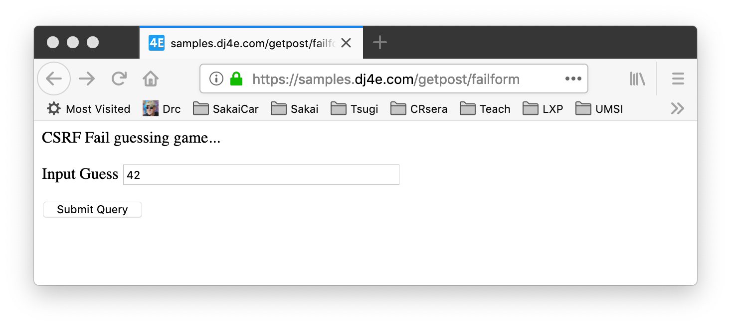
https://samples.dj4e.com/getpost/failform

Slide 22
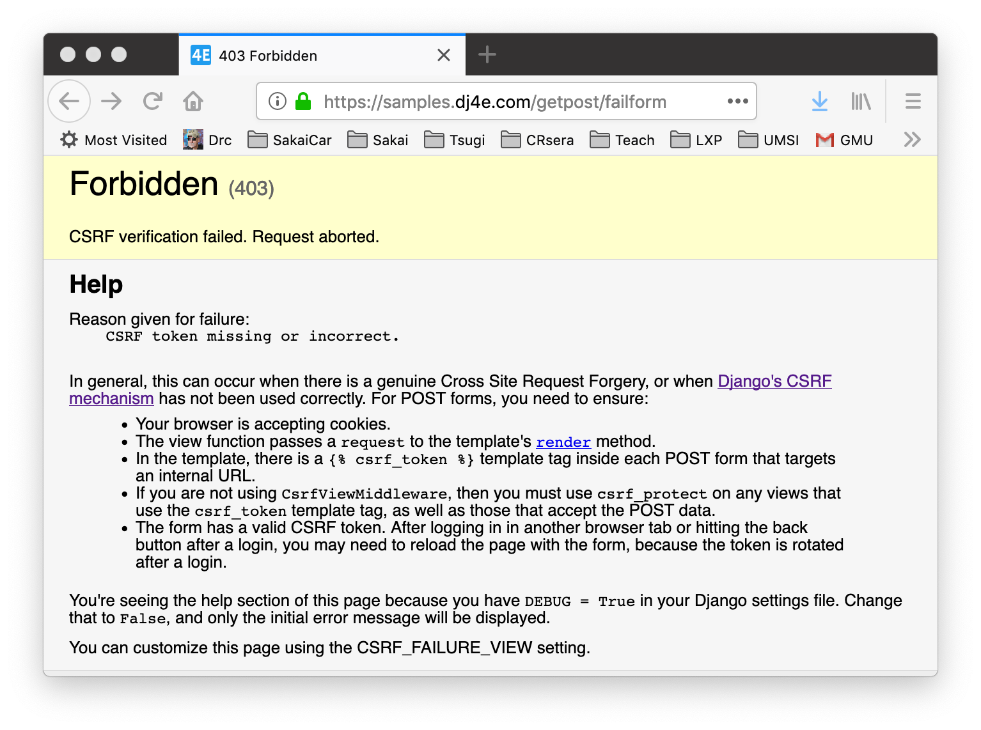

Slide 23
https://samples.dj4e.com/getpost/csrfform
from django.middleware.csrf import get_token
def csrfform(request):
response = """<p>CSRF Success guessing game...</p>
<form method="POST">
<p><label for="guess">Input Guess</label>
<input type="text" name="guess" size="40" id="guess"/></p>
<input type="hidden" name="csrfmiddlewaretoken"
value="__token__"/>
<input type="submit"/>
</form>"""
token = get_token(request)
response = response.replace('__token__', html.escape(token))
response += dumpdata('POST', request.POST)
return HttpResponse(response)

Slide 24
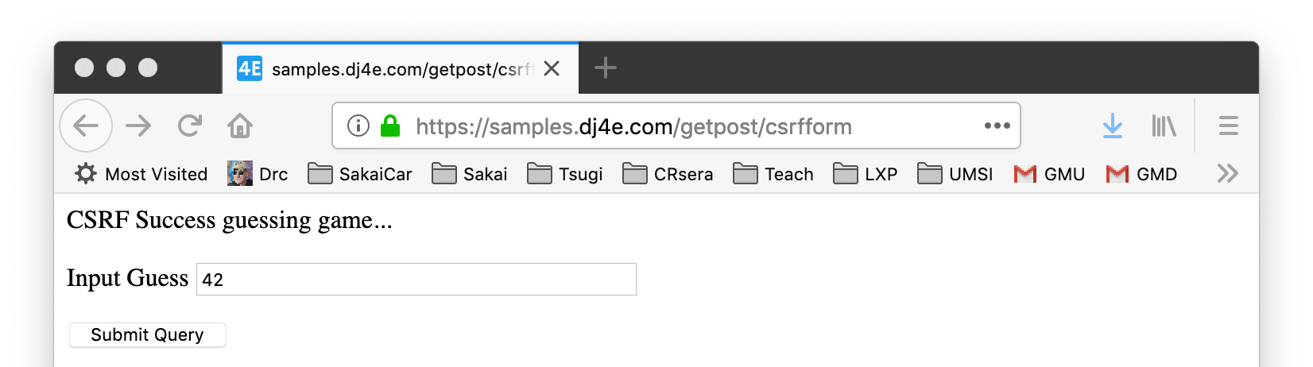
<p>CSRF Success guessing game...</p>
<form method="POST">
<p><label for="guess">Input Guess</label>
<input type="text" name="guess" size="40" id="guess"/></p>
<input type="hidden" name="csrfmiddlewaretoken"
value="fSv596BjrYhRoBkJO08jWm0h3TrTxqiIj5x32K0vXgHaHjSlX33UCJfz52b0CVa2"/>
<input type="submit"/>
</form>

Slide 25
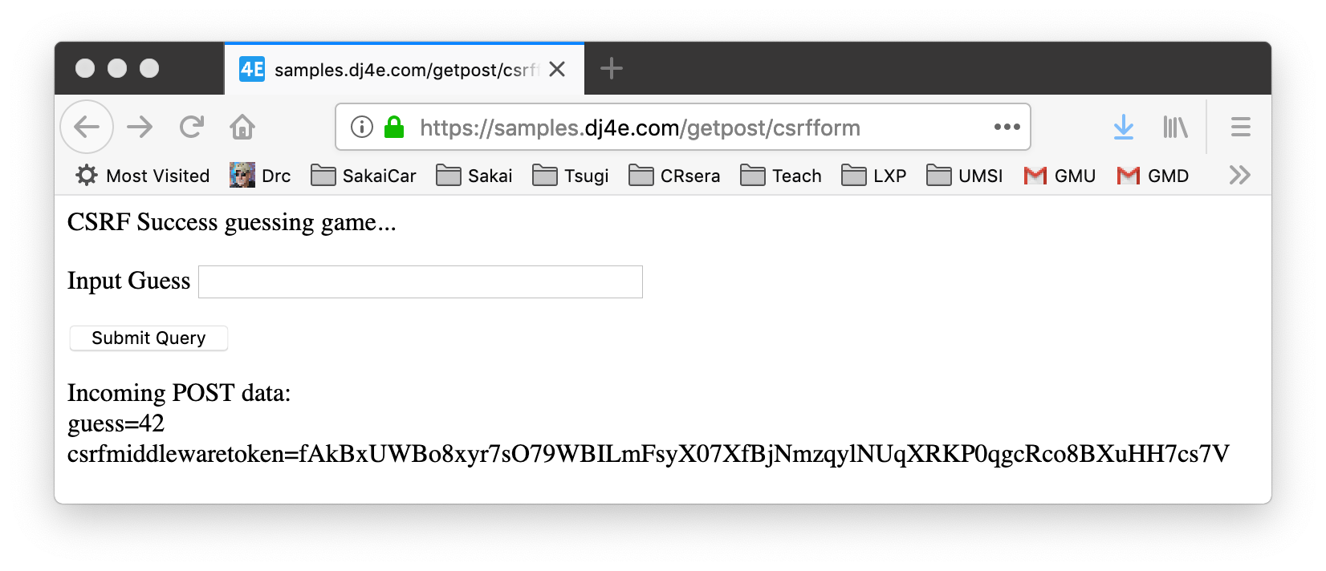

Slide 26
CSRF In Django

Slide 27
Django support for CSRF
Django has built in support to generate, use, and check CSRF Tokens
Activated by default in settings.py
MIDDLEWARE = [
'django.middleware.security.SecurityMiddleware',
'django.contrib.sessions.middleware.SessionMiddleware',
'django.middleware.common.CommonMiddleware',
'django.middleware.csrf.CsrfViewMiddleware',
'django.contrib.auth.middleware.AuthenticationMiddleware',
'django.contrib.messages.middleware.MessageMiddleware',
'django.middleware.clickjacking.XFrameOptionsMiddleware',
]

Slide 28
Django CSRF in Templates
<p>Guessing game</p>
{% if message %}
<p>{{ message }}</p>
{% endif %}
<form method="post">
<p><label for="guess">Input Guess</label>
{% csrf_token %}
<input type="text" name="guess" size="40" id="guess"/></p>
<input type="submit"/>
</form>
dj4e-samples/getpost/templates/getpost/guess.html

Slide 29
Utility Code for Guesses
dj4e-samples/getpost/views.py
# Call as checkguess('42')
def checkguess(guess) :
msg = False
if guess :
try:
if int(guess) < 42 :
msg = 'Guess too low'
elif int(guess) > 42 :
msg = 'Guess too high'
else:
msg = 'Congratulations!'
except:
msg = 'Bad format for guess:' + html.escape(guess)
return msg

Slide 30
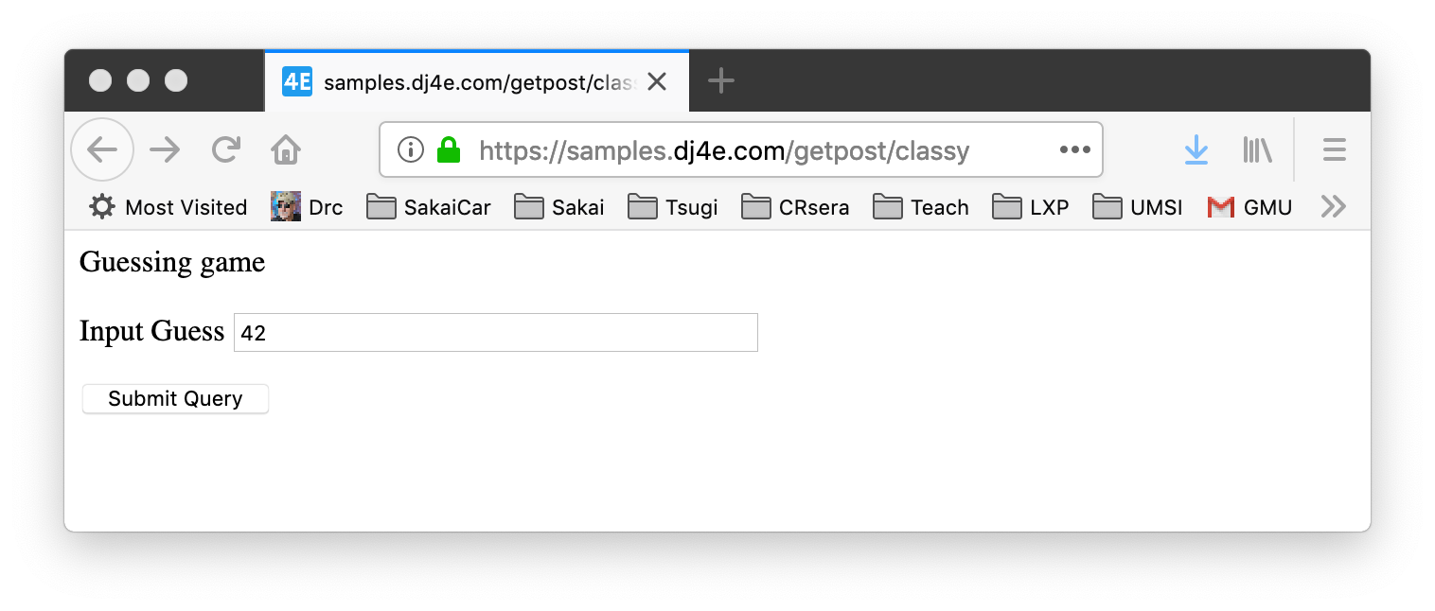
class ClassyView(View) :
def get(self, request):
return render(request, 'getpost/guess.html')
def post(self, request):
guess = request.POST.get('guess')
msg = checkguess(guess)
return render(request, 'getpost/guess.html', {'message' : msg })
dj4e-samples/getpost/views.py
https://samples.dj4e.com/getpost/classy

Slide 31
https://samples.dj4e.com/getpost/classy
<p>Guessing game</p>
<form method="post">
<p><label for="guess">Input Guess</label>
<input type="hidden" name="csrfmiddlewaretoken" value="1oV2XIi9kNx710Lcu9V4rf0TmMsAZm9w5BX0QmHlQ5XqkIjODcQF7CfboVcH4R1Q">
<input type="text" name="guess" size="40" id="guess"/></p>
<input type="submit"/>
</form>

Slide 32
class ClassyView(View) :
def get(self, request):
return render(request, 'getpost/guess.html')
def post(self, request):
guess = request.POST.get('guess')
msg = checkguess(guess)
return render(request, 'getpost/guess.html', {'message' : msg })
dj4e-samples/getpost/views.py
<p>Guessing game</p>
{% if message %}
<p>{{ message }}</p>
{% endif %}
<form method="post">
<p><label for="guess">Input Guess</label>
{% csrf_token %}
<input type="text" name="guess" size="40" id="guess"/></p>
<input type="submit"/>
</form>
dj4e-samples/getpost/templates/getpost/guess.html

Slide 33
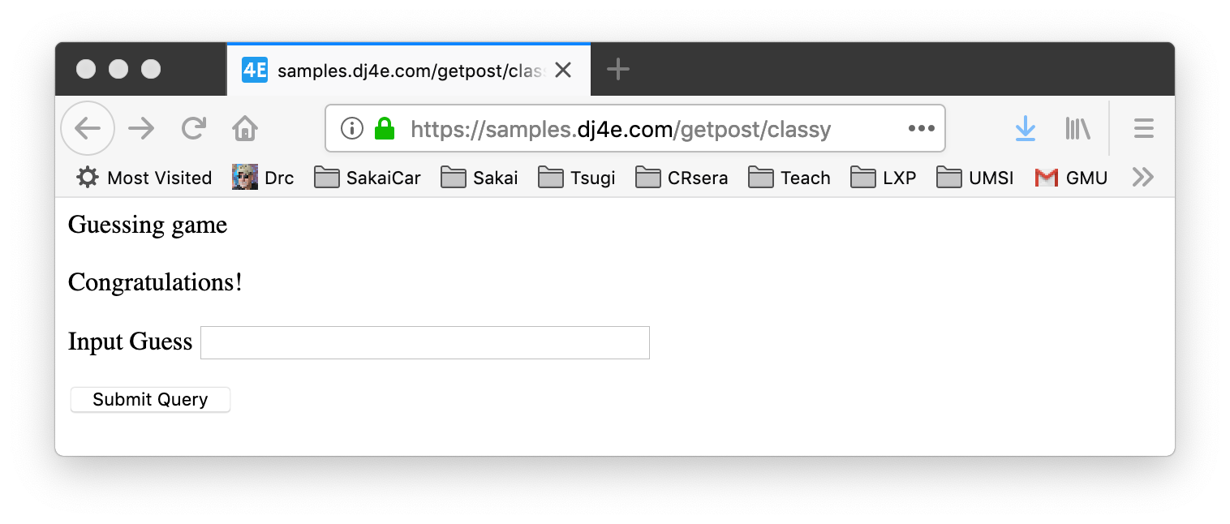
https://samples.dj4e.com/getpost/classy
Success!!!!!

Slide 34
POST-Refresh … Oops!

Slide 35
Remember this?
https://samples.dj4e.com/getpost/classy
Success!!!!!

Slide 36
POST / Refresh / ☹
Once you do a POST and receive 200 status + a page of HTML, if you tell the browser to refresh, the browser will re-send the POST data a second time.
The user gets a browser pop-up that tries to explain what is about to happen.

Slide 37
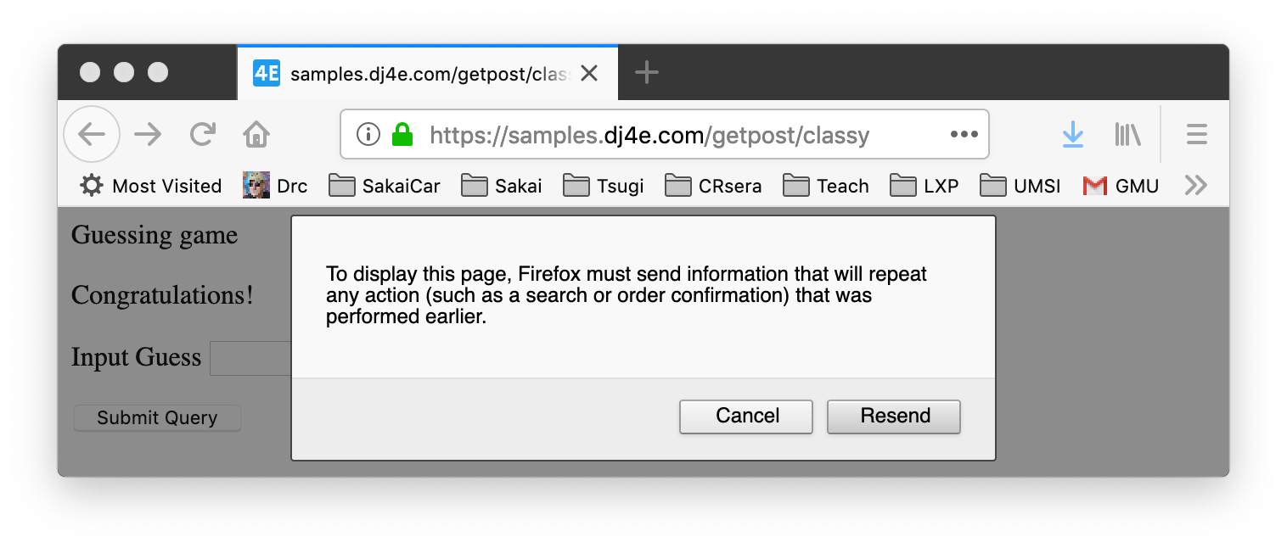
Make a POST
https://samples.dj4e.com/getpost/classy
See Success
Press Refresh
Yucky Message ☹

Slide 38
Don't Allow Double Posts
Typically POST requests are adding or modifying data whilst GET requests view data
It may be dangerous to do the same POST twice (say withdrawing funds from a bank account)
So the browser insists on asking the user (out of your control)
Kind of an ugly UX / bad usability
As developers we work so this never can happen

Slide 39
POST-REDIRECT-GET-Refresh

Slide 40
POST Redirect Rule
The simple rule for pages intended for a browser is to never generate a page with HTML content when the app receives POST data and data has been modified
Must cause a GET by redirecting somewhere - even a GET to the same URL- forcing the browser to make a GET after the POST

Slide 41
Review: HTTP Status Codes
http://www.dr-chuck.com/page1.htm - 200 OK
http://www.wa4e.com/nowhere.htm - 404 Not Found
http://www.drchuck.com/ - 302 Found / Moved
Also known as “redirect”
https://en.wikipedia.org/wiki/List_of_HTTP_status_codes

Slide 42
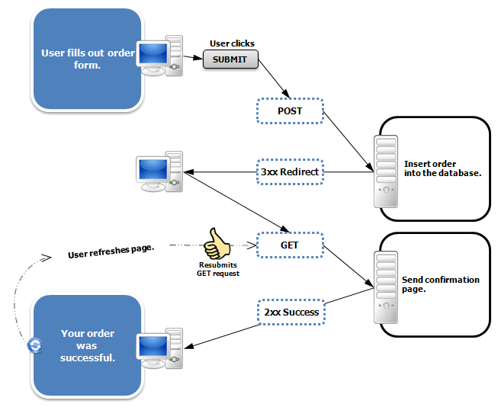
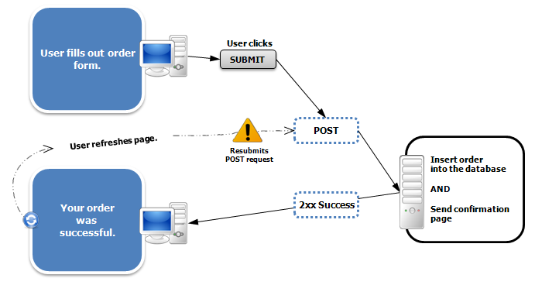
https://en.wikipedia.org/wiki/Post/Redirect/Get

Slide 43
class AwesomeView(View) :
def get(self, request):
msg = request.session.get('msg', False)
if ( msg ) : del(request.session['msg'])
return render(request, 'getpost/guess.html', {'message' : msg })
def post(self, request):
guess = request.POST.get('guess')
msg = checkguess(guess)
request.session['msg'] = msg
return redirect(request.path)
dj4e-samples/getpost/views.py
<p>Guessing game</p>
{% if message %}
<p>{{ message }}</p>
{% endif %}
<form method="post">
<p><label for="guess">Input Guess</label>
{% csrf_token %}
<input type="text" name="guess" size="40" id="guess"/></p>
<input type="submit"/>
</form>
dj4e-samples/getpost/templates/getpost/guess.html

Slide 44
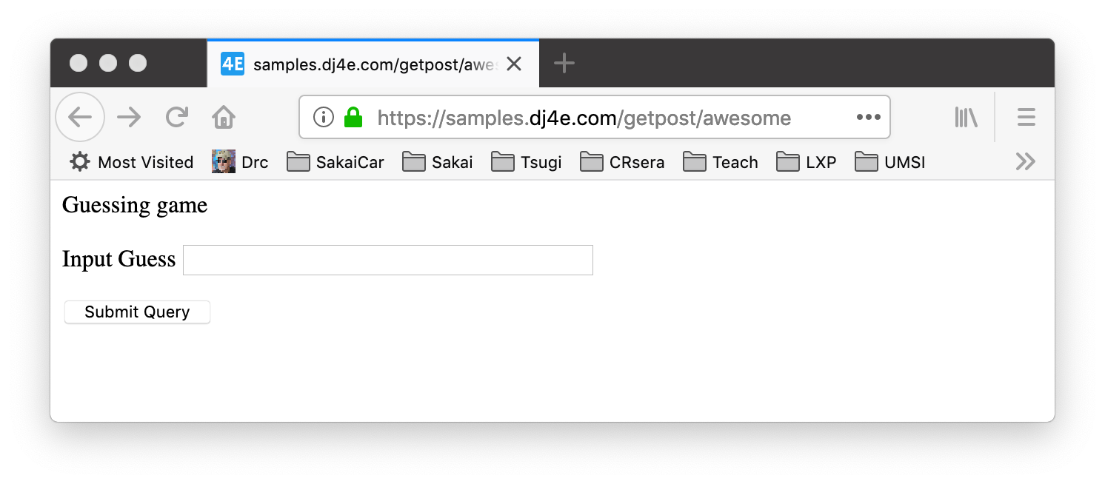
https://samples.dj4e.com/getpost/awesome
Enter guess and press Submit

Slide 45
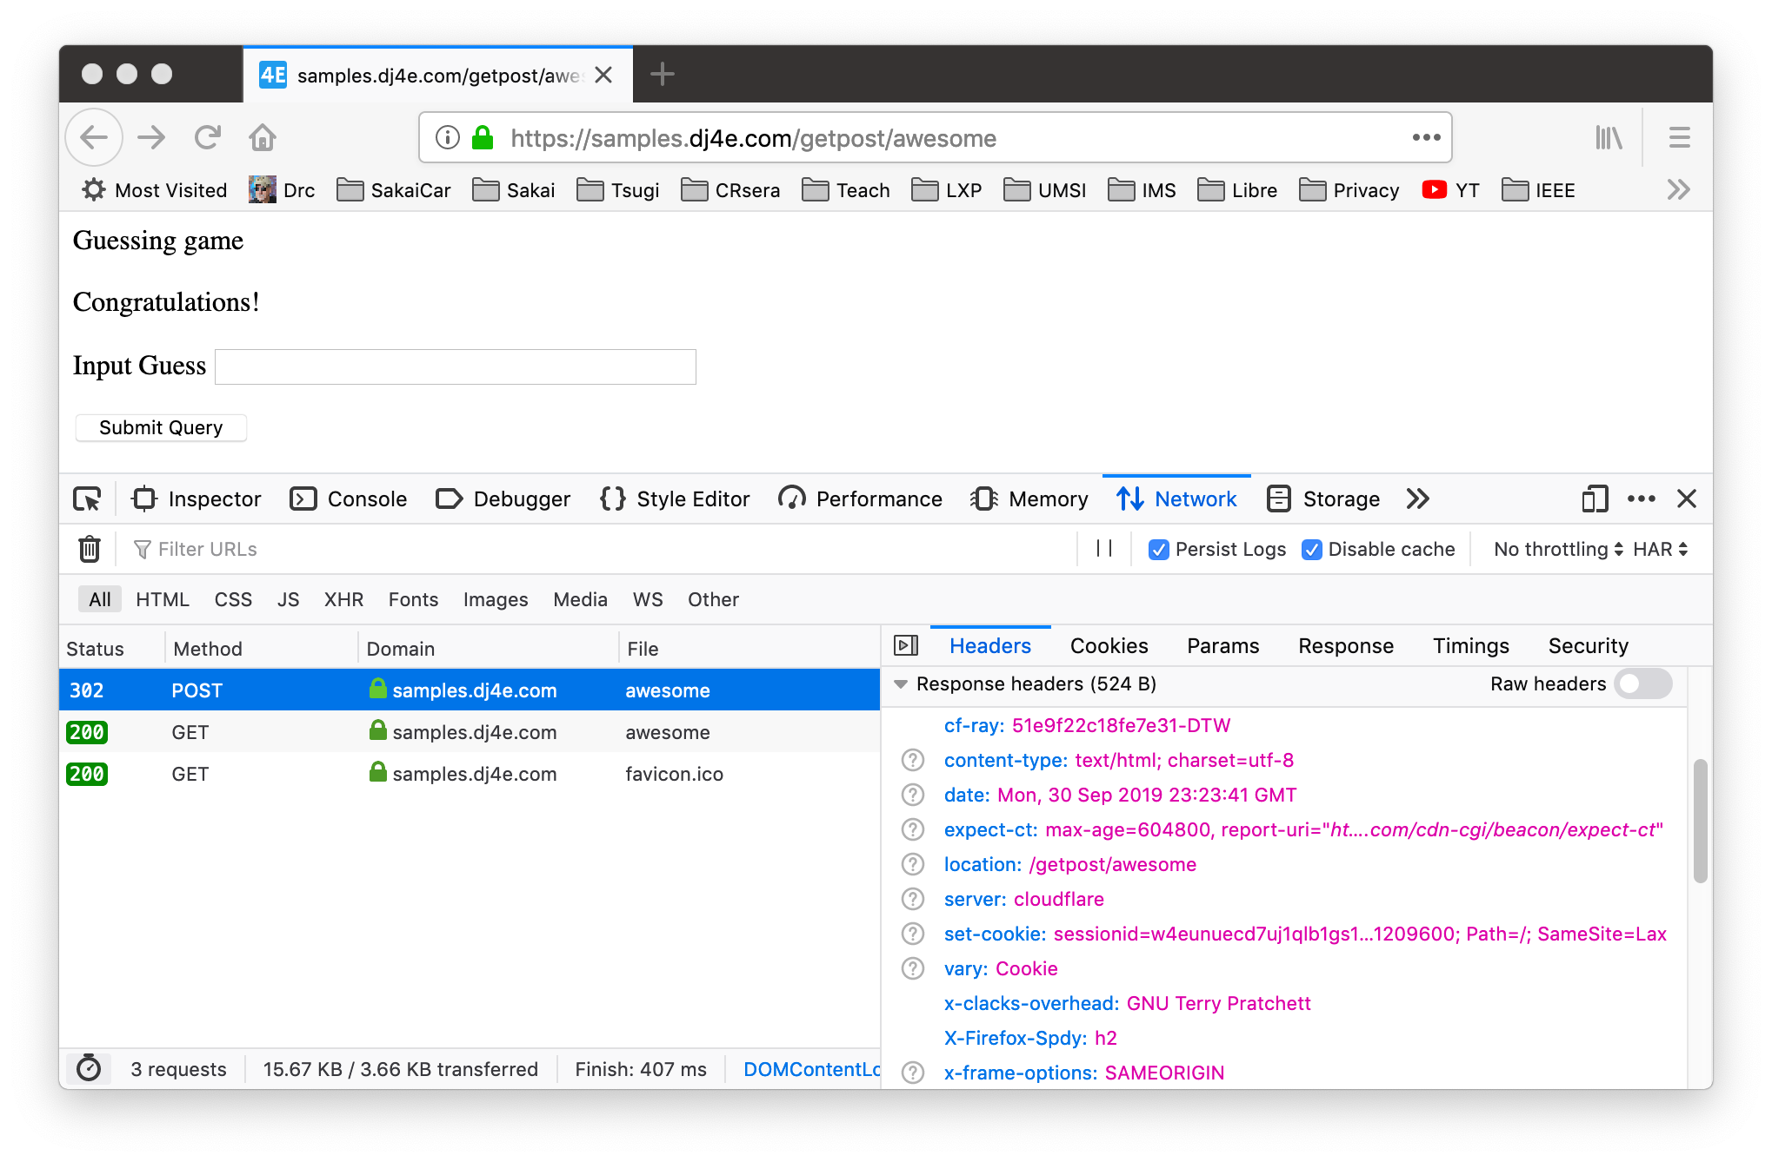
POST Response

Slide 46
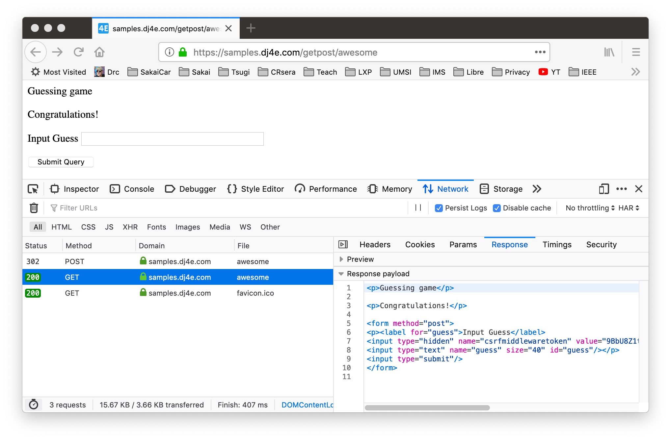
GET after Redirect

Slide 47
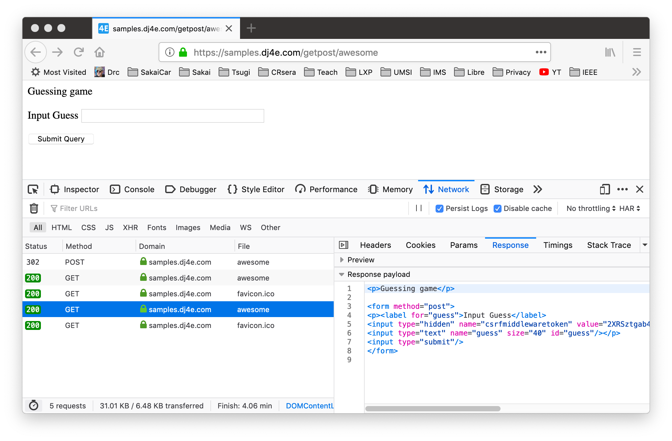
Refreshed GET

Slide 48
The response to a POST must be a redirect
Pass data to the GET – "flash message pattern"
Session can be used for flash messages
class AwesomeView(View) :
def get(self, request):
msg = request.session.get('msg', False)
if ( msg ) : del(request.session['msg'])
return render(request, 'getpost/guess.html', {'message' : msg })
def post(self, request):
guess = request.POST.get('guess')
msg = checkguess(guess)
request.session['msg'] = msg
return redirect(request.path)
dj4e-samples/getpost/views.py

Slide 49
Django support for forms
https://samples.dj4e.com/form/
https://docs.djangoproject.com/en/2.2/topics/forms/
https://github.com/csev/dj4e-samples/tree/master/form

Slide 50
Django's role in forms (DRY)
Handling forms is a complex business. Consider Django’s admin, where numerous items of data of several different types may need to be prepared for display in a form, rendered as HTML, edited using a convenient interface, returned to the server, validated and cleaned up, and then saved or passed on for further processing. Django’s form functionality can simplify and automate vast portions of this work, and can also do it more securely than most programmers would be able to do in code they wrote themselves.
Django handles three distinct parts of the work involved in forms:
preparing and restructuring data to make it ready for rendering
creating HTML forms for the data
receiving and processing submitted forms and data from the client
It is possible to write code that does all of this manually, but Django can take care of it all for you.
https://docs.djangoproject.com/en/2.2/topics/forms/#django-s-role-in-forms

Slide 51
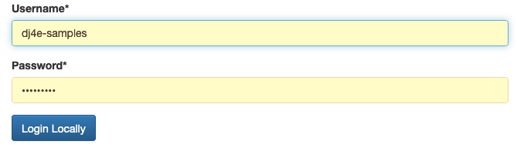
Do you want to build this from from scratch?
https://samples.dj4e.com/accounts/login/

Slide 52
Browser
Linux
D
O
M
N
G
I
N X
WGSIConfig
settings.py
Django
Routing
Click
urls.py
views.py
Parse
Response
Views
Templates
forms.py
Javascript
Database
Shell
Models
models.py
/admin
admin.py

Slide 53
Data Validation in FORMS

Slide 54
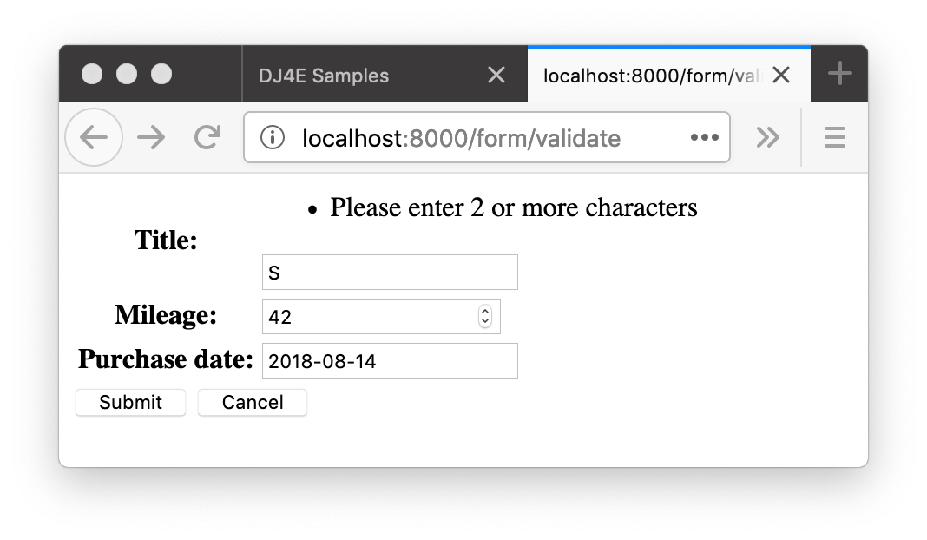
Form Data Errors
https://samples.dj4e.com/form/validate
Sometimes there are validation rules when you are filling out a form.
When you submit the form, the view code checks the data to see if there are errors
If there are errors, data is not saved and the user is notified and often given a chance to edit and resubmit the

Slide 55
Django form validation
https://samples.dj4e.com/form/validate
class BasicForm(forms.Form):
title = forms.CharField(validators=[
validators.MinLengthValidator(2, "Please enter 2 or more characters")
])
mileage = forms.IntegerField()
purchase_date = forms.DateField()
https://docs.djangoproject.com/en/2.1/ref/validators/

Slide 56
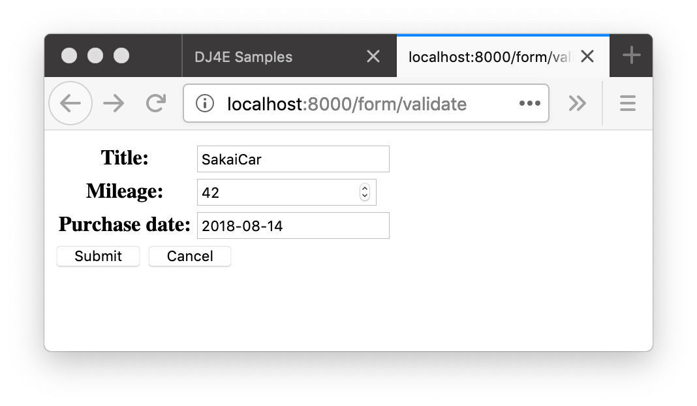
GET
class Validate(View):
def get(self, request) :
old_data = {
'title': 'SakaiCar',
'mileage' : 42,
'purchase_date': '2018-08-14'
}
form = BasicForm(initial=old_data)
ctx = {'form' : form}
return render(request, 'form/form.html', ctx)
def post(self, request) :
form = BasicForm(request.POST)
if not form.is_valid() :
ctx = {'form' : form}
return render(request, 'form/form.html', ctx)
# Save the Data
return redirect('/form/success')
def success(request) :
return HttpResponse('Thank you!')
200
dj4e-samples/form/views.py

Slide 57
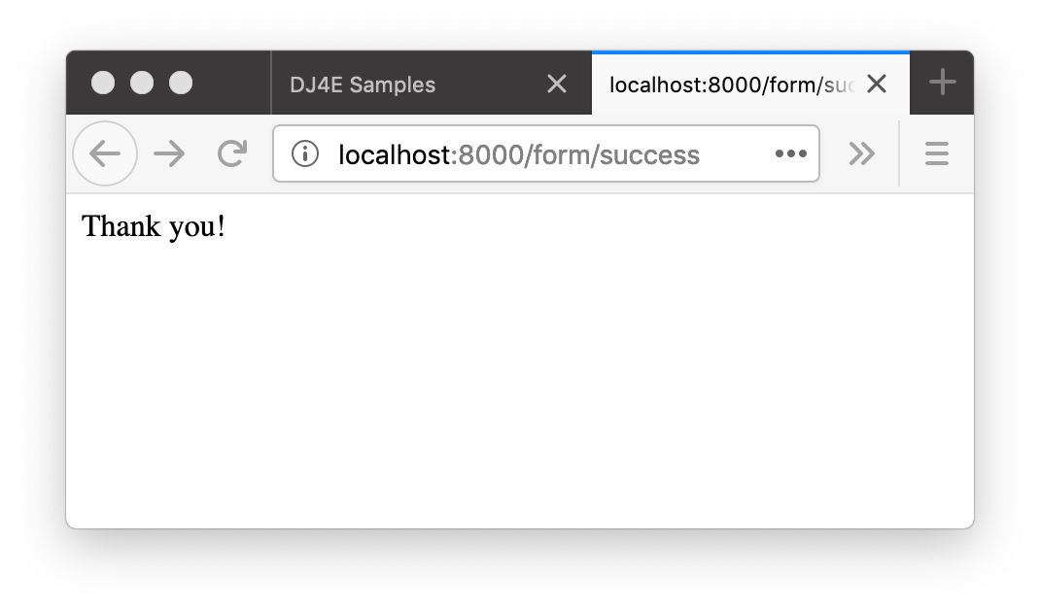
dj4e-samples/form/views.py
class Validate(DumpPostView):
def get(self, request) :
old_data = {
'title': 'SakaiCar',
'mileage' : 42,
'purchase_date': '2018-08-14'
}
form = BasicForm(initial=old_data)
ctx = {'form' : form}
return render(request, 'form/form.html', ctx)
def post(self, request) :
form = BasicForm(request.POST)
if not form.is_valid() :
ctx = {'form' : form}
return render(request, 'form/form.html', ctx)
# Save the Data return redirect('/form/success')
def success(request) :
return HttpResponse('Thank you!')
POST
302
200
GET

Slide 58
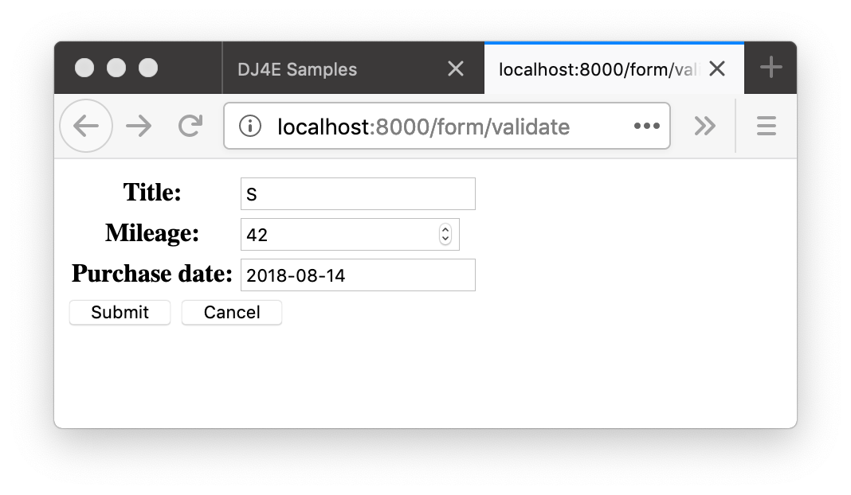
class Validate(DumpPostView):
def get(self, request) :
old_data = {
'title': 'SakaiCar',
'mileage' : 42,
'purchase_date': '2018-08-14'
}
form = BasicForm(initial=old_data)
ctx = {'form' : form}
return render(request, 'form/form.html', ctx)
def post(self, request) :
form = BasicForm(request.POST)
if not form.is_valid() :
ctx = {'form' : form}
return render(request, 'form/form.html', ctx)
# Save the Data
return redirect('/form/success')
def success(request) :
return HttpResponse('Thank you!')
POST
200

Slide 59
Summary
HTML for Forms
GET versus POST
POST Redirect GET
CSRF
Form Validation

Slide 60
Acknowledgements / Contributions
These slides are Copyright 2019- Charles R. Severance (www.dr-chuck.com) as part of www.dj4e.com and made available under a Creative Commons Attribution 4.0 License. Please maintain this last slide in all copies of the document to comply with the attribution requirements of the license. If you make a change, feel free to add your name and organization to the list of contributors on this page as you republish the materials.
Initial Development: Charles Severance, University of Michigan School of Information
Insert new Contributors and Translators here including names and dates
Continue new Contributors and Translators here

Slide 61
Additional Source Information
Portions of the text of these slides is adapted from the text www.djangoproject.org web site. Those slides which use text from that site have a reference to the original text on that site. Django is licensed under the three-clause BSD license.

