Slide 1

Generic Views
Charles Severance
www.dj4e.com

Slide 2
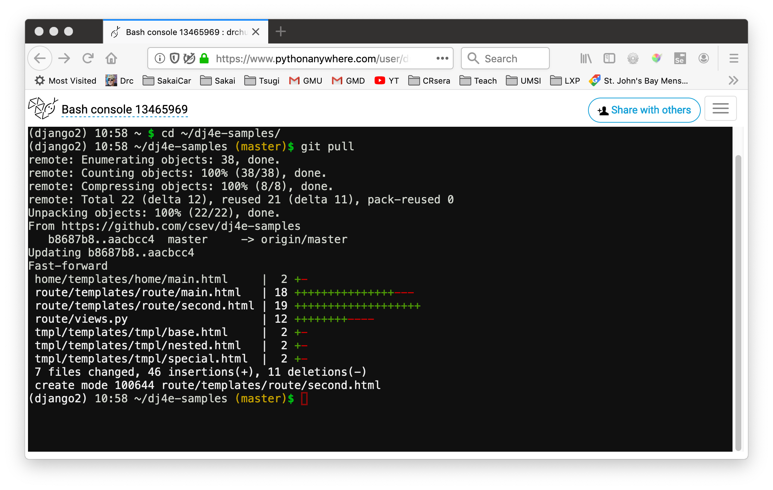
Update your dj4e-samples
cd ~/dj4e-samples
git pull

Slide 3
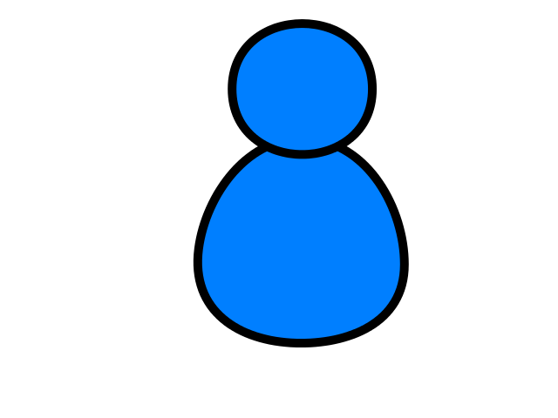
Browser
Linux
D
O
M
N
G
I
N X
WGSIConfig
settings.py
Django
Routing
Click
urls.py
views.py
Parse
Response
Views
Templates
forms.py
Javascript
Database
Shell
Models
models.py
/admin
admin.py

Slide 4
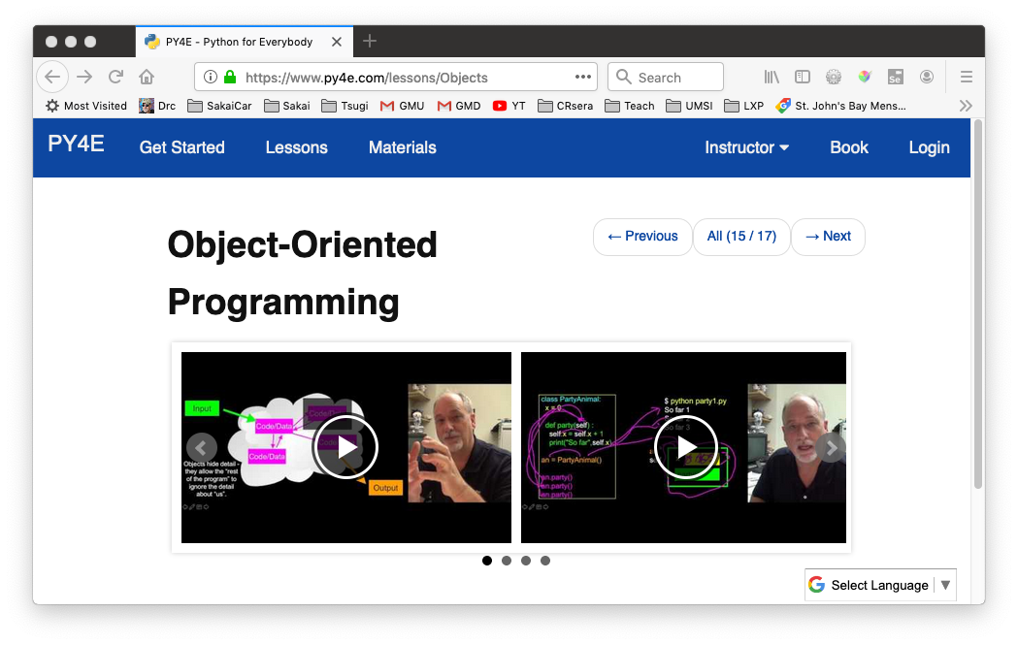
Review Python Object-Oriented Programming
https://www.py4e.com/lessons/Objects

Slide 5
Looking back: SQL
Structured Query Language is the language we use to issue commands to the database
- Create data (a.k.a Insert)
- Retrieve data
- Update data
- Delete data
http://en.wikipedia.org/wiki/SQL

Slide 6
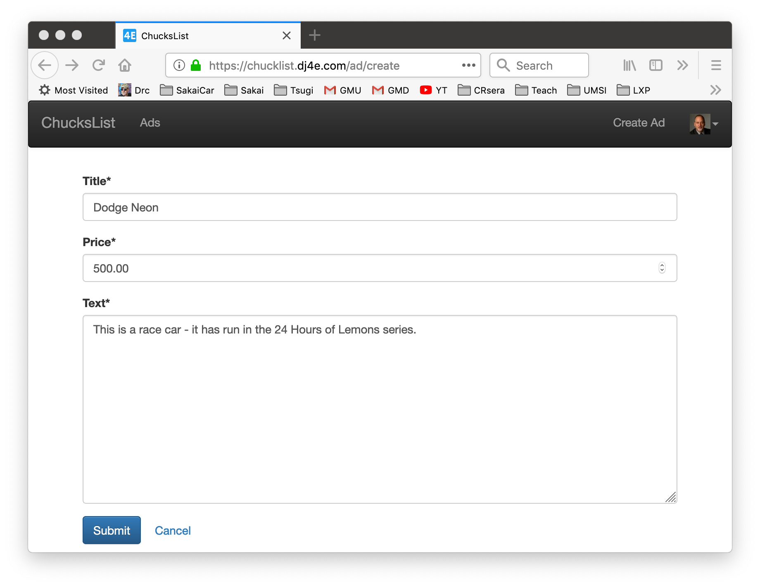
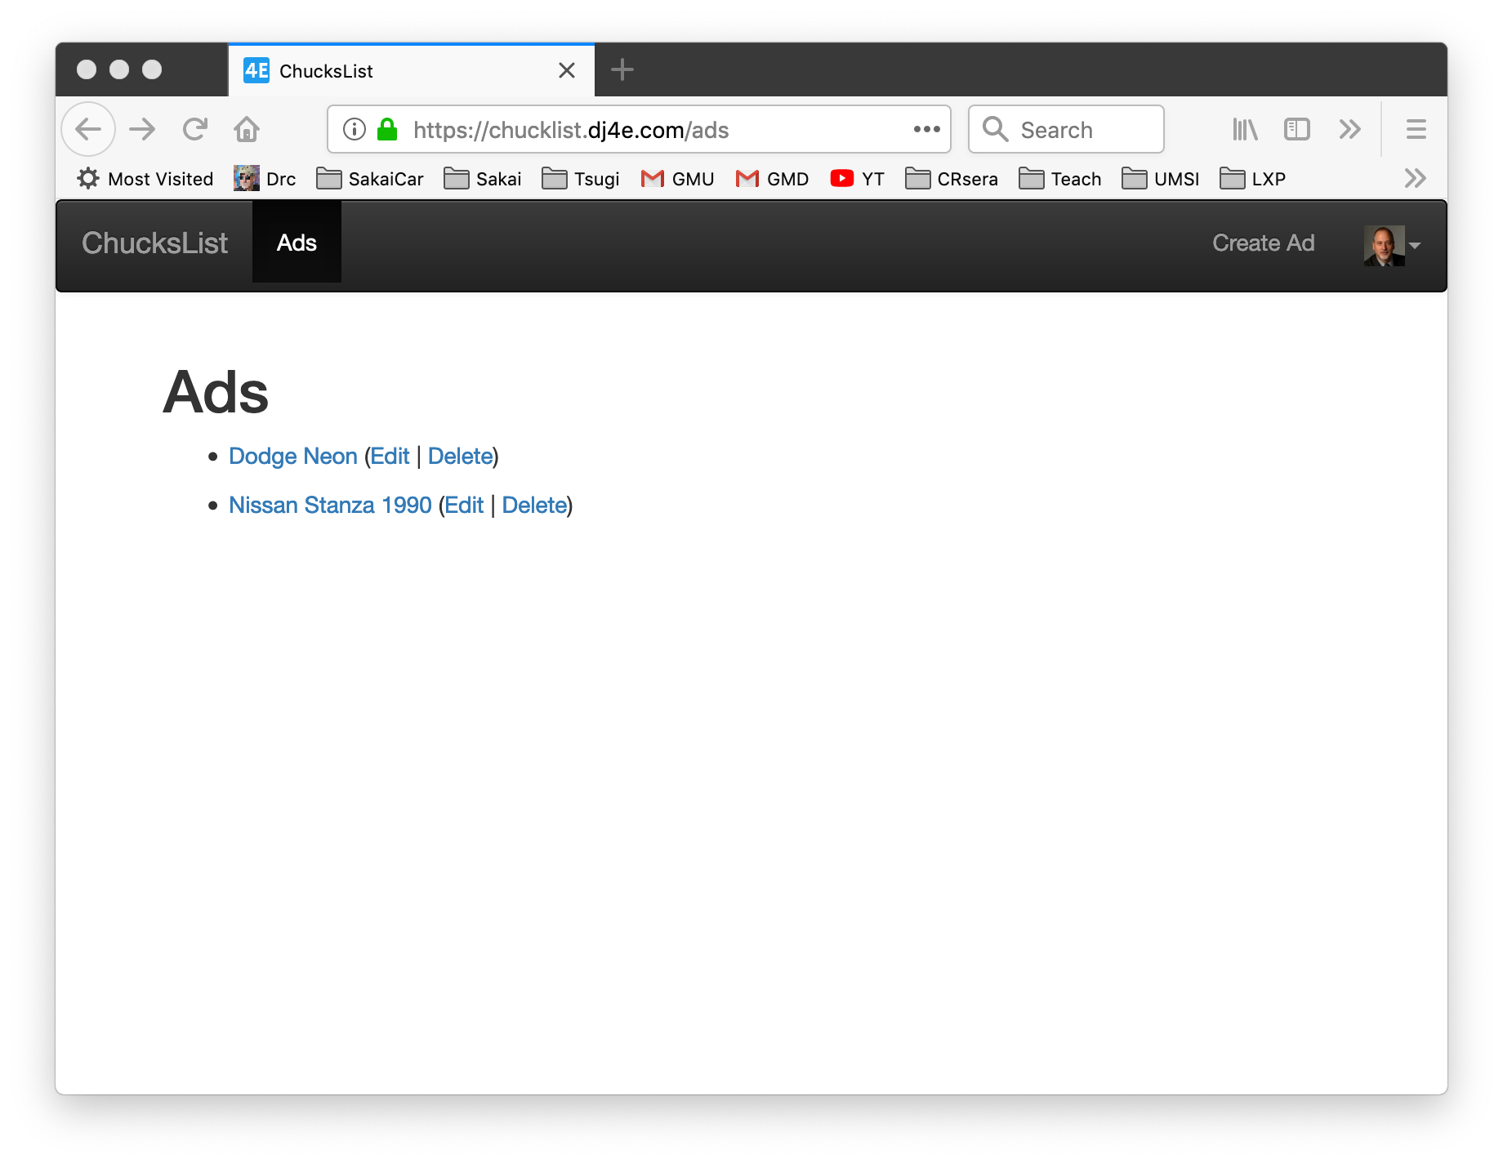
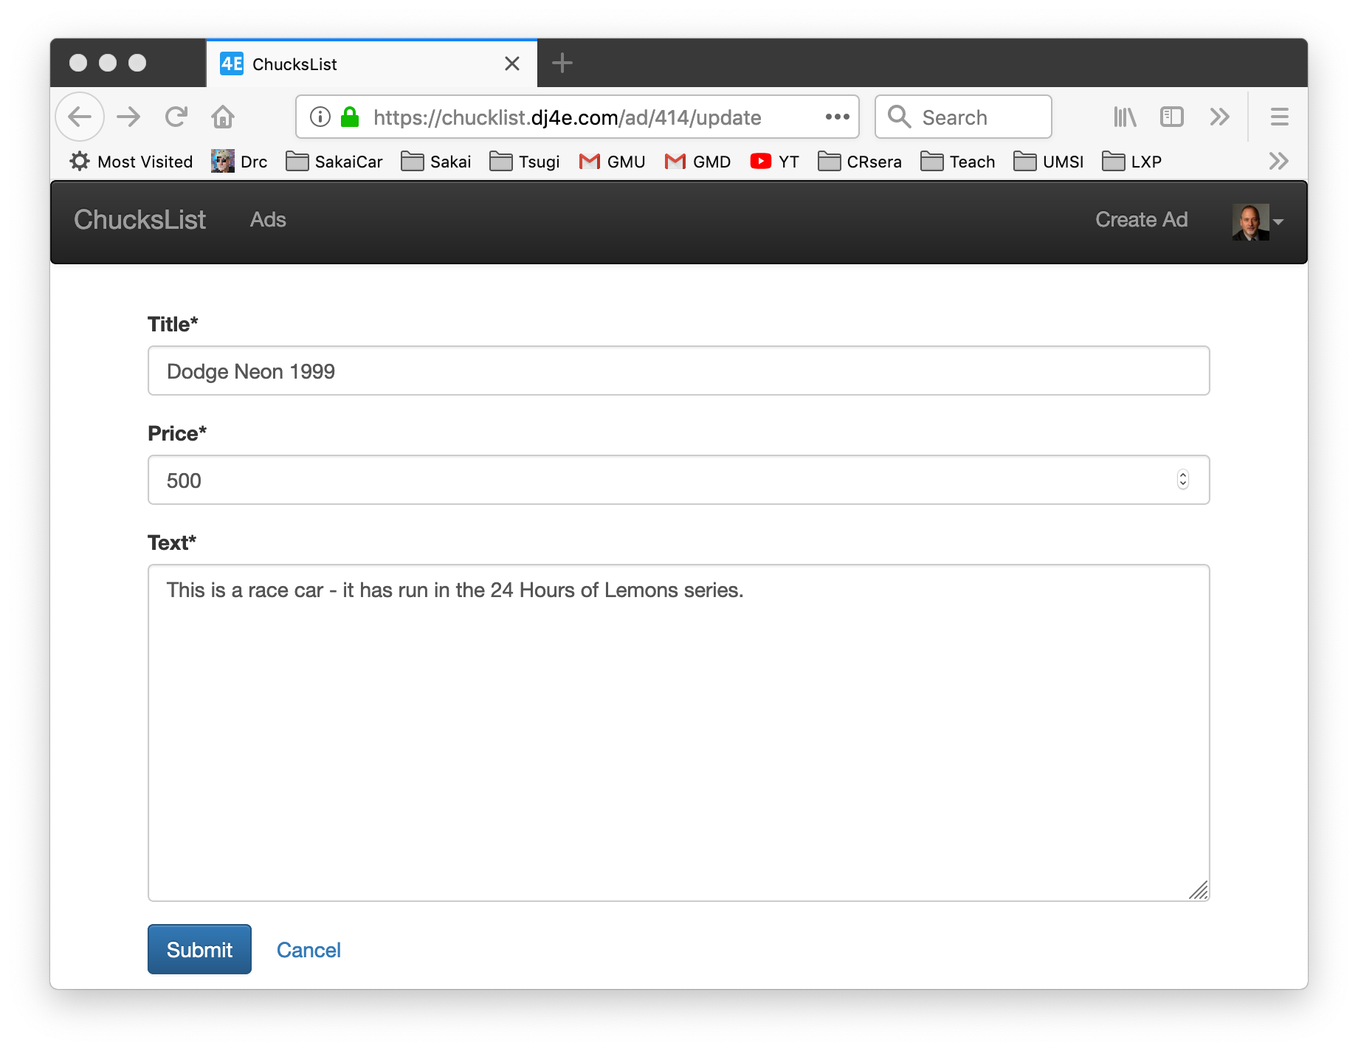
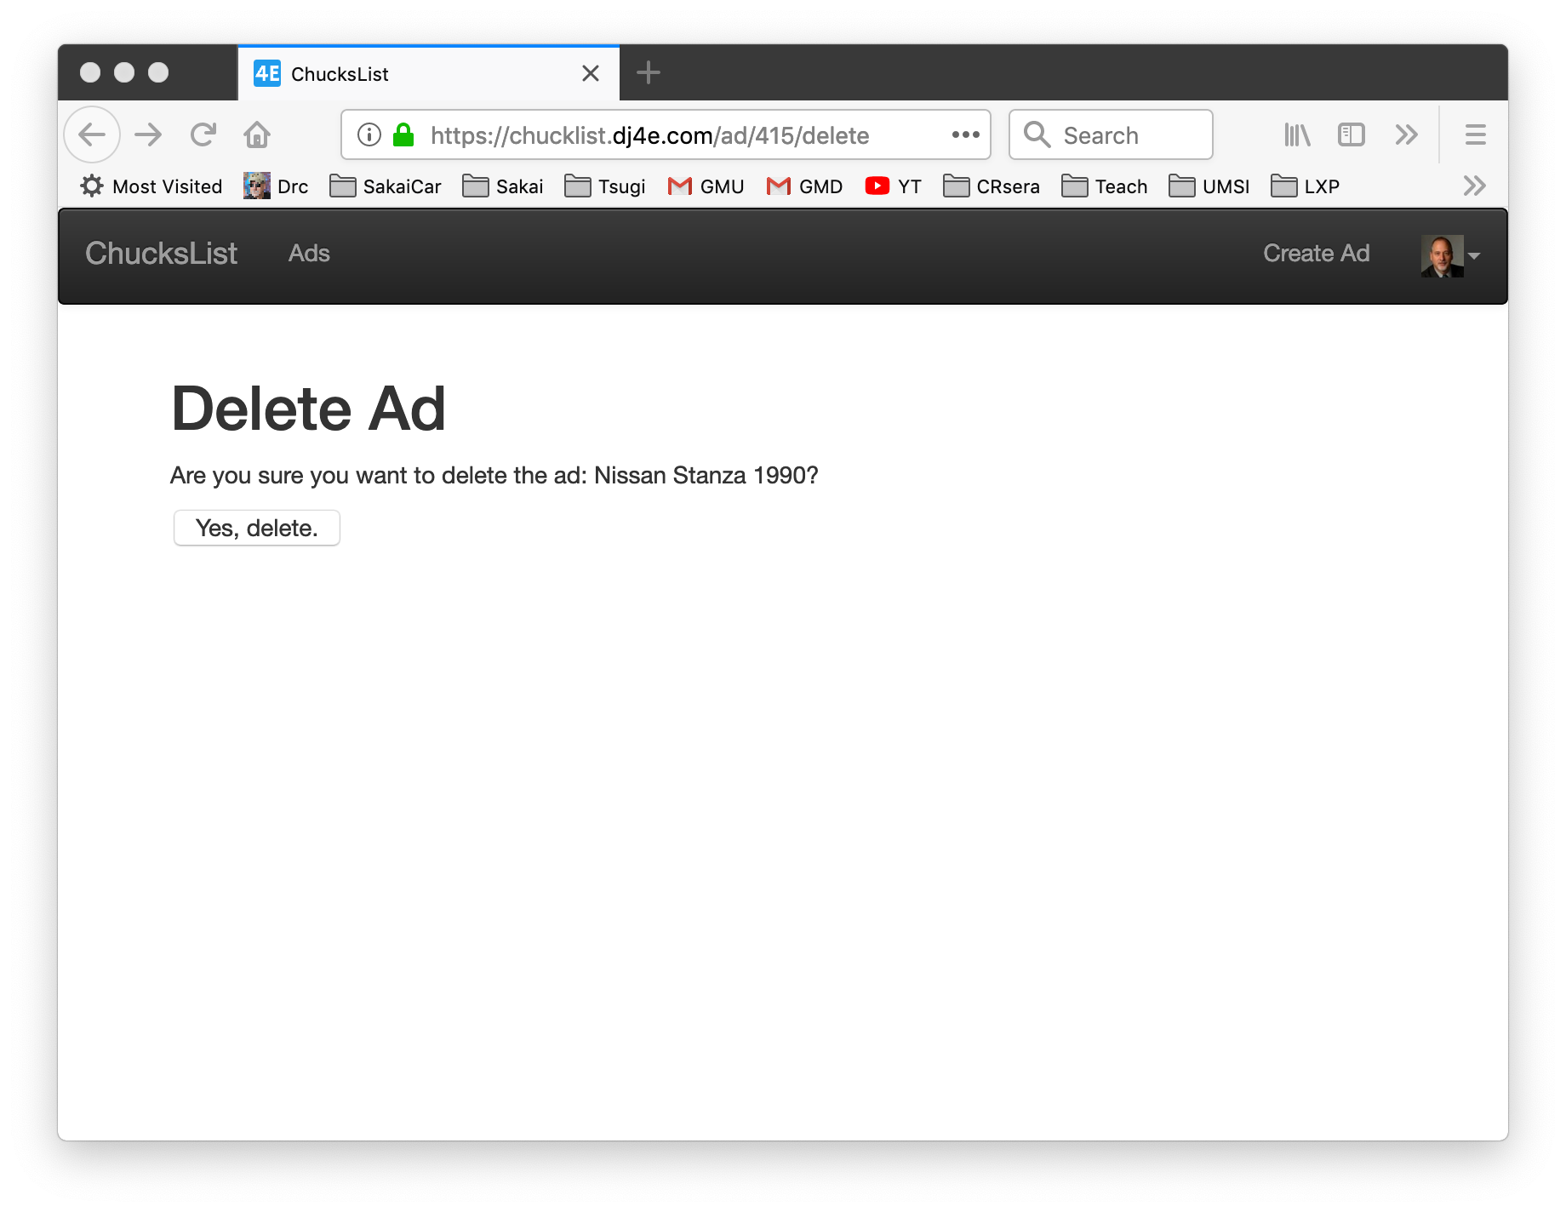
Peeking Ahead: CRUD UI

Slide 7
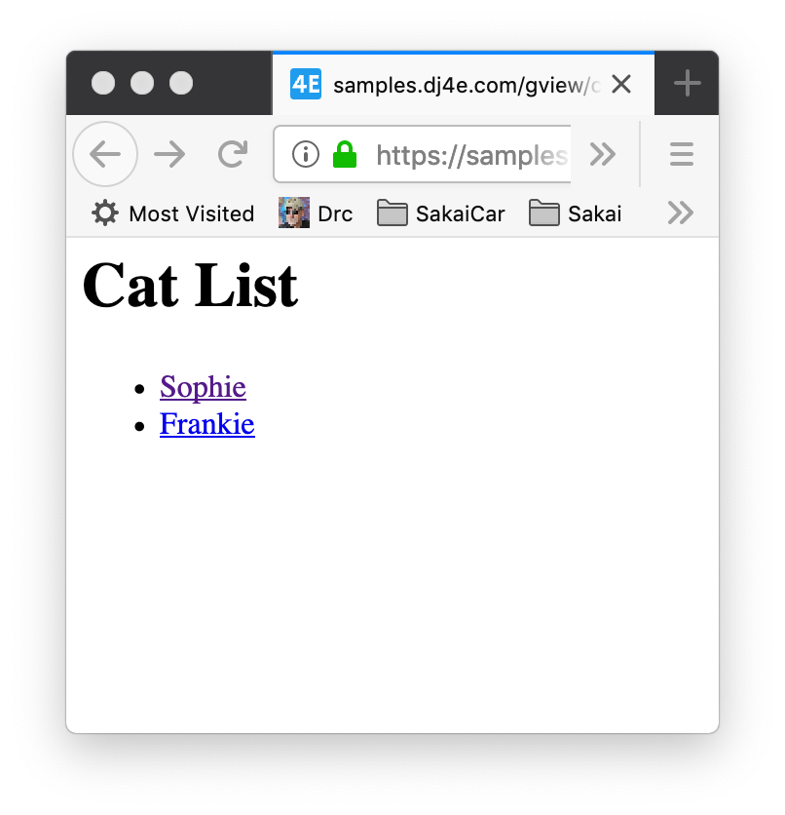
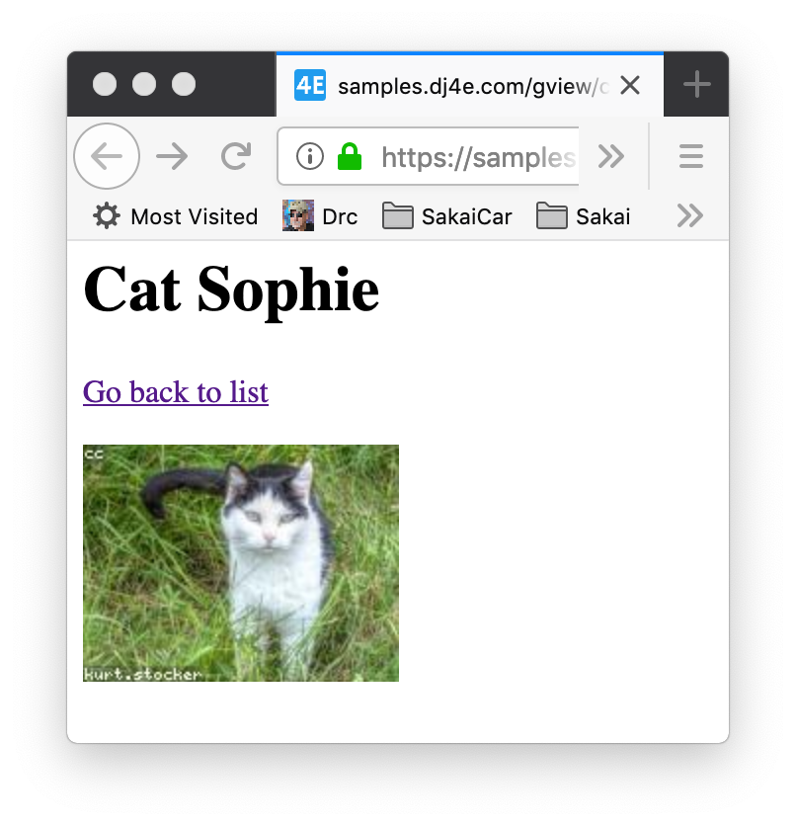
https://samples.dj4e.com/gview/cats
https://samples.dj4e.com/gview/cat/1

Slide 8
Generic Views – List / Detail

Slide 9
dj4e-samples/gview/urls.py
from django.urls import path
from . import views
from django.views.generic import TemplateView
app_name = 'gview'
# Note use of plural for list view and singular for detail view
urlpatterns = [
path('', TemplateView.as_view(template_name='gview/main.html')),
path('cats', views.CatListView.as_view(), name='cats'),
path('cat/<int:pk_from_url>', views.CatDetailView.as_view(), name='cat'),
path('dogs', views.DogListView.as_view(), name='dogs'),
path('dog/<int:pk>', views.DogDetailView.as_view(), name='dog'),
path('horses', views.HorseListView.as_view(), name='horses'),
path('horse/<int:pk>', views.HorseDetailView.as_view(), name='horse'),
path('cars', views.CarListView.as_view(), name='cars'),
path('car/<int:pk>', views.CarDetailView.as_view(), name='car'),
]

Slide 10
dj4e-samples/gview/templates/gview/cat_list.html
https://samples.dj4e.com/gview/cats
<h1>Cat List</h1>
<p>
{% if cat_list %}
<ul>
{% for cat in cat_list %}
<li>
<a href="{% url 'gview:cat' cat.id %}">{{ cat.name }}</a>
</li>
{% endfor %}
</ul>
{% else %}
<p>There are no cats in the database.</p>
{% endif %}
</p>

Slide 11
dj4e-samples/gview/templates/gview/cat_detail.html
https://samples.dj4e.com/gview/cat/1
<h1>Cat {{ cat.name }}</h1>
<p>
<a href="{% url 'gview:cats' %}">Go back to list</a>
</p>
<p>
<img src="https://loremflickr.com/160/120/cat"
alt="A random picture of a cat">
</p>

Slide 12
Concept: Don't Repeat Yourself (DRY)
Don't repeat yourself (DRY, or sometimes do not repeat yourself) is a principle of software development aimed at reducing repetition of software patterns] replacing it with abstractions or using data normalization to avoid redundancy. The principle has been formulated by Andy Hunt and Dave Thomas in their book The Pragmatic Programmer.
When the DRY principle is applied successfully, a modification of any single element of a system does not require a change in other logically unrelated elements. Additionally, elements that are logically related all change predictably and uniformly, and are thus kept in sync.
https://en.wikipedia.org/wiki/Don%27t_repeat_yourself

Slide 13
Built-in class-based generic views
Writing Web applications can be monotonous, because we repeat certain patterns again and again. Django’s generic views were developed to ease that pain. They take certain common idioms and patterns found in view development and abstract them so that you can quickly write common views of data without having to write too much repetitive code.
We can recognize certain common tasks, like displaying a list of model objects, and write code that displays a list of any model object. Django ships with generic views to display list and detail pages for a single model object.
https://docs.djangoproject.com/en/2.2/topics/class-based-views/generic-display/

Slide 14
dj4e-samples/gview/views.py
https://samples.dj4e.com/gview/cats
class CatListView(View):
def get(self, request) :
stuff = Cat.objects.all()
cntx = { 'cat_list': stuff }
return render(request, 'gview/cat_list.html', cntx)
class DogListView(View):
model = Dog
def get(self, request) :
modelname = self.model._meta.verbose_name.title().lower()
stuff = self.model.objects.all()
cntx = { modelname+'_list': stuff }
return render(request, 'gview/'+modelname+'_list.html', cntx)
from django.views import generic
class HorseListView(generic.ListView):
model = Horse
https://docs.djangoproject.com/en/2.2/topics/class-based-views/generic-display/

Slide 15
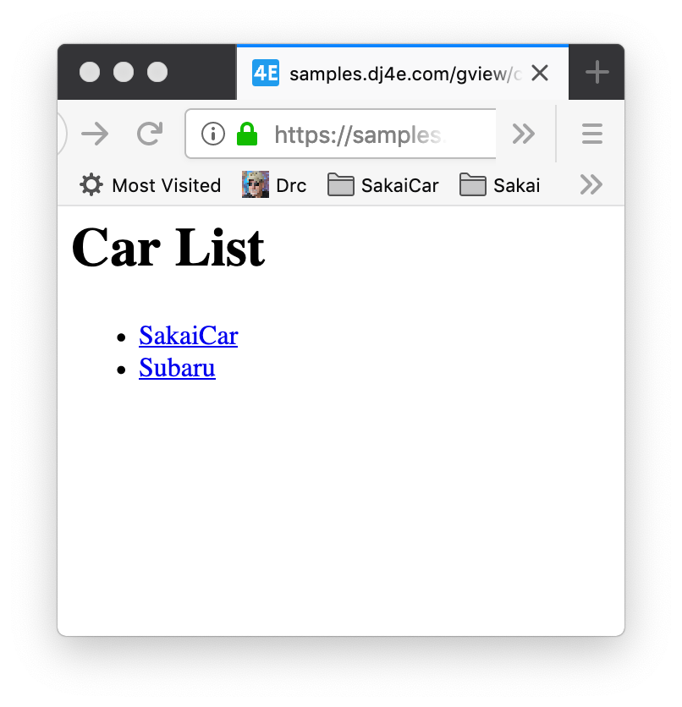
dj4e-samples/gview/views.py
https://samples.dj4e.com/gview/cars
# Lets review how inheritance works to avoid repeating ourselves
# It is all about convention
class DJ4EListView(View):
def get(self, request) :
modelname = self.model._meta.verbose_name.title().lower()
stuff = self.model.objects.all()
cntx = { modelname+'_list': stuff }
return render(request, 'gview/'+modelname+'_list.html', cntx)
# Lets reuse those "generic" classes
class CarListView(DJ4EListView):
model = Car
https://docs.djangoproject.com/en/2.2/topics/class-based-views/generic-display/

Slide 16
dj4e-samples/gview/views.py
gview.views.HorseListView
model = gviews.models.Horse
from django.views import generic
from gview.models import Cat, Dog, Horse, Car
class HorseListView(generic.ListView):
model = Horse
django.views.generic.ListView
https://docs.djangoproject.com/en/2.2/topics/class-based-views/generic-display/

Slide 17
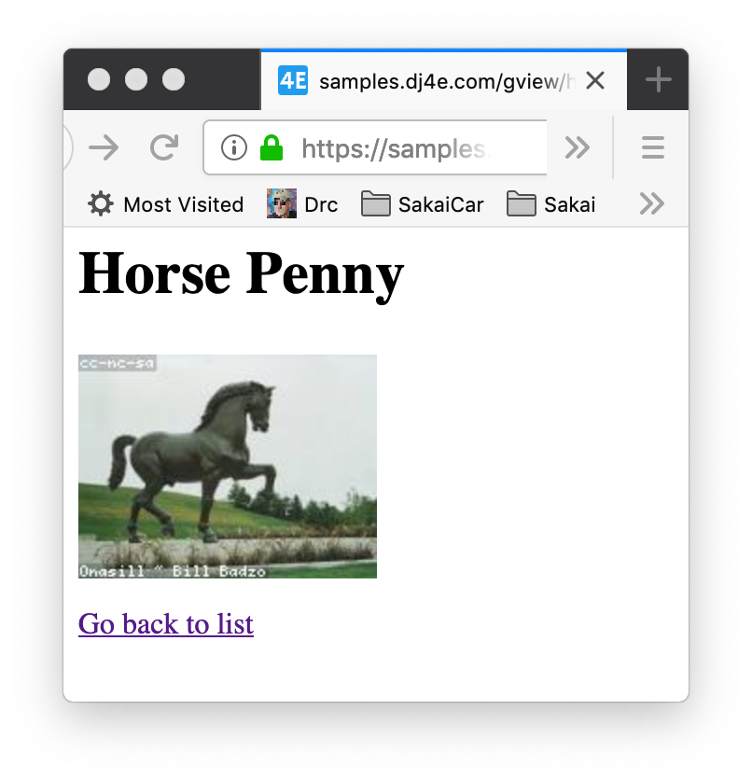
dj4e-samples/gview/views.py
https://samples.dj4e.com/gview/horse/1
from django.views import generic
from gview.models import Cat, Dog, Horse, Car
class HorseListView(generic.ListView):
model = Horse
dj4e-samples/gview/templates/gview/horse_detail.html
<h1>Horse {{ horse.name }}</h1>
<p>
<img src="https://loremflickr.com/160/120/horse"
alt="A random picture of a horse">
</p>
<p>
<a href="{% url 'gview:horses' %}">Go back to list</a>
</p>
Lots of convention – no repetition

Slide 18
Summary
Generic views allow us to produce lots of similar pages without cutting, pasting and editing boiler plate
Quicker development
Consistent User Experience
Less lines of code means fewer mistakes

Slide 19
Acknowledgements / Contributions
These slides are Copyright 2019- Charles R. Severance (www.dr-chuck.com) as part of www.dj4e.com and made available under a Creative Commons Attribution 4.0 License. Please maintain this last slide in all copies of the document to comply with the attribution requirements of the license. If you make a change, feel free to add your name and organization to the list of contributors on this page as you republish the materials.
Initial Development: Charles Severance, University of Michigan School of Information
Insert new Contributors and Translators here including names and dates
Continue new Contributors and Translators here

Slide 20
Additional Source Information
Snowman Cookie Cutter" by Didriks is licensed under CC BY https://www.flickr.com/photos/dinnerseries/23570475099
Portions of the text of these slides is adapted from the text www.djangoproject.org web site. Those slides which use text from that site have a reference to the original text on that site. Django is licensed under the three-clause BSD license.

