Slide 1

Login and Logout
Charles Severance
www.dj4e.com
https://samples.dj4e.com/authz/
https://github.com/csev/dj4e-samples/tree/master/authz

Slide 2
User authentication in Django
Django comes with a user authentication system. It handles user accounts, groups, permissions and cookie-based user sessions. The authentication system consists of:
Users
Permissions: Binary (yes/no) flags designating whether a user may perform a certain task.
Groups: A generic way of applying labels and permissions to more than one user.
A configurable password hashing system
Forms and view tools for logging in users, or restricting content
A pluggable backend system
Authentication support is bundled as a Django contrib module in django.contrib.auth. By default, the required configuration is already included in settings.py.
https://docs.djangoproject.com/en/2.2/topics/auth/

Slide 3
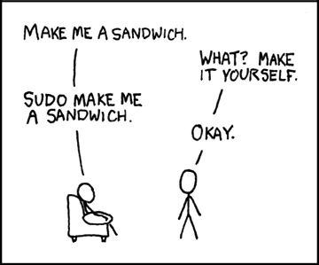
Making the super user
We need to "bootstrap" our system and make a user that can log into the admin page and make more users
dj4e-samples$ python3 manage.py createsuperuser
Username: dj4e-samples
Email address: csev@umich.edu
Password:
Password (again):
Superuser created successfully.
https://xkcd.com/149/

Slide 4
Restarting the database
Sometimes you want to clear out and re-initialize your db.sqlite3 file
The super users and users are stored in the database so when you remove it, you need to re-create the super users.
dj4e-samples$ rm db.sqlite3
dj4e-samples$ python3 manage.py migrate
dj4e-samples$ python3 manage.py createsuperuser
Username: dj4e-samples
Email address: csev@umich.edu
Password:
Password (again):
Superuser created successfully.

Slide 5
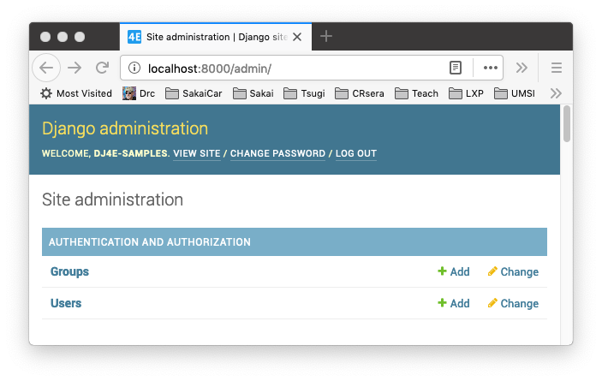
Additional Users and Permissions
Once you have a super user you can log into your application and create additional new users, associate them with groups, and give them permissions in the "/admin" user interface
Many applications don’t need to use the groups or permissions features of Django

Slide 6
Logging Users into Our Application

Slide 7
Sessions are not "logging in"
A session is a way of marking a browser and storing data on the server which can be stored and retrieved across multiple request-response-cycles
Sessions exist irrespective of whether or not the user is logged in
When the user passes the login check, the server adds markers to the session identifying the user
When the user logs out, that information in the session is removed
Sessions are required to implement login

Slide 8
Sessions, Users, Login, and Django
Login functionality is built into Django and included in your settings.py by default
dj4e-samples/dj4e-samples/settings.py
INSTALLED_APPS = [
'django.contrib.admin',
'django.contrib.auth',
'django.contrib.contenttypes',
...
https://docs.djangoproject.com/en/2.2/topics/auth/default

Slide 9
Sessions, Users, Login, and Django
We need to add a path to the code that gives us login and logout urls
We can reverse lookup these urls using the 'login' and 'logout' view names
dj4e-samples/dj4e-samples/urls.py
urlpatterns = [
path('', include('home.urls')),
path('admin/', admin.site.urls),
path('accounts/', include('django.contrib.auth.urls')),
...
https://docs.djangoproject.com/en/2.2/topics/auth/default

Slide 10
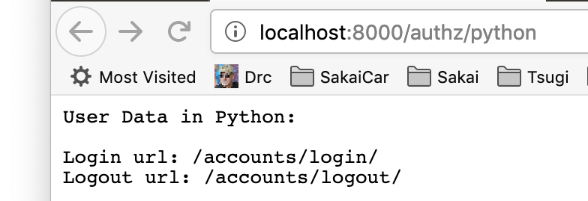
from django.urls import reverse
class DumpPython(View) :
def get(self, req):
resp = "<pre>\nUser Data in Python:\n\n"
resp += "Login url: " + reverse('login') + "\n"
resp += "Logout url: " + reverse('logout') + "\n\n"
dj4e-samples/authz/views.py
You can get the login and logout urls using reverse()

Slide 11
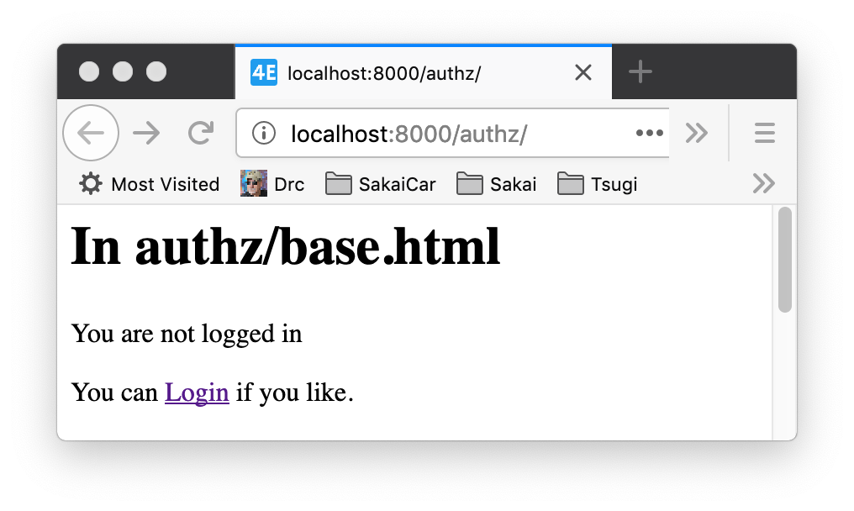
dj4e-samples/authz/templates/base.html
<p>You can <a href="{% url 'logout' %}">Logout</a></p>
<p>You can <a href="{% url 'login' %}">Login</a> if you like.</p>
You can also get the login and logout urls using the url template tag.

Slide 12
Where to go after login success
We want to transfer the user to a login page from many pages in our application and when they successfully log in, we want to bring them back to our page
The "next=" parameter tells login or logout where to redirect the user after login

Slide 13
<p>You can <a href="{% url 'login' %}?next={% url 'authz:protect' %}">
Login</a> if you like.</p>
<p>You can <a href="/accounts/login/?next=/authz/protect">Login</a>
if you like.</p>
dj4e-samples/authz/templates/base.html

Slide 14
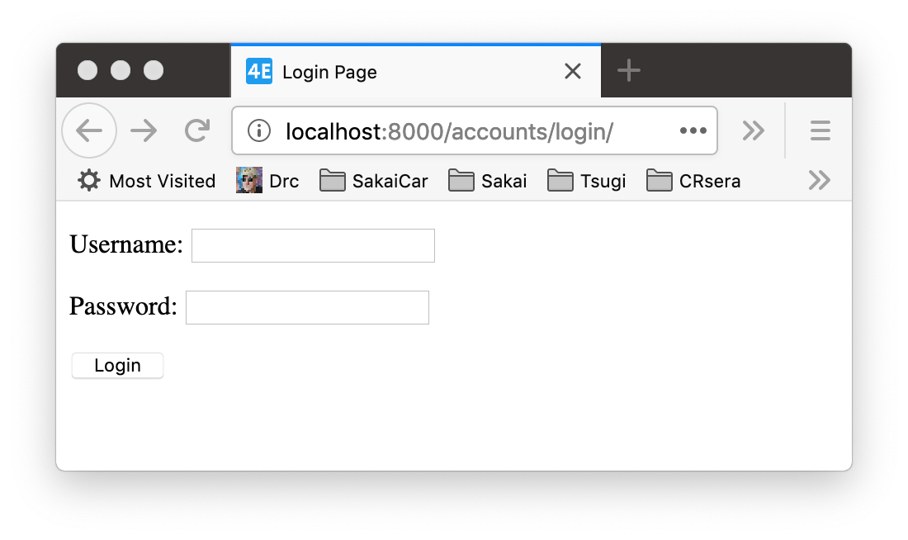
Look and Feel - Login Template
To allow us to control the look and feel of the login page we must provide a template called "registration/login.html"
Django describes what needs to be in this template
We can put this in any of our application templates folders
https://docs.djangoproject.com/en/2.2/topics/auth/default/#django.contrib.auth.views.LoginView

Slide 15
dj4e-samples/home/templates/registration/login.html
<html>
<title>Login Page</title>
</head>
<body>
{% if form.errors %}
<p>Your username and password didn't match. Please try again.</p>
{% endif %}
{% if next %}
{% if user.is_authenticated %}
<p>Your account doesn't have access to this page. To proceed,
please login with an account that has access.</p>
{% else %}
<p>Please login to see this site.</p>
{% endif %}
{% endif %}
<form method="post" action="{% url 'login' %}">
{% csrf_token %}
{{ form.as_p }}
<input type="submit" class="btn btn-primary" value="Login" />
<input type="hidden" name="next" value="{{ next }}" />
</form>
</body>

Slide 16
Summary

Slide 17
Acknowledgements / Contributions
These slides are Copyright 2019- Charles R. Severance (www.dr-chuck.com) as part of www.dj4e.com and made available under a Creative Commons Attribution 4.0 License. Please maintain this last slide in all copies of the document to comply with the attribution requirements of the license. If you make a change, feel free to add your name and organization to the list of contributors on this page as you republish the materials.
Initial Development: Charles Severance, University of Michigan School of Information
Insert new Contributors and Translators here including names and dates
Continue new Contributors and Translators here

