Slide 1
The Structure of a Django Application

Slide 2
Virtual Hosting Technology
HTTP – Hypertext Transport Protocol
Connects to a domain
Includes the domain in the GET request
Virtual Hosting – Many domains on one system
https://blog.pythonanywhere.com/36/

Slide 3
Web Server
$ telnet data.pr4e.org 80
Trying 74.208.28.177...
Connected to data.pr4e.org character is '^]'.
GET http://data.pr4e.org/page1.htm HTTP/1.0
HTTP/1.1 200 OK
Date: Thu, 04 Jan 2018 14:45:10 GMT
Server: Apache/2.4.7 (Ubuntu)
Last-Modified: Mon, 15 May 2017 11:11:47 GMT
Content-Type: text/html
<h1>The First Page</h1>
<p>If you like, you can switch to
the <a href="http://www.dr-chuck.com/page2.htm">Second Page</a>.</p>
Connection closed by foreign host.
Browser

Slide 4
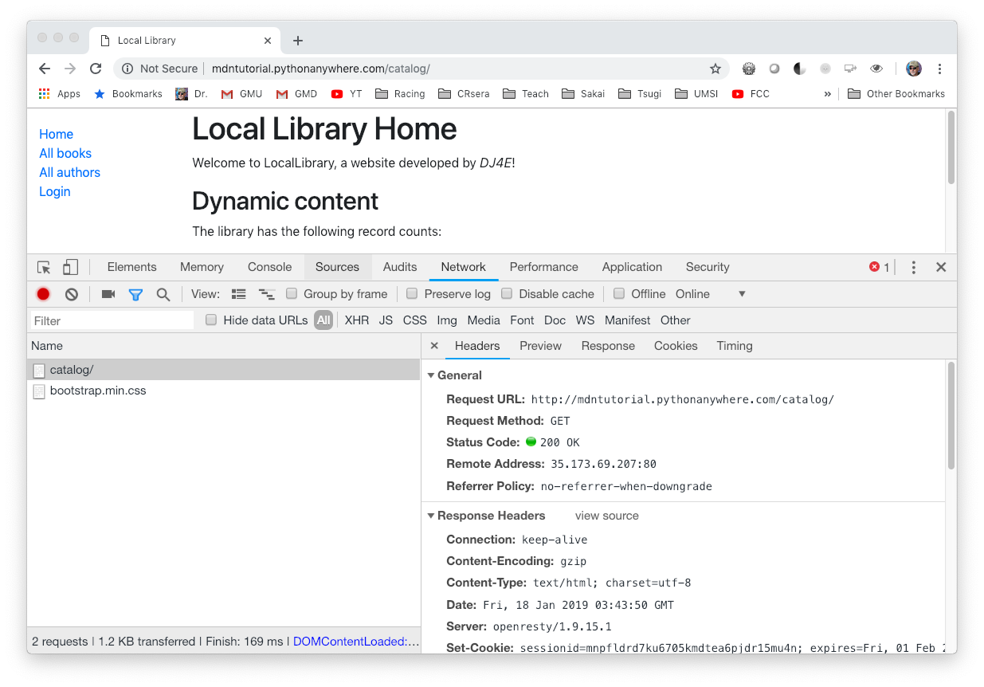

Slide 5
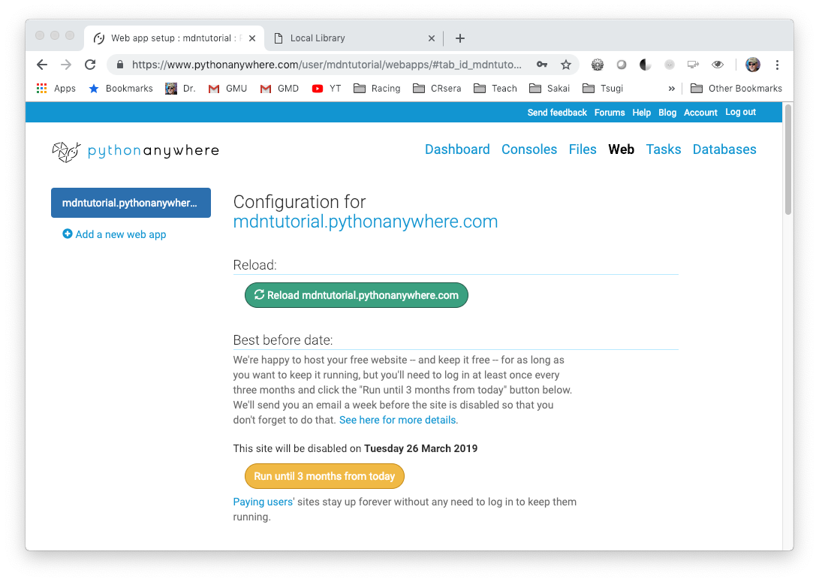
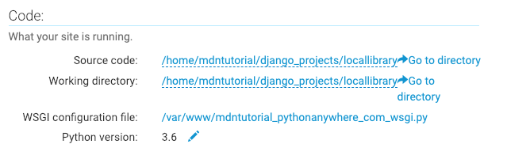

Slide 6
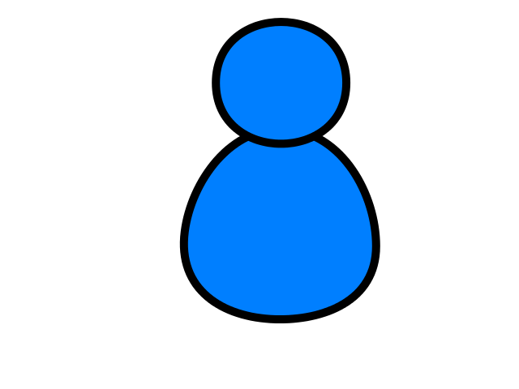
Browser
Linux
N
G
I
N X
WGSIConfig
settings.py
Django – mdntutorial.pythonanywhere.com
urls.py
views.py
model.py
WGSIConfig
settings.py
Django – dj4e.pythonanywhere.com
urls.py
views.py
model.py
……
WGSIConfig
Flask – flaskfun.pythonanywhere.com

Slide 7
Browser
Linux
D
O
M
WGSIConfig
settings.py
DJango
Routing
urls.py
Parse
Response
views.py
Views
forms.py
Javascript
Templates
model.py
Models
Database

Slide 8
Django Terminology (i.e. folders)
Project is a collection of applications
Our project is "locallibrary"
Project wide configuration is in locallibrary/locallibrary
Our first application is "catalog"
We will do most of our web development in the application folder locallibrary/catalog

Slide 9
Flow of a Web Request
When the request arrives at a Django app the incoming request URL is compared to the list of paths in urls.py in the variable urlpatterns
When there is a url match, it selects a "View" which is a bit of code that handles any database access and then produces and delivers the response to the browser
The view access the database indirectly through an abstraction called a "model"
This is a general web pattern called "Model-View-Controller" or MVC

Slide 10
Browser
Linux
D
O
M
WGSIConfig
settings.py
1: Click
2: GET
DJango
Routing
urls.py
Parse
Response
views.py
Views
forms.py
Javascript
Templates
model.py
Models
Database

Slide 11
Browser
Linux
D
O
M
WGSIConfig
settings.py
DJango
Routing
3: Choose
urls.py
Parse
Response
views.py
Views
forms.py
Javascript
Templates
4: Store Data (optional)
model.py
Models
Database

Slide 12
Browser
Linux
D
O
M
WGSIConfig
settings.py
DJango
Routing
urls.py
Parse
Response
views.py
7: Render
Views
5: Choose
forms.py
Javascript
Templates
6: Read Data
model.py
Models
Database

Slide 13
Browser
Linux
D
O
M
WGSIConfig
settings.py
1: Click
2: GET
DJango
Routing
3: Choose
urls.py
Parse
Response
views.py
7: Render
Views
5: Choose
forms.py
Javascript
Templates
4: Store Data (optional)
6: Read Data
model.py
Models
Database

Slide 14

Acknowledgements / Contributions
These slides are Copyright 2019- Charles R. Severance (www.dr-chuck.com) of the University of Michigan School of Information and made available under a Creative Commons Attribution 4.0 License. Please maintain this last slide in all copies of the document to comply with the attribution requirements of the license. If you make a change, feel free to add your name and organization to the list of contributors on this page as you republish the materials.
Initial Development: Charles Severance, University of Michigan School of Information
… Insert new Contributors and Translators here
Continue…

