Slide 1
Google App Engine Data Store
ae-10-datastore
www.appenginelearn.com

Slide 2




Unless otherwise noted, the content of this course material is licensed under a Creative Commons Attribution 3.0 License.
http://creativecommons.org/licenses/by/3.0/.
Copyright 2009, Charles Severance, Jim Eng

Slide 3
Data @ Google is BIG
Google’s main applications are their search and mail
The entire Internet and everyone’s mail is a lot of data
Traditional data storage approaches such as a relational database just don’t scale to the size at which Google applications operate
Sharded, sorted, array with hierarchical keys
http://labs.google.com/papers/bigtable.html

Slide 4
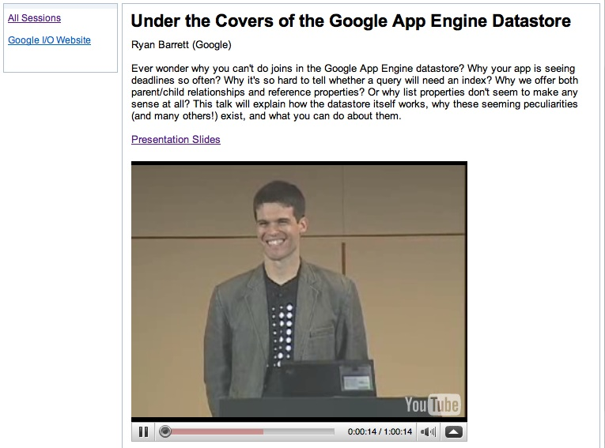
Advanced Stuff
http://sites.google.com/site/io/under-the-covers-of-the-google-app-engine-datastore

Slide 5
Model-View-Controller
Design Pattern

Slide 6
Web Server
HTTP
Request
HTTP
Response
Browser

Slide 7
Tasks Inside the Server
Process any form input - possibly storing it in a database or making some other change to the database such as a delete
Decide which screen to send back to the user
Retrieve any needed data
Produce the HTML response and send it back to the browser

Slide 8
Store Data
Retrieve
Data
Web Server
2
3
Handle
Input
Build
HTML
1
4
HTTP
Request
HTTP
Response
Browser

Slide 9

Data
Server
Store Data
Retrieve
Data
Web Server
2
3
Handle
Input
Build
HTML
1
4
Request
Response

Slide 10
Terminology
We call the Data bit - the “Model” or Data Model
We call the “making the next HTML” bit the “View” or “Presentation Layer”
We call the handling of input and the general orchestration of it all the “Controller”

Slide 11
Model View Controller
We name the three basic functions of an application as follows
Controller - The Python code that does the thinking and decision making
View - The HTML, CSS, etc. which makes up the look and feel of the application
Model - The persistent data that we keep in the data store
http://en.wikipedia.org/wiki/Model-view-controller

Slide 12
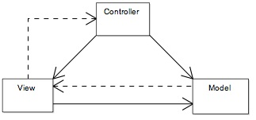
Model-View-Controller
“In MVC, the model represents the information (the data) of the application and the business rules used to manipulate the data; the view corresponds to elements of the user interface such as text, checkbox items, and so forth; and the controller manages details involving the communication to the model of user actions.”
http://en.wikipedia.org/wiki/Model-View-Controller

Slide 13
Model
Web Server
2
3
4
Controller
View
5
1
6
HTTP
Request
HTTP
Response
Browser

Slide 14
Our Architecture: MVC
Model - Holds the permanent data which stays long after the user has closed their web browsers
View - Produces the HTML Response
Controller - Receives each request and handles input and orchestrates the other elements

Slide 15
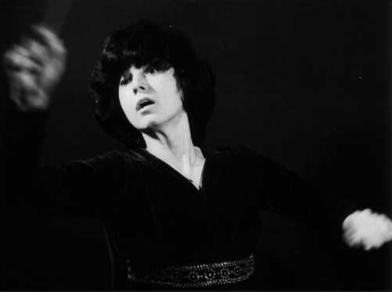
Controller “Orchestrates”
http://www.kapralova.org/MORAL.htm
Session
Cookies
Model
Ajax
Logic
Browser
View
The controller is the conductor of all of the other aspects of MVC.

Slide 16
Adding Models to our Application
ae-10-datastore
http://code.google.com/appengine/docs/datastore/

Slide 17

DJango Models
We use a very simple interface to define objects (a.k.a. Models) and store them in BigTable
BigTable is where the models are stored
We don’t need to know the details
The pattern of these models is taken from the DJango project
http://docs.djangoproject.com/en/dev/ref/models/instances/?from=olddocs

Slide 18
A Simple Model
from google.appengine.ext import db
# A Model for a User
class User(db.Model):
acct = db.StringProperty()
pw = db.StringProperty()
name = db.StringProperty()
Each model is a Python class which extends the db.Model class.
newuser = User(name="Chuck", acct="csev", pw="pw")
newuser.put()

Slide 19
Property Types
StringProperty - Any string
IntegerProperty - An Integer Number
DateTimeProperty - A date + time
BlobProperty - File data
ReferenceProperty - A reference to another object in the datastore
http://code.google.com/appengine/docs/datastore/

Slide 20
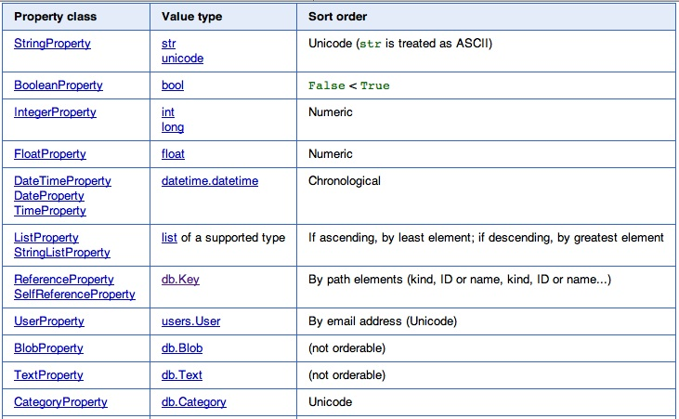

Slide 21
Keep it simple for a while
from google.appengine.ext import db
# A Model for a User
class User(db.Model):
acct = db.StringProperty()
pw = db.StringProperty()
name = db.StringProperty()
Each model is a Python class which extends the db.Model class.
newuser = User(name=”Chuck”, acct=”csev”, pw=”pw”);
newuser.put();

Slide 22
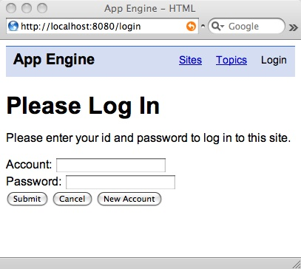
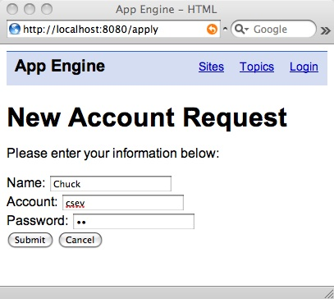
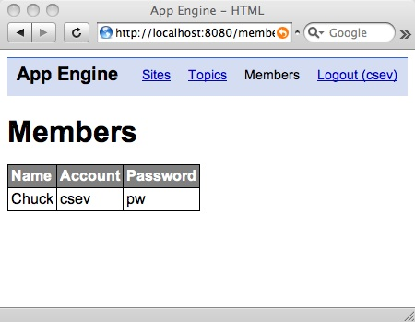
Inserting a User and listing Users

Slide 23
class ApplyHandler(webapp.RequestHandler):
def post(self): self.session = Session()
xname = self.request.get('name')
xacct = self.request.get('account')
xpw = self.request.get('password')
# Check for a user already existing
que = db.Query(User).filter("acct =",xacct)
results = que.fetch(limit=1)
if len(results) > 0 :
doRender(self,"apply.htm",{'error' : 'Account Already Exists'} )
return
newuser = User(name=xname, acct=xacct, pw=xpw);
newuser.put();
self.session['username'] = xacct
doRender(self,"index.htm",{ })
Get Session
Form
Data
Check for existing user.
Insert User
Update Session

Slide 24
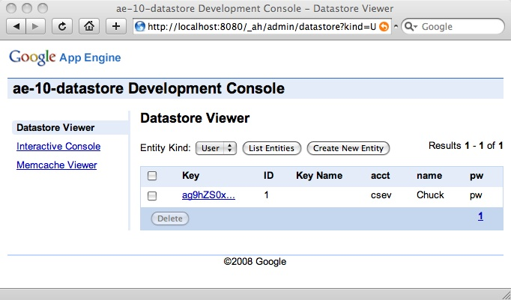
http://localhost:8080/_ah/admin/
Using the Developer console we can see the results of the put() operation as a new User object is now in the data store.
newuser = User(name=xname, acct=xacct, pw=xpw);
newuser.put();

Slide 25
class MembersHandler(webapp.RequestHandler):
def get(self):
que = db.Query(User)
user_list = que.fetch(limit=100)
doRender(self, 'memberscreen.htm',
{'user_list': user_list})
We simply construct a query for the User objects, and fetch the first 100 User Objects. Then we pass this list into the memberscreen.htm template as a context variable named ‘user_list’.

Slide 26
{% extends "_base.htm" %}
{% block bodycontent %}
<h1>Members</h1>
<p>
<table>
<tr><th>Name</th><th>Account</th><th>Password</th></tr>
{% for user in user_list %}
<tr>
<td>{{ user.name }}</td>
<td>{{ user.acct }}</td>
<td>{{ user.pw }}</td>
</tr>
{% endfor %}
</table>
{% endblock %}
templates/members.htm
In the template, we use the for directive to loop through each user in the user_list variable in the context. For each user we construct a table row with their name, account, and pw.

Slide 27
Google App Engine References
ae-11-chat

Slide 28
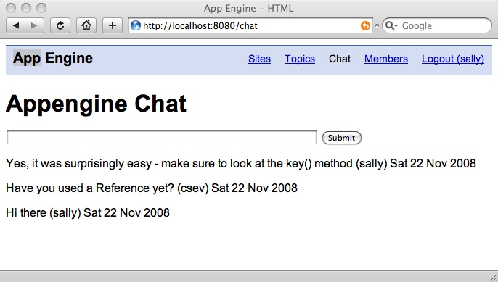
Which user posted each message?

Slide 29
Relationships
We need to create a new model for Chat messages and then relate Chat messages by marking them as belonging to a particular user
Chat msg
User csev
Chat msg
User sally
Chat msg

Slide 30
Three Kinds of Keys
Logical Key - What we use to look something up from the outside world - usually unique for a model
Primary Key - Some “random” number which tells the database where it put the data - also unique - and opaque
Reference - When we have a field that points to the primary key of another model (a.k.a. Foreign Key)

Slide 31
User
class User(db.Model):
acct = db.StringProperty()
pw = db.StringProperty()
name = db.StringProperty()
acct
pw
name

Slide 32
User
class User(db.Model):
acct = db.StringProperty()
pw = db.StringProperty()
name = db.StringProperty()
key()
acct
pw
name
newuser = User(name=name, acct=acct, pw=pw)
newuser.put()
self.session['username'] = acct
self.session['userkey'] = newuser.key()

Slide 33
User
class User(db.Model):
acct = db.StringProperty()
pw = db.StringProperty()
name = db.StringProperty()
key()
acct
pw
name
newuser = User(name=name, acct=acct, pw=pw)
key = newuser.put();
self.session['username'] = acct
self.session['userkey'] = key

Slide 34
Fast Lookup By Primary Key
Lookup by primary key is faster than by logical key - because the primary key is about “where” the object is placed in the data store and there is *only one*
So we put it in session for later use...
newuser = User(name=name, acct=acct, pw=pw);
key = newuser.put();
self.session['username'] = acct
self.session['userkey'] = key

Slide 35
When we log in...
que = db.Query(User).filter("acct =",acct).filter("pw = ",pw)
results = que.fetch(limit=1)
if len(results) > 0 :
user = results[0]
self.session['username'] = acct
self.session['userkey'] = user.key()
doRender(self,"index.htm",{ } )
else:
doRender(self,"loginscreen.htm",
{'error' : 'Incorrect login data'} )

Slide 36
When we log Out...
class LogoutHandler(webapp.RequestHandler):
def get(self):
self.session = Session()
self.session.delete_item('username')
self.session.delete_item('userkey')
doRender(self, 'index.htm')
When we log out - we make sure to remove the key from the session as well as the account name.

Slide 37
Making References

Slide 38
References
When we make a new object that needs to be associated with or related to another object - we call this a “Reference”
Relational Databases call these “Foreign Keys”

Slide 39
Who posted each message?

Slide 40
Database
Normalization
We could just store the account strings in each chat message. This is bad practice generally - particularly if we might want to know more detail about the User later. We don’t like to make multiple copies of anything except primary keys.
http://en.wikipedia.org/wiki/Database_normalization

Slide 41
class ChatMessage(db.Model):
user = db.ReferenceProperty()
text = db.StringProperty()
created = db.DateTimeProperty(auto_now=True)
So we make a reference property in our Chat message model. The property does *not* need to be named “user” - but it is a convienent pattern. Also note the created field that we let the data store auto-populate.

Slide 42
Relating Models
User
ChatMessage
key()
key()
acct
user
class User(db.Model):
acct = db.StringProperty()
pw = db.StringProperty()
name = db.StringProperty()
pw
text
name
created
class ChatMessage(db.Model):
user = db.ReferenceProperty()
text = db.StringProperty()
created = db.DateTimeProperty(auto_now=True)

Slide 43
class ChatMessage(db.Model):
user = db.ReferenceProperty()
text = db.StringProperty()
created = db.DateTimeProperty(auto_now=True)
Populating
References
def post(self):
self.session = Session()
msg = self.request.get('message')
newchat = ChatMessage(user = self.session['userkey'], text=msg)
newchat.put();
When we create a ChatMessage, we get the message text from the chatscreen.htm form, and then user reference is the key of the current logged in user taken from the Session. Note: Some error checking removed from this example.

Slide 44
We need to display the list of the most recent ChatMessage objects on the page.

Slide 45
def post(self):
self.session = Session()
msg = self.request.get('message')
newchat = ChatMessage(user = self.session['userkey'], text=msg)
newchat.put();
que = db.Query(ChatMessage).order("-created"); chat_list = que.fetch(limit=10) doRender(self,"chatscreen.htm",
{ 'chat_list': chat_list })
ChatMessage
key()
user
text
We retrieve the list of chat messages, and pass them into the template as context variable named “chat_list” and then render “chatscreen.htm”.
created

Slide 46
{% extends "_base.htm" %}
{% block bodycontent %}
<h1>Appengine Chat</h1>
<p>
<form method="post" action="/chat">
<input type="text" name="message" size="60"/>
<input type="submit" name="Chat"/>
</form>
</p>
{% ifnotequal error None %}
<p>
{{ error }}
</p>
{% endifnotequal %}
{% for chat in chat_list %}
<p>{{ chat.text }} ({{chat.user.acct}})
{{chat.created|date:"D d M Y"}}</p>
{% endfor %}
{% endblock %}
chatscreen.htm
In the chatscreen.htm template, we loop through the context variable and process each chat message.

Slide 47
{% extends "_base.htm" %}
{% block bodycontent %}
<h1>Appengine Chat</h1>
<p>
<form method="post" action="/chat">
<input type="text" name="message" size="60"/>
<input type="submit" name="Chat"/>
</form>
</p>
{% ifnotequal error None %}
<p>
{{ error }}
</p>
{% endifnotequal %}
{% for chat in chat_list %}
<p>{{ chat.text }} ({{chat.user.acct}})
{{chat.created|date:"D d M Y"}}</p>
{% endfor %}
{% endblock %}
chatscreen.htm
In the chatscreen.htm template, we loop through the context variable and process each chat message.
For a reference value we access the .user attribute and then the .acct attribute within the .user related to this chat message.

Slide 48
Walking a reference
The chat_list contains a list of chat objects
The iteration variable chat is each chat object in the list
chat.user is the associated user object (follow the reference)
chat.user.acct is the user’s account
{% for chat in chat_list %}
<p>{{ chat.text }} ({{chat.user.acct}})
{{chat.created|date:"D d M Y"}}</p>
{% endfor %}

Slide 49
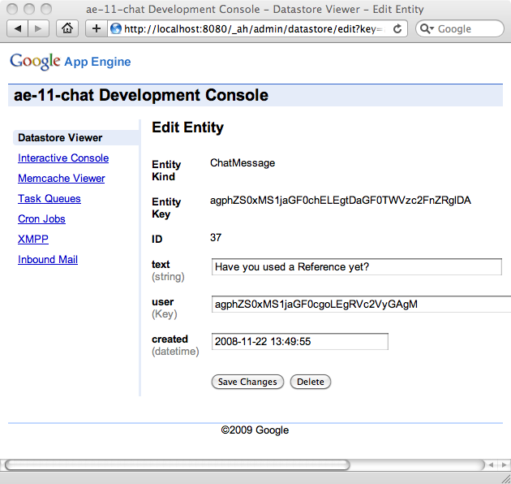
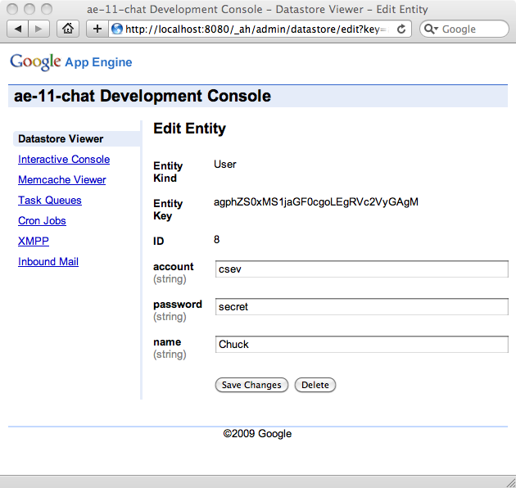
chat
chat.user
chat.text
chat.user.acct
chat.user
{% for chat in chat_list %}
<p>{{ chat.text }} ({{chat.user.acct}})
{{chat.created|date:"D d M Y"}}</p>
{% endfor %}

Slide 50
{% extends "_base.htm" %}
{% block bodycontent %}
<h1>Appengine Chat</h1>
<p>
<form method="post" action="/chat">
<input type="text" name="message" size="60"/>
<input type="submit" name="Chat"/>
</form>
</p>
{% ifnotequal error None %}
<p>
{{ error }}
</p>
{% endifnotequal %}
{% for chat in chat_list %}
<p>{{ chat.text }} ({{chat.user.acct}})
{{chat.created|date:"D d M Y"}}</p>
{% endfor %}
{% endblock %}
chatscreen.htm
To make the date format a little nicer we use a |date: formatter which shows the day of week, day of month, month, and year.

Slide 51
Summary
All objects stored in the data store are given a primary key which we get from either the put() call or the key() call
We place these keys in ReferenceProperty values to connect one model to another
When an attribute is a reference property, we use syntax like chat.user.acct - to look up fields in the referenced object

Slide 52

Acknowledgements / Contributions
These slides are Copyright 2010- Charles R. Severance (www.dr-chuck.com) of the University of Michigan School of Information and made available under a Creative Commons Attribution 4.0 License. Please maintain this last slide in all copies of the document to comply with the attribution requirements of the license. If you make a change, feel free to add your name and organization to the list of contributors on this page as you republish the materials.
Initial Development: Charles Severance, University of Michigan School of Information
Contributions: Jim Eng, University of Michigan
… Insert new Contributors and Translators here
Continue…

