Slide 1
Google App Engine
Using Templates
Charles Severance
csev@umich.edu
Jim Eng
jimeng@umich.edu
Textbook: Using Google App Engine, Charles Severance

Slide 2





Unless otherwise noted, the content of this course material is licensed under a Creative Commons Attribution 3.0 License.
http://creativecommons.org/licenses/by/3.0/.
Copyright 2009-2010, Charles Severance and Jim Eng

Slide 3
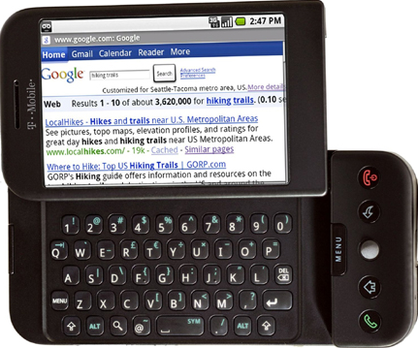

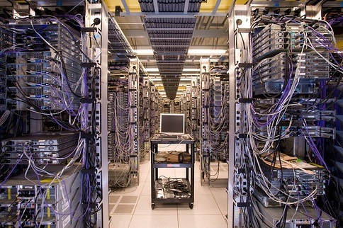
Internet
HTTP
Request
Python
HTML
JavaScript
Response
GET
Data Store
AJAX
Templates
memcache
CSS
POST

Slide 4
Templates
While we could write all of the HTML into the response using self.response.out.write(), we really prefer not to do this
Templates allow us to separately edit HTML files and leave little areas in those files where data from Python gets dropped in
Then when we want to display a view, we process the template to produce the HTTP Response
http://docs.djangoproject.com/en/dev/ref/templates/builtins/?from=olddocs

Slide 5
Google App Engine
Basic Templates
ae-04-template
www.appenginelearn.com

Slide 6
formstring = """<form method="post" action="/"
enctype="multipart/form-data">
Zap Data: <input type="text" name="zap"><br>
Zot Data: <input type="text" name="zot"><br>
File Data: <input type="file" name="filedat"><br>
<input type="submit">
</form>"""
def dumper(self):
self.response.out.write(self.formstring)
self.response.out.write("<pre>\n")
self.response.out.write('Request parameters:\n')
for key in self.request.params.keys():
value = self.request.get(key)
if len(value) < 100:
self.response.out.write(key+':'+value+'\n')
else:
self.response.out.write(key+':'+str(len(value))+' (bytes long)\n')
self.response.out.write('\n')
YUCK!!
Python is a *lousy* way to store and edit HTML. Your code gets obtuse and nasty. Lets move the HTML into a separate file.

Slide 7
Separation of Concerns
A well written App Engine Application has no HTML in the Python code - it processes the input data, talks to databases, makes lots of decisions, figures out what to do next and then
Grabs some HTML from a template - replacing a few selected values in the HTML from computed data - and viola! We have a response.

Slide 8
Terminology
We name the three basic functions of an application as follows
Controller - The Python code that does the thinking and decision making
View - The HTML, CSS, etc. which makes up the look and feel of the application
Model - The persistent data that we keep in the data store

Slide 9
HTTP
Request
1
2
Model
3
Controller
Browser
View
4
5
HTTP
Response
Web Server

Slide 10
MVC
We call this pattern the “Model - View - Controller” pattern (or MVC for short)
It is a very common pattern in web applications - not just Google Application Engine
Ruby on Rails
Spring MVC
We will meet the “Model” later - for now we will work with the View and Controller

Slide 11
Back to: Templates
A template is mostly HTML but we have some little syntax embedded in the HTML to drop in bits of data at run-time
The controller computes the “bits” and gives them to the “Render Engine” to put into the template.

Slide 12
A Simple Template
<form method="post" action="/"
enctype="multipart/form-data">
Zap Data: <input type="text" name="zap"><br>
Zot Data: <input type="text" name="zot"><br>
File Data: <input type="file" name="filedat"><br>
<input type="submit">
</form>
<pre>
Request Data:
{{ dat }}
</pre>
Mostly HTML - with a little place to drop in data from the Controller.

Slide 13
In The Controller
In the controller, we prepare a Python Dictionary object with the data for the template and call the “Render Engine”
outstr = template.render(filepath, { ‘dat’ : ‘hello there’})
The Render Engine takes the path to a template file, and a dictionary with key value pairs of the data areas in the template.

Slide 14
Render
Data
Template
Render
Engine
Rendered
Output

Slide 15
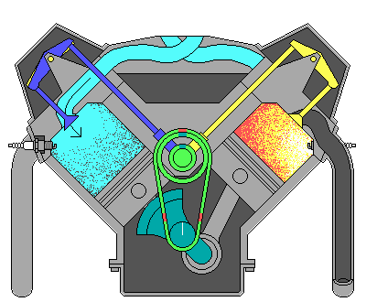
<h1>Hi!</h1>
<pre>
{{ dat }}
</pre>
{ ‘dat’ : ‘Fun Stuff’ }
V-8 Render Engine
<h1>Hi!</h1>
<pre>
Fun Stuff
</pre>

Slide 16
Template Pattern
We store templates in a folder called “templates” under the main application directory to keep the templates (views) separate from the Python code (controller)
We need to load the template from the right place in our Python code (it is a little ugly...)
filepath = os.path.join(os.path.dirname(__file__), 'templates/index.htm’)
outstr = template.render(filepath, { ‘dat’ : ‘hello there’})

Slide 17
We loop through the parameters and make a string of the the parameter output and then render the template with this data.
def dumper(self):
prestr = ' '
for key in self.request.params.keys():
value = self.request.get(key)
if len(value) < 100:
prestr = prestr + key + ':' + value + '\n'
else:
prestr = prestr + key + ':' + str(len(value)) + ' (bytes long)\n'
temp = os.path.join(os.path.dirname(__file__), 'templates/index.htm’)
outstr = template.render(temp, {'dat': prestr})
self.response.out.write(outstr)

Slide 18
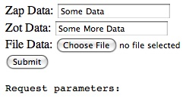
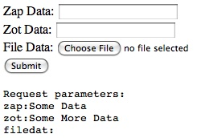
No
Separation
of
Concerns
def dumper(self):
self.response.out.write(self.formstring)
self.response.out.write("<pre>\n")
self.response.out.write('Request parameters:\n')
for key in self.request.params.keys():
value = self.request.get(key)
if len(value) < 100:
self.response.out.write(key+':'+value+'\n')
else:
self.response.out.write(key+':'+str(len(value))+' (bytes long)\n')
self.response.out.write('\n')

Slide 19
Controller
and
View
def dumper(self):
prestr = ‘ ‘
for key in self.request.params.keys():
value = self.request.get(key)
if len(value) < 100:
prestr = prestr + key+':'+value+'\n'
else:
prestr = prestr + key+':'+str(len(value))+’\n’;
temp = os.path.join(os.path.dirname(__file__),
'templates/index.htm’)
outstr = template.render(temp, {'dat': prestr})
self.response.out.write(outstr)
<form method="post" action="/"
enctype="multipart/form-data">
Zap Data: <input type="text" name="zap"><br>
Zot Data: <input type="text" name="zot"><br>
File Data: <input type="file" name="filedat"><br>
<input type="submit">
</form>
<pre>
Request Data:
{{ dat }}
</pre>
Controller
View

Slide 20

Application Structure
We keep the app.yaml and index.py files in the main application folder and the templates are stored in a folder called “templates”
This is not a *rule* - just a pattern that it makes it easier to look at someone else’s code

Slide 21
Template Summary
We separate the logic of our program (Controller) from the HTML bits of the program (View) to keep things cleaner and more organization
We use the Google templating engine to read the templates and substitute bits of computed data into the resulting HTML
<h1>Hi!</h1>
<pre>
{{ dat }}
</pre>
<h1>Hi!</h1>
<pre>
Fun Stuff
</pre>
+
{ ‘dat’ : ‘Fun Stuff’ }
=

Slide 22
Several Templates
Program: ae-05-templates
www.appenginelearn.com

Slide 23
Real Applications
Real applications have lots of handlers and lots of templates
In this section we start to look at techniques for managing and organizing templates
http://docs.djangoproject.com/en/dev/ref/templates/builtins/?from=olddocs

Slide 24
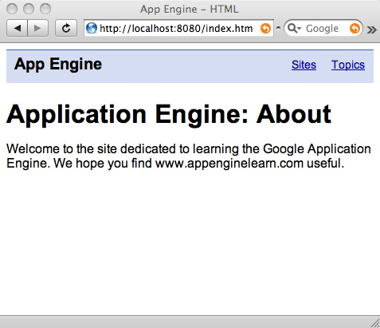
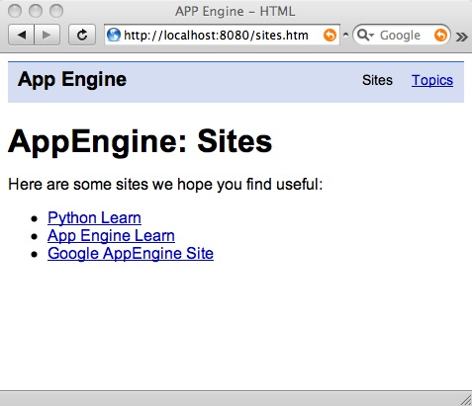
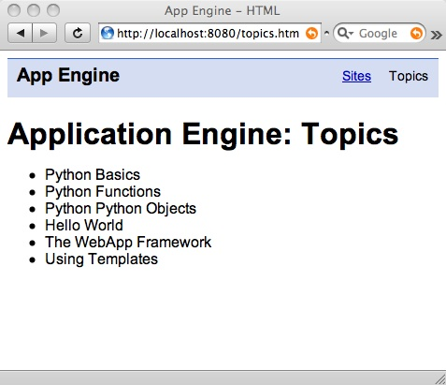
Our Application
Our Application has three pages - no forms, and a bit of CSS to make the navigation pretty and light blue. It is mostly a static site.

Slide 25
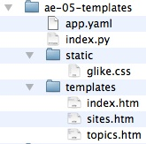
Application Layout
There are three templates in the templates directory
The CSS file is in the static directory - this is a special directory

Slide 26
Looking at app.yaml
application: ae-05-templates
version: 1
runtime: python
api_version: 1
handlers:
- url: /static
static_dir: static
- url: /.*
script: index.py
The app.yaml file has a new handler for static data which does not change like images, CSS, javascript libraries, etc
Google serves these “read-only” files *very* efficiently
Identifying them as static can save you money

Slide 27
Looking at app.yaml
application: ae-05-templates
version: 1
runtime: python
api_version: 1
handlers:
- url: /static
static_dir: static
- url: /.*
script: index.py
The handlers in the app.yaml file are checked in order
First it looks at the url to see if it starts with “/static”
The last URL is a catch-all - send everything to the controller (index.py)

Slide 28
<!DOCTYPE html PUBLIC "-//W3C//DTD XHTML 1.0 Strict//EN"
"http://www.w3.org/TR/xhtml1/DTD/xhtml1-strict.dtd">
<html xmlns="http://www.w3.org/1999/xhtml">
<head>
<title>App Engine - HTML</title>
<link href="/static/glike.css" rel="stylesheet" type="text/css" />
</head>
<body>
<div id="header">
<h1><a href="index.htm" class="selected">App Engine</a></h1>
<ul class="toolbar">
<li><a href="sites.htm">Sites</a></li>
<li><a href="topics.htm" >Topics</a></li>
</ul>
</div>
<div id="bodycontent">
<h1>Application Engine: About</h1>
<p>
Welcome to the site dedicated to
learning the Google Application Engine.
We hope you find www.appenginelearn.com useful.
</p>
</div>
</body>
</html>
The templates are
just flat HTML. The only real App Engine change is that the CSS file is coming from “/static”

Slide 29
Controller Code
The controller code is going to be very general
It will look at the path on the URL and try to find a template of that name - if that fails, render the index.htm template
Path
http://localhost:8080/topics.htm
For this URL, the path is /topics.htm

Slide 30
class MainHandler(webapp.RequestHandler):
def get(self):
path = self.request.path
try:
temp = os.path.join(os.path.dirname(__file__), 'templates' + path)
outstr = template.render(temp, { })
self.response.out.write(outstr)
except:
temp = os.path.join(os.path.dirname(__file__), 'templates/index.htm')
outstr = template.render(temp, { })
self.response.out.write(outstr)
http://localhost:8080/topics.htm
If all else fails, render templates/index.htm
Note that we are *not* passing any data to the templates.

Slide 31
http://localhost:8080/topics.htm
path = self.request.path
temp = os.path.join(... 'templates' + path)
outstr = template.render(temp, { })
self.response.out.write(outstr)
The browser also does a GET request for /static/glike.css

Slide 32
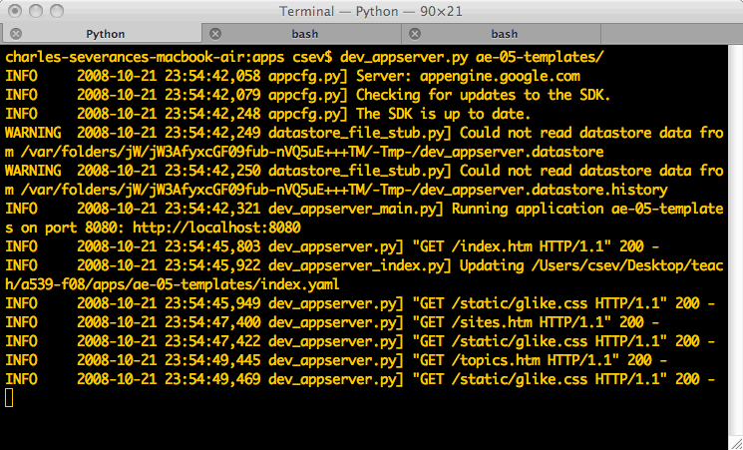

In the Log....

Slide 33
Extending Base Templates
Program: ae-06-templates
www.appenginelearn.com

Slide 34
Base Templates
When building web sites there is a great deal of common material across pages
head
navigation
Often only a small amount of information changes between pages

Slide 35
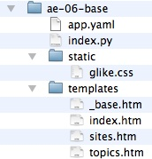
Application Layout
This is the same as the previous application except we refactor the templates, putting the common material into the file _base.htm
We reuse the _base.htm content in each of the other templates

Slide 36
<head>
<title>App Engine - HTML</title>
<link href="/static/glike.css" rel="stylesheet" type="text/css" />
</head>
<body>
<div id="header">
<h1><a href="index.htm" class="selected">
App Engine</a></h1>
<ul class="toolbar">
<li><a href="sites.htm">Sites</a></li>
<li><a href="topics.htm" >Topics</a></li>
</ul>
</div>
<div id="bodycontent">
<h1>Application Engine: About</h1>
<p>
Welcome to the site dedicated to
learning the Google Application Engine.
We hope you find www.appenginelearn.com useful.
</p>
</div>
</body>
</html>
<head>
<title>App Engine - HTML</title>
<link href="/static/glike.css" rel="stylesheet" type="text/css" />
</head>
<body>
<div id="header">
<h1><a href="index.htm" >
App Engine</a></h1>
<ul class="toolbar">
<li><a href="sites.htm">Sites</a></li>
<li><a href="topics.htm" class="selected">Topics</a></li>
</ul>
</div>
<div id="bodycontent">
<h1>Application Engine: Topics</h1>
<ul>
<li>Python Basics</li>
<li>Python Functions</li>
<li>Python Python Objects</li>
<li>Hello World</li>
<li>The WebApp Framework</li>
<li>Using Templates</li>
</ul>
</div>
</body>
</html>
These files are nearly identical. And we have lots of files like this.

Slide 37
A Base Template
We create a base template that contains the material that is common across the pages and leave a little place in the base template to put in the bits that change

Slide 38
<head>
<title>App Engine - HTML</title>
<link href="/static/glike.css" rel="stylesheet" type="text/css" />
</head>
<body>
<div id="header">
<h1><a href="index.htm" class="selected">
App Engine</a></h1>
<ul class="toolbar">
<li><a href="sites.htm">Sites</a></li>
<li><a href="topics.htm" >Topics</a></li>
</ul>
</div>
<div id="bodycontent">
<h1>Application Engine: About</h1>
<p>
Welcome to the site dedicated to
learning the Google Application Engine.
We hope you find www.appenginelearn.com useful.
</p>
</div>
</body>
</html>
<head>
<title>App Engine - HTML</title>
<link href="/static/glike.css" rel="stylesheet" type="text/css" />
</head>
<body>
<div id="header">
<h1><a href="index.htm" class="selected">
App Engine</a></h1>
<ul class="toolbar">
<li><a href="sites.htm">Sites</a></li>
<li><a href="topics.htm" >Topics</a></li>
</ul>
</div>
<div id="bodycontent">
{% block bodycontent %}
Replace this
{% endblock %}
</div>
</body>
</html>
<h1>Application Engine: About</h1>
<p>
Welcome to the site dedicated to
learning the Google Application Engine.
We hope you find www.appenginelearn.com useful.
</p>
_base.htm
index.htm

Slide 39
<head>
<title>App Engine - HTML</title>
<link href="/static/glike.css" rel="stylesheet" type="text/css" />
</head>
<body>
<div id="header">
<h1><a href="index.htm" class="selected">
App Engine</a></h1>
<ul class="toolbar">
<li><a href="sites.htm">Sites</a></li>
<li><a href="topics.htm" >Topics</a></li>
</ul>
</div>
<div id="bodycontent">
{% block bodycontent %}
Replace this
{% endblock %}
</div>
</body>
</html>
The “extends” indicates that this page is to “start with” _base.htm as its overall text and replace the bodycontent block in _base.htm with the given text.
{% extends "_base.htm" %}
{% block bodycontent %}
<h1>Application Engine: About</h1>
<p>
Welcome to the site dedicated to
learning the Google Application Engine.
We hope you find www.appenginelearn.com useful.
</p>
{% endblock %}
_base.htm
index.htm

Slide 40
Base
Template
Render
Data
Template
Render
Engine
Rendered
Output

Slide 41
{% extends "_base.htm" %}
{% block bodycontent %}
<h1>Application Engine: About</h1>
<p>
Welcome to the site dedicated to
learning the Google Application Engine.
We hope you find www.appenginelearn.com useful.
</p>
{% endblock %}
<head>
<title>App Engine - HTML</title>
</head>
<body>
</div>
<div id="bodycontent">
{% block bodycontent %}
Replace this
{% endblock %}
</div>
</body>
</html>
{ ‘dat’ : ‘Fun Stuff’ }
V-8 Render
Engine
....
<div id="bodycontent">
<h1> .....
</div>
...

Slide 42
Extending a Base Template
This capability to extend a base template is just part of the standard template render processing
The template which is rendered is “index.htm”
The render engine reads through index.htm. It sees the extend directive and goes to get the content of _base.htm as the starting point for index.htm
{% extends "_base.htm" %}
{% block bodycontent %}
<h1>Application Engine: About</h1>
...
{% endblock %}

Slide 43
Making Navigation
Look Nice
Program: ae-06-templates
www.appenginelearn.com

Slide 44
Navigation Issues
As we navigate between pages, we want the look of the "current" page to change color or provide some indication which page we are on.
This is usually done with a CSS class on the <li> tag
<ul class="toolbar">
<li><a href="sites.htm">Sites</a></li>
<li><a href="topics.htm" class="selected">Topics</a></li>
</ul>

Slide 45
<ul class="toolbar">
<li><a href="sites.htm">Sites</a></li>
<li><a href="topics.htm" class="selected">Topics</a></li>
</ul>
In topics.htm, the style sheet changes the Topics link to be Black and not underlined.
a.selected {
color: black;
text-decoration: none;
}

Slide 46
Problem
In this situation - the link that is selected changes between pages
We need to put class=”selected” on <a> tag for the current page but not for the other pages

Slide 47
Solution
We pass the current path for the page into the template as a render parameter
In the template we *check* the current path and only emit the class=”selected” when the path is the current page

Slide 48
http://localhost:8080/topics.htm
Path
class MainHandler(webapp.RequestHandler):
def get(self):
path = self.request.path
try:
temp = os.path.join(os.path.dirname(__file__), 'templates' + path)
outstr = template.render(temp, { 'path': path })
self.response.out.write(outstr)
except:
temp = os.path.join(os.path.dirname(__file__), 'templates/index.htm')
outstr = template.render(temp, { 'path': path })
self.response.out.write(outstr)

Slide 49
_base.htm
<ul class="toolbar">
<li><a href="sites.htm"
{% ifequal path '/sites.htm' %}
class="selected"
{% endifequal %}
>Sites</a></li>
<li><a href="topics.htm"
{% ifequal path '/topics.htm' %}
class="selected"
{% endifequal %}
>Topics</a></li>
</ul>
For each of the links, if the path matches, we emit class=”selected” otherwise we do not.
Conditional HTML generation.

Slide 50
_base.htm
topics.htm (rendered)
<ul class="toolbar">
<li><a href="sites.htm"
{% ifequal path '/sites.htm' %}
class="selected"
{% endifequal %}
>Sites</a></li>
<li><a href="topics.htm"
{% ifequal path '/topics.htm' %}
class="selected"
{% endifequal %}
>Topics</a></li>
</ul>
<ul class="toolbar">
<li><a href="sites.htm"
>Sites</a></li>
<li><a href="topics.htm"
class="selected"
>Topics</a></li>
</ul>
The path variable comes from the Python code.

Slide 51
Our Application
Program: ae-06-templates

Slide 52

More on Templates
This is only scratching the surface of templates
The Google Application Engine templating language is taken from the django templating framework
You can read further in the django documentation
http://docs.djangoproject.com/en/dev/ref/templates/builtins/?from=olddocs

Slide 53
Summary
We can use the ability to create a base template and then extend it in our regular templates to reduce the amount of repeated HTML code in templates.
We can even make pretty navigation links which change based on which page is the current page
When we don’t have to repeat the same code over and over - it is easy to make changes without breaking things

Slide 54

Acknowledgements / Contributions
These slides are Copyright 2009- Charles R. Severance (www.dr-chuck.com) of the University of Michigan School of Information and made available under a Creative Commons Attribution 4.0 License. Please maintain this last slide in all copies of the document to comply with the attribution requirements of the license. If you make a change, feel free to add your name and organization to the list of contributors on this page as you republish the materials.
Initial Development: Charles Severance, University of Michigan School of Information
Contributions: Jim Eng, University of Michigan
… Insert new Contributors and Translators here
Continue…

