Slide 1

Data Modelling One to Many
Charles Severance
www.dj4e.com

Slide 2


Browser
Linux
D
O
M
N
G
I
N X
WGSIConfig
settings.py
Django
Routing
urls.py
views.py
Parse
Response
Views
Templates
forms.py
Javascript
Database
Shell
Models
model.py
/admin
admin.py

Slide 3
Model Design
Model design is an art form of its own with particular skills and experience
Our goal is to avoid the really bad mistakes and design clean and easily understood models
Model design starts with a sample data set and draws a picture

Slide 4
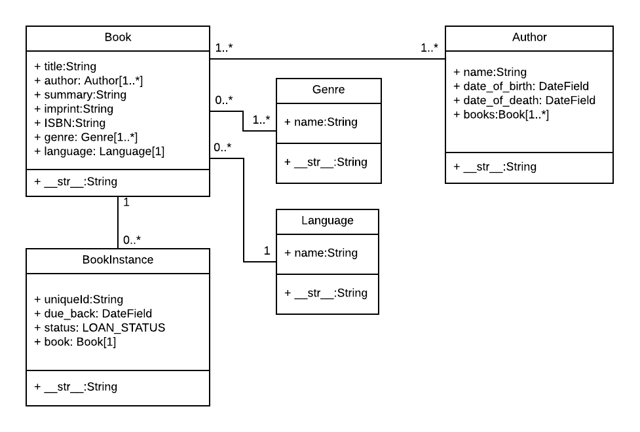
Table
Field
Method
"One Book can hav between zero and infinite number of BookInstances"
https://developer.mozilla.org/en-US/docs/Learn/Server-side/Django/Models

Slide 5
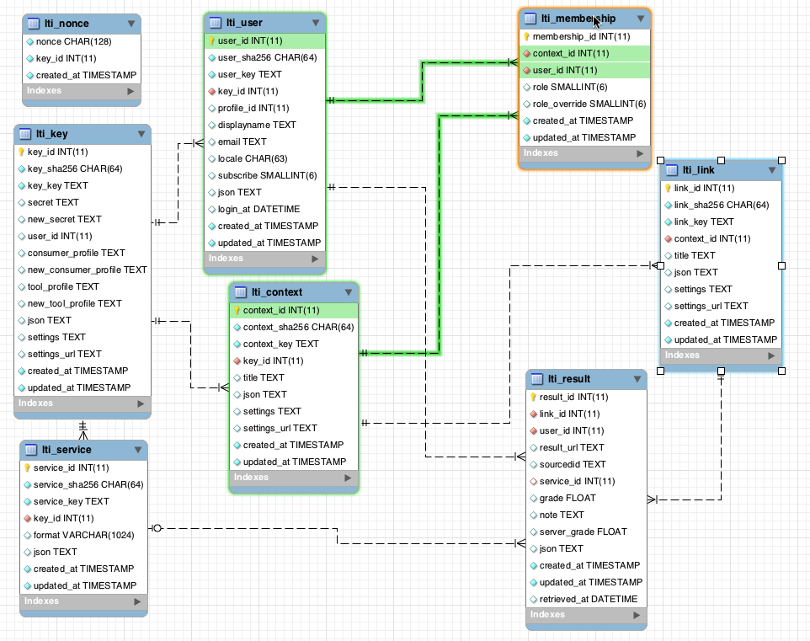
www.tsugi.org

Slide 6
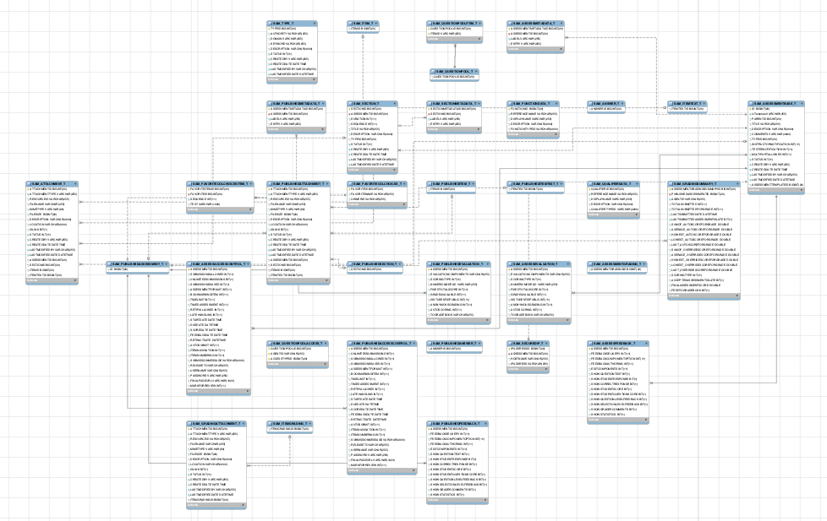
www.sakaiproject.org

Slide 7
Database Normalization (3NF)
There is *tons* of database theory / math – we simplify this to a few rules…
Do not replicate data - reference data - point at data
Add a special “unique key” column to each table which we will make references to. By convention, many programmers and frameworks call this column “id”
Use integers for to make links between tables – integers are fast and small
http://en.wikipedia.org/wiki/Database_normalization

Slide 8
Designing a Data Model

Slide 9
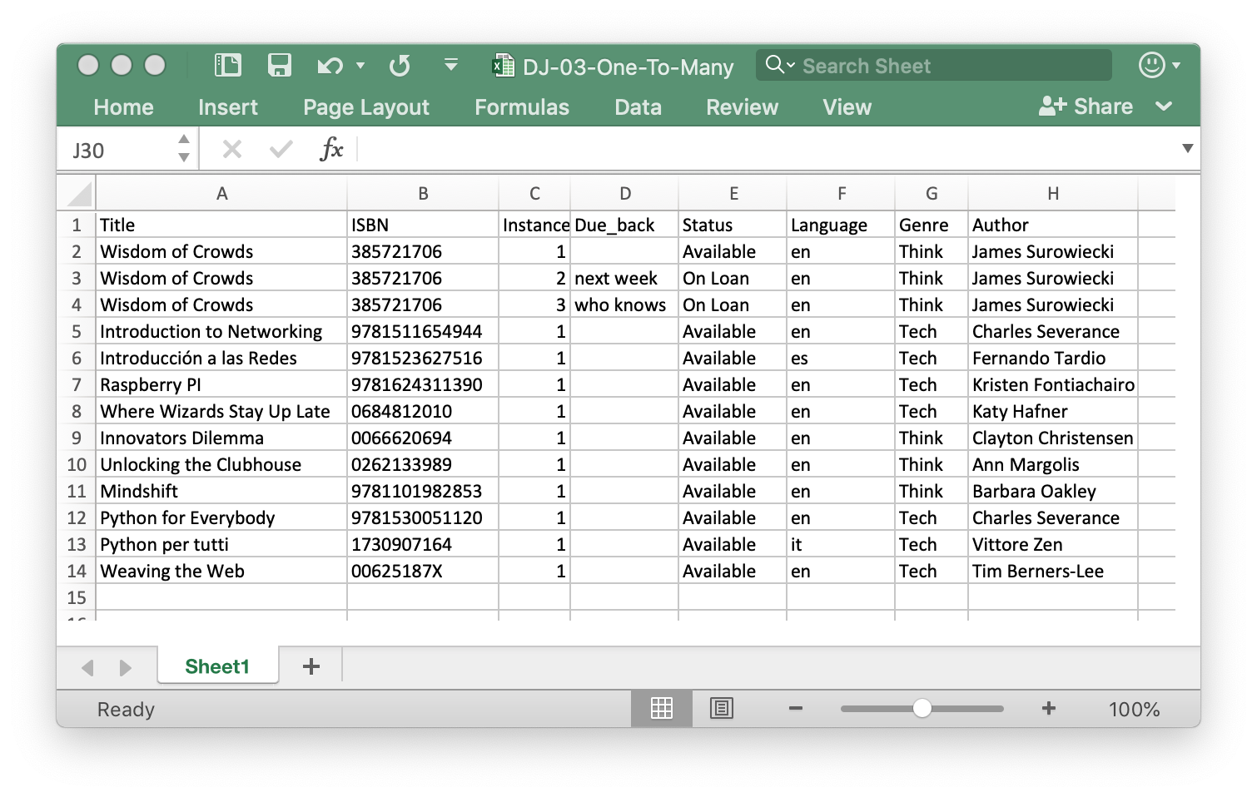

Slide 10
Title | ISBN | Instance | Due_back | Status | Language | Genre | Author
Wisdom of Crowds | 385721706 | 1 |  | Available | en | Think | James Surowiecki
Wisdom of Crowds | 385721706 | 2 | next week | On Loan | en | Think | James Surowiecki
Wisdom of Crowds | 385721706 | 3 | who knows | On Loan | en | Think | James Surowiecki
Introduction to Networking | 9781511654944 | 1 |  | Available | en | Tech | Charles Severance
Introducción a las Redes | 9781523627516 | 1 |  | Available | es | Tech | Fernando Tardio
Raspberry PI | 9781624311390 | 1 |  | Available | en | Tech | Kristen Fontichiaro
Where Wizards Stay Up Late | 0684812010 | 1 |  | Available | en | Tech | Katy Hafner
Innovators Dilemma | 0066620694 | 1 |  | Available | en | Think | Clayton Christensen
Unlocking the Clubhouse | 0262133989 | 1 |  | Available | en | Think | Ann Margolis
Mindshift | 9781101982853 | 1 |  | Available | en | Think | Barbara Oakley
Python for Everybody | 9781530051120 | 1 |  | Available | en | Tech | Charles Severance
Python per tutti | 1730907164 | 1 |  | Available | it | Tech | Vittore Zen
Weaving the Web | 00625187X | 1 |  | Available | en | Tech | Tim Berners-Lee

Slide 11
Title | ISBN | Instance | Due_back | Status | Language | Genre | Author
Wisdom of Crowds | 385721706 | 1 |  | Available | en | Think | James Surowiecki
Wisdom of Crowds | 385721706 | 2 | next week | On Loan | en | Think | James Surowiecki
Wisdom of Crowds | 385721706 | 3 | who knows | On Loan | en | Think | James Surowiecki
Introduction to Networking | 9781511654944 | 1 |  | Available | en | Tech | Charles Severance
Introducción a las Redes | 9781523627516 | 1 |  | Available | es | Tech | Fernando Tardio
Raspberry PI | 9781624311390 | 1 |  | Available | en | Tech | Kristen Fontichiaro
Where Wizards Stay Up Late | 0684812010 | 1 |  | Available | en | Tech | Katy Hafner
Innovators Dilemma | 0066620694 | 1 |  | Available | en | Think | Clayton Christensen
Unlocking the Clubhouse | 0262133989 | 1 |  | Available | en | Think | Ann Margolis
Mindshift | 9781101982853 | 1 |  | Available | en | Think | Barbara Oakley
Python for Everybody | 9781530051120 | 1 |  | Available | en | Tech | Charles Severance
Python per tutti | 1730907164 | 1 |  | Available | it | Tech | Vittore Zen
Weaving the Web | 00625187X | 1 |  | Available | en | Tech | Tim Berners-Lee

Slide 12
Removing Duplication
Title | ISBN | Instance | Due_back | Status | Language
Wisdom of Crowds | 385721706 | 1 |  | Available | en
Wisdom of Crowds | 385721706 | 2 | next week | On Loan | en
Wisdom of Crowds | 385721706 | 3 | who knows | On Loan | en
Introduction to Networking | 9781511654944 | 1 |  | Available | en
Introducción a las Redes | 9781523627516 | 1 |  | Available | es
Instance | Due_back
1
2 | next week
3 | who knows
1
1
Title | ISBN
Wisdom of Crowds | 385721706
Introduction to Networking | 9781511654944
Introducción a las Redes | 9781523627516
Language
en
es

Slide 13
Adding Links
Title | ISBN | Instance | Due_back | Status | Language
Wisdom of Crowds | 385721706 | 1 |  | Available | en
Wisdom of Crowds | 385721706 | 2 | next week | On Loan | en
Wisdom of Crowds | 385721706 | 3 | who knows | On Loan | en
Introduction to Networking | 9781511654944 | 1 |  | Available | en
Introducción a las Redes | 9781523627516 | 1 |  | Available | es
Instance | Due_back | Status
1 |  | Available
2 | next week | On Loan
3 | who knows | On Loan
1 |  | Available
1 |  | Available
Title | ISBN
Wisdom of Crowds | 385721706
Introduction to Networking | 9781511654944
Introducción a las Redes | 9781523627516
Language
en
es
To
One
To
One
Many
Many

Slide 14
Title | ISBN
Wisdom of Crowds | 385721706
Introduction to Networking | 9781511654944
Introducción a las Redes | 9781523627516
Language
en
es
To
One
Many
Legend:
1 One
1..* Many with a minimum of 1
0..* Many with a minimum of 0
https://developer.mozilla.org/en-US/docs/Learn/Server-side/Django/Models

Slide 15
Instance | Due_back | Status
1 |  | Available
2 | next week | On Loan
3 | who knows | On Loan
1 |  | Available
1 |  | Available
Title | ISBN
Wisdom of Crowds | 385721706
Introduction to Networking | 9781511654944
Introducción a las Redes | 9781523627516
To
One
Many
Legend:
1 One
1..* Many with a minimum of 1
0..* Many with a minimum of 0
https://developer.mozilla.org/en-US/docs/Learn/Server-side/Django/Models

Slide 16
Representing Links (Relationships) in a Database
Lets get physical…

Slide 17
Links in a Logical Model
Title | ISBN | Instance | Due_back | Status | Language
Wisdom of Crowds | 385721706 | 1 |  | Available | en
Wisdom of Crowds | 385721706 | 2 | next week | On Loan | en
Wisdom of Crowds | 385721706 | 3 | who knows | On Loan | en
Introduction to Networking | 9781511654944 | 1 |  | Available | en
Introducción a las Redes | 9781523627516 | 1 |  | Available | es
Instance | Due_back | Status
1 |  | Available
2 | next week | On Loan
3 | who knows | On Loan
1 |  | Available
1 |  | Available
Title | ISBN
Wisdom of Crowds | 385721706
Introduction to Networking | 9781511654944
Introducción a las Redes | 9781523627516
Language
en
es
To
One
To
One
Many
Many

Slide 18
Links in a Physical Model
Title | ISBN | Instance | Due_back | Status | Language
Wisdom of Crowds | 385721706 | 1 |  | Available | en
Wisdom of Crowds | 385721706 | 2 | next week | On Loan | en
Wisdom of Crowds | 385721706 | 3 | who knows | On Loan | en
Introduction to Networking | 9781511654944 | 1 |  | Available | en
Introducción a las Redes | 9781523627516 | 1 |  | Available | es
id | Instance | Due_back | book_id
1 | 1 |  | 1
2 | 2 | next week | 1
3 | 3 | who knows | 1
4 | 1 |  | 2
5 | 1 |  | 2
id | Title | ISBN | lang_id
1 | Wisdom of Crowds | 385721706 | 1
2 | Introduction to Networking | 9781511654944 | 1
3 | Introducción a las Redes | 9781523627516 | 2
id | Lang
1 | en
2 | es

Slide 19
Key Terminology
We add an automatically incrementing column to every row which we call the "Primary Key" for that row. We often name the column "id" to indicate that it is the "identifier" for that row.
When we add a column to a table that "points to" a row in another table we call it a "Foreign Key" and often include the name of the destination table in the column name like "lang_id"
id | Title | ISBN | lang_id
1 | Wisdom of Crowds | 385721706 | 1
2 | Introduction to Networking | 9781511654944 | 1
3 | Introducción a las Redes | 9781523627516 | 2
id | Lang
1 | en
2 | es

Slide 20
Physical / Logical
id | Instance | Due_back | book_id
1 | 1 |  | 1
2 | 2 | next week | 1
3 | 3 | who knows | 1
4 | 1 |  | 2
5 | 1 |  | 2
id | Lang
1 | en
2 | es
id | Title | ISBN | lang_id
1 | Wisdom of Crowds | 385721706 | 1
2 | Introduction to Networking | 9781511654944 | 1
3 | Introducción a las Redes | 9781523627516 | 2

Slide 21
Representing Links (Relationships) in Django
Lets get our ORM on…

Slide 22
Model Field Types
AutoField
BigAutoField
BigIntegerField
BinaryField
BooleanField
CharField
DateField
DateTimeField
DecimalField
DurationField
EmailField
FileField
FilePathField
FloatField
ImageField
IntegerField
GenericIPAddressField
NullBooleanField
PositiveIntegerField
PositiveSmallIntegerField
SlugField
SmallIntegerField
TextFIeld
TimeField
URLField
ForeignKey
ManyToManyField
OneToOneField
https://docs.djangoproject.com/en/2.1/ref/models/fields/#field-types

Slide 23
Instance | Due_back | Status
1 |  | Available
2 | next week | On Loan
3 | who knows | On Loan
Title | ISBN
Wisdom of Crowds | 385721706
Introduction to Networking | 9781511654944
Introducción a las Redes | 9781523627516
Language
en
es
from django.db import models
class Lang(models.Model):
name = models.CharField(max_length=200)
class Book(models.Model):
title = models.CharField(max_length=200)
isbn = models.CharField(max_length=13)
lang = models.ForeignKey('Lang', on_delete=models.SET_NULL, null=True)
class Instance(models.Model):
book = models.ForeignKey('Book', on_delete=models.CASCADE)
due_back = models.DateField(null=True, blank=True)

Slide 24
from django.db import models
class Lang(models.Model):
name = models.CharField(max_length=200)
class Book(models.Model):
title = models.CharField(max_length=200)
isbn = models.CharField(max_length=13)
lang = models.ForeignKey('Lang',
on_delete=models.SET_NULL, null=True)
class Instance(models.Model):
due_back = models.DateField(null=True, blank=True)
book = models.ForeignKey('Book',
on_delete=models.CASCADE)
https://github.com/csev/dj4e-samples/blob/master/bookone/models.py

Slide 25
From Model to Database
$ python3 manage.py makemigrations
Migrations for 'bookone':
bookone/migrations/0001_initial.py
- Create model Book
- Create model Instance
- Create model Lang
- Add field lang to book
$ python3 manage.py makemigrations
No changes detected
$ python3 manage.py migrate
Operations to perform:
Apply all migrations: admin,...
Running migrations:
Applying bookone.0001_initial... OK
$ python3 manage.py migrate
Operations to perform:
Apply all migrations: admin, auth, autos, bookone, ...
Running migrations:
No migrations to apply.
Note that makemigrations only "does something" when you create or alter a models.py file. The migrate only "does something" when there are migrations that are not yet applied to the database. Also an application must be added to settings.py before these commands see the models.py file for an application.

Slide 26
dj4e-samples$ sqlite3 db.sqlite3
SQLite version 3.24.0 2018-06-04 14:10:15
Enter ".help" for usage hints.
sqlite> .tables 'bookone%'
bookone_book bookone_instance bookone_lang
sqlite> .schema bookone_book
CREATE TABLE IF NOT EXISTS "bookone_book" (
"id" integer NOT NULL PRIMARY KEY AUTOINCREMENT,
"title" varchar(200) NOT NULL,
"isbn" varchar(13) NOT NULL,
"lang_id" integer NULL REFERENCES "bookone_lang" ("id")
DEFERRABLE INITIALLY DEFERRED
);
CREATE INDEX "bookone_book_lang_id_24ba3759"
ON "bookone_book" ("lang_id");
sqlite> .schema bookone_lang
CREATE TABLE IF NOT EXISTS "bookone_lang" (
"id" integer NOT NULL PRIMARY KEY AUTOINCREMENT,
"name" varchar(200) NOT NULL
);
sqlite> .schema bookone_instance
CREATE TABLE IF NOT EXISTS "bookone_instance" (
"id" integer NOT NULL PRIMARY KEY AUTOINCREMENT,
"due_back" date NULL,
"book_id" integer NOT NULL REFERENCES "bookone_book" ("id")
DEFERRABLE INITIALLY DEFERRED
);
CREATE INDEX "bookone_instance_book_id_1fa5e2e7"
ON "bookone_instance" ("book_id");
sqlite> .quit
dj4e-samples$

Slide 27
About on_delete
What do we do when a row in one table points to a row in a "foreign" table via a forgign key and the "destination row" is deleted
on_delete = set_null – Keep the row but set foreign key to null
on_delete = cascade - Delete the row
id | Title | ISBN | lang_id
1 | Wisdom of Crowds | 385721706 | 1
2 | Introduction to Networking | 9781511654944 | 1
3 | Introducción a las Redes | 9781523627516 | 2
id | Lang
1 | en
2 | es
https://docs.djangoproject.com/en/2.2/ref/models/fields/#django.db.models.ForeignKey.on_delete

Slide 28
Instance | Due_back | Status
1 |  | Available
2 | next week | On Loan
3 | who knows | On Loan
Title | ISBN
Wisdom of Crowds | 385721706
Introduction to Networking | 9781511654944
Introducción a las Redes | 9781523627516
Language
en
es
from django.db import models
class Lang(models.Model):
name = models.CharField(max_length=200)
class Book(models.Model):
title = models.CharField(max_length=200)
isbn = models.CharField(max_length=13)
lang = models.ForeignKey('Lang', on_delete=models.SET_NULL, null=True)
class Instance(models.Model):
book = models.ForeignKey('Book', on_delete=models.CASCADE)
due_back = models.DateField(null=True, blank=True)

Slide 29
Models, Migrations, and Database Tables

Slide 30
Migrations: From Model to Database
The makemigrations command reads all the models.py files in all the applications, end creates / evolves the migration files
Guided by the applications listed in settings.py
Migrations are portable across databases
The migrate command reads all the migrations folders in the application folders and creates / evolves the tables in the database (i.e. db.sqlite3)

Slide 31
makemigrations
dj4e-samples$ ls */migrations/0*.py
autos/migrations/0001_initial.py
bookone/migrations/0001_initial.py
favs/migrations/0001_initial.py
favs/migrations/0002_auto_20190420_1624.py
favsql/migrations/0001_initial.py
forums/migrations/0001_initial.py
gview/migrations/0001_initial.py
many/migrations/0001_initial.py
many/migrations/0002_auto_20190329_1653.py
myarts/migrations/0001_initial.py
pics/migrations/0001_initial.py
rest/migrations/0001_initial.py
tracks/migrations/0001_initial.py
users/migrations/0001_initial.py
dj4e-samples$
dj4e-samples$ ls */models.py
autos/models.py many/models.py
bookone/models.py menu/models.py
crispy/models.py myarts/models.py
favs/models.py pics/models.py
favsql/models.py rest/models.py
form/models.py route/models.py
forums/models.py session/models.py
getpost/models.py tmpl/models.py
gview/models.py tracks/models.py
hello/models.py users/models.py
home/models.py views/models.py
dj4e-samples$

Slide 32
migrate
dj4e-samples$ sqlite3 db.sqlite3
SQLite version 3.24.0 2018-06-04 14:10:15
Enter ".help" for usage hints.
sqlite> .tables
auth_group gview_car
auth_group_permissions gview_cat
auth_permission gview_dog
auth_user gview_horse
auth_user_groups many_course
auth_user_user_permissions many_membership
autos_auto many_person
autos_make myarts_article
bookone_book pics_pic
bookone_instance rest_breed
bookone_lang rest_cat
django_admin_log social_auth_association
django_content_type social_auth_code
django_migrations social_auth_nonce
django_session social_auth_partial
favs_fav social_auth_usersocialauth
favs_thing tracks_album
favsql_fav tracks_artist
favsql_thing tracks_genre
forums_comment tracks_track
forums_forum users_user
sqlite> .quit
dj4e-samples$
dj4e-samples$ ls */migrations/0*.py
autos/migrations/0001_initial.py
bookone/migrations/0001_initial.py
favs/migrations/0001_initial.py
favs/migrations/0002_auto_20190420_1624.py
favsql/migrations/0001_initial.py
forums/migrations/0001_initial.py
gview/migrations/0001_initial.py
many/migrations/0001_initial.py
many/migrations/0002_auto_20190329_1653.py
myarts/migrations/0001_initial.py
pics/migrations/0001_initial.py
rest/migrations/0001_initial.py
tracks/migrations/0001_initial.py
users/migrations/0001_initial.py
dj4e-samples$

Slide 33
Re-running makemigrate
dj4e-samples$ rm bookone/migrations/0001_initial.py
MacBook-Pro-92:dj4e-samples csev$ python3 manage.py makemigrations
Migrations for 'bookone':
bookone/migrations/0001_initial.py
- Create model Book
- Create model Instance
- Create model Lang
- Add field lang to book
dj4e-samples$

Slide 34
Re-running migrate from scratch
dj4e-samples$ rm db.sqlite3
dj4e-samples$ python3 manage.py migrate
Operations to perform:
Apply all migrations: admin, auth, autos, bookone, contenttypes, ...
Running migrations:
Applying contenttypes.0001_initial... OK
Applying auth.0001_initial... OK
Applying admin.0001_initial... OK
Applying admin.0002_logentry_remove_auto_add... OK
Applying contenttypes.0002_remove_content_type_name... OK
Applying auth.0002_alter_permission_name_max_length... OK
[ ...snip ... ]
Applying social_django.0008_partial_timestamp... OK
Applying tracks.0001_initial... OK
Applying users.0001_initial... OK
dj4e-samples$

Slide 35
Using Models in the Django Shell

Slide 36
$ cd ~/dj4e-samples
$ python3 manage.py shell
>>> from bookone.models import Book,
... Lang, Instance
>>> z = Lang(name='en')
>>> z.save()
>>> z.id
1
>>> x = Book(title='PY4E', isbn='42', lang=z)
>>> x.save()
>>> x.id
1
>>> a = Instance(due_back="2020-07-06", book=x)
>>> a.save()
>>> a.id
1
>>> quit()
$

Slide 37
$ cd ~/dj4e-samples
$ python3 manage.py shell
>>> from bookone.models import Book,
... Lang, Instance
>>> x = Book.objects.get(pk=1)
>>> x
<Book: Book object (1)>
>>> x.title
'PY4E'
>>> x.lang.name
'en'
>>> y = Instance.objects.get(pk=1)
>>> y.due_back
datetime.date(2020, 7, 6)
>>> y.book.title
'PY4E'
>>> quit()
$

Slide 38
Coming Up Many-to-Many
"The relationship between Book and Genre is many-to-many"
https://developer.mozilla.org/en-US/docs/Learn/Server-side/Django/Models

Slide 39
Acknowledgements / Contributions
These slides are Copyright 2019- Charles R. Severance (www.dr-chuck.com) as part of www.dj4e.com and made available under a Creative Commons Attribution 4.0 License. Please maintain this last slide in all copies of the document to comply with the attribution requirements of the license. If you make a change, feel free to add your name and organization to the list of contributors on this page as you republish the materials.
Initial Development: Charles Severance, University of Michigan School of Information
Insert new Contributors and Translators here including names and dates
Continue new Contributors and Translators here

