Slide 1

Generic Views
Charles Severance
www.dj4e.com

Slide 2
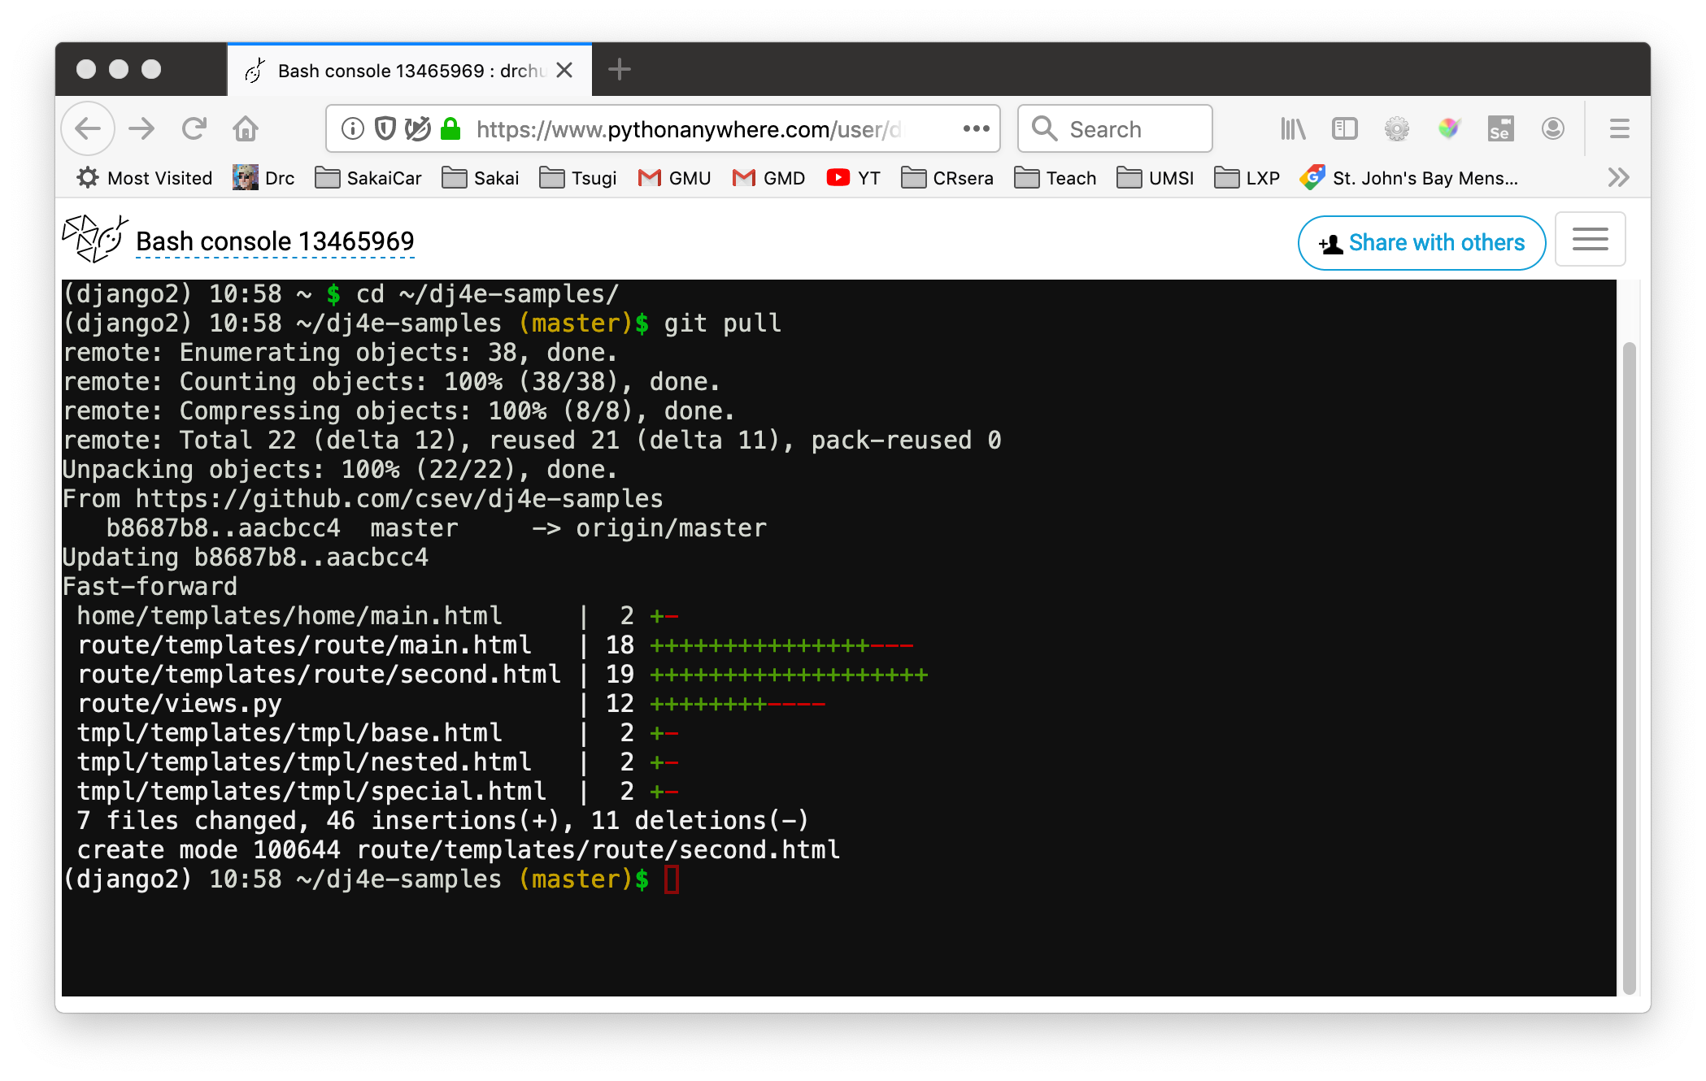
Update your dj4e-samples
cd ~/dj4e-samples
git pull

Slide 3

Browser
Linux
D
O
M
N
G
I
N X
WGSIConfig
settings.py
Django
Routing
Click
urls.py
views.py
Parse
Response
Views
Templates
forms.py
Javascript
Database
Shell
Models
models.py
/admin
admin.py

Slide 4
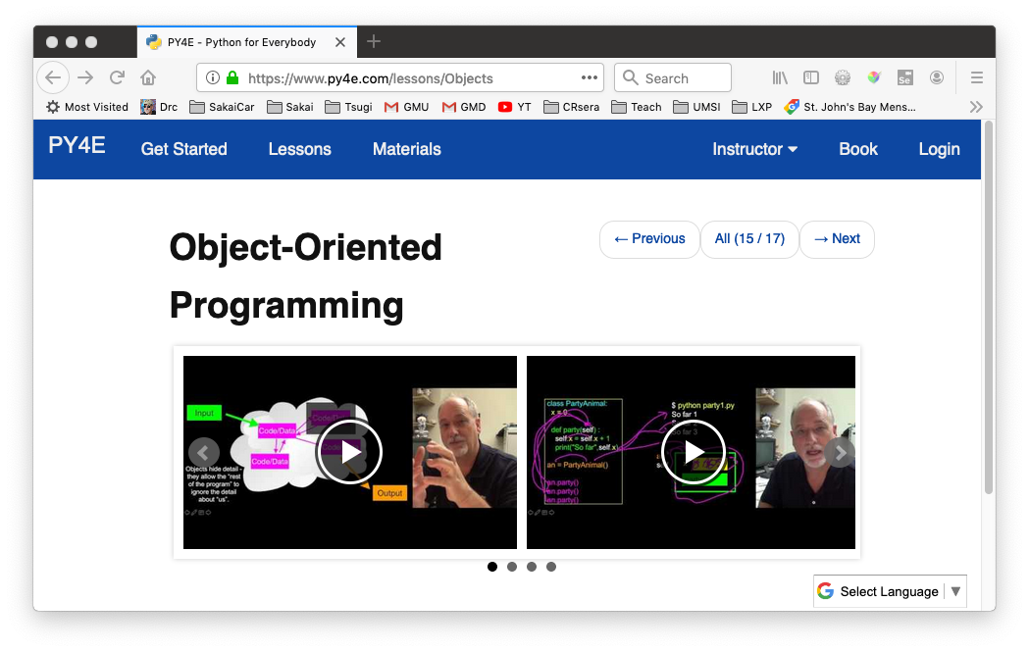
Review Python Object-Oriented Programming
https://www.py4e.com/lessons/Objects

Slide 5
Looking back: SQL
Structured Query Language is the language we use to issue commands to the database
- Create data (a.k.a Insert)
- Retrieve data
- Update data
- Delete data
http://en.wikipedia.org/wiki/SQL

Slide 6
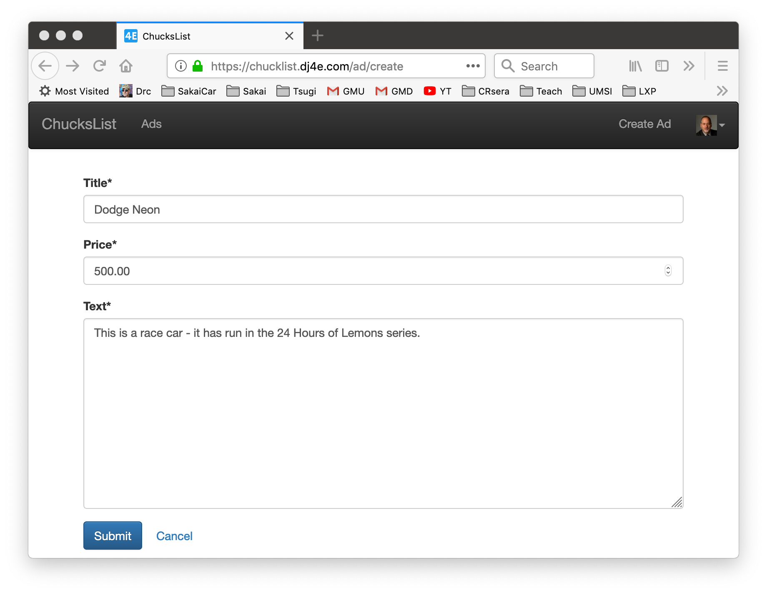
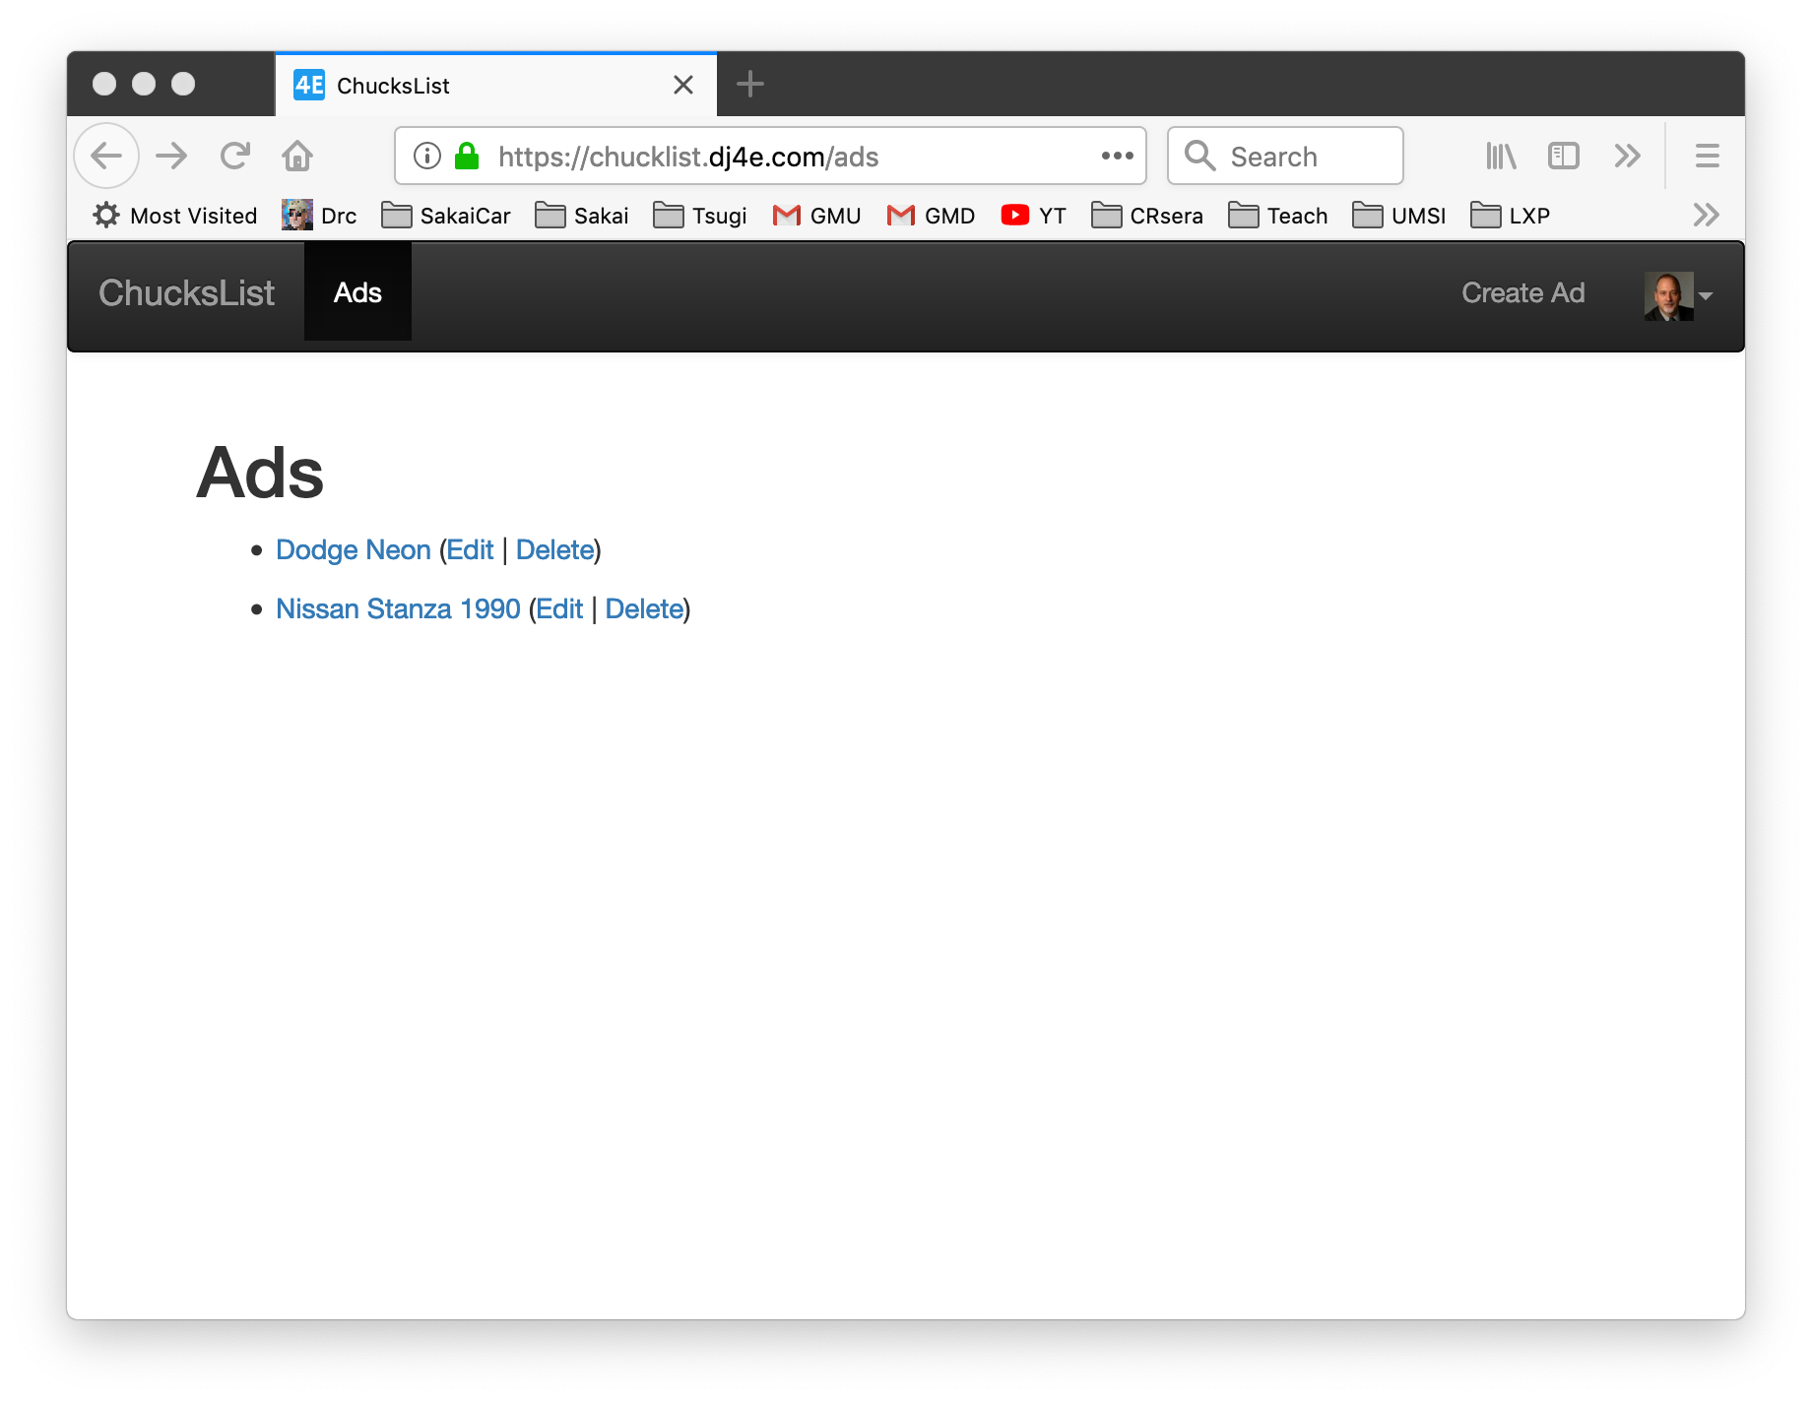
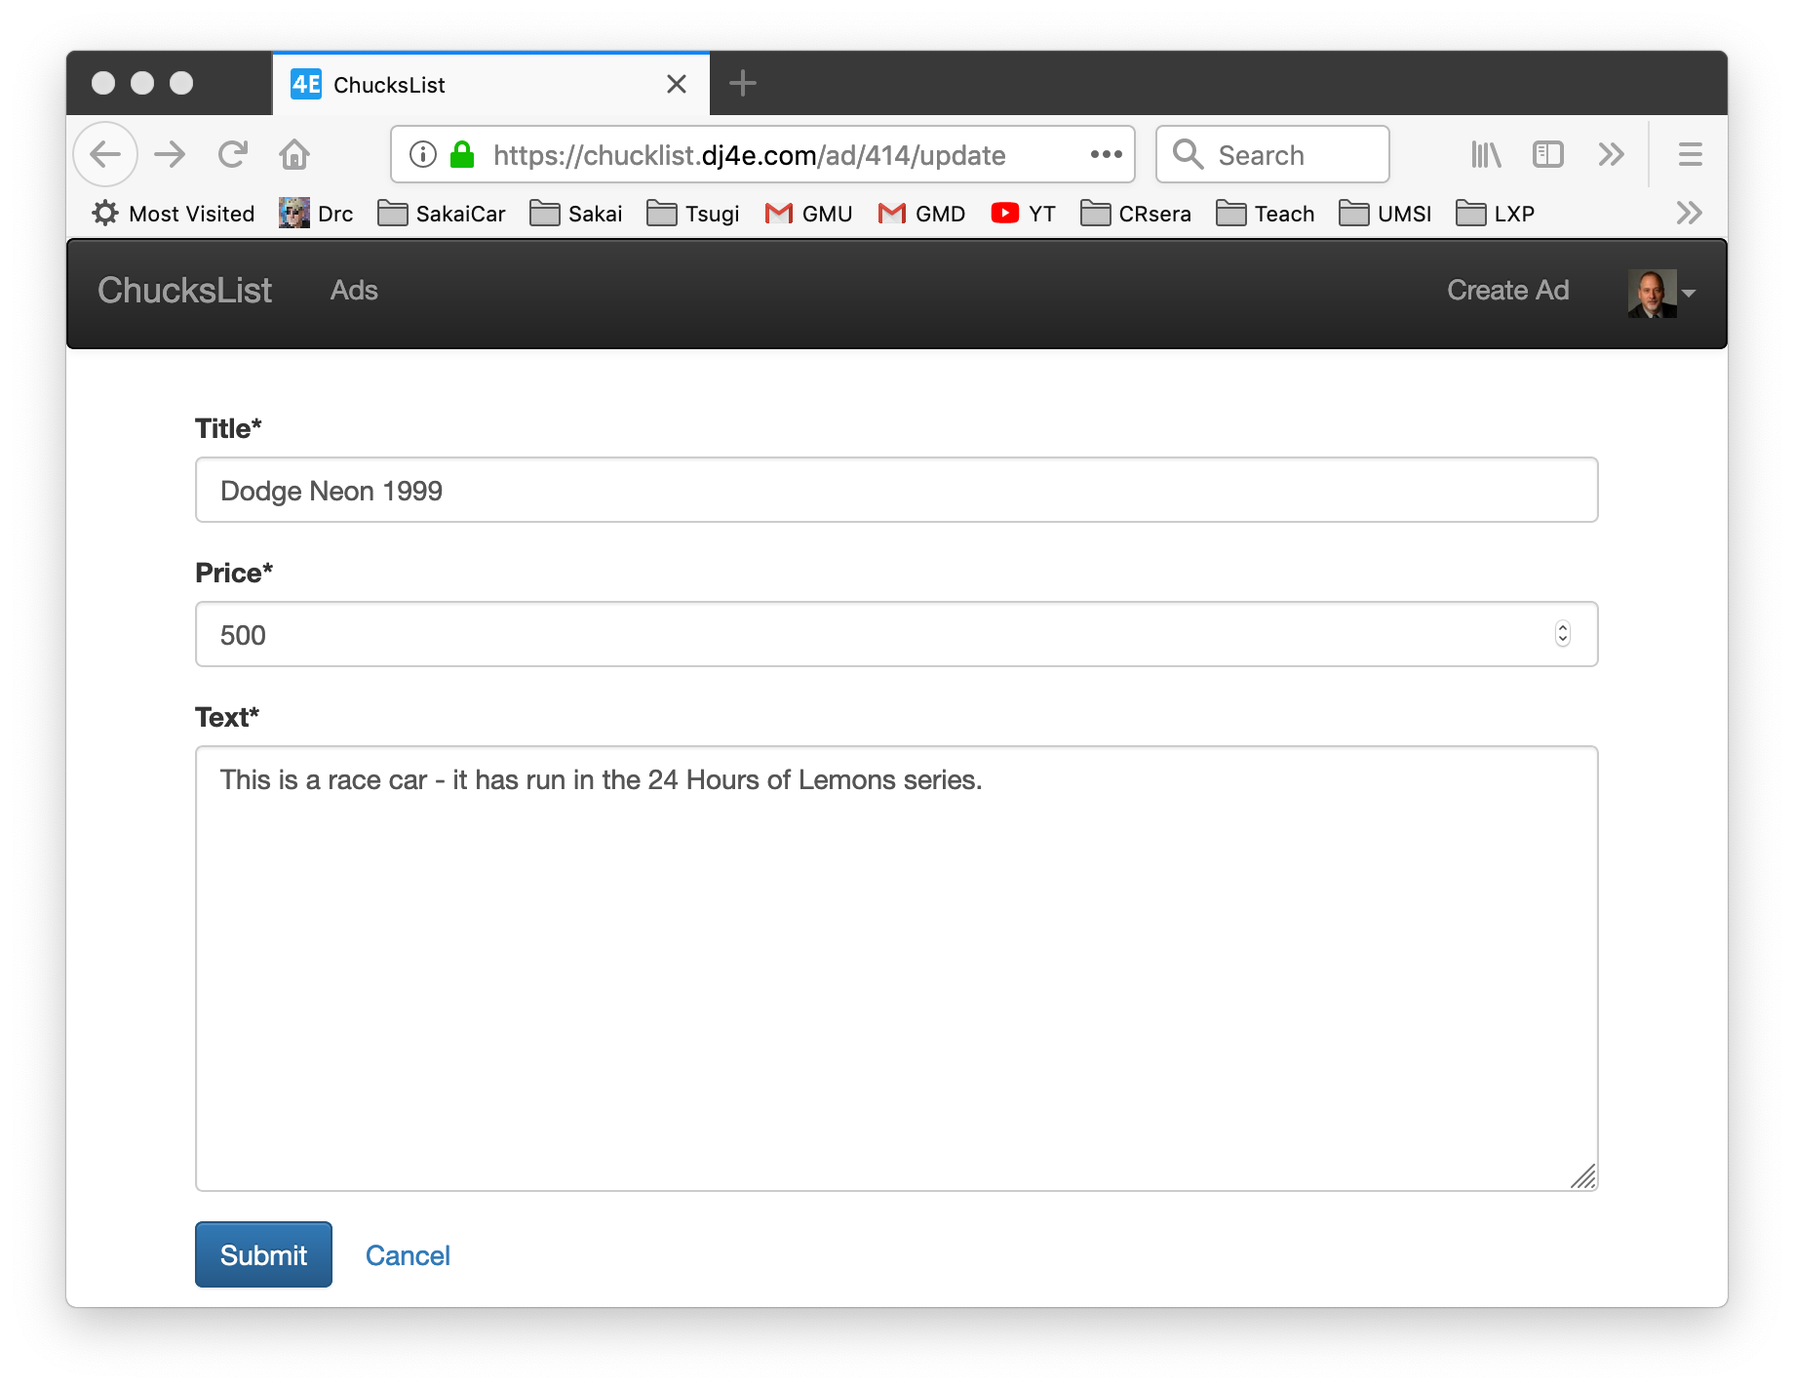
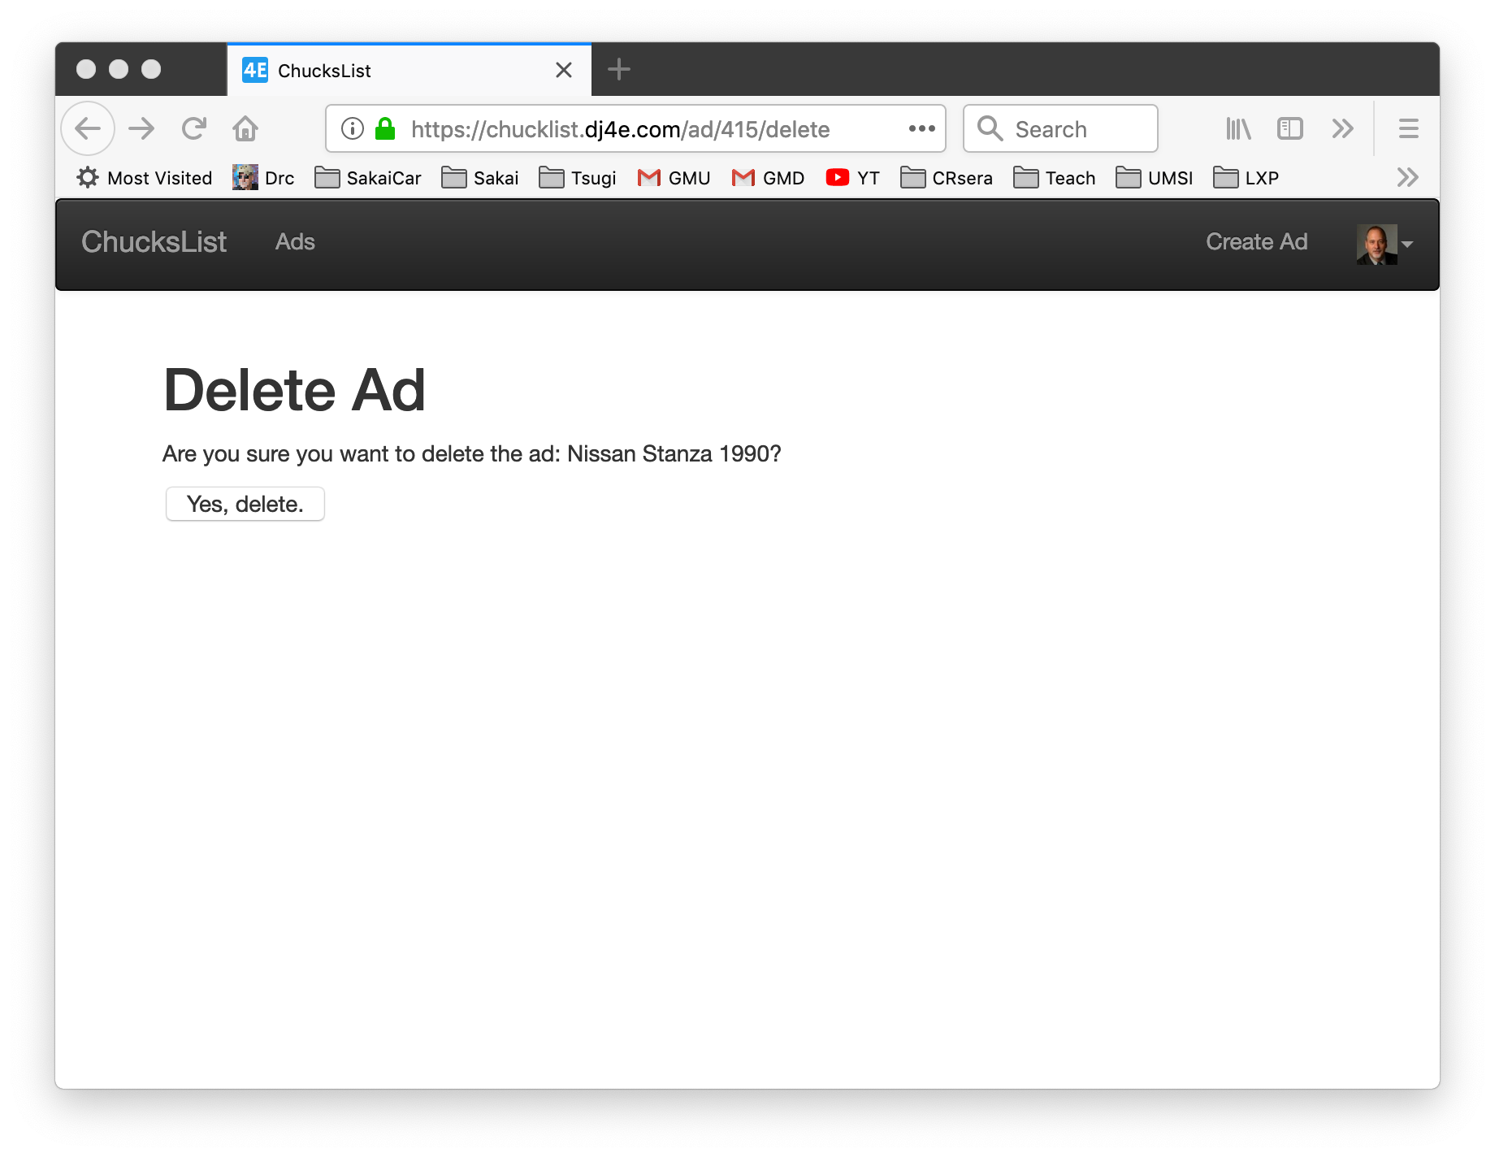
Peeking Ahead: CRUD UI

Slide 7
DRY : Don't Repeat Yourself
Don't repeat yourself (DRY, or sometimes do not repeat yourself) is a principle of software development aimed at reducing repetition of software patterns] replacing it with abstractions or using data normalization to avoid redundancy. The principle has been formulated by Andy Hunt and Dave Thomas in their book The Pragmatic Programmer.
When the DRY principle is applied successfully, a modification of any single element of a system does not require a change in other logically unrelated elements. Additionally, elements that are logically related all change predictably and uniformly, and are thus kept in sync.
https://en.wikipedia.org/wiki/Don%27t_repeat_yourself

Slide 8
Summary

Slide 9
Acknowledgements / Contributions
These slides are Copyright 2019- Charles R. Severance (www.dr-chuck.com) as part of www.dj4e.com and made available under a Creative Commons Attribution 4.0 License. Please maintain this last slide in all copies of the document to comply with the attribution requirements of the license. If you make a change, feel free to add your name and organization to the list of contributors on this page as you republish the materials.
Initial Development: Charles Severance, University of Michigan School of Information
Insert new Contributors and Translators here including names and dates
Continue new Contributors and Translators here

