Slide 1

Form Processing
Charles Severance
www.dj4e.com
https://samples.dj4e.com/getpost/
https://samples.dj4e.com/form/

Slide 2

Browser
Linux
D
O
M
N
G
I
N X
WGSIConfig
settings.py
Django
Routing
Click
urls.py
views.py
Parse
Response
Views
Templates
forms.py
Javascript
Database
Shell
Models
models.py
/admin
admin.py

Slide 3
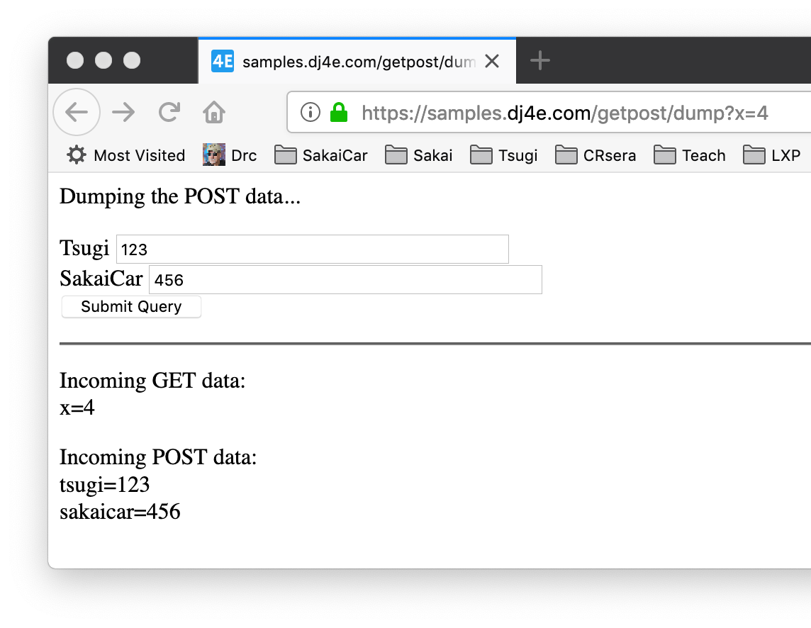
Forms gather data and send it to the server

Slide 4
FORMS in HTML

Slide 5
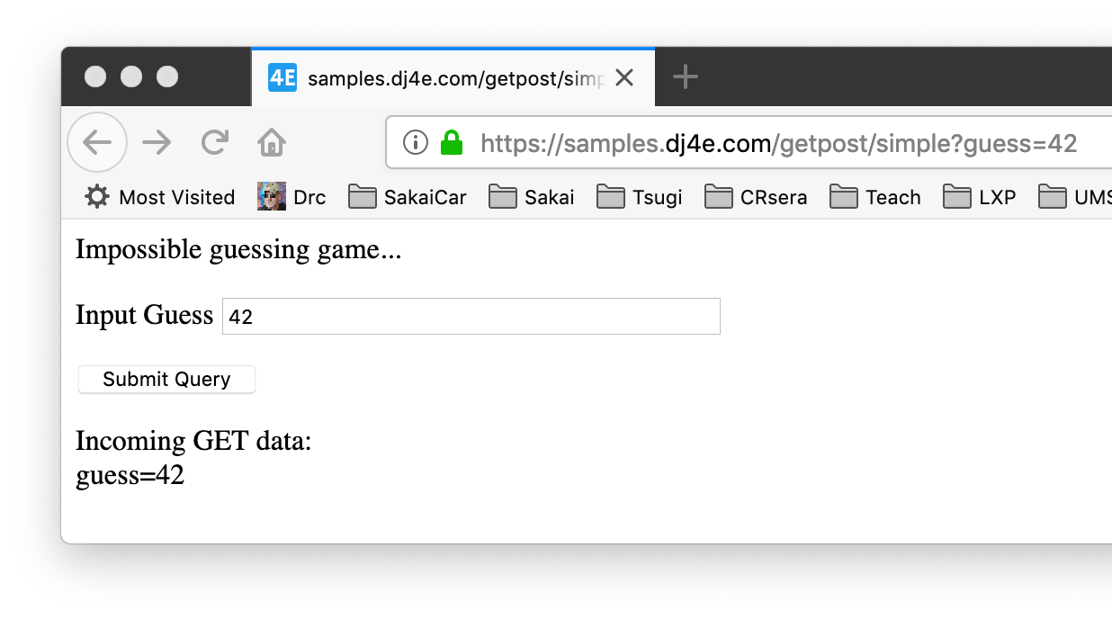
Submit form as GET
def simple(request):
response = '<p>Impossible guessing game...</p>'
response += '''<form>
<p><label for="guess">Input Guess</label>
<input type="text" name="guess" size="40" id="guess"/></p>
<input type="submit"/>
</form>
'''
if len(request.GET) > 0 :
response += '<p>Incoming GET data:<br/>\n'
for key, value in request.GET.items():
response += html.escape(key) + '=' +
html.escape(value) + '</br>\n'
response += '</p>\n'
return HttpResponse(response)
https://samples.dj4e.com/getpost/simple

Slide 7
<form method="post">
<p><label for="abc123">Tsugi</label>
<input type="text" name="tsugi" size="40" id="abc123"/><br/>
<label for="xyzzy">SakaiCar</label>
<input type="text" name="sakaicar" size="40" id="xyzzy"/><br/>
<input type="submit"/></p>
</form><hr/>

Slide 8
FORMS in HTTP

Slide 9
Forms GET vs. POST
Two ways the browser can send parameters to the web server
GET - Parameters are placed on the URL which is retrieved.
POST - The URL is retrieved and parameters are appended to the request in the the HTTP connection.

Slide 10
Passing Parameters to The Server
GET /form/simple?guess=42
Accept: text/html
User-Agent: Lynx/2.4 libwww/2.14
Web Server
HTTP
Request
POST /form/guess
Accept: text/html
User-Agent: Lynx/2.4 libwww/2.14
Content-type: application/x-www-form-urlencoded
Content-length: 13
guess=42
Browser
<input type="text" name="guess" id="yourid" />

Slide 11
Rules of the POST/GET Choice
POST is used when data is being created or modified.
GET is used when your are reading or searching things.
GET should never be used to insert, modify or delete data.
Web search spiders will follow GET URLs but generally not POST URLs.
GET URLs should be “idempotent” - the same URL should give the “same thing” each time you access it.
GET has an upper limit of the number of bytes of parameters and values (think about 2K).

Slide 12
POST-REDIRECT-GET (Refresh)

Slide 13
HTTP Status Codes
http://www.dr-chuck.com/page1.htm - 200 OK
http://www.wa4e.com/nowhere.htm - 404 Not Found
http://www.drchuck.com/ - 302 Found / Moved
Also known as “redirect”
https://en.wikipedia.org/wiki/List_of_HTTP_status_codes

Slide 14
HTTP Location Header
If your application has not yet sent any data, it can send a special header as part of the HTTP Response.
The redirect header includes a URL that the browser is supposed to forward itself to.
It was originally used for web sites that moved from one URL to another.
http://en.wikipedia.org/wiki/URL_redirection

Slide 15
POST / Refresh / ☹
Once you do a POST, if you refresh, the browser will re-send the POST data a second time.
The user gets a pop-up that tries to explain what is about to happen.

Slide 16
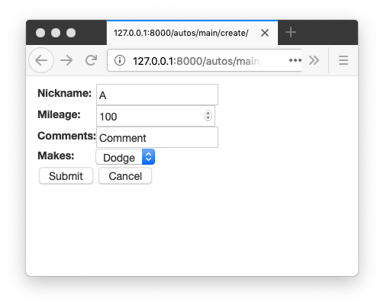
https://samples.dj4e.com/
https://samples.dj4e.com/autos
Log in, add a make, then while adding an auto, press Submit then Refresh

Slide 17
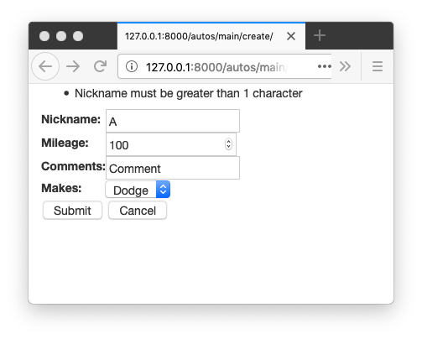
https://samples.dj4e.com/
https://samples.dj4e.com/autos
Press Submit then Refresh

Slide 18
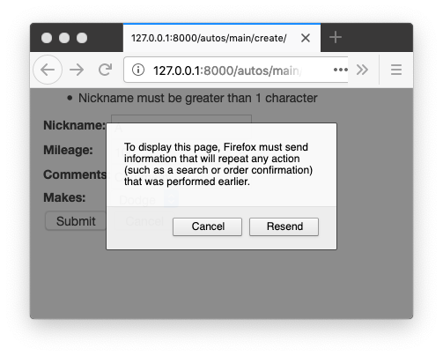
https://samples.dj4e.com/
https://samples.dj4e.com/autos
Press Submit then Refresh

Slide 19
No Double Posts
Typically POST requests are adding or modifying data whilst GET requests view data
It may be dangerous to do the same POST twice (say withdrawing funds from a bank account)
So the browser insists on asking the user (out of your control)
Kind of an ugly UX / bad usability

Slide 20
POST Redirect Rule
The simple rule for pages intended for a browser is to never generate a page with HTML content when the app receives POST data and data has been modified
Must redirect somewhere - even to the same script - forcing the browser to make a GET after the POST

Slide 21
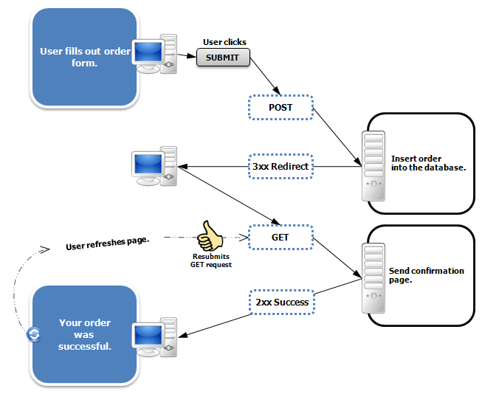
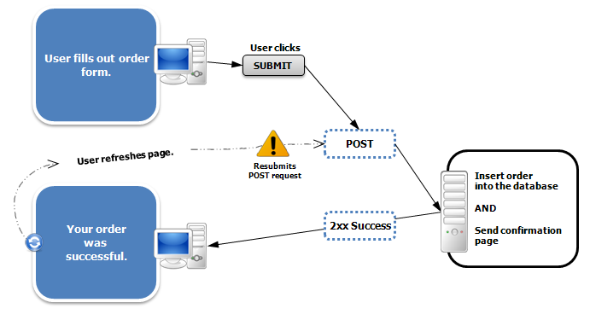
https://en.wikipedia.org/wiki/Post/Redirect/Get

Slide 22
Data Validation in FORMS

Slide 23
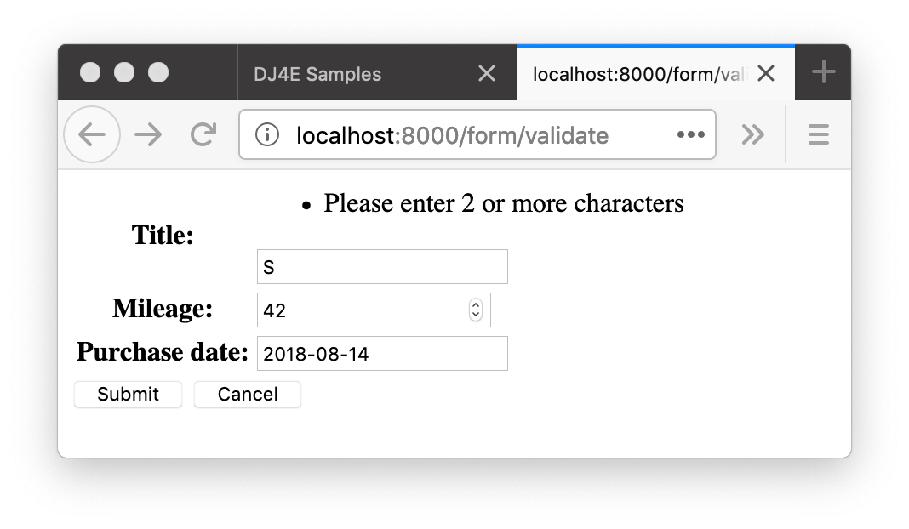
Form Data Errors
https://samples.dj4e.com/form/validate
Sometimes there are validation rules when you are filling out a form.
When you submit the form, the view code checks the data to see if there are errors
If there are errors, data is not saved and the user is notified and often given a chance to edit and resubmit the

Slide 24
Django form validation
https://samples.dj4e.com/form/validate
class BasicForm(forms.Form):
title = forms.CharField(validators=[
validators.MinLengthValidator(2, "Please enter 2 or more characters")
])
mileage = forms.IntegerField()
purchase_date = forms.DateField()
https://docs.djangoproject.com/en/2.1/ref/validators/

Slide 25
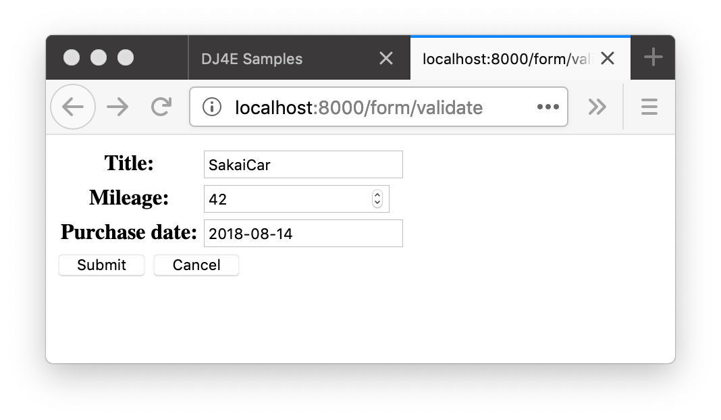
GET
class Validate(View):
def get(self, request) :
old_data = {
'title': 'SakaiCar',
'mileage' : 42,
'purchase_date': '2018-08-14'
}
form = BasicForm(initial=old_data)
ctx = {'form' : form}
return render(request, 'form/form.html', ctx)
def post(self, request) :
form = BasicForm(request.POST)
if not form.is_valid() :
ctx = {'form' : form}
return render(request, 'form/form.html', ctx)
# Save the Data
return redirect('/form/success')
def success(request) :
return HttpResponse('Thank you!')
200
dj4e-samples/form/views.py

Slide 26
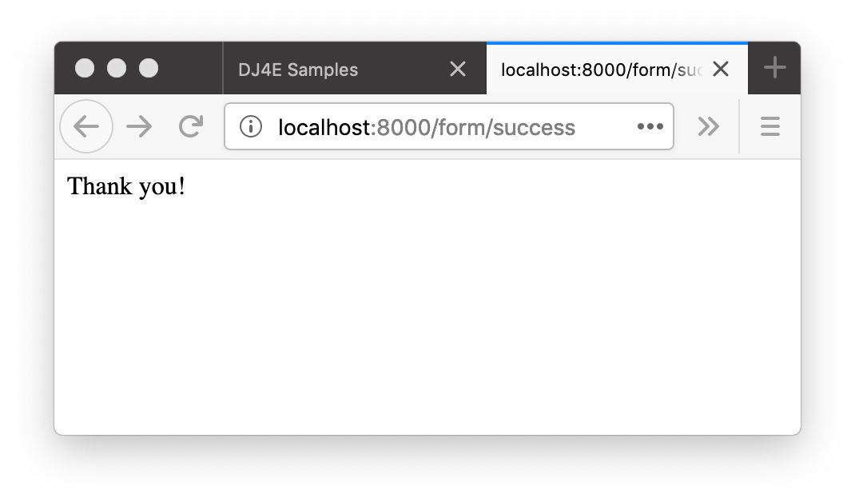
dj4e-samples/form/views.py
class Validate(DumpPostView):
def get(self, request) :
old_data = {
'title': 'SakaiCar',
'mileage' : 42,
'purchase_date': '2018-08-14'
}
form = BasicForm(initial=old_data)
ctx = {'form' : form}
return render(request, 'form/form.html', ctx)
def post(self, request) :
form = BasicForm(request.POST)
if not form.is_valid() :
ctx = {'form' : form}
return render(request, 'form/form.html', ctx)
# Save the Data return redirect('/form/success')
def success(request) :
return HttpResponse('Thank you!')
POST
302
200
GET

Slide 27
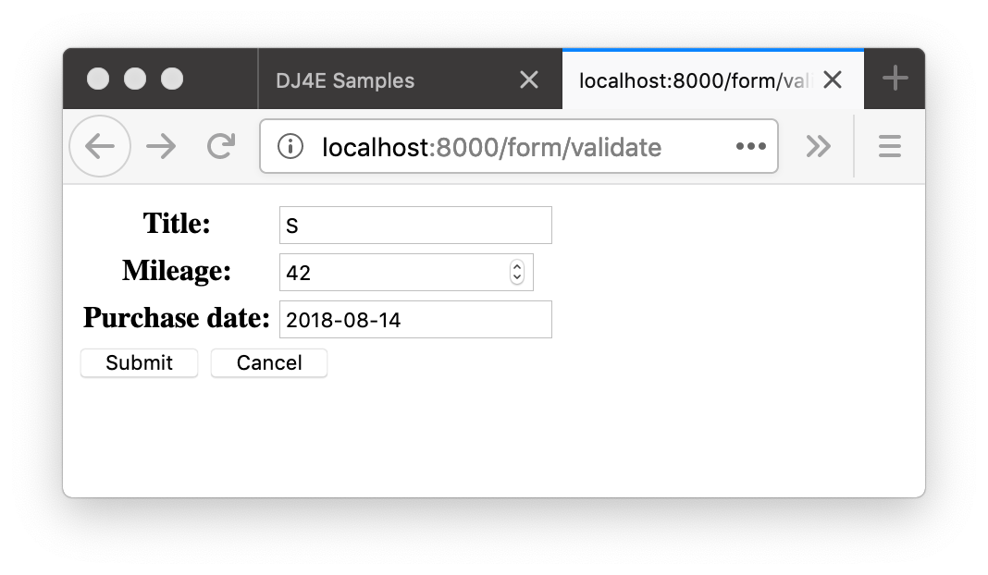
class Validate(DumpPostView):
def get(self, request) :
old_data = {
'title': 'SakaiCar',
'mileage' : 42,
'purchase_date': '2018-08-14'
}
form = BasicForm(initial=old_data)
ctx = {'form' : form}
return render(request, 'form/form.html', ctx)
def post(self, request) :
form = BasicForm(request.POST)
if not form.is_valid() :
ctx = {'form' : form}
return render(request, 'form/form.html', ctx)
# Save the Data
return redirect('/form/success')
def success(request) :
return HttpResponse('Thank you!')
POST
200

Slide 28
Cross-Site-Request-Forgery (CSRF)
Security

Slide 29
CSRF Attack
A rogue site generates a page that includes form that posts data to a site where the user is logged in via a session cookie
The form is submitted to the legitimate site and the cookie is included
The legitimate site accepts the request because of the cookie value
Note that the rogue site does not need to know the cookie value – it just knows that the cookie will be sent on requests to the legitimate site
https://en.wikipedia.org/wiki/Cross-site_request_forgery

Slide 30
CSRF Defense
The legitimate site chooses a large random number (the CSRF Token) and puts it in the session
When the legitimate site generates a POST form, it includes the CSRF Token as a hidden input field
When the form is submitted the CSRF Token is sent as well as the cookie
The site looks up the session and rejects the request if the incoming CSRF Token does not match the session's CSRF Token
https://en.wikipedia.org/wiki/Cross-site_request_forgery

Slide 31
Scenario: Time to Change a Student Grade
www.dj4e.com
Browser
<form method="post"
action="https://www.dj4e.com/grades/123">
<input type="text" name="new-grade"
value="0.5">
<input type="submit">
</form>
user: csev
instructor: true
42
POST /grades/123
cookie: sessid=42
new-grade=0.5
cookies
www.dj4e.com
sessid: 42
Student | Grade
123 | 0.5
456 | 1.0

Slide 32
Attack (without CSRF)
www.csrf.com
Browser
<form method="post"
action="https://www.dj4e.com/grades/123">
<input type="text" name="new-grade"
value="1.0">
<input type="submit">
</form>
user: csev
instructor: true
42
www.dj4e.com
POST /grades/123
cookie: sessid=42
new-grade=1.0
cookies
www.dj4e.com
sessid: 42
Student | Grade
123 | 1.0
456 | 1.0

Slide 33
With CSRF
www.dj4e.com
Browser
<form method="post"
action="https://www.dj4e.com/grades/123">
<input type="hidden" name="csrf" value="99">
<input type="text" name="new-grade"
value="0.5">
<input type="submit">
</form>
user: csev
instructor: true
csrf: 99
42
POST /grades/123
cookie: sessid=42
new-grade=0.5
csrf=99
cookies
www.dj4e.com
sessid: 42
Student | Grade
123 | 0.5
456 | 1.0

Slide 34
CSRF Attack Blocked
www.csrf.com
Browser
<form method="post"
action="https://www.dj4e.com/grades/123">
<input type="hidden" name="csrf" value="42">
<input type="text" name="new-grade"
value="1.0">
<input type="submit">
</form>
user: csev
instructor: true
csrf: 99
42
www.dj4e.com
POST /grades/123
cookie: sessid=42
new-grade=1.0
csrf=42
cookies
www.dj4e.com
sessid: 42
STOP
Student | Grade
123 | 0.5
456 | 1.0

Slide 35
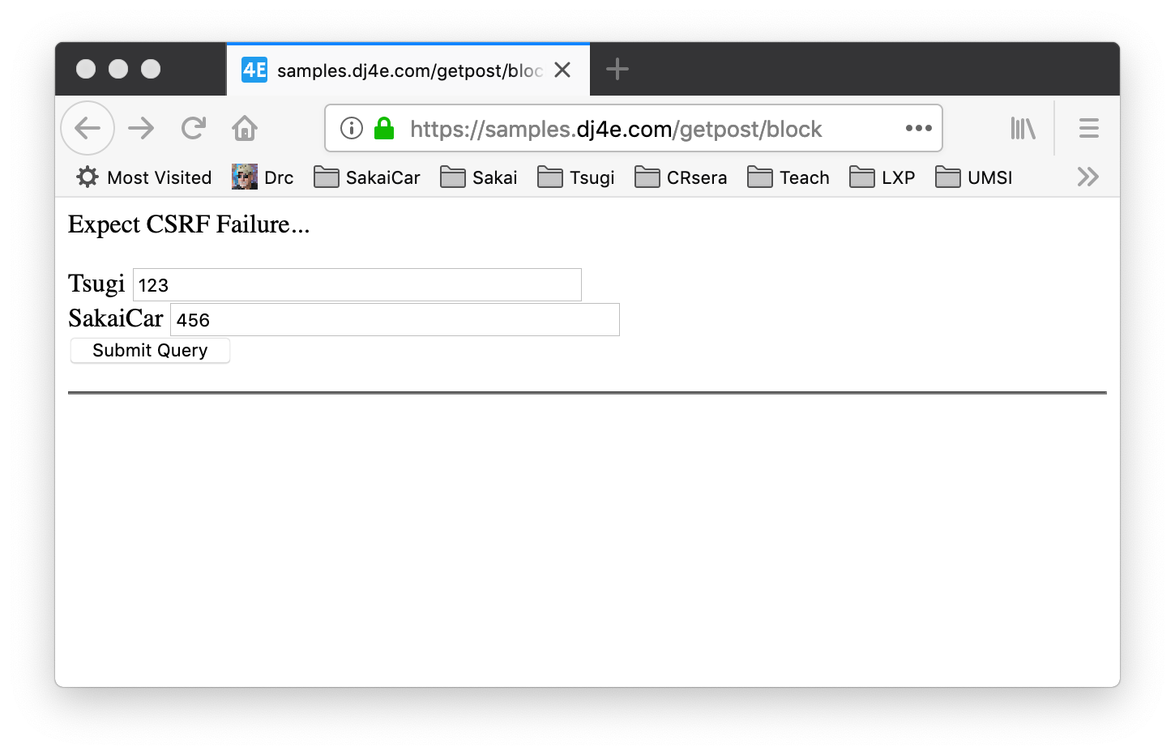
https://samples.dj4e.com/getpost/block
<p>Expect CSRF Failure...</p>
<form method="post">
<p><label for="abc123">Tsugi</label>
<input type="text" name="tsugi" size="40" id="abc123"/><br/>
<label for="xyzzy">SakaiCar</label>
<input type="text" name="sakaicar" size="40" id="xyzzy"/><br/>
<input type="submit"/></p>
</form>
<hr/>

Slide 36
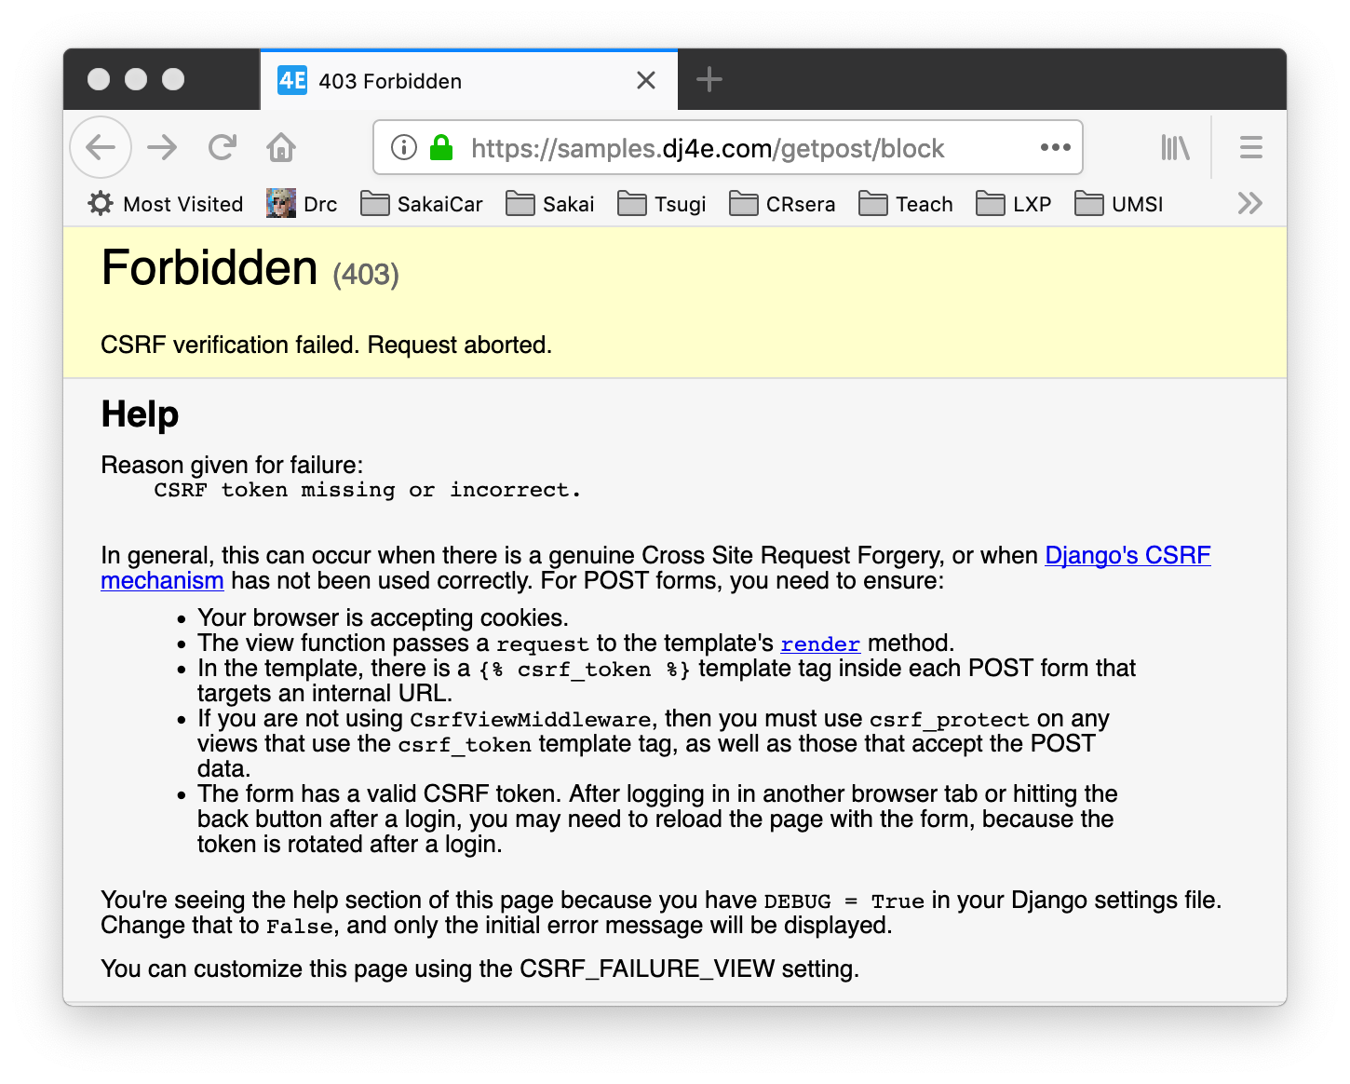

Slide 37
Django support for CSRF
Django has built in support to generate, use, and check CSRF Tokens
MIDDLEWARE = [
'django.middleware.security.SecurityMiddleware',
'django.contrib.sessions.middleware.SessionMiddleware',
'django.middleware.common.CommonMiddleware',
'django.middleware.csrf.CsrfViewMiddleware',
'django.contrib.auth.middleware.AuthenticationMiddleware',
'django.contrib.messages.middleware.MessageMiddleware',
'django.middleware.clickjacking.XFrameOptionsMiddleware',
]

Slide 38
Django CSRF in Templates
<form action="" method="post">
{% csrf_token %}
<table>
{{ form.as_table }}
</table>
<input type="submit" value="Submit">
</form>

Slide 39
Django CSRF in HTML
<form action="" method="post">
<input type="hidden" name="csrfmiddlewaretoken"
value="mzuvSAjCqJ2N61cX6m17t1jBvqULLbavAMZYoIgM1DQpRZFZFaRLzm3GrBukk95P">
<table>
<tr><th><label for="id_name">Name:</label></th>
<td><input type="text" name="name" value="Tabby" maxlength="200"
required id="id_name"></td></tr>
<tr><td>&nbsp;</td><td><span class="helptext">Enter an item</span></td></tr>
</table>
<input type="submit" value="Submit">
</form>

Slide 40
Demo - Forms in Code…

Slide 41
Summary
HTML for Forms
GET versus POST
POST Redirect GET
CSRF
Form Validation

Slide 42
Acknowledgements / Contributions
These slides are Copyright 2019- Charles R. Severance (www.dr-chuck.com) as part of www.dj4e.com and made available under a Creative Commons Attribution 4.0 License. Please maintain this last slide in all copies of the document to comply with the attribution requirements of the license. If you make a change, feel free to add your name and organization to the list of contributors on this page as you republish the materials.
Initial Development: Charles Severance, University of Michigan School of Information
Insert new Contributors and Translators here including names and dates
Continue new Contributors and Translators here

