Slide 1

The Structure of a Django Application
Dr. Charles R. Severance
www.dj4e.com
https://samples.dj4e.com/
https://github.com/csev/dj4e-samples

Slide 2
Django Terminology (i.e. folders)
Project is a collection of applications
Our project is "dj4e-samples"
Project-wide configuration is in dj4e-samples/dj4e-samples
Our first application is "hello"
We will do most of our web development in the application folder dj4e-samples/hello
https://samples.dj4e.com/
https://github.com/csev/dj4e-samples

Slide 3
Django files
$ ls -l mysite polls
mysite:
-rw-r--r-- 1 csev staff 0 Feb 15 __init__.py
-rw-r--r-- 1 csev staff 6106 Apr 23 settings.py
-rw-r--r-- 1 csev staff 2382 Apr 26 urls.py
-rw-r--r-- 1 csev staff 391 Feb 15 wsgi.py
-rw-r--r-- 1 csev staff 389 Feb 15 asgi.py
polls:
-rw-r--r-- 1 csev staff 0 Feb 24 __init__.py
-rw-r--r-- 1 csev staff 63 Feb 24 admin.py
-rw-r--r-- 1 csev staff 85 Feb 24 apps.py
drwxr-xr-x 4 csev staff 128 Feb 24 migrations
-rw-r--r-- 1 csev staff 57 Feb 24 models.py
-rw-r--r-- 1 csev staff 60 Feb 24 tests.py
-rw-r--r-- 1 csev staff 101 Feb 24 urls.py
-rw-r--r-- 1 csev staff 509 Feb 24 views.py
mysite/mysite/urls.py

Slide 4
Flow of a Web Request
When the request arrives at a Django app the incoming request URL is compared to the list of paths in urls.py in the variable urlpatterns
When there is a url match, it selects a "View" which is a bit of code that handles any database access and then produces and delivers the response to the browser
The view access the database indirectly through an abstraction called a "model"
This is a general web pattern called "Model-View-Controller" or MVC

Slide 5


Browser
Linux
D
O
M
WGSIConfig
settings.py
Django
Routing
Click
urls.py
views.py
Parse
Response
Views
Templates
forms.py
Javascript
Database
Shell
Models
model.py
/admin
admin.py

Slide 6
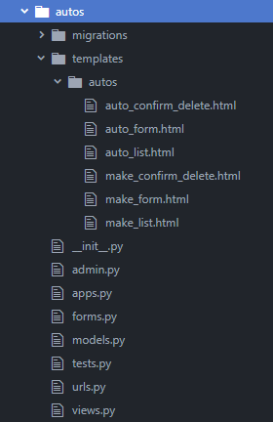
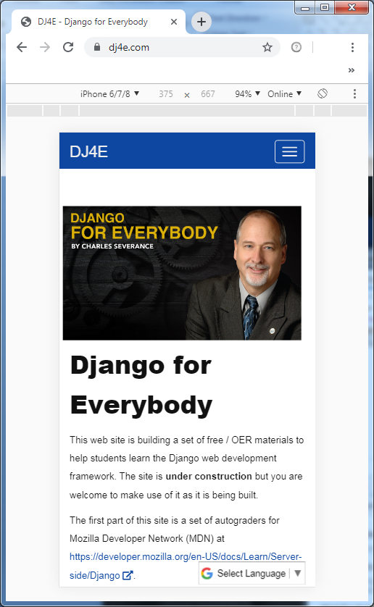
Routing
Click
urls.py
views.py
Views
Templates
forms.py

Slide 7

Routing
Click
urls.py
views.py
Views
Templates
forms.py
Urls.py

Slide 8
Routing
Click
urls.py
views.py
Views
Templates
forms.py
Urls.py
Will look for “class AutoCreate” in views.py

Slide 9
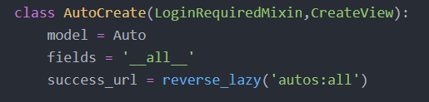
Built-in Class-based Views
Pre-existing views for common design requirements;
Generic views are included for display, editing, and date.
Urls.py
views.py

Slide 10
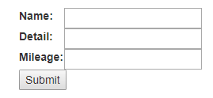
views.py
CreateView – invokes one of the generic edit views;
model = Auto – calls the database table “Auto”;
fields = ‘__all__’ – renders all fields from the table in the form;
success_url – specifies which URL name to return after ‘submit’;

Slide 11
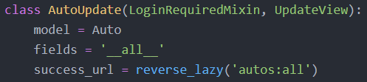
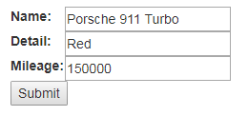
views.py
“CreateView”
Renders a blank form for adding new records.
views.py
“UpdateView”
Renders a form populated with an existing record for editing.

Slide 12
views.py
success_url – specifies which URL name to return after ‘submit’. The URL name is a Named URL Pattern which is specified in urls.py. This creates a DRY mechanism (Don’t Repeat Yourself) for referencing a URL which is useful in simplifying the code and helps prevent errors when PATH values are changed.
‘autos:all’ – This reference includes two elements (i) application namespace (autos) and (ii) the URL Name (all). The application namespace helps distinguish conflicting URL Names from different applications.
Urls.py

Slide 13
Summary
It will take a while to fully understand the internal workings of a Django application – it gets easier after you have built and extended a few applications.
Having consistency in the "shape" of Django applications is very helpful when you get "dropped into" an existing project developed by someone else.

Slide 14

Acknowledgements / Contributions
These slides are Copyright 2019- Charles R. Severance (www.dr-chuck.com) of the University of Michigan School of Information and made available under a Creative Commons Attribution 4.0 License. Please maintain this last slide in all copies of the document to comply with the attribution requirements of the license. If you make a change, feel free to add your name and organization to the list of contributors on this page as you republish the materials.
Initial Development: Charles Severance, University of Michigan School of Information
… Insert new Contributors and Translators here
Continue…

