Slide 1

NLP Project Presentation
TwitterSherlock

Slide 2
Research Problem
Twitter authorship detection (Who wrote the tweet?) in different domains (politics, sports, news, …)
First take: Classifying tweets from politicians
20 politicians
Baseline accuracy: 5 % (100 % / 20) => Random classification

Slide 3
Approach
Crawled twitter data using Twitter API in Java
Train – Test – Split (90 %/ 10 %)
Feature Engineering (presented later)
Preprocessing in DKPro TC (Tokenization, POS-Tagging, no normalization) depending on classifiers we used
Train classifiers (Naïve Bayes, Random Forests, Logistic Regression, Neural Networks)
Evaluation measure: Accuracy

Slide 4
Frameworks and Resources
DKPro TC/UIMA
Weka
Keras (for Deep Learning) as replacement for DeepLearning4J (did not work)
Twitter4J

Slide 5
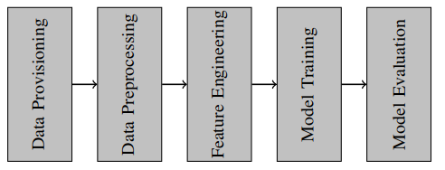
Pipeline

Slide 6
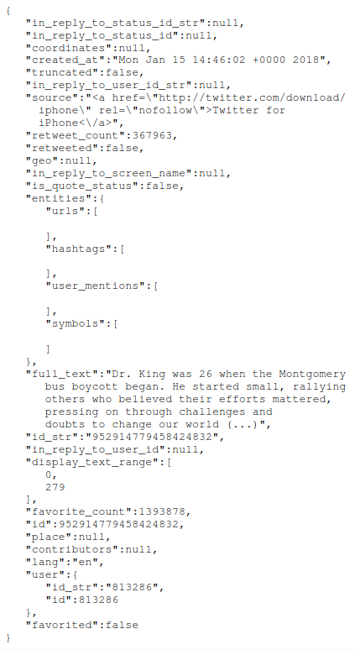
Data Provisioning
Twitter Crawler
English Tweets
Data: no retweets, persons have tweeted at least 1,000 times, most current 1,000 tweets first
Crawled types of Tweets
Politicians
Actors
Broadcast Stars
Sports Stars
FunMix

Slide 7
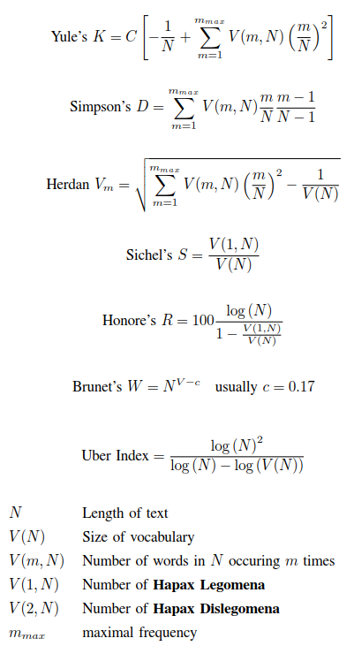
Feature Engineering
Features
Ratio of emoticons
Number of hashtags
Number of tokens per sentence
Type-Token ratio (lexical diversity)
Character features (Upper case, white spaces, tabs, alphabetic, digits)
Contextuality measure
Exclamation ratio
Superlative ratio
Number of tokens
N-Grams
POS-N-Grams
Spelling-Error ratio

Slide 8
Classifiers
Naïve Bayes
Random Forests
Logistic Regression
Deep Learning (Neuronal Networks)

Slide 9
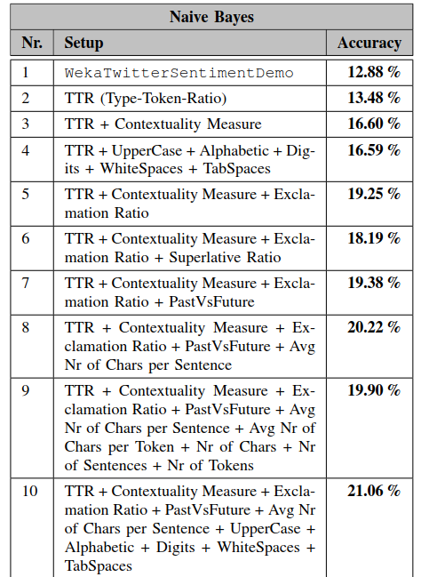
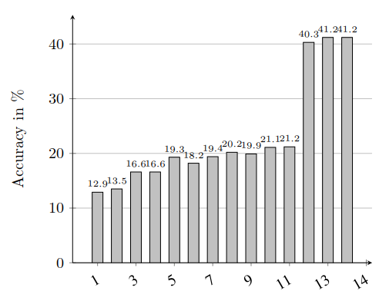
Naïve Bayes

Slide 10
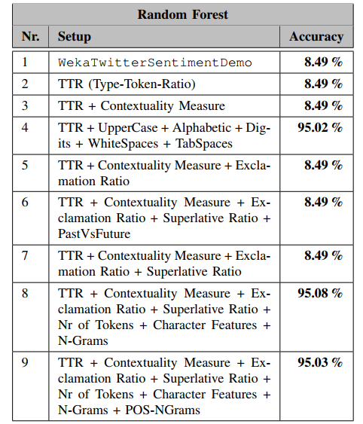
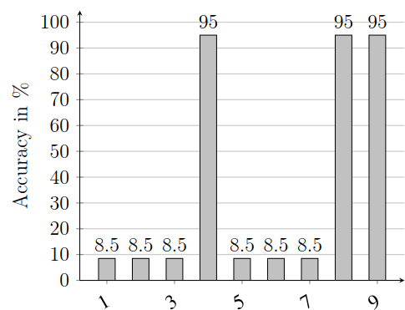
Random Forests

Slide 11
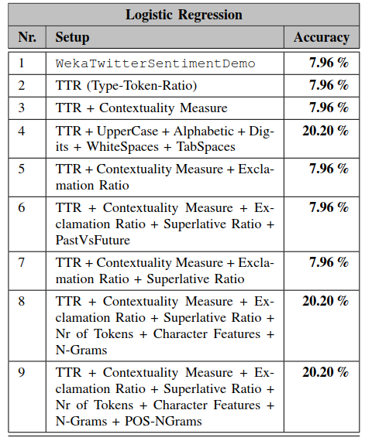
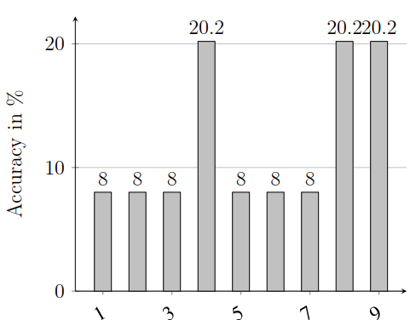
Logistic Regression

Slide 12
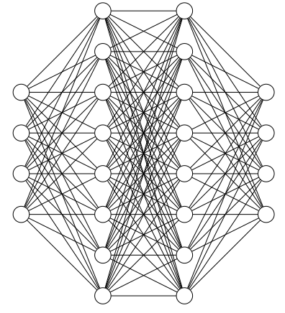
Deep Learning
Reached up to 98 % using a neural network in Keras
Need further tests to evaluate the validity of the results (maybe overfitting?)
Drop-Out rate of 35 %
Architecture: Combination of convolutional and recurrent network
Embedding Layer (= Input Layer) => Drop-Out Layer => Convolutional Layer => Recurrent Layer => Output Layer

Slide 13
Component Diagram
cnn_lstm.py
Pipeline
CharacterFeatureExtractor
jCas
Crawler
JSON
TweetReader
VocabularyRichnessFeatureExtractor

Slide 14
Findings
Sentence-based/Vocabulary richness features did not work well
Token-based and character-based features performed better
Combination of features with POS and Token N-Grams
=> Short texts/tweets

Slide 15
Thank you for Listening

