Slide 1

Unsupervised Learning for Detecting Cognitive Distortions
A novel framework for analyzing patient narratives in psychotherapy.
Bobo, S., & Kolonin, A. (2025). Unsupervised learning for detection of cognitive distortions in patient narratives . In Twenty-Seventh International Conference on Neural Networks “Neuroinformatics-2025” . https://openreview.net/forum?id=RiDhbCyws2

Slide 2
Introduction to Cognitive Distortions
Cognitive distortions (CDs) are systematic thought errors common in mental health conditions, fueling anxiety and negatively impacting life. Bobo, S., & Kolonin, A. (2025).
1
2
3
Definition
Prevalence
Impact
Internal subconscious and conscious mental filters or biases that increase self-misery.
37% increase in CD prevalence in public discourse since 1980.
Manifest as maladaptive automatic thoughts perpetuating psychological distress.

Slide 3



Problem and Motivation
Current methods face significant limitations, hindering accessible mental healthcare.
Time-Intensive
Subjectivity
Scalability
Diagnostics take an average of 5 minutes per case. (Asghar et al. (2020) Automatic detection of Cognitive Distortions form text using Machine learning)
Clinician judgment varies (Fleiss Kappa = 0.45-0.60]).
Limited for large datasets, restricting accessibility.

Slide 4
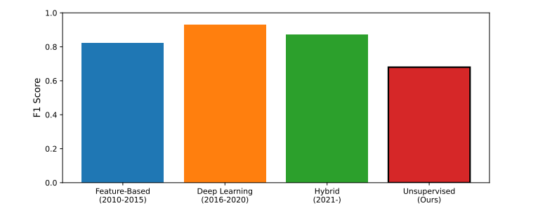
EVOLUTION OF COGNITIVE DISTORTION DETECTION METHODS

Slide 5
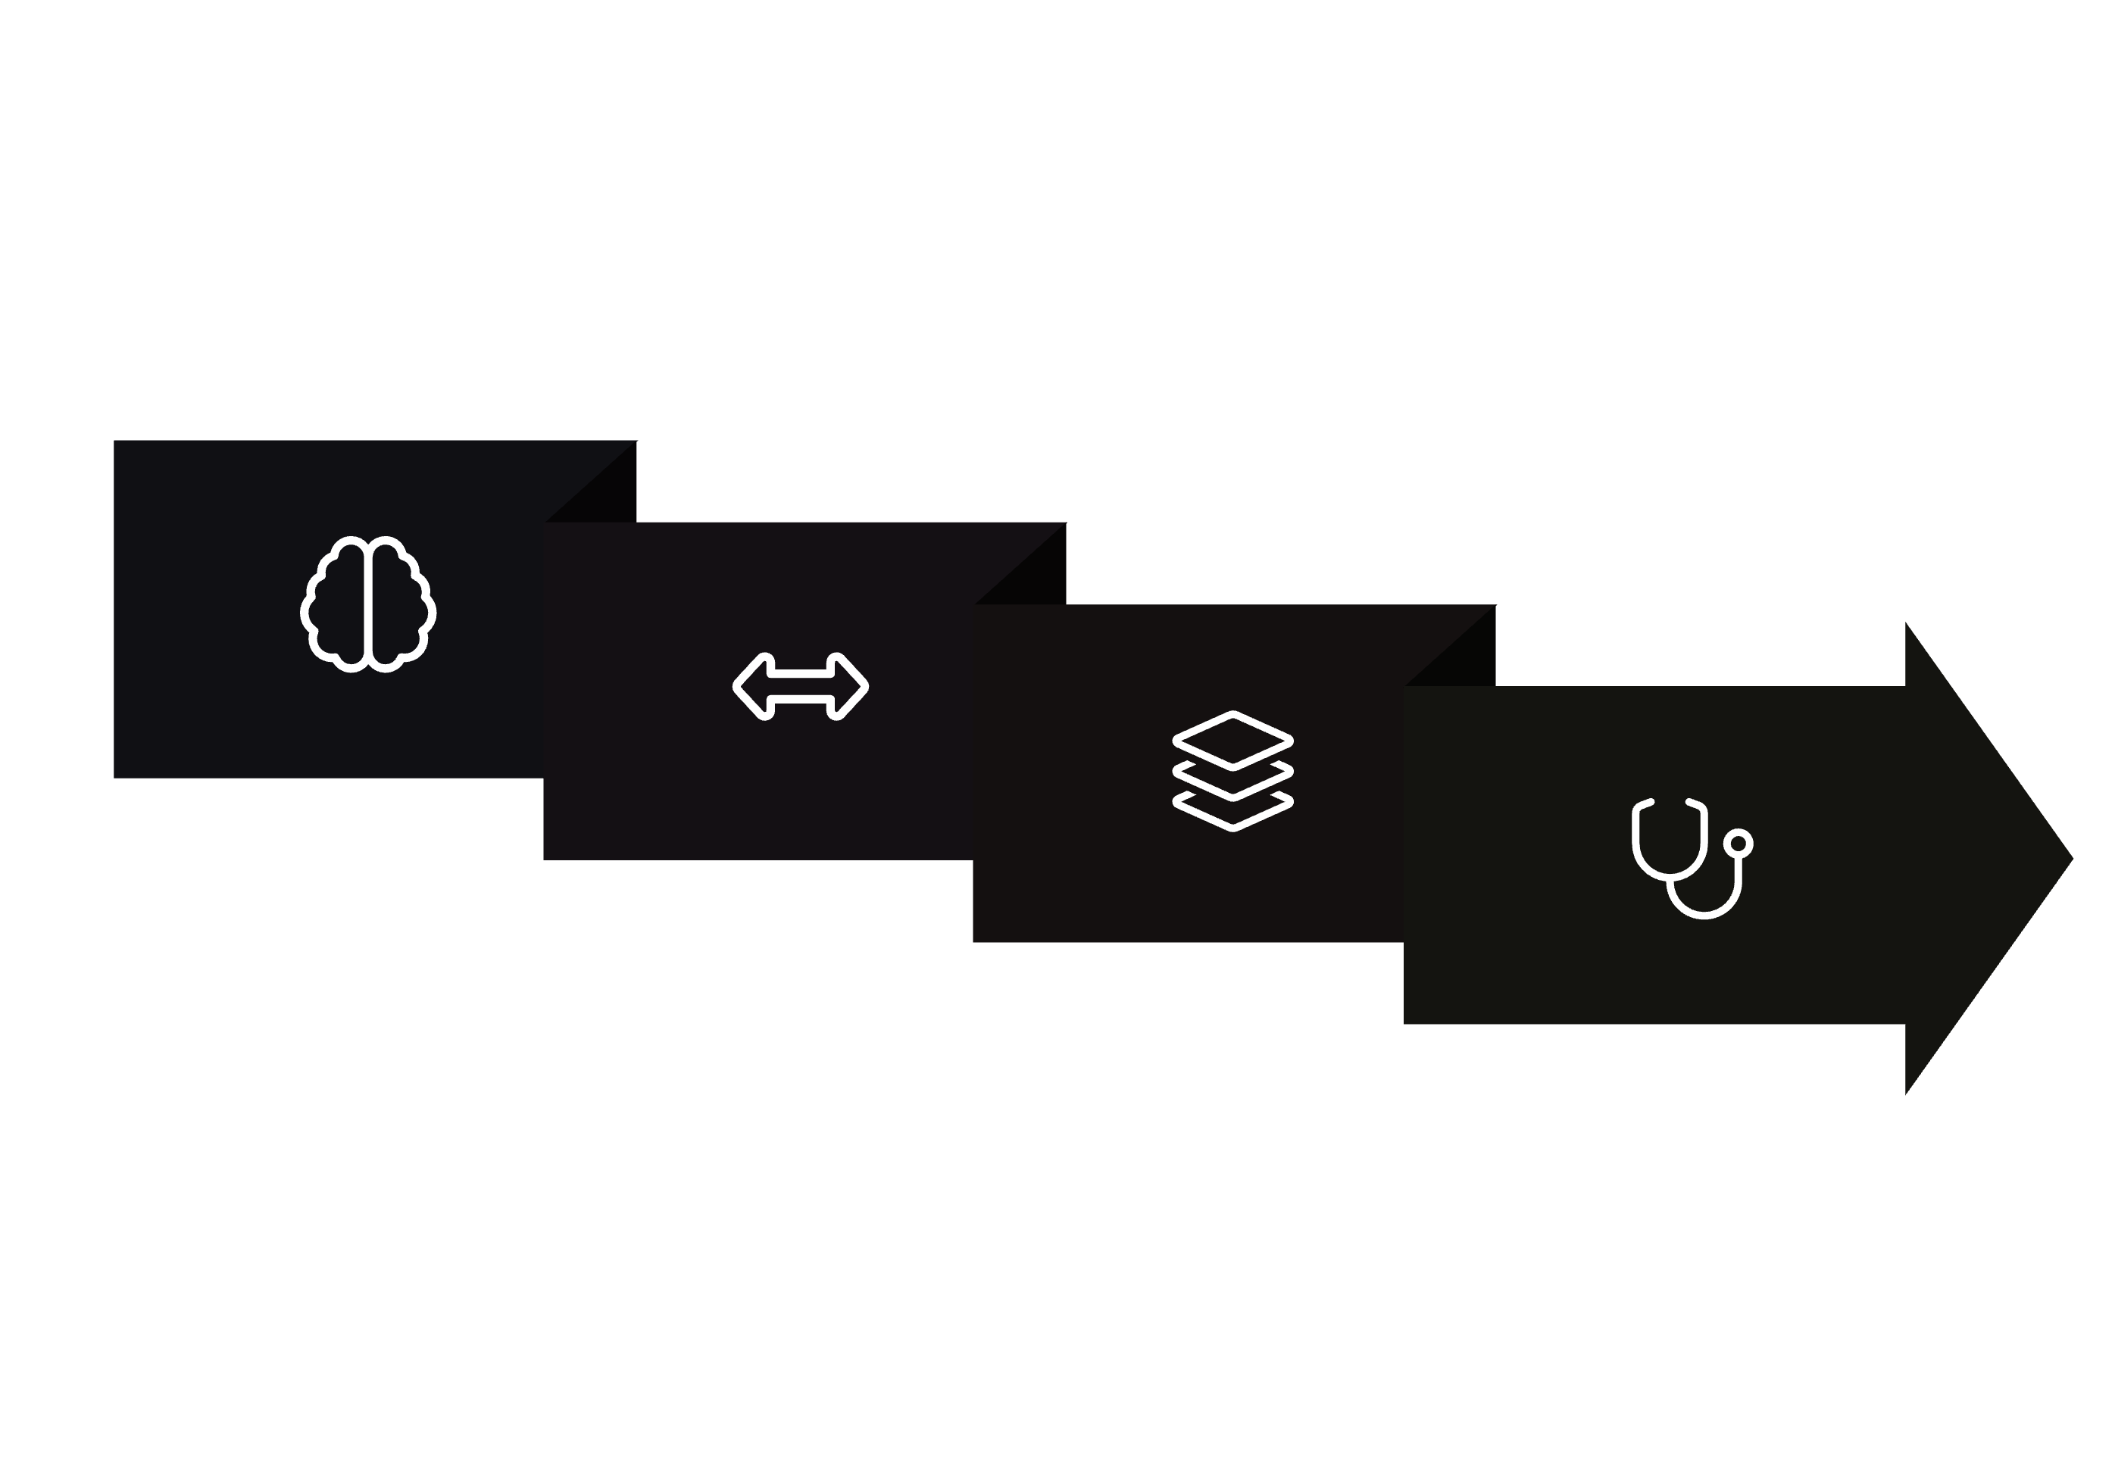




Our Unsupervised Approach
We propose a framework using unsupervised machine learning to address current challenges.
Dimensionality Reduction
Clinical Interpretation
Semantic Embedding
Clustering
This approach offers significant advantages:
Discover Hidden Patterns
Enhance Scalability
Unsupervised learning uncovers subtle and complex structures within patient narratives that manual methods might miss.
Automated analysis allows for processing large datasets, making mental healthcare insights more accessible and efficient.

Slide 6
Methodological Innovations
Our framework integrates several techniques for robust CD detection.
Text Processing
Cleanup from formatting and irrelevant/junk characters
Clustering
Dynamic HDBSCAN thresholds adapting to distortion density.
Validation
Mixed quantitative-clinical evaluation protocol against Public anonymized
labeled clinical and synthetic data, AI-assisted
Interpretability
KeyBERT-assisted clinical labeling of clusters.
Notes:
Interpreting the Silhouette Score: While the global silhouette score of 0.09 on PCA-reduced
embeddings (75 components) suggests suboptimal cluster separation, this metric alone fails to
capture clinical validity. The score’s limitation stems from:
• High dimensionality of clinical semantics where Euclidean distances poorly reflect therapeutic relationships
• Presence of clinically meaningful subclusters within broader categories (e.g., 15 anxiety
subtypes in Cluster 1)
• Cognitive distortions’ inherent overlap across Beck’s taxonomy categories
The quantitative distortion detection rates (64.9-100%) and expert validation (𝜅=0.76) demon_x0002_strate that cluster quality transcends this geometric metric. This aligns with recent clinical NLP
findings that silhouette scores <0.2 can still yield clinically actionable groupings when validated
thematically

Slide 7
Where
C = Cluster
T = Text
MiniLM = Semantic embedding
1
Where R = Semantic embeddings
Clustering Optimisation (HDBSCAN)
2
With K = 4 (The number of clusters obtained) at 1st level clustering with HDBSCAN

Slide 8
Key Results - Cluster Profiles
- Dominant CD Profiles:
• Performance Anxiety (n=93): 100% CDs
• Social Anxiety (n=3,680): 64.9% CDs
• Social Exclusion (n=122): 98.4% CDs
• Mixed Symptoms (n=2,162): 74.1% CDs
- Hierarchical Insights: Subclusters ↑ topic specificity improved

Slide 9
SUBCLUSTER DISTRIBUTION AND THEMATIC SCOPE
CLUSTER | THEME | # SUB CLUSTERS | SCOPE OF SUBCLUSTER THEMES
Perfomance Anxiety | Professional Failures | 19 | Project rejections, academic failures, promotion denials
Social Anxiety | Social rejection | 18 | Wedding anxieties, party exclusions, friend disputes
Social Exclusion | Daily Challenges | 20 | Mental health subtypes, work stress, social insecurities
Mixed Symptoms | Relationship concerns | 20 | Romantic conflicts, family tensions, peer exclusion

Slide 10
Hierarchical Subclustering with KeyBERT
KeyBERT keyword extraction refines broad clusters into clinically meaningful subgroups.
Work/School
Mind Reading
"must think I'm incompetent"
Work/School
Personalization
"my fault project failed"
Relationships
Labeling
"I'm a terrible friend"
Relationships
Catastrophizing
"Nobody will ever love me"
This approach enhances therapeutic relevance and uncovers latent themes, enabling precise linkage between life contexts and cognitive distortions.

Slide 11
Key Subclustering Observations
Our hierarchical approach significantly improves thematic specificity and clinical relevance.
1
2
3
Thematic Expansion
Noise Utilization
Distortion Resolution
Subclusters increased topic specificity.
100% of “Mixed symptoms” (noise) cluster entries reorganized into clinically relevant subgroups.
Achieved 97% keyword non-overlap (Jaccard similarity = 2.2 × 10⁻⁵).

Slide 12
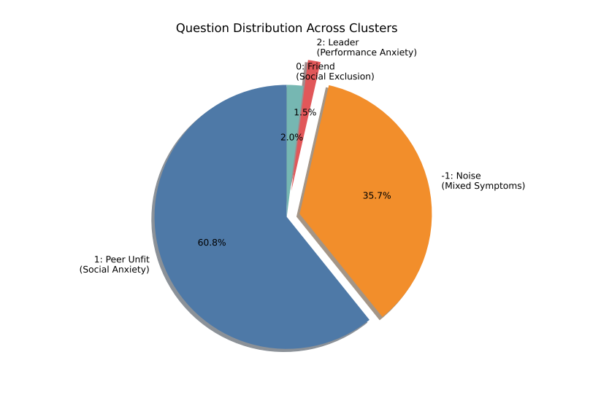
Clinical Patterns in Cognitive Distortions
Our clustering pipeline revealed distinct patient profiles with high distortion prevalence.
Notes:
Performance Anxiety showed 100% distortion, while Social Exclusion demonstrated near-universal distortion presence (98.4%)

Slide 13
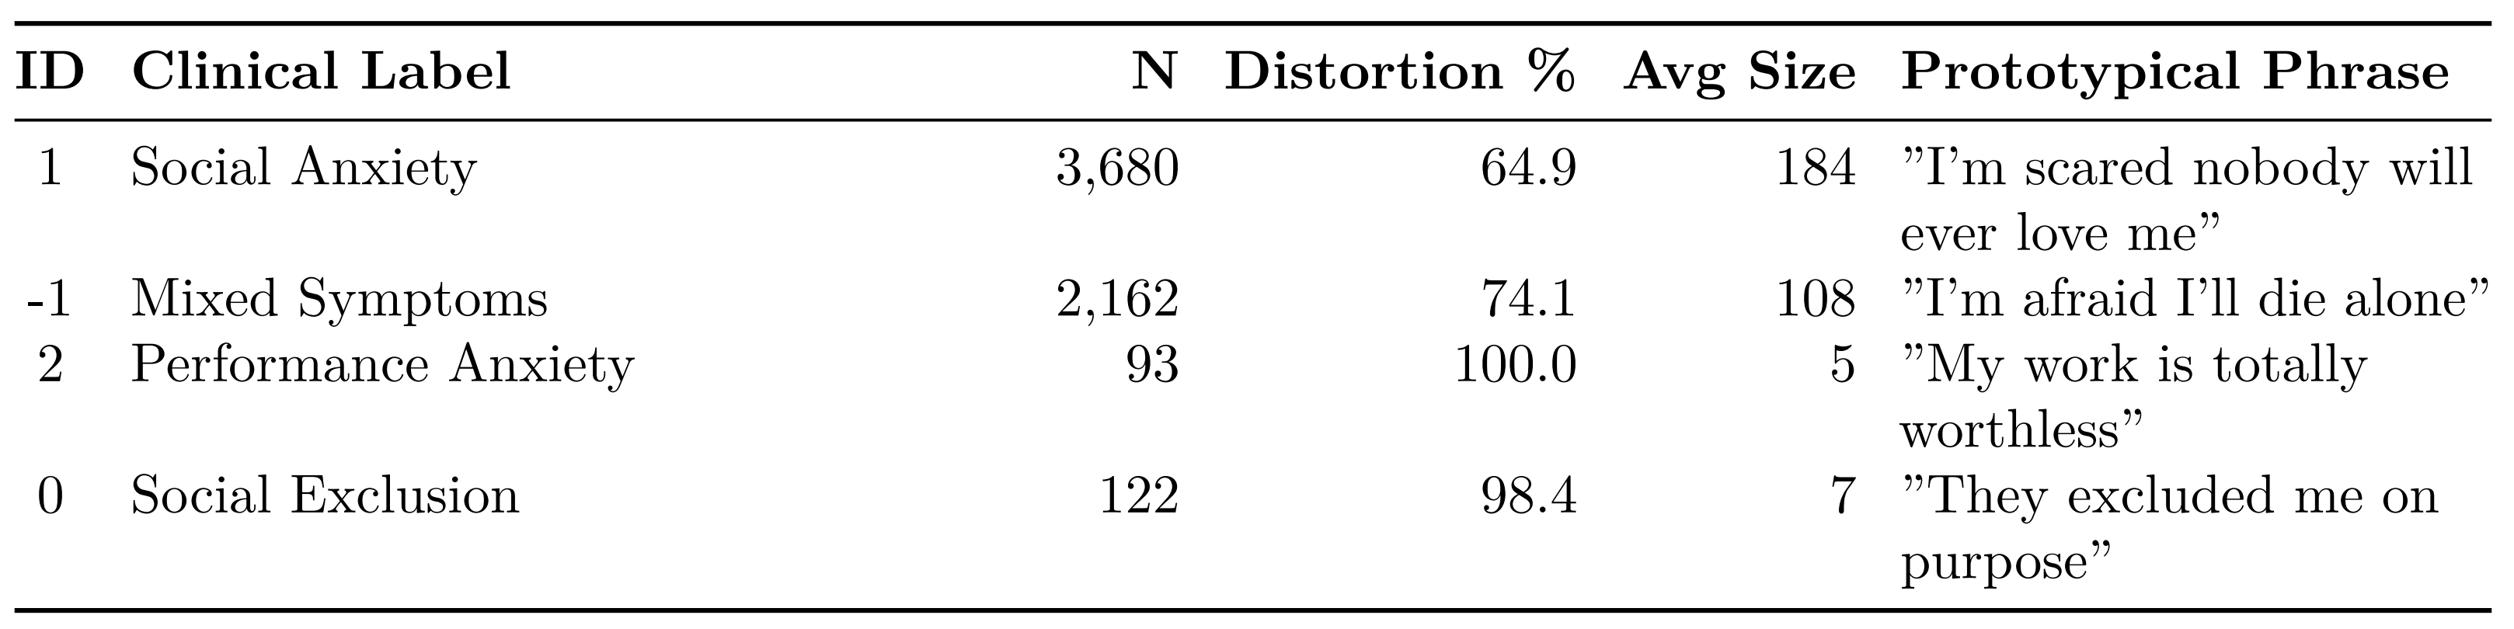
Cluster Profiles with clinical interpretation

Slide 14
Key Findings & Clinical Utility
Our research provides actionable insights for mental healthcare.
100%
0.82
92%
2.7
High-Risk Group
Linguistic Markers
Clinical Alignment
Efficient Pipeline
Performance Anxiety cluster shows 100% distortion.
Absolute terms ("Total"/"Never") predict distortions (AUC).
Our model aligns with CBT intervention targets.
Processes 6,057 texts in under 3 hours.

Slide 15
Clinical Validation
- Expert Evaluation: AI-Assisted validation with (MetaA!, ChatGPT, DeepSeek
- Agreement: Fleiss’ κ = 0.68 ("substantial agreement")
- Linguistic-Distortion Correlations:
• Absolute terms → 100% CDs

Slide 16
Advantages & Applications
- Efficiency: 6,057 texts in <3 hrs (CPU, 47× faster than manual)
- Clinical Use Cases:
1. Cognitive distortion diagnostics time reduced
2. Population Health (real-time CD tracking)
- Scalability: No predefined labels; adapts to new CD patterns

Slide 17
Limitations
• English-only corpus
• Small clusters (e.g., n=93)
• Concept drift

Slide 18
Conclusion & Future Directions
This work establishes foundational advances in unsupervised clinical validity and operational scalability.
Risk Prioritization
Linguistic Markers
Treatment Personalization
Urgency scoring for immediate intervention.
Absolute terms ("never," "totally") as diagnostic indicators.
Cluster-specific CBT protocol recommendations.
Future work includes integrating patient clinical profiles and EHR for enhanced utility.

Slide 19
Future Directions and Scalability
• Expand to multilingual datasets using mBERT.
• Integrate Electronic Health Records (EHR) for real-time monitoring.
• Link patient phenotype (age, comorbidities) with CD patterns.
• Enhance model adaptability to concept drift (19% new terms/year).
• Deploy on edge devices (CPU-only inference in <3 hours).

Slide 20
Q&A
- Acknowledgements: Dataset providers, clinical validators
- Contact: bobosamson8@gmail.com

