Slide 1

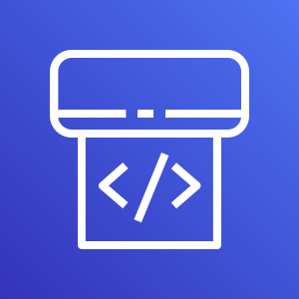
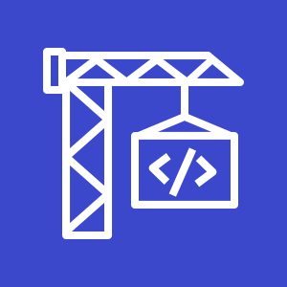
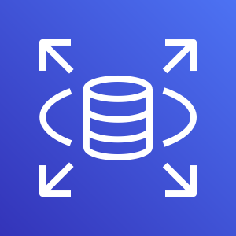



AWS Cloud
AWS CodePipeline
AWS CodeBuild
of AWS CDK
Amazon RDS
Git push/
merge
Git repository
/aws-app-resources
/k8s-app-resources
Git webhook
Git users
Amazon EKS Cluster

