Slide 1

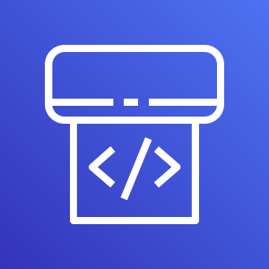
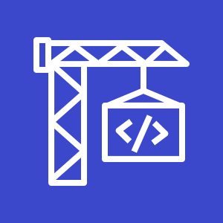
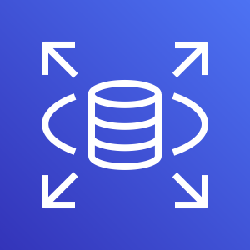

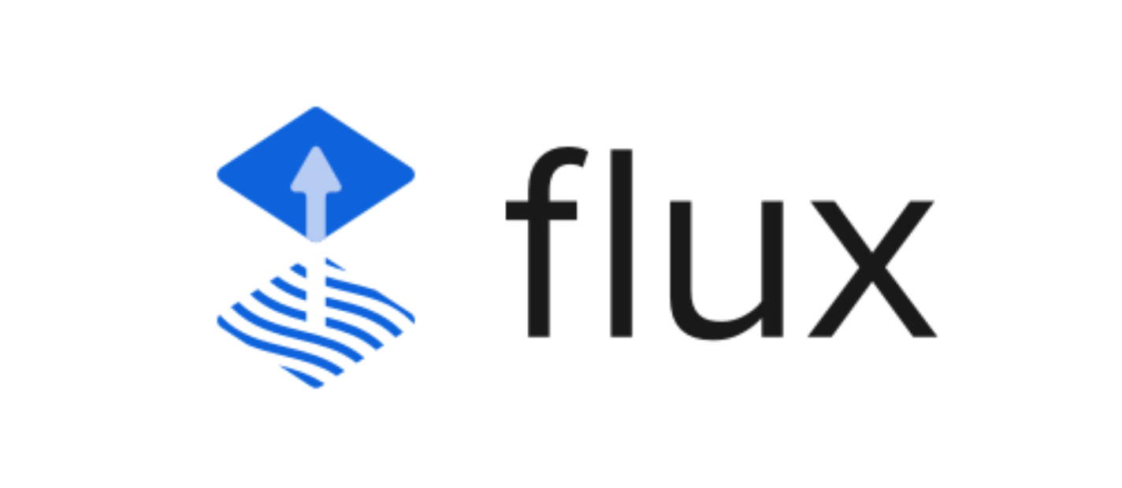

AWS Cloud
AWS CodePipeline
AWS CodeBuild
of AWS CDK
Amazon RDS
Git push/
merge
Git repository
/aws-app-resources
/k8s-app-resources
Git webhook
Git users
Amazon EKS Cluster

Slide 2

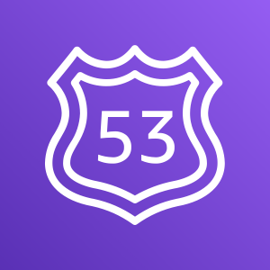

AWS Cloud
RDS secret from
AWS Secrets Manager
(autogenerated by CDK)
Application Load Balancer
(created/managed by ingress controller exposing pod(s))
Amazon Route 53
(CNAME created/managed by external DNS controller)
EKS Cluster
External Secrets Controller
ALB Ingress Controller
External DNS Controller
ghost-database k8s secret
ghost pod(s)
ghost ingress
Amazon RDS

