Slide 1
Development of a versatile auto-balanced Photodetector
22 April 2026
Melvin Reka
Supervisor: Peter Vass, Maximillian Thier
Notes:
"Good afternoon. I'm presenting the interim status of my project on an auto-balanced photodetector front-end that uses a bootstrap mechanism to support a wide range of photodiodes in a single circuit topology."

Slide 2
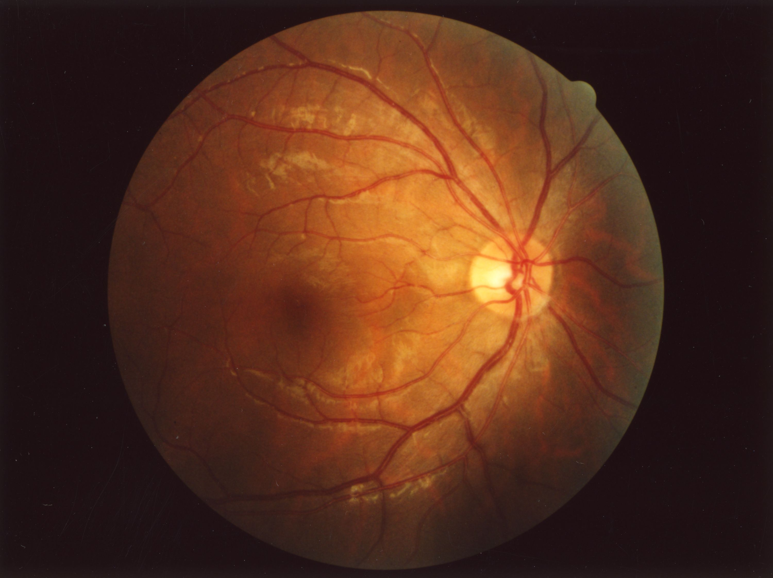
Applications
Laser noise cancellation spectroscopy weak absorption signal on a noisy laser
Optical coherence tomography (OCT) interferometric, strongly common-mode dominated
LIDAR front-ends small reflected signal plus large background light
Quantum / low-light detection single-photon-level signals, laser excess noise dominates
An opthalmogram, an image of the fundus of an eye, of a healthy human male (Source Wikipedia [1])
Notes:
"Optical detection is used across many demanding fields — spectroscopy where a faint absorption line sits on noisy laser light, OCT where an interferometric signal rides on a dominating common-mode component, LIDAR where a small reflected pulse has to be separated from strong background light, and quantum experiments where single-photon-level signals are buried under laser excess noise.
What these applications share is not a wavelength or a bandwidth — it's the physics of the measurement: a weak signal is always superimposed on a much larger common-mode optical background. A single photodiode followed by a transimpedance amplifier usually cannot extract it."

Slide 3
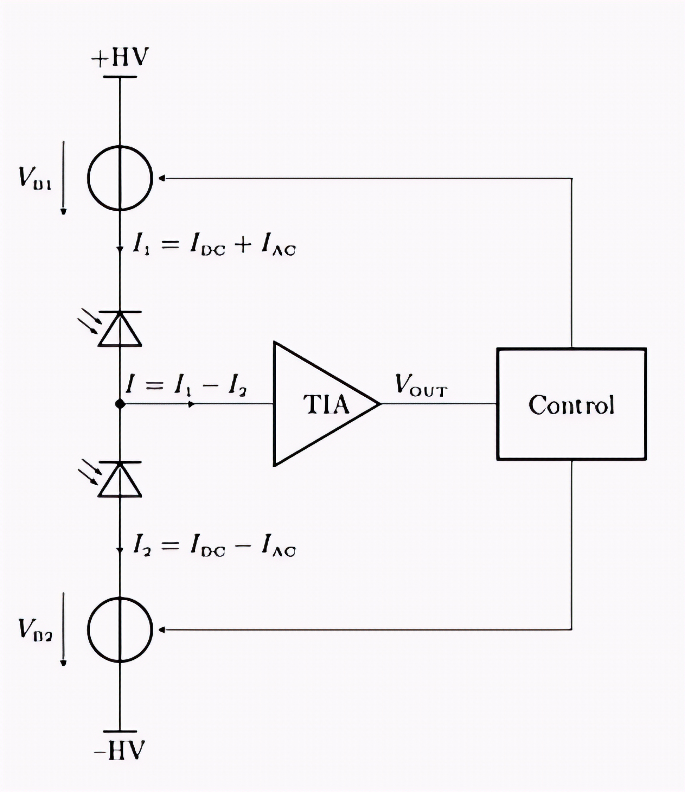
Common-mode rejection and flexibility
I = I₁ − I₂ = 2·I_AC → common-mode cancels
I1 and I2 are 180° Phase shifted
PIN (no gain) vs. APD (internal gain M, needs stable reverse bias)
Wavelengths / materials (Si, InGaAs, …)
Bandwidths from ~1 MHz up to 100MHz
Wide range of effective responsivities
One platform for all → topology must be flexible
Notes:
"Two requirements follow directly from the applications.
The first is common-mode rejection at the front-end. If we use two matched photodiodes, illuminated such that their signals are antiphase and their common-mode light is in phase, and subtract their currents at a common node before amplification, the common-mode part cancels and only the useful signal enters the TIA. This is called balanced detection, and it addresses the shared problem from the previous slide directly.
The second requirement is flexibility. Each application uses a different photodiode — PINs for robust wideband detection, APDs for low-light work with internal gain, different materials for different wavelengths, bandwidths from a few megahertz up to hundreds, and effective responsivities that span many orders of magnitude depending on the APD gain. If we want one platform that serves many applications — rather than one detector per application — the topology itself must accept all these diodes without redesign.
These two requirements — common-mode rejection and diode-independent flexibility — shape the topology"

Slide 4
Our proposed topology
Two photodiodes stacked between +HV and −HV — one signal, one
Currents: I₁ = I_DC + I_AC and I₂ = I_DC − I_AC (antiphase AC components)
Summing node: I = I₁ − I₂ = 2·I_AC → common-mode DC cancels; only signal enters TIA
Control block → V_B1, V_B2: senses the state of the front-end and drives the two bias sources this is the bootstrap / auto-balance mechanism
Active bias control is what makes the same topology usable across different diode types
Notes:
This is the topology we use. Two photodiodes are stacked between a positive and a negative high-voltage rail. Each diode current has a DC part from the common background and an AC part carrying the signal — antiphase between the two diodes. At the middle node the two currents meet and subtract: what enters the TIA is I₁ minus I₂, which is twice the AC signal, while the common-mode DC cancels. That is the balanced-detection requirement from the previous slide, realised in hardware.
The block on the right is the key one for this project. It senses the state of the front-end and drives the two bias sources V_D1 and V_D2. It does two things at once: it keeps the currents balanced even when the two diodes are not perfectly matched, and it bootstraps the bias so the diodes' reverse voltages stay well-defined even while the internal nodes swing with the signal. This active bias control is exactly what satisfies the flexibility requirement: because the bias point is adjusted dynamically, the same topology can host PINs or APDs, at different bias levels, without changing the circuit around them.

Slide 5
Challenges of this topology
Photocurrents span orders of magnitude across the supported diode types — large dynamic range
Control loop must be fast enough not to attenuate the signal, slow enough not to destabilise the TIA
Diode capacitance and parasitics directly affect loop stability and bandwidth
Achievable CMRR depends on matching and on loop bandwidth
Wide swing stresses op-amp supply range and dynamic behaviour
Notes:
"This topology is conceptually elegant, but it is not trivial. The photocurrents span several orders of magnitude; the control loop must be fast enough not to attenuate the signal, yet slow enough not to destabilise the TIA; the diode capacitance and layout parasitics directly shape loop behaviour; CMRR depends not only on matching but also on the loop's bandwidth; and large signal swings stress the op-amp supply range. To understand what is achievable and how others have approached this, I looked at existing commercial solutions and at the bootstrap literature."

Slide 6
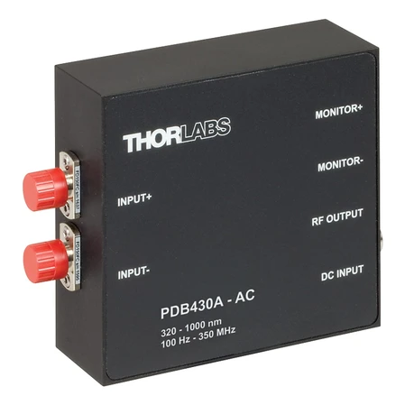
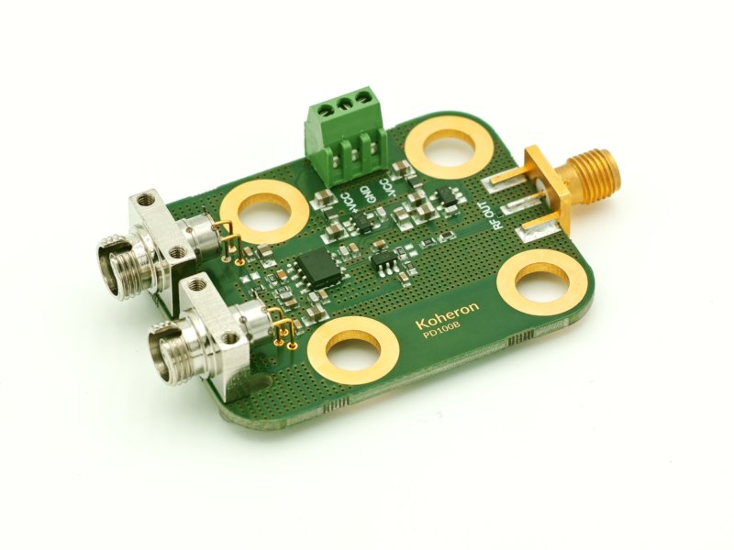
Commercial grade detectors
Device | CMRR (typ.) | Bandwidth (-3 dB) | Detector Type | Source
Thorlabs PDB430A / PDB430C | >20 dB (typ. >25 dB) | DC – 350 MHz | Si / InGaAs PIN | Thorlabs PDB4xx Series Datasheet[2]
Koheron PD100B (auto-balanced) | >30 dB | up to ~200 MHz | InGaAs | Koheron, PD100B Datasheet [3]
Balanced photodetectors used for differential signal detection. Left: Thorlabs [4], Right: Koheron PD100B[5]
Notes:
"Commercial auto-balanced detectors reach common-mode rejection between roughly 25 and 50 dB, at bandwidths from the kilohertz range up to a few hundred megahertz. Each of these products, however, is hard-wired to a specific photodiode: the diode, its bias network, and the subtraction stage are co-designed. Replacing the diode means redesigning the front-end — which is precisely the flexibility gap that our topology tries to close."

Slide 7
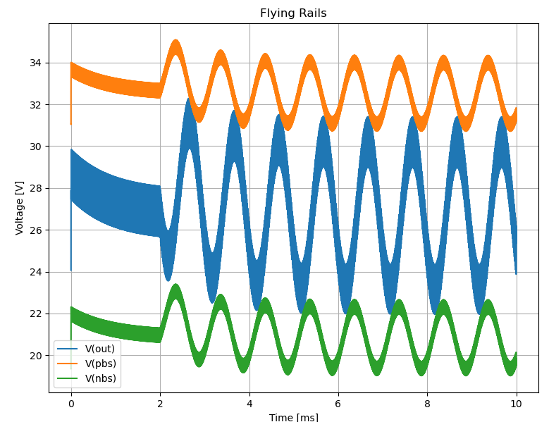
Bootstrap techniques what the literature tells us
Flying rails principle: local op-amp supply follows V_out; large effective swing from low-voltage op-amp (AN-1593 [6], Jung EDN [7])
Loop speed > signal speed: FET gate C + bias R form a low-pass; decoupling goes between transistor bases, not to ground
Op-amp criteria: supply range, CM close to rails, slew rate, low bias current, no phase reversal (TLV9162: 16 V max)
High-impedance care: guarding, shield bootstrapping, dielectric choice (AN-241 [8])
Proven in hardware: 50 Vpp @ 1 MHz with 3 op-amps; series R for capacitive loads (TIDUEW8 [10])
Notes:
"The literature gives a consistent picture of how bootstrapping works and where it breaks. The principle is that the local supply rails follow the op-amp output, which multiplies the usable swing. Several design constraints are repeated across all references: the bootstrap loop must be faster than the signal path; the FET gate capacitance together with the bias resistors builds a low-pass that limits loop speed; and — an often overlooked point — the local bypassing cannot tie the flying rails to ground. The literature also tells us what a bootstrap-capable op-amp needs: high supply range, common-mode range close to the rails, a sufficient slew rate, low bias current, and no phase reversal. A quick check on the TLV9162 used in our starting simulation shows it fits most of these, but its 16 V maximum supply is borderline. Two documents complement this for our specific APD case: AN-241 on high-impedance design, directly relevant for any photodetector front-end, and TIDUEW8, a TI reference design showing a real bootstrap circuit with its stability and thermal constraints. Importantly, none of these documents addresses the auto-balanced APD case we study — which defines the open space for this project."

Slide 8
Research question and scope
Main question: Can a bootstrapbased auto-balanced front-end serve as a single, flexible topology for a wide range of photodiodes (PIN and APD) with useful CMRR and bandwidth?
  How does the bootstrap loop bandwidth affect the achievable CMRR?
  Does the APD reverse bias remain constant under bootstrapping?
  How do diode capacitance and parasitics influence loop stability?
  Can the auto-balance mechanism compensate asymmetries without distorting the signal?
Scope / working assumptions:
  Target different PIN / APD diodes, modelled as current source with ‖ capacitance
  Bandwidth target: 1–10 MHz initially; extension to hundreds of MHz out of scope
  Focus: topology & dynamic behaviour, not a specific optical application
Notes:
"From the applications, the requirements, and the state of the art, the central question of this project is whether a bootstrap-based auto-balanced front-end can be a single topology supporting a broad class of photodiodes.
Four more concrete sub-questions follow — partly from the literature gap, partly from discussions with my supervisor: first, how the bootstrap-loop bandwidth influences the resulting CMRR; second, whether the APD reverse bias actually remains constant when the bias node is bootstrapped; third, how diode capacitance and parasitics affect the stability of the loop; and fourth, whether the auto-balance mechanism can compensate asymmetries between the two diodes without distorting the signal.
For the scope of this interim phase I assume two concrete diode families — the Hamamatsu PIN and APD we have in the lab, plus the Roithner PIN — modelled at circuit level as a capacitance in parallel with a current source. The bandwidth target starts at 1–10 MHz, which is sufficient to study the topology. Material and wavelength do not matter from a circuit viewpoint."

Slide 9
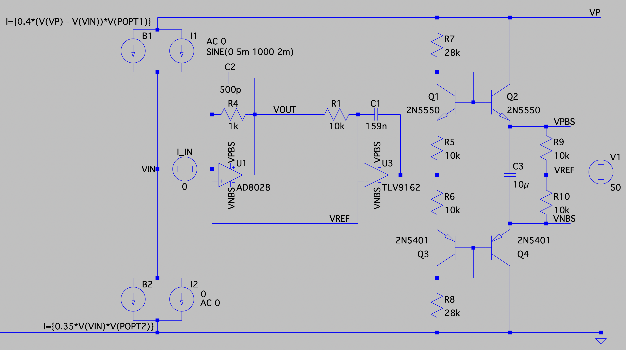
Simulation setup and first observations
Setup: TIA (AD8028) R_f = 1 kΩ, C_f = 500 pF → BW ≈ 318 kHz; autobalance integrator (TLV9162) τ ≈ 1.59 ms → corner ≈ 100 Hz
Diode models: current sources with deliberate asymmetry (0.4 vs. 0.35 A/W) to test balancing
Observation 1: autobalance loop nulls the DC offset between the two diode currents as expected
Observation 2: 100 kHz probe signal propagates across internal nodes (V_PBS, V_NBS) a consequence of loop dynamics
Still open: TIA gain sizing for realistic APD currents; quantitative frequency-response analysis of bootstrap loop
Notes:
The simulation testbed shown here is up and running. Two photodiodes are modelled with deliberately asymmetric responsivities to test the balancing; the TIA has roughly 300 kHz of bandwidth; the auto-balance loop is a slow integrator with a corner near 100 Hz, and its output is the handle that restores balance. The op-amp originally used in the received schematic was a placeholder; I replaced it with a realistic TLV9162, which is also what the literature recommends.
First observations: the auto-balance loop nulls the DC asymmetry as expected. The 100 kHz probe I use to stimulate the bootstrap path appears on several internal nodes — this is a consequence of the loop dynamics, not a fault. What is still open is proper TIA gain sizing for realistic APD currents and a quantitative analysis of the bootstrap-loop frequency response.

Slide 10
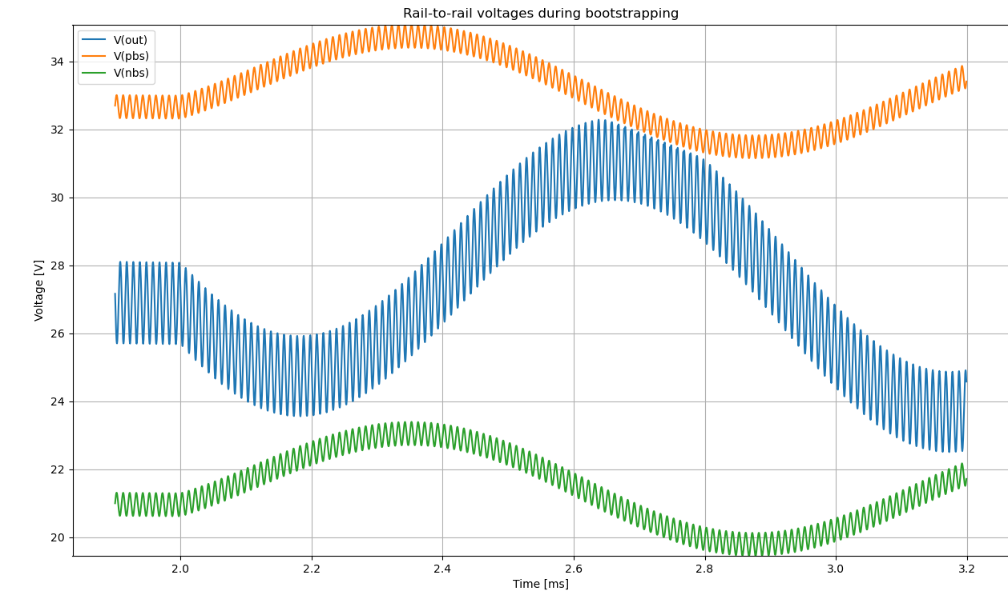

Slide 11
Next steps: design, build, measure
Design
  Dimension TIA gain for realistic APD photocurrents
  Frequency-response design of bootstrap / autobalance loop analyse two nested loops
  Quantify CMRR as a function of loop bandwidth
  Evaluate op-amp candidates against supply / slew / phase-reversal criteria
Build
  Perfboard → PCB implementation with selected op-amps and one PIN + one APD from available devices
Measure
  Characterise CMRR, bandwidth, bias stability under optical excitation
  Cross-validate against simulation predictions
Notes:
The next steps fall into three phases. First, the design phase: proper TIA gain sizing, the frequency-response design of the bootstrap loop including the interaction of the two nested loops, a quantitative CMRR-versus-loop-bandwidth picture, and op-amp selection against the literature criteria. This feeds into the build phase — a breadboard and then a PCB with a PIN and an APD from the devices we already have. Finally, the measurement phase: CMRR, bandwidth, and bias stability, cross-validated with the simulation. Thank you — I'm happy to take questionsintr

Slide 12
References
[1] Wikimedia Commons, 'Fundus of eye (normal)', https://commons.wikimedia.org/wiki/Category:Ocular_fundus#/media/File:Fundus_of_eye_normal.jpg
[2] Thorlabs Inc., PDB4xx Series Datasheet, https://www.manualslib.com/manual/2916657/Thorlabs-Pdb4-Series.html
[3] Koheron, PD100B Photodetector, https://www.koheron.com/photonics/pd100b/
[4] Thorlabs Inc., "PDB430A-AC Balanced Photodetector", https://www.thorlabs.com/item/PDB430A-AC, accessed 21. April 2026.
[5] Koheron, "PD100B Photodetector", https://www.koheron.com/photonics/pd100b-photodetection/, accessed 21. April 2026.
[6] W. Jung, "Bootstrapping your op amp yields wide voltage swings", EDN Network, 2006.
[7] Texas Instruments, "AN-1593: Extending Op Amp Operating Range via Bootstrapping" (SNAA049).
[8] Texas Instruments, "AN-241: Working with High Impedance Op Amps" (SNOA664).
[9] Texas Instruments, "AN-20: An Applications Guide for Op Amps" (SNOA621).
[10] Texas Instruments, "Bootstrap High-Output Voltage-Extension Reference Design" (TIDUEW8), 2020. https://www.ti.com/lit/ug/tiduew8/tiduew8.pdf

