Slide 1

MySQL事务控制语句
MySQL事务隔离级别
InnoDB锁机制

Slide 2


START TRANSACTION | BEGIN [WORK]
COMMIT [WORK] [AND [NO] CHAIN] [[NO] RELEASE]
ROLLBACK [WORK] [AND [NO] CHAIN] [[NO] RELEASE]
SET AUTOCOMMIT = {0 | 1}

Slide 3
简单的事务演示

Slide 4

#查看MySQL隔离级别
mysql> SHOW VARIABLES LIKE 'tx_isolation';
#未提交读
SET GLOBAL TRANSACTION ISOLATION LEVEL READ UNCOMMITTED;
#提交读
SET GLOBAL TRANSACTION ISOLATION LEVEL READ COMMITTED;
#可重复读
SET GLOBAL TRANSACTION ISOLATION LEVEL REPEATABLE READ;
#可串行化
SET GLOBAL TRANSACTION ISOLATION LEVEL SERIALIZABLE;

Slide 5

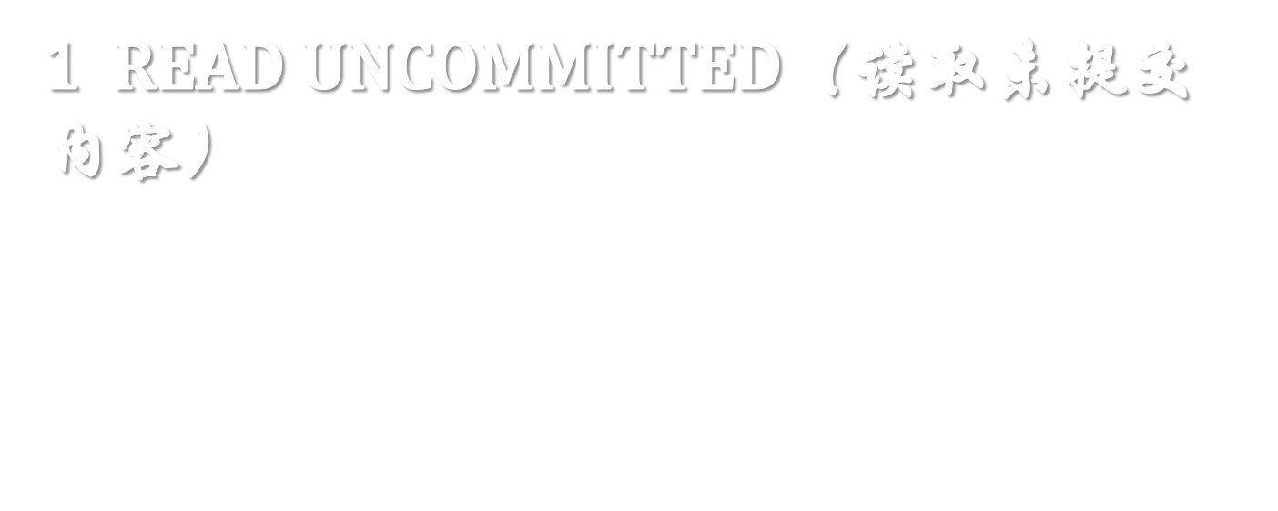
脏读（Dirty Read）演示

Slide 6

READ-COMMITTED 级别不可重复读问题演示

Slide 7

READ-REPEATABLE级别操作演示

Slide 8

隐式事务提交操作演示

Slide 9


锁的应用演示

