Slide 1
PRODUCT ANALYTICS CASE STUDY
NordicFlow CRM
From Business Problem to Actionable Insight — A Raw-to-Dashboard Analytics Build
PYTHON
SQL
POWER BI
A end-to-end analytics build: Raw data → Python cleaning → SQL gold layer → Power BI dashboard

Slide 2
WHERE WE'RE HEADED
Agenda
01
The Business Problem
Who NordicFlow is, and the challenges pushing them toward product analytics
02
Our Approach
How raw data became a governed, decision-ready dashboard — Python, SQL, Power BI
03
Findings
What the data actually shows about accounts, activation, channels and churn
04
Recommendations & Conclusion
What NordicFlow should do next, grounded in the evidence
NordicFlow CRM | Product Analytics

Slide 3
PROBLEM STATEMENT
Who is NordicFlow CRM?
NordicFlow CRM is a Copenhagen-based, European B2B SaaS company that sells a subscription CRM platform to small and mid-sized businesses (roughly 20–300 employees).
AT A GLANCE
HQ
Copenhagen, Denmark
Its market position: a GDPR-first alternative to US platforms — competing on usability, workflow design, and compliance rather than feature parity with global incumbents.
FOUNDED
2019
PRODUCT
The core tension: logging in and clicking around isn't the same as running your sales process through NordicFlow. Activity is not value — and that distinction shapes every metric in this project.
Subscription B2B CRM
CUSTOMER SIZE
~20–300 employees
POSITIONING
GDPR-first, privacy-led
KEY INDUSTRIES
SaaS, Prof. Services, Logistics,
Manufacturing, B2B Agencies
NordicFlow CRM | Product Analytics

Slide 4
PROBLEM STATEMENT
Four Challenges Driving This Project
1
2
3
4
Inconsistent Activation
Activity Mistaken for Value
Early Churn
Conflicting Dashboards
Trial signups are climbing steadily, but a meaningful share of new accounts never reach real day-to-day usage.
Users log in without touching pipeline, deal progression, or automation — surface activity looks like engagement, but isn't.
Churn is emerging among smaller customers, usually because they fail to realize value quickly enough — not because of missing features.
Different teams pull different numbers from the same data, making it hard for leadership to prioritize or measure impact.
NordicFlow CRM | Product Analytics

Slide 5
PROBLEM STATEMENT
The Objective
Turn fragmented raw data into a single, trusted view of how customers actually adopt NordicFlow — so leadership can act on evidence instead of opinion.
SCOPE OF THIS BUILD
116
Accounts analyzed
Define trusted, consistent metrics for activation, engagement and churn
352
Make assumptions explicit so results are interpreted the same way across teams
Active users tracked
Explain why activation and churn happen — not just report the numbers
4
Deliver a governed data pipeline that any team can query with confidence
Fact tables (Gold layer)
3
Power BI report pages
NordicFlow CRM | Product Analytics

Slide 6
OUR APPROACH
One Pipeline, Three Tools
Raw exports were carried through a Bronze → Silver → Gold model before ever reaching a chart — each stage adding trust, not just transformation.
Raw
→
Silver
→
Gold
→
Dashboard
CSV / Excel exports:
accounts, users, deals,
product events, geography
Python (Pandas) cleaning,
typing & enrichment
SQL modeling into
fact & dimension tables
Power BI report:
3 pages, live KPIs
Python — Pandas, NumPy, SQLAlchemy
SQL — MySQL gold-layer analytics
Power BI — report design & DAX
NordicFlow CRM | Product Analytics

Slide 7
APPROACH — STEP 1
Cleaning & Shaping the Data in Python
Four raw sources — accounts, users, deals, and product events — were profiled and cleaned with Pandas before loading into the Silver layer (MySQL).
1
2
3
4
Profile & Inspect
Checked shape, dtypes, nulls
Standardize
Enrich & Model
Load to Silver
Trimmed whitespace in text fields
Parsed date fields (trial, deal, activity dates)
Pushed clean frames to MySQL via SQLAlchemy
Reviewed distributions with .describe()
Unified category labels (product-led → product_led)
Derived trial length, sales-cycle days, recency
Built silver_dim_accounts / _users / _deals
Dropped records missing key fields (e.g. industry)
Normalized inconsistent country codes
Joined accounts to a geography lookup table
Built silver_product_event for behavioral data
NordicFlow CRM | Product Analytics

Slide 8
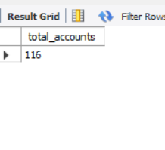
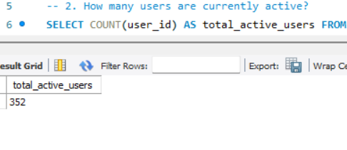
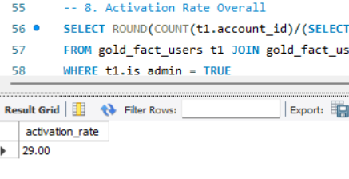
APPROACH — STEP 2
SQL: Establishing the Core KPIs
Once data landed in the Gold layer (gold_fact_accounts, gold_fact_users, gold_fact_product_event), SQL queries produced the platform's headline numbers.
QUERY 1 · TOTAL ACCOUNTS
QUERY 2 · ACTIVE USERS
QUERY 8 · ACTIVATION RATE
116
352
29%
Registered accounts on the platform
Users currently active
Overall admin-activation rate
NordicFlow CRM | Product Analytics

Slide 9
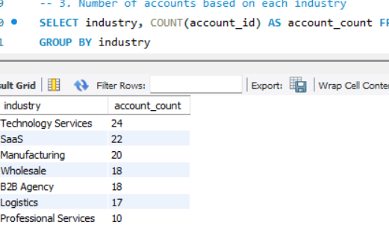
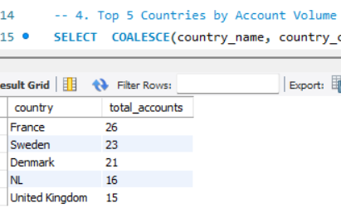
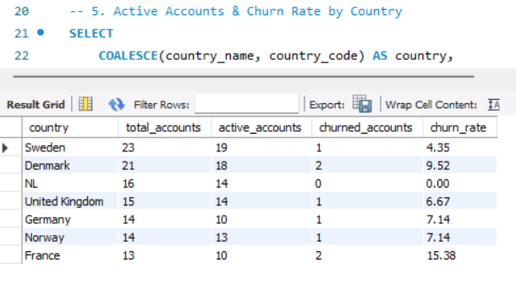
APPROACH — STEP 2
SQL: Segmenting Accounts
Grouping and window-style aggregation queries broke the account base down by industry and geography to spot where volume — and risk — concentrates.
Query 3 — Accounts by Industry
Query 4 — Top 5 Countries by Volume
Query 5 — Active vs. Churned by Country
Technology Services and SaaS lead by industry volume, while France, Sweden and Denmark are the three largest markets — and two of them also carry the highest churn (see next slides).
NordicFlow CRM | Product Analytics

Slide 10
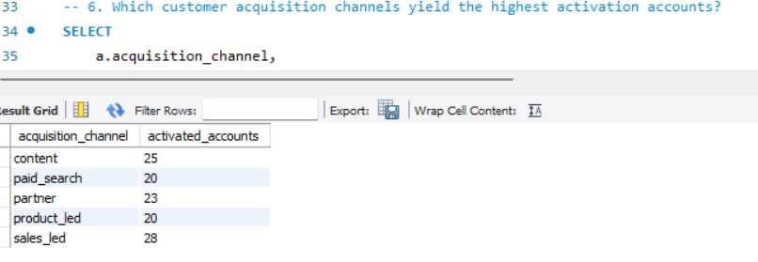
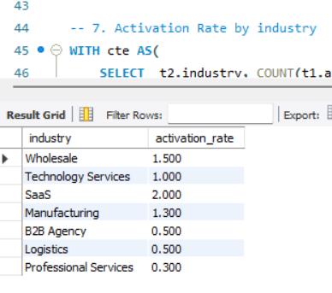
APPROACH — STEP 2
SQL: What Drives Activation?
Joining accounts to product-event activity isolated which acquisition channels and industries actually convert signups into activated, admin-configured accounts.
Query 6 — Activated Accounts by Acquisition Channel
Sales-led and content channels activate the most accounts. Activation rate varies sharply by industry — SaaS converts best, Professional Services and B2B Agency lag furthest behind.
Query 7 — Activation Rate by Industry
NordicFlow CRM | Product Analytics

Slide 11
APPROACH — STEP 3
Bringing It Together in Power BI
The gold-layer tables feed a 3-page Power BI report — each page built for a different audience and question.
PAGE 1
PAGE 2
PAGE 3
Executive Overview
Product Usage & Adoption
Activation & Time-to-Value
Leadership snapshot
Which features actually get used
Speed and depth of onboarding
VISUALS ON THIS PAGE
VISUALS ON THIS PAGE
VISUALS ON THIS PAGE
KPI cards
Bar chart
KPI cards
Trend (area)
Pivot table
Trend (area)
Column chart
Trend (area)
Column + Pie
Donut / Pie
Treemap
Treemap
NordicFlow CRM | Product Analytics

Slide 12
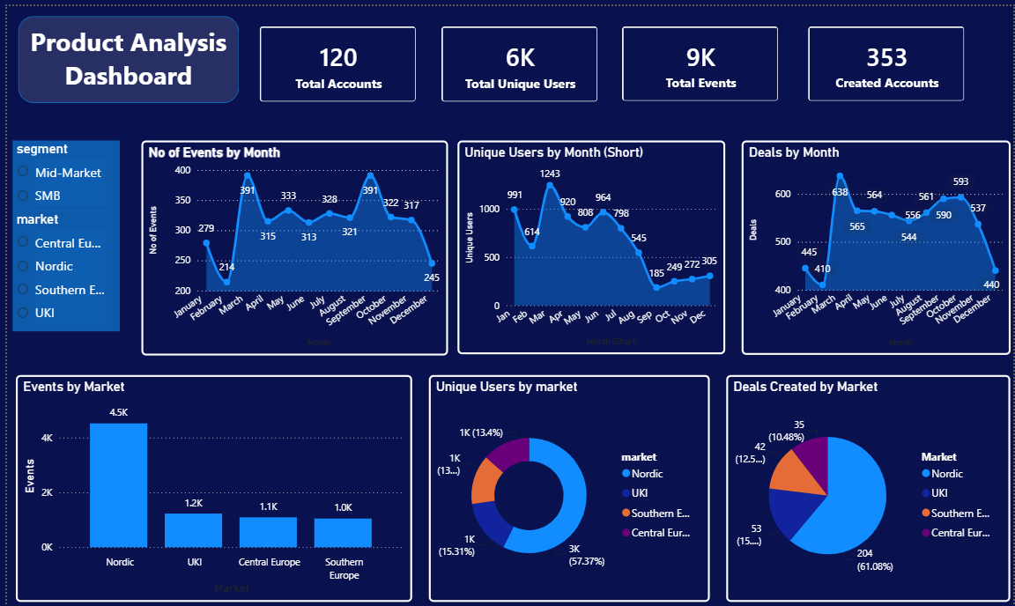
FINDINGS
Executive Dashboard Snapshot
NordicFlow CRM | Product Analytics

Slide 13
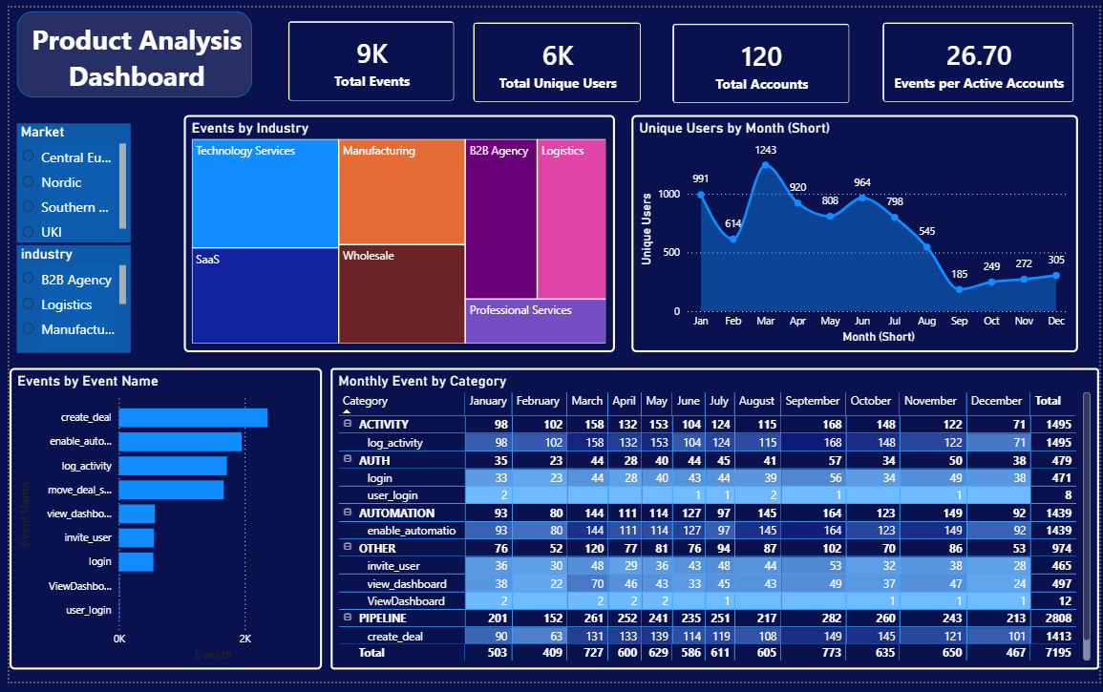
FINDINGS
Where Activation and Churn Diverge
France and Denmark combine high account volume with the highest churn rates (15.4% and 9.5%) — while sales-led and content channels activate meaningfully more accounts than paid search or product-led signup.
NordicFlow CRM | Product Analytics

Slide 14
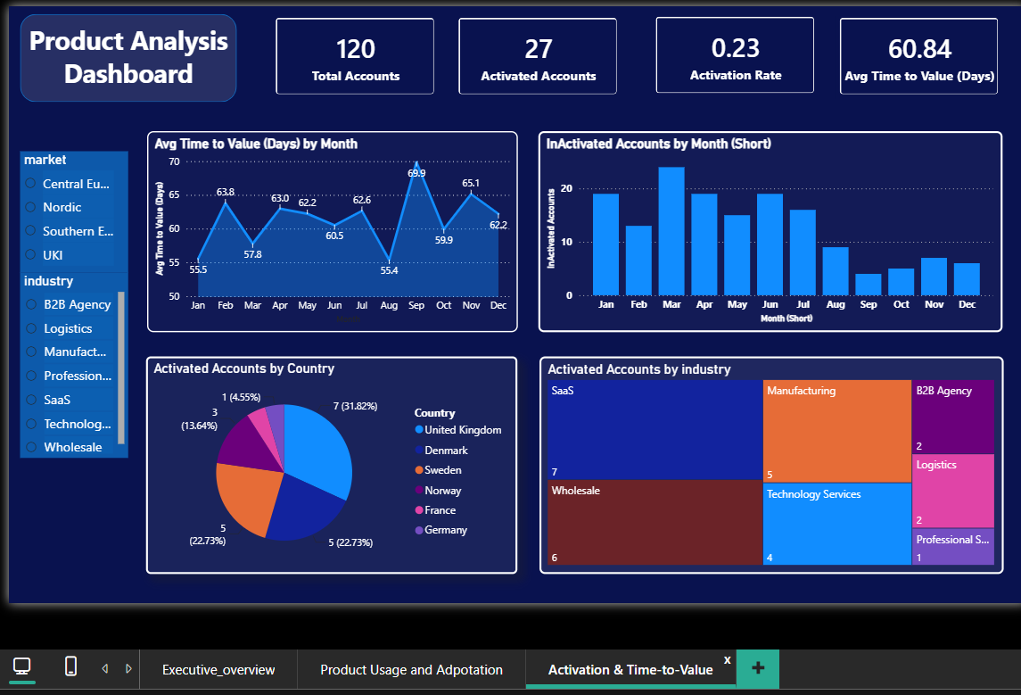
FINDINGS
France and Denmark combine high account volume with the highest churn rates (15.4% and 9.5%) — while sales-led and content channels activate meaningfully more accounts than paid search or product-led signup.
NordicFlow CRM | Product Analytics

Slide 15
RECOMMENDATIONS
What NordicFlow Should Do Next
Redesign onboarding for low-activation industries
Double down on sales-led and content acquisition
Launch a proactive save motion in France and Denmark
Professional Services (0.3%) and B2B Agency (0.5%) lag far behind SaaS (2.0%). Build industry-specific onboarding playbooks around their most common workflows.
These channels activate the most accounts (28 and 25). Shift growth budget and rep time toward them before scaling paid search or self-serve product-led signup.
The two highest-churn markets (15.4%, 9.5%) also carry large account volumes. Trigger Customer Success outreach the moment early usage signals stall.
Redefine “engagement” around core actions
Establish one governed source of truth
Track pipeline configuration, deal progression and automation — not logins — as the activation signal, so every team reports the same number.
Standardize entities like country codes and channel labels at ingestion (this project found join mismatches from inconsistent codes) so every dashboard agrees.
Grounded in SQL & Power BI findings from the Gold layer
NordicFlow CRM | Product Analytics

Slide 16
CONCLUSION
From Raw Data to a Decision-Ready Story
This project turned scattered CSV/Excel exports into a governed Python → SQL → Power BI pipeline, and the resulting numbers tell a clear story: NordicFlow's activation problem is uneven across industries and channels, and its churn risk is concentrated in a few key markets — both fixable with targeted, not company-wide, action.
PROJECT AT A GLANCE
116
Accounts
352
NEXT STEPS
Extend the fact tables with historical cohorts to trend activation and churn over time
Active Users
29%
Automate the Silver → Gold refresh so the dashboard stays current without manual reruns
Activation
Roll the Executive Overview page out as the single shared source of truth across teams
7.2%
Avg. Churn
Python • SQL • Power BI

