Slide 1
Busi
ness
Pay
ments
https://busipay.net

Slide 2
BusiPay allows you to
Digitise your invoices using Machine Learning
Pay in batch using BoC API
Get charged for what you use

Slide 3

BusiPay is
On the cloud
Serverless (i.e. Pay-Per-Use & Auto-Scalable)
Smart (not startup-smart … -level smart)

Slide 4
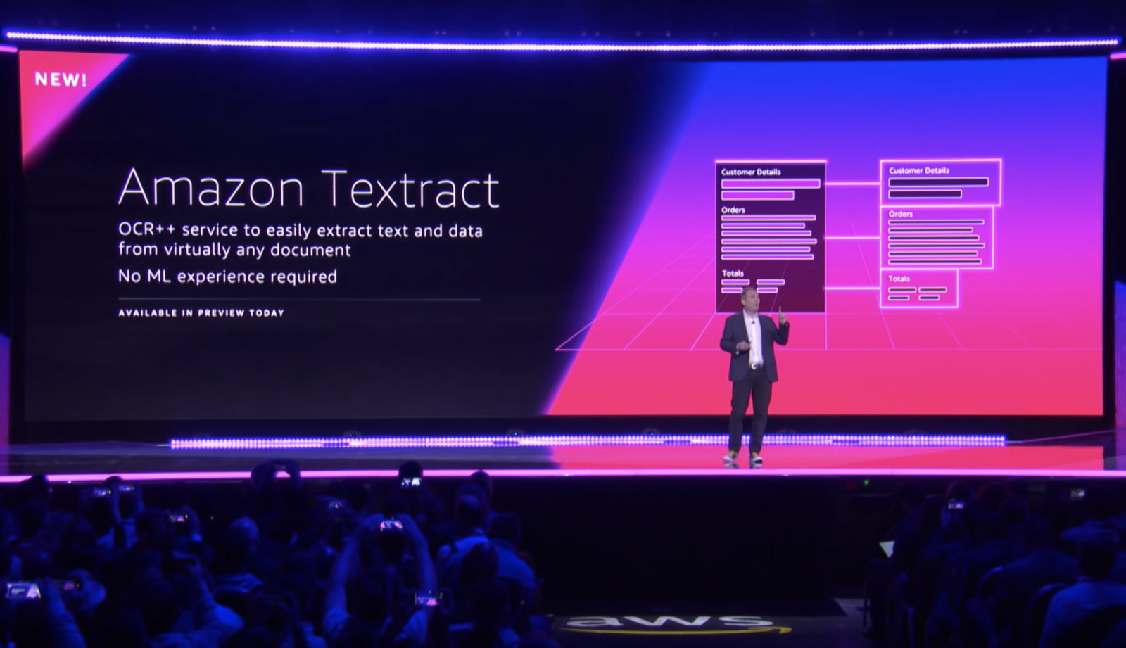
AWS TEXTRACT – Released May 2019

Slide 5
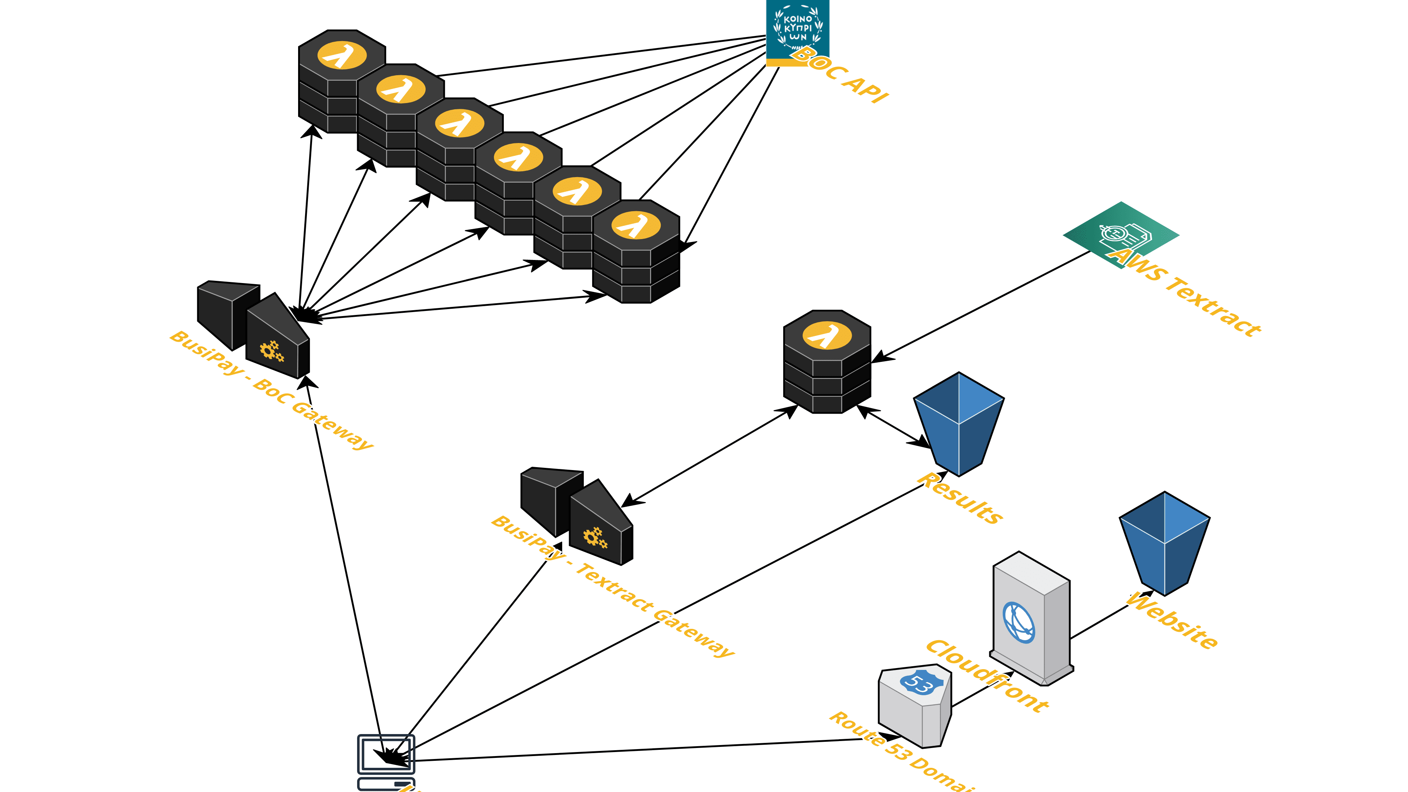

Slide 6

https://nodeslinks.com

Slide 7
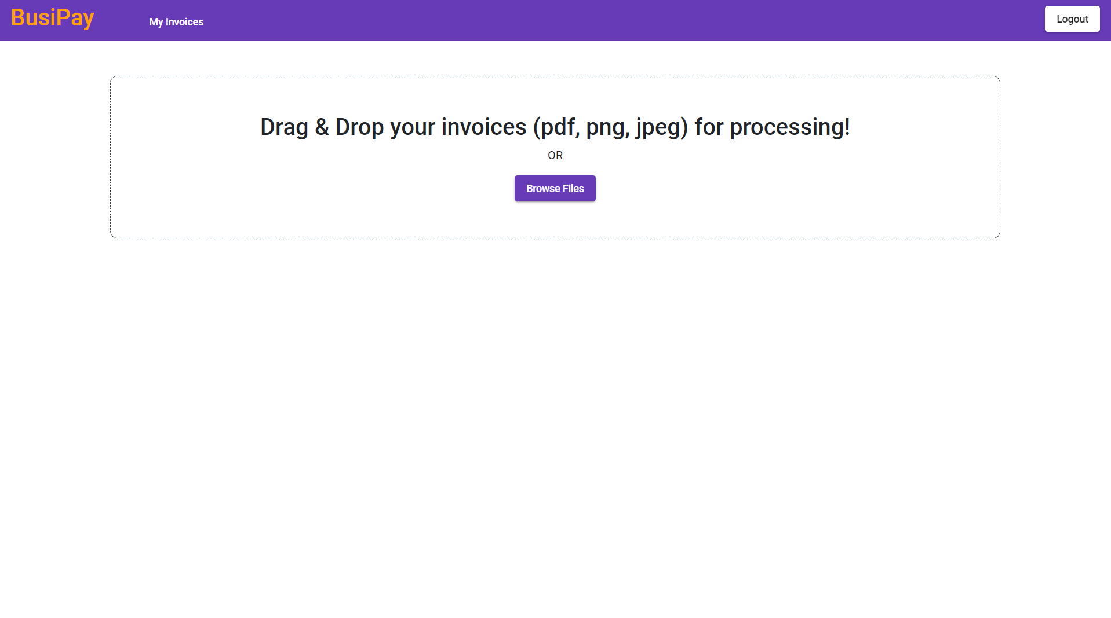

Slide 8
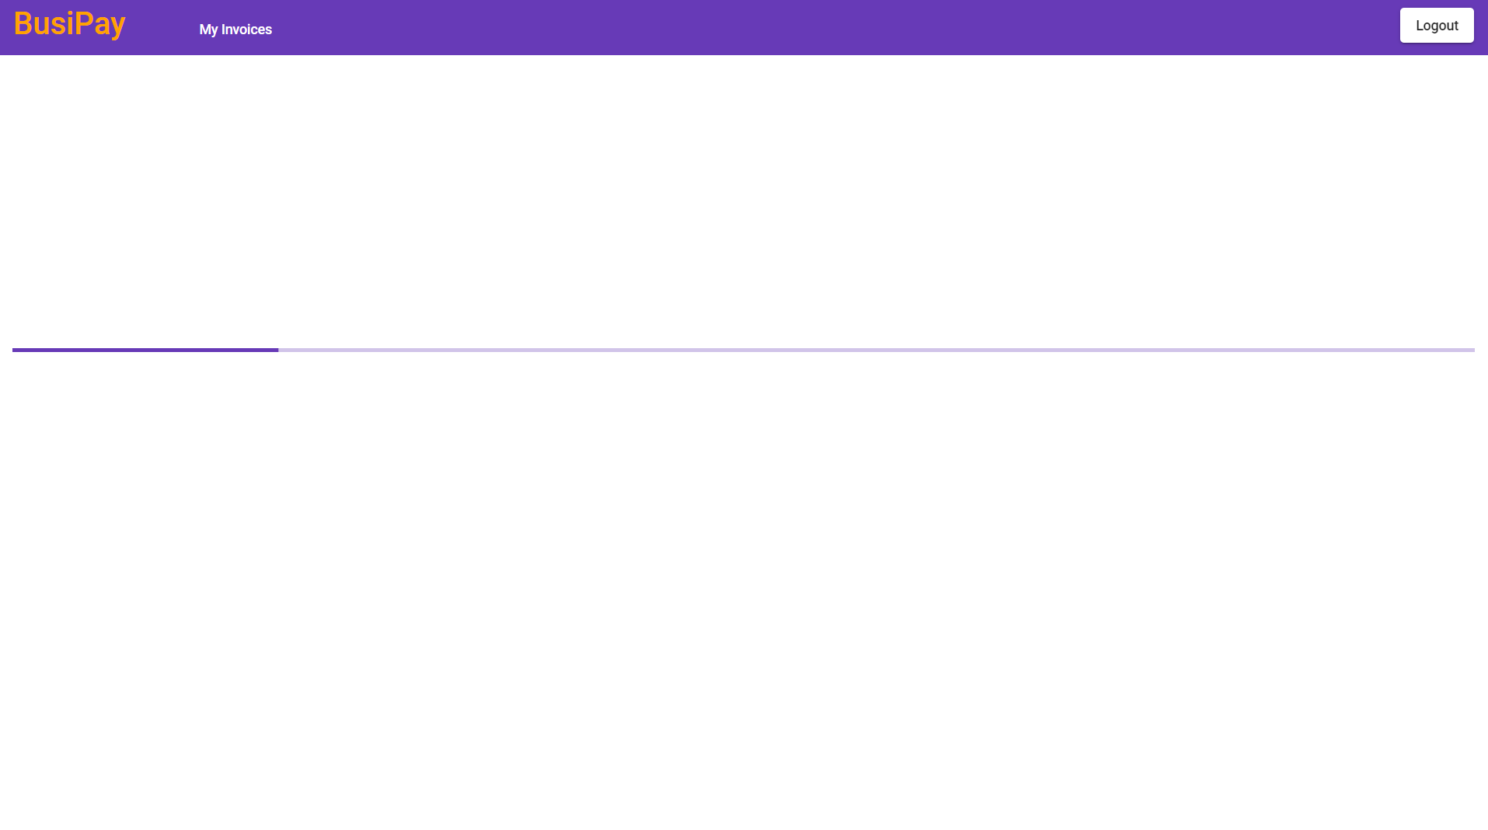

Slide 9
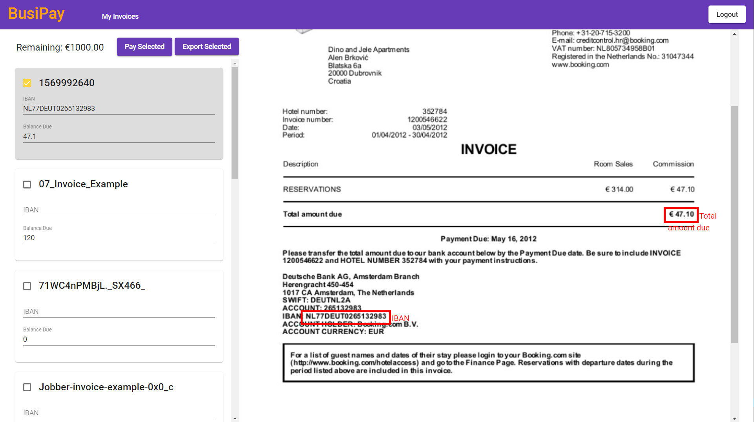

Slide 10

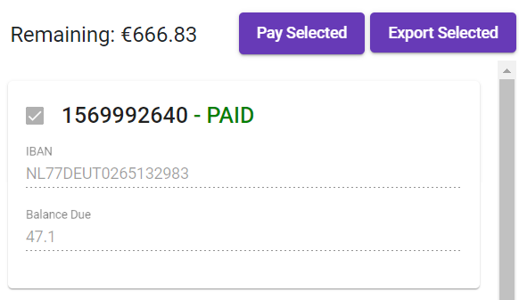

Slide 11
