Slide 1

TBD TEAM
Nicolas Hadjipaschalis Marios Constantinou

Slide 2
Contents
Introduction
Stating the problem
Idea information
What?, How?, Who?
Client
Bank
Private Companies
Charities
Demonstration
Potential issue

Slide 3
Introduction
Stating the problem
Idea information
What?, How?, Who?
Client
Bank
Private Companies
Charities
Demonstration
Potential issue

Slide 4
Social media
TV/News/Articles
A
Find Banking Information for charity
Log in , navigate in the bank site, fill the information
Complete the transaction
Word of mouth
Search
Problem Identification
Process A
Process B
Payment
Notifications
G
Open the application
Complete the transaction
Problem Identification
Process A
Payment

Slide 5
Introduction
Stating the problem
Idea information
What? ,How?, Who?
Client
Bank
Private Companies
Charities
Demonstration
Potential issue

Slide 6
Social e-Banking Idea
e-Banking additional feature platform
Connect people with same causes
Implementation in the existing e-Bank platform
Allow customers to donate one-off fee
Create a subscription plan
Benefits of any bank who decide to install it
Customers donations
Charity
Private company or organizations

Slide 7
Introduction
Stating the problem
Idea information
What?, How?, Who?
Client
Bank
Private Companies
Charities
Demonstration
Potential issue

Slide 8
Client
Easy Donations
Without registrations
Without giving critical information
Safe and trusted environment
Discover Issues
Based on preferences
Upon previous donations
Subscription plans
Suggestion based on average donations
One-off donation in specific cause

Slide 9
Client
Notifications
For urgent issues/campaigns
Possible participation
Promotions by various third parties
Satisfaction of giving out
Helping your society
Changing the world

Slide 10
Introduction
Stating the problem
Idea information
What?, How?, Who?
Client
Bank
Private Companies
Charities
Demonstration
Potential issue

Slide 11
Bank
CSR (Corporate Social Responsibility)
Bank cares about society
Active participant
Customer Acquisition
Customers who find the idea innovating
Customers who want to participate
Current customers retention
Business relationship development
Bank who provide this feature
Private companies which set up campaigns

Slide 12
Introduction
Stating the problem
Idea information
What,How,Who
Client
Bank
Private Companies
Charities
Demonstration
Potential issue

Slide 13
Private Companies
Setting up campaigns
Issued by private companies
Promoting their company or cause
Choosing charities to donate
Available list of charity organizations in Cyprus
Obtained and updated automatically
Easy process to start a campaign
Application form for creating an event/ a cause
Reviewed by bank employees
Improve Private’s Company CSR ( Corporate Social Responsibility )

Slide 14
Introduction
Stating the problem
Idea information
What,How,Who
Client
Bank
Private Companies
Charities
Demonstration
Potential issue

Slide 15
Charities
Raise awareness
Existing problems
Racism, Sexiscm
Trending problems
Cyber bullying
Resolution process
Summary of charity solution and its objectives
Easy way to set up charities
Applying online form
Network that connects each bank user with charity account
Simple layout transaction process

Slide 16
Introduction
Stating the problem
Idea information
What?, How?, Who?
Client
Bank
Private Companies
Charities
Demonstration
Potential issue

Slide 17
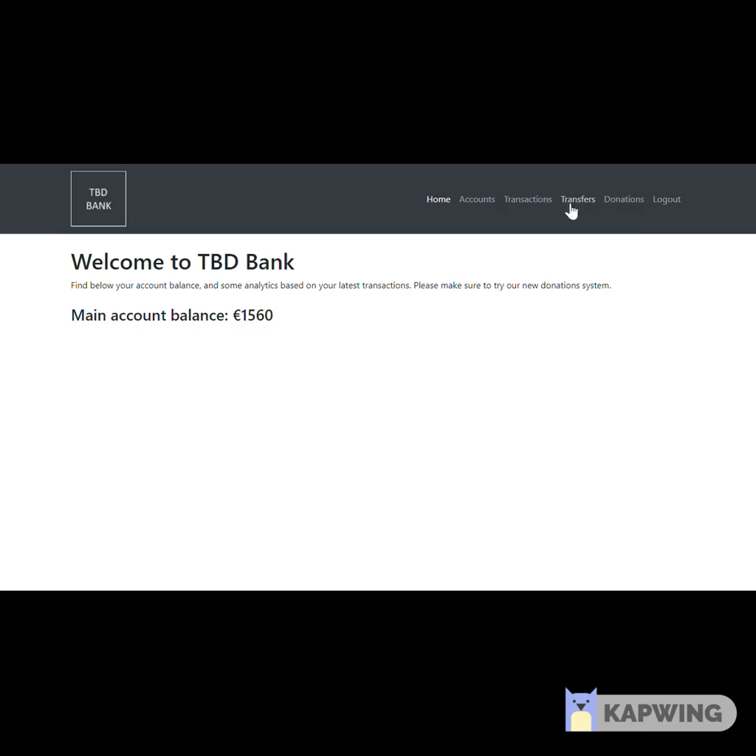

Slide 18
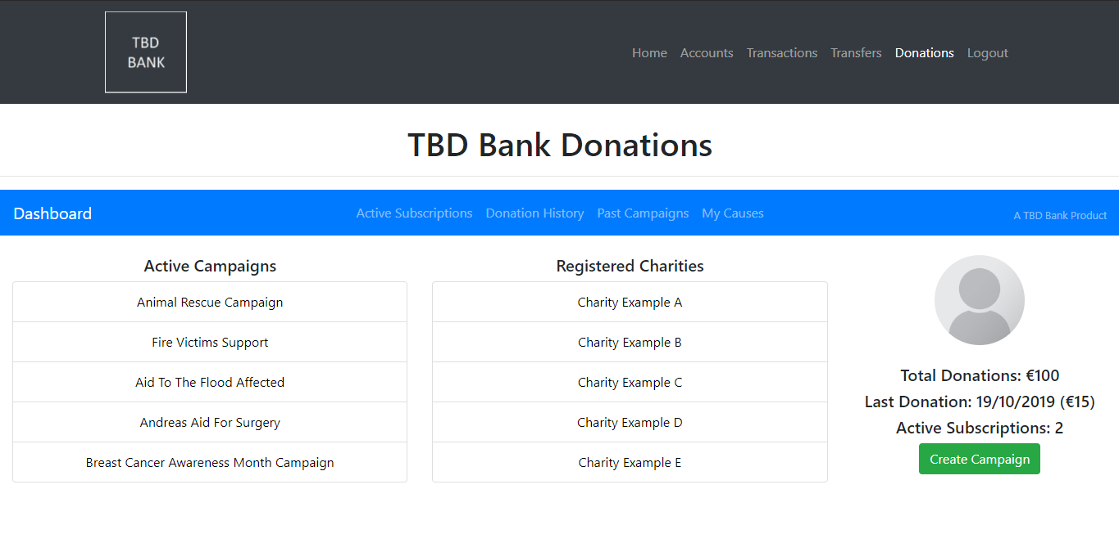

Slide 19
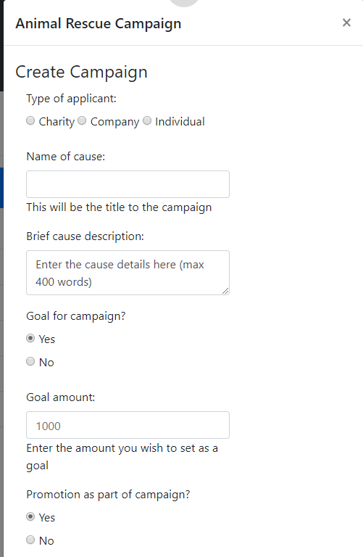
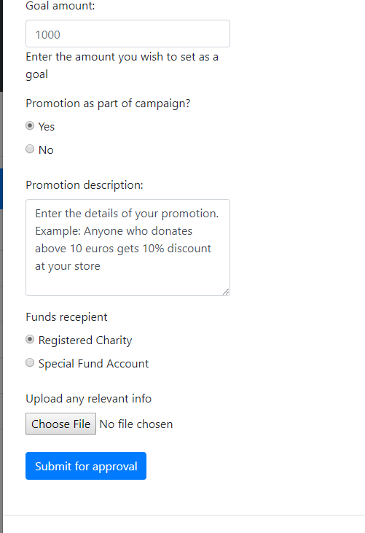

Slide 20
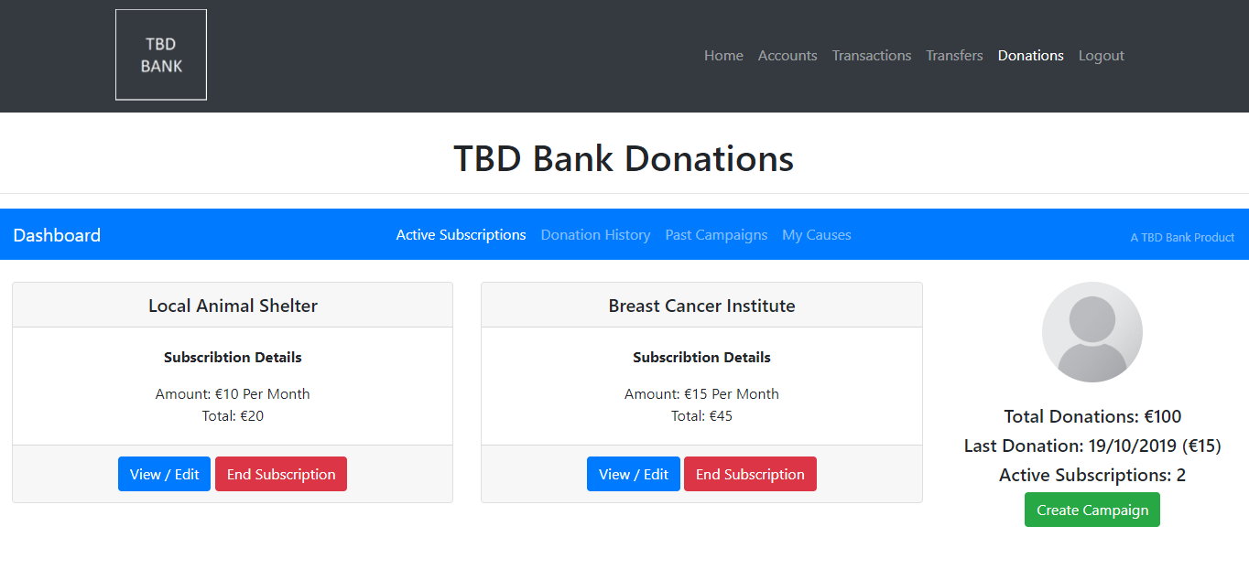
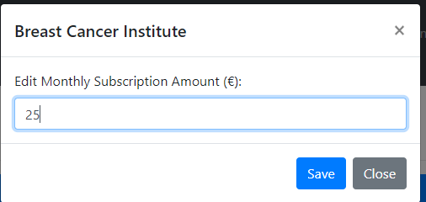
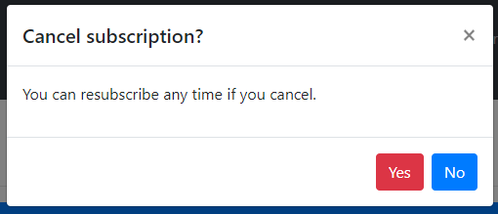

Slide 21
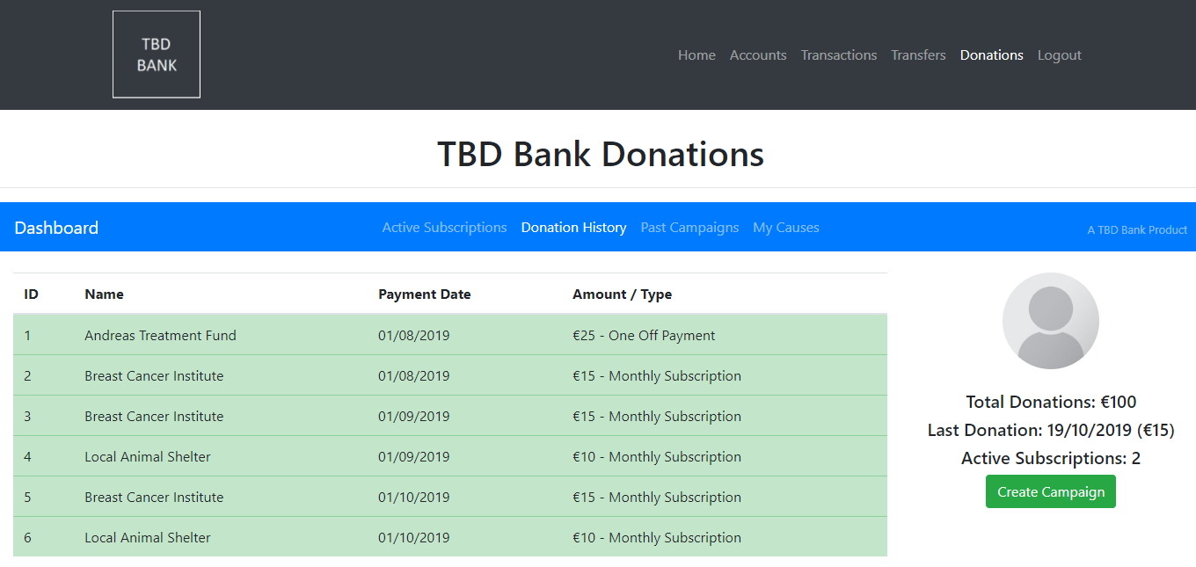

Slide 22
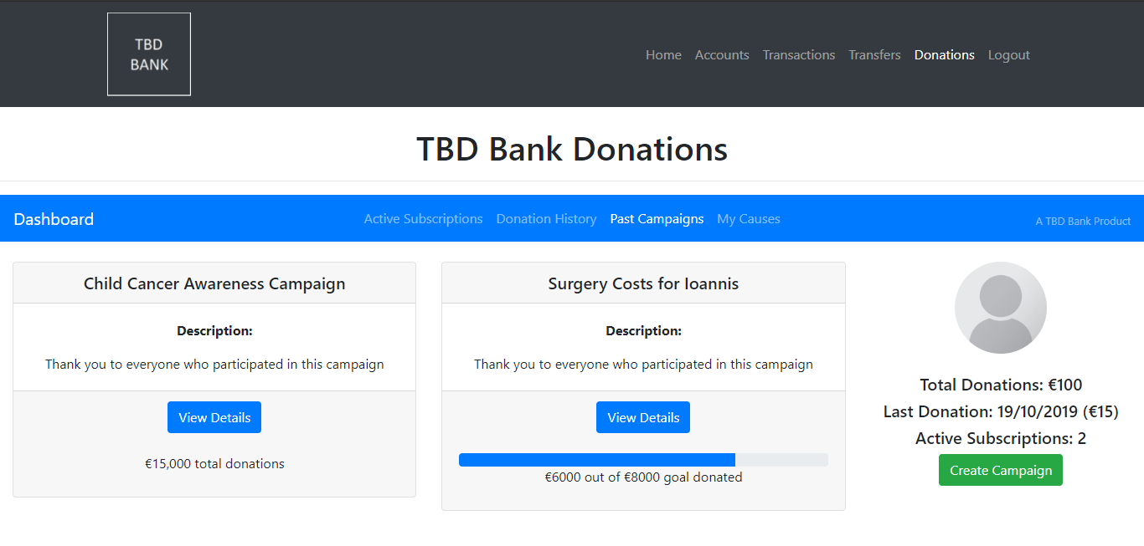

Slide 23
Introduction
Stating the problem
Idea information
What?, How?, Who?
Client
Bank
Companies
Demonstration
Potential issue

Slide 24
Potential issue
Bank employees
Avoid scamming

Slide 25
Thank you for your attention

