Slide 1

Crowdfunding for social causes through micro-donations

Slide 2
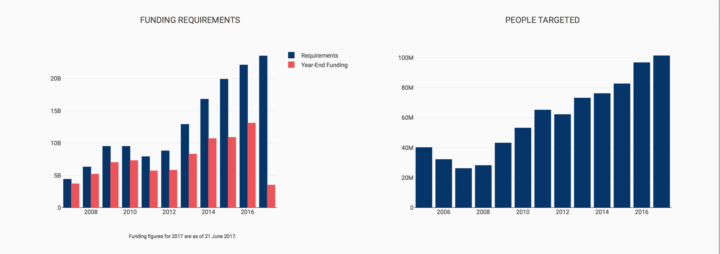
WE HAVE A PROBLEM…
Funding Trends (Source: OCHA, Global Humanitarian Overview)
Notes:
The number of natural disasters and escalated conflicts has significantly increased over recent years. Financing from traditional sources is no longer sufficient to cover humanitarian relief operations, and funding gaps are reaching threatening levels.
Looking ahead, the widening gap between the number of affected people and sufficient resources will be the greatest challenge facing the humanitarian system.
For 2017, the United Nations Office for the Coordination of Humanitarian Affairs (OCHA) estimated that $23.5 billion in humanitarian funds would be necessary to support 101.2 million people in 37 countries. But, by mid-year, a mere $3.5 billion had been mobilized, leaving a frightful funding gap of $20.0 billion (85%) to be mobilized before the end of the year. In analyzing fundraising records from past years, it becomes evident that traditional fundraising is no longer sufficient. We need to radically change the way we fundraise for humanitarian relief aid, experimenting with and capitalizing on innovative fundraising methodologies.

Slide 3
MORE LIKELY TO DONATE
MICRO-DONATIONS
REQUIRES MINIMAL EFFORT
WE DON’T NOTICE IT

Slide 4

HOW IT WORKS
ONLINE MERCHANTS
Matches micro-donations
Submit campaigns on our Network
NGO
Use our APIs
Release Payment
BUY / SELL
Intelligent Automatic micro-donations
CUSTOMERS

Slide 5
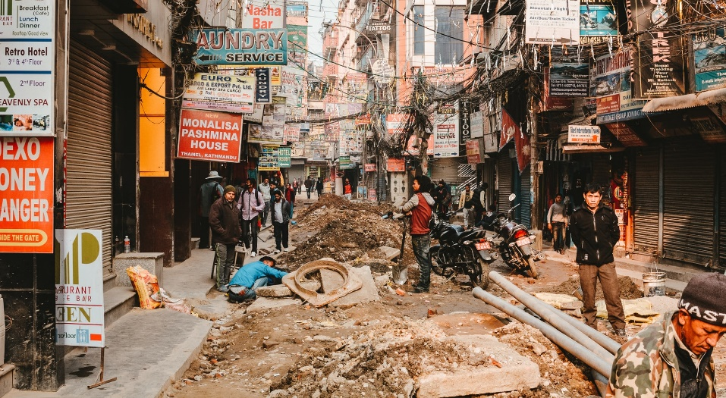
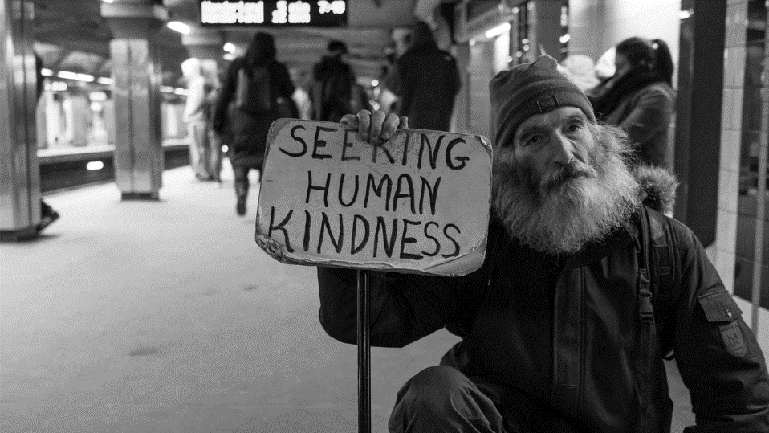
INTELLIGENT MICRO-DONATION ALGORITHMS ~ Future Extension
A.I. DISCOVERS GLOBAL DISASTER THROUGH ONLINE NEWS
PRIORITY IN GLOBAL DISASTER CAUSES
A.I. PREDICTS HOMELESS CRISIS IN LIMASSOL
PRIORITY IN HOMELESS CAUSES AROUND LIMASSOL DISTRICT

Slide 6
BUSINESS MODEL
SUBSCRIPTION MODEL (MERCHANTS)
OPTIONAL MICRO-DONATIONS
DONATIONS

