Slide 1

Crowdfunding for social causes through micro-donations

Slide 2
MORE LIKELY TO DONATE
MICRO-DONATIONS
REQUIRES MINIMAL EFFORT
WE DON’T NOTICE IT

Slide 3
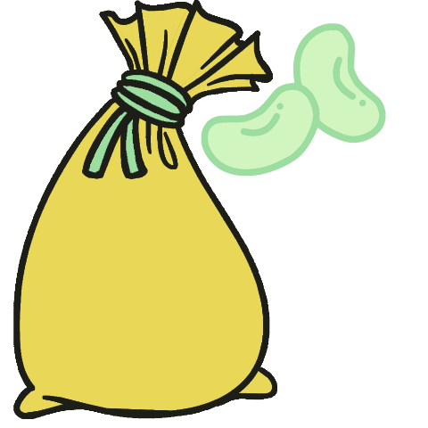
HOW IT WORKS
NGO

