Slide 1
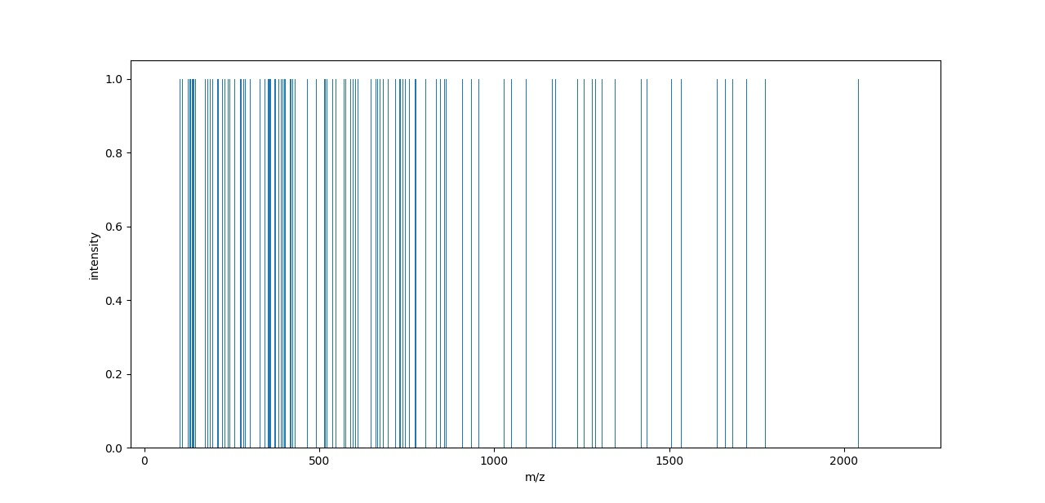
intensity

Slide 2
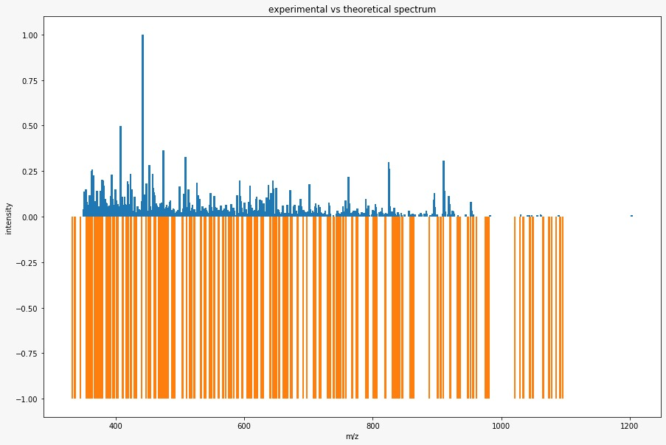
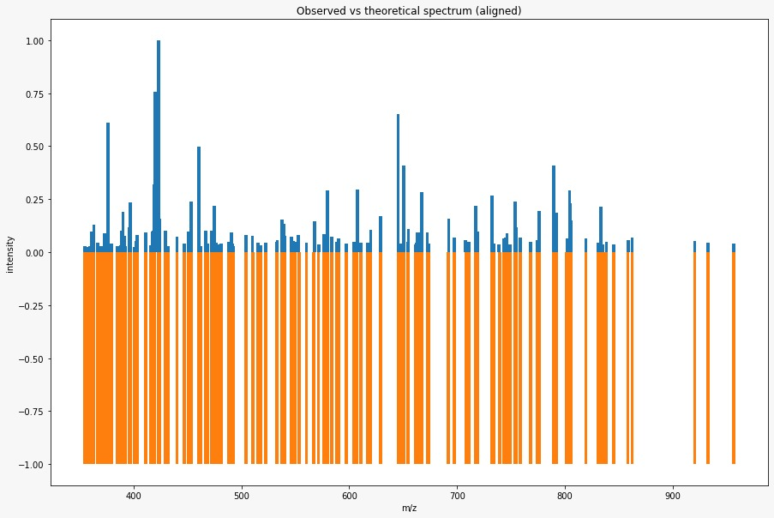
Experimental1
Before
After

Slide 3
Results1:
peptides number : 21
___________________________________
Number of matched peaks: 152
___________________________________
ion theo. m/z observed m/z
y6++ 2 354.637768620721 354.6779479980469
y3+ 1 357.24963348757103 357.2532043457031
y6++ 2 359.220018788771 359.2193908691406
y3+ 1 361.244548487571 361.2479248046875
y3+ 1 362.20341232807107 362.20330810546875
y3+ 1 363.206054153771 363.2084655761719
y6++ 2 366.719851804721 366.7131652832031
y6++ 2 367.691959645221 367.7120056152344
y7++ 2 370.168181129271 370.1594543457031
y7++ 2 372.224147391871 372.2277526855469
y7++ 2 373.19558729617097 373.1878356933594
y3+ 1 373.280933615171 373.28424072265625
y6++ 2 373.700839280221 373.7309875488281
y7++ 2 375.182479732371 375.1827697753906
y3+ 1 375.23504642377105 375.23468017578125
y3+ 1 376.19391026427104 376.195556640625
y3+ 1 377.166693232371 377.167236328125
y7++ 2 379.71140434402093 379.70941162109375
y3+ 1 385.255781487571 385.2579040527344
y4+ 1 388.21906239187103 388.2173767089844
y7++ 2 388.729262939721 388.7403564453125
y3+ 1 390.209560328071 390.2151794433594
y3+ 1 391.21220215377105 391.2200012207031
y3+ 1 392.17106599427103 392.1590576171875
y7++ 2 396.22414739187104 396.22161865234375
y7++ 2 396.73434793972103 396.7349548339844
y3+ 1 397.255781487571 397.23199462890625
y7++ 2 401.23451492377103 401.2325439453125
y3+ 1 402.24594545567106 402.2424011230469
y7++ 2 402.73603336852096 402.7375183105469
y7++ 2 403.16415073237096 403.2132263183594
y4+ 1 403.229961423771 403.2323913574219
y6++ 2 403.74082990782097 403.7342224121094
y3+ 1 411.2238134237711 411.227783203125
y4+ 1 416.250362519471 416.2586364746094
y7++ 2 417.21685385997097 417.217529296875
y7++ 2 418.21579925687104 418.2095947265625
y4+ 1 419.22487642377104 419.23468017578125
y8++ 2 419.702388272821 419.7226257324219
y8++ 2 423.2274189237709 423.22576904296875
y7++ 2 423.741315900421 423.73583984375
y4+ 1 424.186048121871 424.1851806640625
y8++ 2 429.737619471621 429.7417297363281

Slide 4
y8++ 2 431.724511907821 431.7584228515625
y8++ 2 432.245277519471 432.24310302734375
y3+ 1 440.2364433918711 440.239990234375
y4+ 1 447.231024423771 447.23431396484375
y8++ 2 451.26241548017094 451.265625
y7++ 2 453.275037051371 453.2658386230469
y4+ 1 460.258818377071 460.2535400390625
y8++ 2 460.74544450352107 460.74200439453125
y4+ 1 462.29222771087103 462.2738952636719
y9++ 2 466.7434335035209 466.7609558105469
y9++ 2 468.228770384471 468.2333984375
y4+ 1 472.287810647071 472.2840881347656
y8++ 2 474.75783143232104 474.7369384765625
y8++ 2 474.76872206732105 474.7529296875
y8++ 2 476.698357875921 476.9010009765625
y4+ 1 479.203095153771 479.19329833984375
y8++ 2 481.254787980171 481.245849609375
y9++ 2 488.266544083271 488.2754821777344
y5+ 1 489.26674161517104 489.0005187988281
y4+ 1 489.27797461517105 489.27313232421875
y8++ 2 490.751061003521 490.76611328125
y4+ 1 491.264632408971 491.2688903808594
y4+ 1 492.193637391871 492.2117004394531
y4+ 1 504.321418632271 504.2860412597656
y4+ 1 510.2922277108711 510.2821044921875
y4+ 1 510.33984583847104 510.3168029785156
y5+ 1 515.318776806571 515.3221435546875
y5+ 1 516.314025774671 516.3079223632812
y9++ 2 517.7669085992211 517.7708129882812
y9++ 2 522.777276131121 522.7640991210938
y9++ 2 532.794080123721 532.7982788085938
y9++ 2 533.2403900513709 533.2415771484375
y9++ 2 537.7968201556209 537.773681640625
y5+ 1 539.2129922813709 539.2833251953125
y10++ 2 539.771136528021 539.783935546875
y10++ 2 546.277640647071 546.2842407226562
y9++ 2 548.3029292108711 548.2972412109375
y5+ 1 549.324256870371 549.3074951171875
y4+ 1 553.320507742771 553.037353515625
y5+ 1 560.3150887746709 560.3115234375
y5+ 1 567.361309934171 567.8162841796875
y5+ 1 571.356224934171 571.645751953125
y10++ 2 576.310094703471 576.3060913085938
y10++ 2 579.798740226821 579.8224487304688
y10++ 2 583.764229663021 583.7863159179688
y10++ 2 588.320659767271 588.3255004882812
y5+ 1 590.325653838471 590.3197021484375
y5+ 1 597.317730600371 597.3222045898438
y11++ 2 604.292433639671 604.2819213867188
y5+ 1 604.3486967598709 604.3319702148438

Slide 5
y5+ 1 605.304189742771 605.3201293945312
y5+ 1 607.220581551371 607.3121948242188
y11++ 2 610.7989377587211 610.8212890625
y10++ 2 616.8323853225211 616.8455200195312
y6+ 1 617.325319870371 616.9822387695312
y5+ 1 617.4054829831709 617.2830810546875
y11++ 2 619.8261092832211 619.97705078125
y11++ 2 629.332947370371 629.33349609375
y11++ 2 645.342123862971 645.3663940429688
y12++ 2 648.336841331071 648.3175659179688
y5+ 1 650.373271966071 650.3401489257812
y6+ 1 654.393339093671 654.3394165039062
y12++ 2 654.816273251321 654.8468627929688
y6+ 1 661.362767997971 661.3623046875
y6+ 1 662.325653838471 662.3236694335938
y6+ 1 663.367185061771 663.3526000976562
y6+ 1 663.3824400617709 663.8374633789062
y6+ 1 664.366456029871 664.372802734375
y12++ 2 667.3409699341711 667.3339233398438
y6+ 1 672.4039041574711 672.3812866210938
y11++ 2 673.3744174979711 673.3273315429688
y13++ 2 691.8528559108211 692.2987060546875
y12++ 2 697.327725934171 697.3428955078125
y6+ 1 708.268260774671 707.8126831054688
y12++ 2 710.864612013921 710.849853515625
y13++ 2 716.8751770777211 716.9052734375
y6+ 1 717.4327611107709 717.3844604492188
y14++ 2 718.845562378921 718.8683471679688
y6+ 1 732.4324271426709 732.3845825195312
y6+ 1 734.376642823671 734.3446655273438
y7+ 1 739.3290857917709 738.85986328125
y7+ 1 743.441018316971 743.3641967773438
y7+ 1 745.383898125571 745.3701782226562
y6+ 1 746.3944020936709 746.3812866210938
y7+ 1 749.357682997971 749.337890625
y13++ 2 753.869758109621 753.8823852539062
y15++ 2 754.3641194586711 754.3848876953125
y7+ 1 758.415532221271 758.4234619140625
y13++ 2 767.8860761096211 768.3856201171875
y14++ 2 774.3886491574711 774.35986328125
y7+ 1 776.451249412671 776.374755859375
y16++ 2 789.8826765384212 789.4420776367188
y7+ 1 791.4410183169709 791.4468994140625
y7+ 1 792.4614194126709 792.406005859375
y7+ 1 801.461753380771 801.8699340820312
y14++ 2 804.408527150071 804.3842163085938
y7+ 1 804.4647902702709 804.88671875
y7+ 1 805.321024997971 805.38671875
y14++ 2 819.390668554371 819.4132080078125
y15++ 2 830.9306813329212 830.943359375
y7+ 1 833.4264312531709 833.4323120117188
y7+ 1 835.4243220469709 834.9386596679688
y8+ 1 838.397500078871 838.438232421875
y8+ 1 845.4475613807709 845.4453735351562
y8+ 1 858.467962476471 858.4990234375
y8+ 1 862.441747348871 862.3894653320312
y8+ 1 920.483612540271 920.46435546875
y9+ 1 932.4795905402709 932.95703125
y17++ 2 956.4816015402712 956.4805908203125

Slide 6
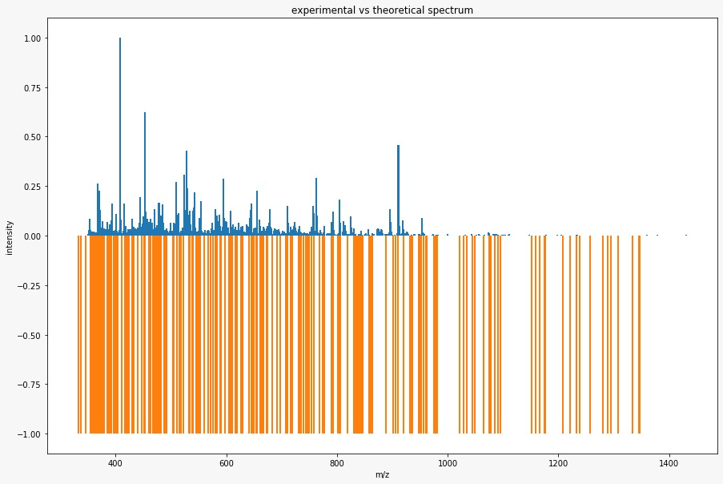
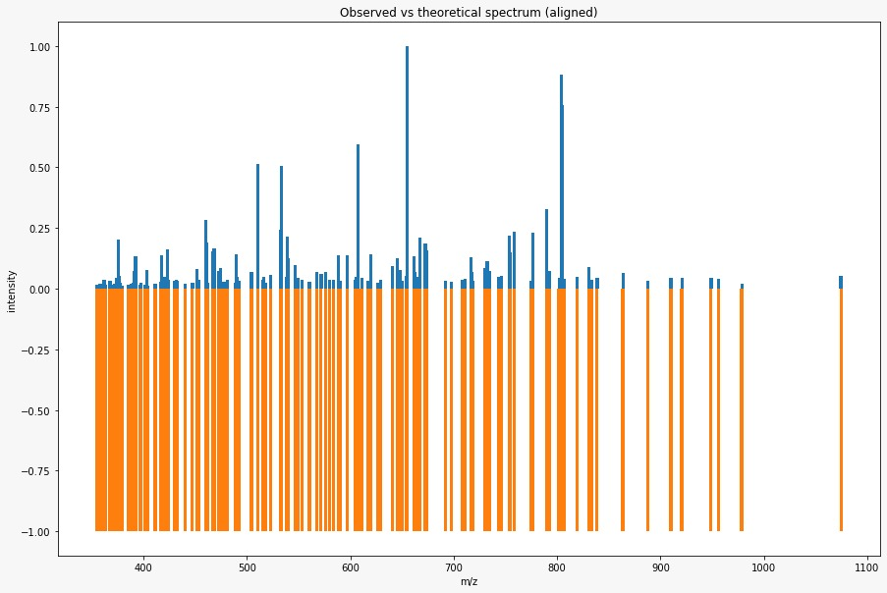
Experimental2
Before
After

Slide 7
Results2:
peptides number : 21
___________________________________
Number of matched peaks: 158
___________________________________
ion theo. m/z observed m/z
y6++ 2 354.637768620721 354.62188720703125
y3+ 1 357.24963348757103 357.25189208984375
y6++ 2 359.220018788771 359.2107849121094
y3+ 1 361.244548487571 361.21759033203125
y3+ 1 362.20341232807107 362.20599365234375
y3+ 1 363.206054153771 363.2055969238281
y6++ 2 366.719851804721 366.7204895019531
y6++ 2 367.691959645221 367.568115234375
y7++ 2 370.168181129271 370.2004699707031
y7++ 2 372.224147391871 372.2222900390625
y7++ 2 373.19558729617097 373.2035217285156
y3+ 1 373.280933615171 373.2830810546875
y6++ 2 373.700839280221 373.68951416015625
y7++ 2 375.182479732371 375.1671447753906
y3+ 1 375.23504642377105 375.23370361328125
y3+ 1 376.19391026427104 376.1948547363281
y3+ 1 377.166693232371 377.1595764160156
y7++ 2 379.71140434402093 379.725830078125
y3+ 1 385.255781487571 385.2546081542969
y4+ 1 388.21906239187103 388.2173767089844
y7++ 2 388.729262939721 388.7221374511719
y3+ 1 390.209560328071 390.21484375
y3+ 1 391.21220215377105 391.2197570800781
y3+ 1 392.17106599427103 392.22943115234375
y7++ 2 396.22414739187104 396.24542236328125
y7++ 2 396.73434793972103 396.7183532714844
y3+ 1 397.255781487571 397.2138366699219
y7++ 2 401.23451492377103 401.2210998535156
y3+ 1 402.24594545567106 402.2311096191406
y7++ 2 402.73603336852096 402.7364196777344
y7++ 2 403.16415073237096 403.2044372558594
y4+ 1 403.229961423771 403.2286376953125
y6++ 2 403.74082990782097 403.7321472167969
y3+ 1 411.2238134237711 411.2103576660156
y4+ 1 416.250362519471 416.25738525390625
y7++ 2 417.21685385997097 417.21624755859375
y7++ 2 418.21579925687104 418.2167663574219
y4+ 1 419.22487642377104 419.225341796875
y8++ 2 419.702388272821 419.7215881347656
y8++ 2 423.2274189237709 423.22454833984375
y7++ 2 423.741315900421 423.74224853515625
y4+ 1 424.186048121871 424.2098693847656
y8++ 2 429.737619471621 429.7433166503906

Slide 8
y8++ 2 431.724511907821 431.7229919433594
y8++ 2 432.245277519471 432.248046875
y3+ 1 440.2364433918711 440.23773193359375
y4+ 1 447.231024423771 447.23760986328125
y8++ 2 451.26241548017094 451.2735290527344
y7++ 2 453.275037051371 453.284912109375
y4+ 1 460.258818377071 460.2525939941406
y8++ 2 460.74544450352107 460.7662658691406
y4+ 1 462.29222771087103 462.2787170410156
y9++ 2 466.7434335035209 466.7377624511719
y9++ 2 468.228770384471 468.25750732421875
y4+ 1 472.287810647071 472.28338623046875
y8++ 2 474.75783143232104 474.735107421875
y8++ 2 474.76872206732105 474.75189208984375
y8++ 2 476.698357875921 476.73992919921875
y4+ 1 479.203095153771 479.24114990234375
y8++ 2 481.254787980171 481.25634765625
y9++ 2 488.266544083271 488.2648620605469
y5+ 1 489.26674161517104 489.271484375
y4+ 1 489.27797461517105 489.29541015625
y8++ 2 490.751061003521 490.75286865234375
y4+ 1 491.264632408971 491.2537841796875
y4+ 1 492.193637391871 492.0401916503906
y4+ 1 504.321418632271 504.2836608886719
y4+ 1 510.2922277108711 510.2824401855469
y4+ 1 510.33984583847104 510.3039855957031
y5+ 1 515.318776806571 515.289306640625
y5+ 1 516.314025774671 516.3099365234375
y9++ 2 517.7669085992211 517.7671508789062
y9++ 2 522.777276131121 522.8037109375
y9++ 2 532.794080123721 532.7967529296875
y9++ 2 533.2403900513709 533.2760009765625
y9++ 2 537.7968201556209 537.7902221679688
y5+ 1 539.2129922813709 539.2802734375
y10++ 2 539.771136528021 539.7825927734375
y10++ 2 546.277640647071 546.2957763671875
y9++ 2 548.3029292108711 548.2838745117188
y5+ 1 549.324256870371 549.2398681640625
y4+ 1 553.320507742771 553.2927856445312
y5+ 1 560.3150887746709 560.3096313476562
y5+ 1 567.313691806571 567.3015747070312
y5+ 1 567.361309934171 567.6121215820312
y5+ 1 571.356224934171 571.798583984375
y10++ 2 576.310094703471 576.2896118164062
y10++ 2 579.798740226821 579.8057250976562
y10++ 2 583.764229663021 583.78515625
y10++ 2 588.320659767271 588.2942504882812
y5+ 1 590.325653838471 590.2985229492188
y5+ 1 597.317730600371 597.3182373046875
y11++ 2 604.292433639671 604.3301391601562

Slide 9
y13++ 2 716.8751770777211 716.9029541015625
y6+ 1 717.4327611107709 717.40478515625
y14++ 2 718.845562378921 718.8451538085938
y12++ 2 730.3958815936711 730.3434448242188
y13++ 2 730.874320006521 730.9019165039062
y6+ 1 732.4324271426709 732.3825073242188
y6+ 1 734.376642823671 734.3717041015625
y7+ 1 743.441018316971 743.4705200195312
y7+ 1 745.383898125571 745.880126953125
y6+ 1 746.3944020936709 746.3609619140625
y13++ 2 753.869758109621 753.8801879882812
y15++ 2 754.3641194586711 754.3821411132812
y7+ 1 758.415532221271 758.4220581054688
y14++ 2 774.3886491574711 774.3404541015625
y7+ 1 776.451249412671 776.3728637695312
y16++ 2 789.8826765384212 789.4398803710938
y7+ 1 791.4410183169709 791.373291015625
y7+ 1 792.4614194126709 792.4056396484375
y7+ 1 801.461753380771 801.9302978515625
y14++ 2 804.408527150071 804.3825073242188
y7+ 1 804.4647902702709 804.8838500976562
y7+ 1 805.321024997971 805.3848266601562
y6+ 1 806.474383348871 806.4027709960938
y14++ 2 819.390668554371 819.383056640625
y15++ 2 830.9306813329212 830.9421997070312
y7+ 1 833.4264312531709 833.4275512695312
y8+ 1 838.397500078871 838.6889038085938
y8+ 1 863.483278572171 863.8779296875
y16++ 2 887.9521454286212 887.5245971679688
y16++ 2 909.9563733574211 909.9730224609375
y8+ 1 920.483612540271 920.8834228515625
y8+ 1 948.5083863978709 948.4022827148438
y8+ 1 948.5301676678711 948.9500732421875
y17++ 2 956.4816015402712 956.4501342773438
y17++ 2 978.4858294690711 978.970703125
y9+ 1 1074.586363844471 1074.466552734375
y5+ 1 604.3486967598709 604.6484375
y5+ 1 605.304189742771 605.3163452148438
y5+ 1 607.220581551371 607.309814453125
y11++ 2 610.7989377587211 610.8375854492188
y10++ 2 616.8323853225211 616.98193359375
y6+ 1 617.325319870371 616.998779296875
y5+ 1 617.4054829831709 617.3155517578125
y11++ 2 619.8261092832211 619.9581909179688
y6+ 1 626.2450214408709 626.2948608398438
y11++ 2 629.332947370371 629.3197631835938
y11++ 2 640.785693758721 640.823974609375
y11++ 2 645.342123862971 645.3499145507812
y12++ 2 648.336841331071 648.314697265625
y5+ 1 650.373271966071 650.3388671875
y6+ 1 654.393339093671 654.3375244140625
y12++ 2 654.816273251321 654.8448486328125
y6+ 1 661.362767997971 661.358642578125
y6+ 1 662.325653838471 662.345458984375
y6+ 1 663.367185061771 662.9490966796875
y6+ 1 663.3824400617709 663.6763305664062
y6+ 1 664.366456029871 664.582275390625
y12++ 2 667.3409699341711 667.33154296875
y6+ 1 672.4039041574711 672.4329833984375
y11++ 2 673.3744174979711 673.435791015625
y12++ 2 673.852855910821 674.0125122070312
y13++ 2 691.8528559108211 691.9119873046875
y12++ 2 697.327725934171 697.341064453125
y6+ 1 708.268260774671 708.5809936523438
y12++ 2 710.864612013921 710.87109375

Slide 10
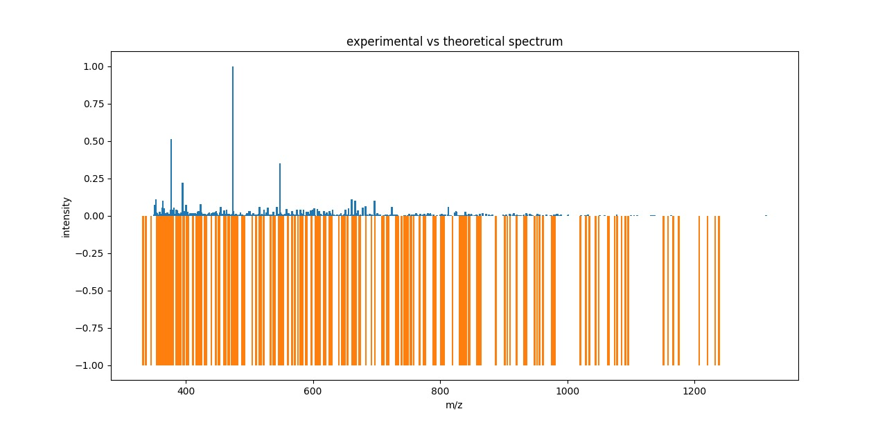
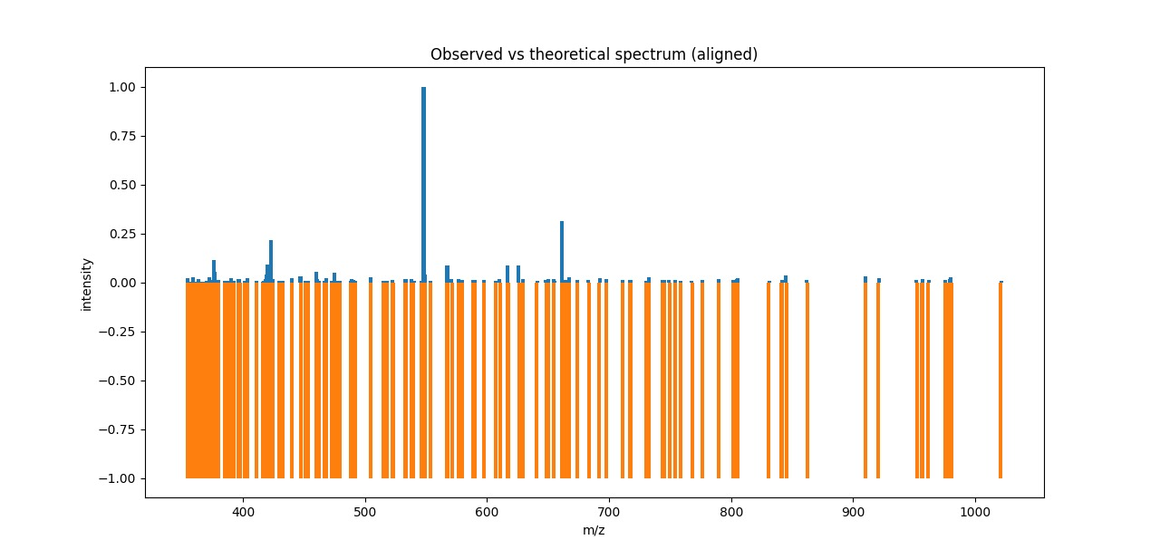
Experimental3
Before
After

Slide 11
Results3:
peptides number : 21
___________________________________
Number of matched peaks: 135
___________________________________
ion theo. m/z observed m/z
y6++ 2 354.63776862072103 354.70458984375
y3+ 1 357.24963348757103 357.2111511230469
y6++ 2 359.22001878877103 359.2132873535156
y3+ 1 361.244548487571 361.23956298828125
y3+ 1 362.203412328071 362.2002258300781
y3+ 1 363.20605415377105 363.20916748046875
y6++ 2 366.719851804721 366.7210388183594
y6++ 2 367.691959645221 367.5621032714844
y7++ 2 370.168181129271 370.1704406738281
y7++ 2 372.224147391871 372.2062072753906
y7++ 2 373.195587296171 373.1965637207031
y3+ 1 373.280933615171 373.28570556640625
y6++ 2 373.700839280221 373.7158203125
y7++ 2 375.182479732371 375.14697265625
y3+ 1 375.23504642377105 375.2364501953125
y3+ 1 376.19391026427104 376.19720458984375
y3+ 1 377.1666932323711 377.16180419921875
y7++ 2 379.71140434402093 379.7105712890625
y3+ 1 385.255781487571 385.258544921875
y4+ 1 388.21906239187103 388.21722412109375
y7++ 2 388.729262939721 388.7425842285156
y3+ 1 390.209560328071 390.2164001464844
y3+ 1 391.21220215377105 391.21392822265625
y3+ 1 392.17106599427103 392.1607971191406
y7++ 2 396.224147391871 396.2232360839844
y7++ 2 396.73434793972103 396.7235107421875
y3+ 1 397.255781487571 397.2331848144531
y7++ 2 401.23451492377103 401.2538146972656
y3+ 1 402.24594545567106 402.2435302734375
y7++ 2 402.736033368521 402.7392578125
y7++ 2 403.164150732371 403.1417236328125
y4+ 1 403.22996142377104 403.2347717285156
y6++ 2 403.74082990782097 403.7386779785156
y3+ 1 411.22381342377105 411.22003173828125
y4+ 1 416.250362519471 416.2343444824219
y7++ 2 417.21685385997097 417.2182312011719
y7++ 2 418.215799256871 418.212890625
y4+ 1 419.22487642377104 419.2362365722656
y8++ 2 419.702388272821 419.7242126464844
y8++ 2 423.2274189237709 423.227294921875
y7++ 2 423.741315900421 423.7376403808594
y4+ 1 424.186048121871 424.23046875
y8++ 2 429.73761947162103 429.7439270019531

Slide 12
y8++ 2 431.724511907821 431.7244567871094
y8++ 2 432.245277519471 432.1549987792969
y3+ 1 440.2364433918711 440.2314147949219
y4+ 1 447.231024423771 447.0102233886719
y8++ 2 451.262415480171 451.26934814453125
y7++ 2 453.275037051371 453.25396728515625
y4+ 1 460.258818377071 460.2559509277344
y8++ 2 460.74544450352096 460.8968200683594
y4+ 1 462.29222771087103 462.2042541503906
y9++ 2 466.7434335035209 466.76373291015625
y9++ 2 468.228770384471 468.23602294921875
y4+ 1 472.287810647071 472.2846984863281
y8++ 2 474.757831432321 474.7397766113281
y8++ 2 474.76872206732105 474.7545166015625
y8++ 2 476.69835787592103 476.9736328125
y4+ 1 479.203095153771 479.24285888671875
y9++ 2 488.266544083271 488.2606201171875
y5+ 1 489.26674161517104 489.0628356933594
y4+ 1 489.27797461517105 489.07635498046875
y8++ 2 490.75106100352093 490.7807312011719
y4+ 1 491.26463240897107 491.26922607421875
y4+ 1 492.1936373918711 492.2142639160156
y4+ 1 504.321418632271 504.760986328125
y5+ 1 515.318776806571 515.3128051757812
y5+ 1 516.314025774671 516.2855224609375
y9++ 2 517.766908599221 517.9282836914062
y9++ 2 522.7772761311211 522.6118774414062
y9++ 2 532.7940801237211 532.7808227539062
y9++ 2 533.240390051371 533.2800903320312
y9++ 2 537.7968201556209 537.7777709960938
y10++ 2 539.771136528021 540.2683715820312
y10++ 2 546.2776406470709 546.26220703125
y9++ 2 548.3029292108711 548.025146484375
y5+ 1 549.324256870371 549.3045043945312
y4+ 1 553.320507742771 553.2910766601562
y5+ 1 567.313691806571 567.2517700195312
y5+ 1 567.361309934171 567.3211669921875
y5+ 1 571.356224934171 571.0288696289062
y10++ 2 576.3100947034711 576.2738037109375
y10++ 2 579.7987402268211 579.805908203125
y10++ 2 588.320659767271 588.7881469726562
y5+ 1 590.325653838471 590.3016967773438
y5+ 1 597.317730600371 597.3002319335938
y5+ 1 607.2205815513711 607.3181762695312
y11++ 2 610.798937758721 610.3211669921875
y10++ 2 616.8323853225211 616.9678955078125
y6+ 1 617.325319870371 616.98779296875
y6+ 1 626.2450214408709 625.9680786132812
y11++ 2 629.3329473703711 629.337158203125
y11++ 2 640.7856937587211 641.1082153320312

Slide 13
y12++ 2 648.3368413310711 648.2800903320312
y5+ 1 650.373271966071 650.3446655273438
y6+ 1 654.393339093671 654.344482421875
y12++ 2 654.816273251321 655.1231689453125
y6+ 1 661.362767997971 661.025634765625
y6+ 1 662.325653838471 662.3255615234375
y6+ 1 664.366456029871 664.2979736328125
y12++ 2 667.340969934171 666.9842529296875
y12++ 2 673.852855910821 673.9810180664062
y13++ 2 683.327005299171 683.1546020507812
y13++ 2 691.8528559108212 692.3034057617188
y12++ 2 697.3277259341711 697.6102905273438
y12++ 2 710.8646120139211 711.0401000976562
y13++ 2 716.875177077721 716.9251708984375
y6+ 1 717.432761110771 717.3877563476562
y12++ 2 730.3958815936711 730.2996215820312
y6+ 1 732.4324271426709 732.3884887695312
y7+ 1 743.4410183169709 743.85107421875
y7+ 1 745.383898125571 744.940673828125
y7+ 1 749.357682997971 748.9763793945312
y13++ 2 753.8697581096211 753.9317016601562
y7+ 1 758.415532221271 758.406005859375
y13++ 2 767.8860761096212 767.4061889648438
y7+ 1 776.451249412671 776.0700073242188
y16++ 2 789.8826765384212 789.4462890625
y7+ 1 801.4617533807709 801.8733520507812
y14++ 2 804.408527150071 804.3899536132812
y7+ 1 804.464790270271 804.8905029296875
y7+ 1 805.321024997971 805.391357421875
y15++ 2 830.930681332921 831.1237182617188
y17++ 2 841.3872689831711 841.4130249023438
y8+ 1 845.4475613807709 844.9850463867188
y8+ 1 862.441747348871 862.0145874023438
y16++ 2 909.9563733574211 909.94677734375
y8+ 1 920.483612540271 920.9193115234375
y8+ 1 952.3894392850709 951.9674682617188
y17++ 2 956.4816015402711 956.9249267578125
y8+ 1 961.502299493571 961.9535522460938
y9+ 1 975.525811699771 975.0872192382812
y17++ 2 978.4858294690711 978.9793090820312
y8+ 1 980.494845540271 980.0444946289062
y18++ 2 1021.0028986519211 1021.3955688476562

Slide 14
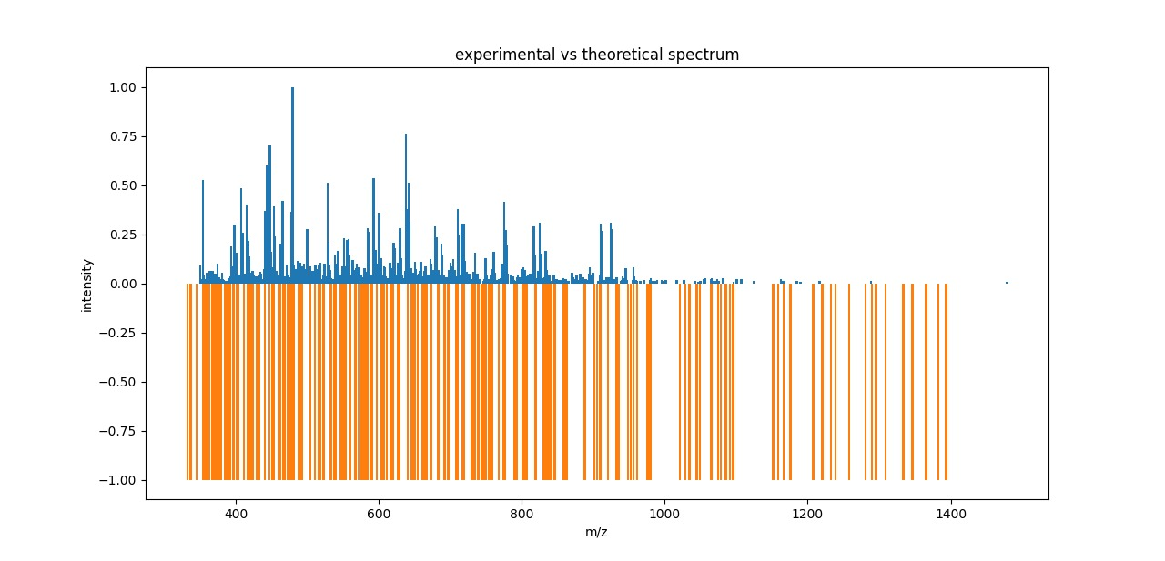
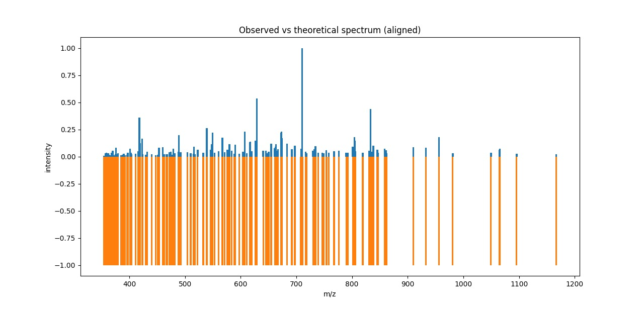
Experimental4
Before
After

Slide 15
Results4:
peptides number : 21
___________________________________
Number of matched peaks: 135
___________________________________
ion theo. m/z observed m/z
y6++ 2 354.63776862072103 354.70458984375
y3+ 1 357.24963348757103 357.2111511230469
y6++ 2 359.22001878877103 359.2132873535156
y3+ 1 361.244548487571 361.23956298828125
y3+ 1 362.203412328071 362.2002258300781
y3+ 1 363.20605415377105 363.20916748046875
y6++ 2 366.719851804721 366.7210388183594
y6++ 2 367.691959645221 367.5621032714844
y7++ 2 370.168181129271 370.1704406738281
y7++ 2 372.224147391871 372.2062072753906
y7++ 2 373.195587296171 373.1965637207031
y3+ 1 373.280933615171 373.28570556640625
y6++ 2 373.700839280221 373.7158203125
y7++ 2 375.182479732371 375.14697265625
y3+ 1 375.23504642377105 375.2364501953125
y3+ 1 376.19391026427104 376.19720458984375
y3+ 1 377.1666932323711 377.16180419921875
y7++ 2 379.71140434402093 379.7105712890625
y3+ 1 385.255781487571 385.258544921875
y4+ 1 388.21906239187103 388.21722412109375
y7++ 2 388.729262939721 388.7425842285156
y3+ 1 390.209560328071 390.2164001464844
y3+ 1 391.21220215377105 391.21392822265625
y3+ 1 392.17106599427103 392.1607971191406
y7++ 2 396.224147391871 396.2232360839844
y7++ 2 396.73434793972103 396.7235107421875
y3+ 1 397.255781487571 397.2331848144531
y7++ 2 401.23451492377103 401.2538146972656
y3+ 1 402.24594545567106 402.2435302734375
y7++ 2 402.736033368521 402.7392578125
y7++ 2 403.164150732371 403.1417236328125
y4+ 1 403.22996142377104 403.2347717285156
y6++ 2 403.74082990782097 403.7386779785156
y3+ 1 411.22381342377105 411.22003173828125
y4+ 1 416.250362519471 416.2343444824219
y7++ 2 417.21685385997097 417.2182312011719
y7++ 2 418.215799256871 418.212890625
y4+ 1 419.22487642377104 419.2362365722656
y8++ 2 419.702388272821 419.7242126464844
y8++ 2 423.2274189237709 423.227294921875
y7++ 2 423.741315900421 423.7376403808594
y4+ 1 424.186048121871 424.23046875
y8++ 2 429.73761947162103 429.7439270019531

Slide 16
y8++ 2 431.724511907821 431.7244567871094
y8++ 2 432.245277519471 432.1549987792969
y3+ 1 440.2364433918711 440.2314147949219
y4+ 1 447.231024423771 447.0102233886719
y8++ 2 451.262415480171 451.26934814453125
y7++ 2 453.275037051371 453.25396728515625
y4+ 1 460.258818377071 460.2559509277344
y8++ 2 460.74544450352096 460.8968200683594
y4+ 1 462.29222771087103 462.2042541503906
y9++ 2 466.7434335035209 466.76373291015625
y9++ 2 468.228770384471 468.23602294921875
y4+ 1 472.287810647071 472.2846984863281
y8++ 2 474.757831432321 474.7397766113281
y8++ 2 474.76872206732105 474.7545166015625
y8++ 2 476.69835787592103 476.9736328125
y4+ 1 479.203095153771 479.24285888671875
y9++ 2 488.266544083271 488.2606201171875
y5+ 1 489.26674161517104 489.0628356933594
y4+ 1 489.27797461517105 489.07635498046875
y8++ 2 490.75106100352093 490.7807312011719
y4+ 1 491.26463240897107 491.26922607421875
y4+ 1 492.1936373918711 492.2142639160156
y4+ 1 504.321418632271 504.760986328125
y5+ 1 515.318776806571 515.3128051757812
y5+ 1 516.314025774671 516.2855224609375
y9++ 2 517.766908599221 517.9282836914062
y9++ 2 522.7772761311211 522.6118774414062
y9++ 2 532.7940801237211 532.7808227539062
y9++ 2 533.240390051371 533.2800903320312
y9++ 2 537.7968201556209 537.7777709960938
y10++ 2 539.771136528021 540.2683715820312
y10++ 2 546.2776406470709 546.26220703125
y9++ 2 548.3029292108711 548.025146484375
y5+ 1 549.324256870371 549.3045043945312
y4+ 1 553.320507742771 553.2910766601562
y5+ 1 567.313691806571 567.2517700195312
y5+ 1 567.361309934171 567.3211669921875
y5+ 1 571.356224934171 571.0288696289062
y10++ 2 576.3100947034711 576.2738037109375
y10++ 2 579.7987402268211 579.805908203125
y10++ 2 588.320659767271 588.7881469726562
y5+ 1 590.325653838471 590.3016967773438
y5+ 1 597.317730600371 597.3002319335938
y5+ 1 607.2205815513711 607.3181762695312
y11++ 2 610.798937758721 610.3211669921875
y10++ 2 616.8323853225211 616.9678955078125
y6+ 1 617.325319870371 616.98779296875
y6+ 1 626.2450214408709 625.9680786132812
y11++ 2 629.3329473703711 629.337158203125
y11++ 2 640.7856937587211 641.1082153320312

Slide 17
y12++ 2 648.3368413310711 648.2800903320312
y5+ 1 650.373271966071 650.3446655273438
y6+ 1 654.393339093671 654.344482421875
y12++ 2 654.816273251321 655.1231689453125
y6+ 1 661.362767997971 661.025634765625
y6+ 1 662.325653838471 662.3255615234375
y6+ 1 664.366456029871 664.2979736328125
y12++ 2 667.340969934171 666.9842529296875
y12++ 2 673.852855910821 673.9810180664062
y13++ 2 683.327005299171 683.1546020507812
y13++ 2 691.8528559108212 692.3034057617188
y12++ 2 697.3277259341711 697.6102905273438
y12++ 2 710.8646120139211 711.0401000976562
y13++ 2 716.875177077721 716.9251708984375
y6+ 1 717.432761110771 717.3877563476562
y12++ 2 730.3958815936711 730.2996215820312
y6+ 1 732.4324271426709 732.3884887695312
y7+ 1 743.4410183169709 743.85107421875
y7+ 1 745.383898125571 744.940673828125
y7+ 1 749.357682997971 748.9763793945312
y13++ 2 753.8697581096211 753.9317016601562
y7+ 1 758.415532221271 758.406005859375
y13++ 2 767.8860761096212 767.4061889648438
y7+ 1 776.451249412671 776.0700073242188
y16++ 2 789.8826765384212 789.4462890625
y7+ 1 801.4617533807709 801.8733520507812
y14++ 2 804.408527150071 804.3899536132812
y7+ 1 804.464790270271 804.8905029296875
y7+ 1 805.321024997971 805.391357421875
y15++ 2 830.930681332921 831.1237182617188
y17++ 2 841.3872689831711 841.4130249023438
y8+ 1 845.4475613807709 844.9850463867188
y8+ 1 862.441747348871 862.0145874023438
y16++ 2 909.9563733574211 909.94677734375
y8+ 1 920.483612540271 920.9193115234375
y8+ 1 952.3894392850709 951.9674682617188
y17++ 2 956.4816015402711 956.9249267578125
y8+ 1 961.502299493571 961.9535522460938
y9+ 1 975.525811699771 975.0872192382812
y17++ 2 978.4858294690711 978.9793090820312
y8+ 1 980.494845540271 980.0444946289062
y18++ 2 1021.0028986519211 1021.3955688476562

Slide 18
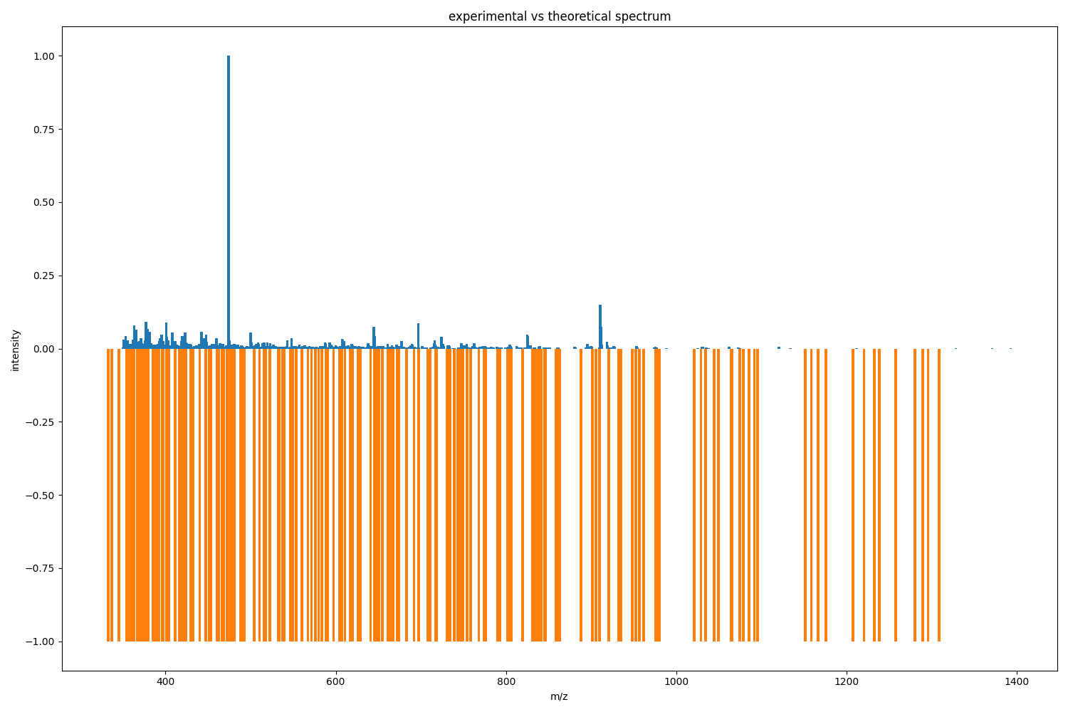
Experimental5
Before
After

Slide 19
Results5:
peptides number : 21
___________________________________
Number of matched peaks: 142
___________________________________
ion theo. m/z observed m/z
y6++ 2 354.637768620721 354.6784362792969
y3+ 1 357.24963348757103 357.2528991699219
y6++ 2 359.220018788771 359.2196960449219
y3+ 1 361.244548487571 361.247802734375
y3+ 1 362.20341232807107 362.20672607421875
y3+ 1 363.206054153771 363.20220947265625
y6++ 2 366.719851804721 366.7205505371094
y6++ 2 367.691959645221 367.71142578125
y7++ 2 370.168181129271 370.1701965332031
y7++ 2 372.224147391871 372.2275085449219
y7++ 2 373.195587296171 373.1877136230469
y3+ 1 373.280933615171 373.28448486328125
y6++ 2 373.700839280221 373.71392822265625
y7++ 2 375.182479732371 375.1823425292969
y3+ 1 375.23504642377105 375.2347412109375
y3+ 1 376.19391026427104 376.196044921875
y3+ 1 377.166693232371 377.1607360839844
y7++ 2 379.71140434402093 379.7097473144531
y3+ 1 385.255781487571 385.2575378417969
y4+ 1 388.21906239187103 388.20794677734375
y7++ 2 388.729262939721 388.723876953125
y3+ 1 390.209560328071 390.2156066894531
y3+ 1 391.21220215377105 391.2124938964844
y3+ 1 392.17106599427103 392.1592102050781
y7++ 2 396.224147391871 396.2238464355469
y7++ 2 396.7343479397209 396.7198791503906
y3+ 1 397.255781487571 397.231689453125
y7++ 2 401.23451492377103 401.23193359375
y3+ 1 402.24594545567106 402.24334716796875
y7++ 2 402.73603336852096 402.7382507324219
y7++ 2 403.16415073237096 403.1402282714844
y4+ 1 403.22996142377104 403.2309265136719
y6++ 2 403.74082990782097 403.7351989746094
y3+ 1 411.223813423771 411.21905517578125
y4+ 1 416.250362519471 416.2544860839844
y7++ 2 417.21685385997097 417.2107238769531
y7++ 2 418.21579925687104 418.211669921875
y4+ 1 419.22487642377104 419.2344970703125
y8++ 2 419.702388272821 419.7229309082031
y8++ 2 423.2274189237709 423.2259521484375
y7++ 2 423.741315900421 423.7360534667969
y4+ 1 424.186048121871 424.18597412109375
y8++ 2 429.73761947162103 429.74224853515625

Slide 20
y8++ 2 431.724511907821 432.20062255859375
y8++ 2 432.245277519471 432.2269287109375
y3+ 1 440.2364433918711 440.2405700683594
y4+ 1 447.231024423771 447.2492980957031
y8++ 2 451.26241548017094 451.2818908691406
y7++ 2 453.275037051371 453.2865905761719
y4+ 1 460.258818377071 460.254150390625
y8++ 2 460.74544450352096 460.5887451171875
y4+ 1 462.29222771087103 462.27545166015625
y9++ 2 466.7434335035209 466.7366943359375
y9++ 2 468.228770384471 468.2333068847656
y4+ 1 472.287810647071 472.28173828125
y8++ 2 474.75783143232104 474.7370910644531
y8++ 2 474.76872206732105 474.76568603515625
y8++ 2 476.6983578759209 476.7721862792969
y4+ 1 479.203095153771 479.19512939453125
y8++ 2 481.254787980171 481.209716796875
y9++ 2 488.266544083271 488.2572937011719
y5+ 1 489.26674161517104 489.2344665527344
y4+ 1 489.27797461517105 489.27313232421875
y8++ 2 490.75106100352093 490.7651062011719
y4+ 1 491.264632408971 491.25244140625
y4+ 1 504.321418632271 504.28656005859375
y4+ 1 510.292227710871 510.2613525390625
y4+ 1 510.33984583847104 510.3062438964844
y5+ 1 515.318776806571 515.1781616210938
y5+ 1 516.314025774671 516.2972412109375
y9++ 2 517.766908599221 517.76953125
y9++ 2 522.7772761311211 522.609375
y9++ 2 532.794080123721 532.7788696289062
y9++ 2 533.2403900513709 533.2996215820312
y9++ 2 537.7968201556209 537.7743530273438
y5+ 1 539.2129922813709 539.2536010742188
y10++ 2 539.771136528021 539.78173828125
y10++ 2 546.2776406470709 546.297607421875
y9++ 2 548.3029292108711 548.239013671875
y5+ 1 549.324256870371 549.2870483398438
y4+ 1 553.320507742771 553.1956176757812
y5+ 1 560.3150887746709 560.311767578125
y5+ 1 567.3136918065709 567.253173828125
y5+ 1 567.361309934171 567.8173217773438
y5+ 1 571.356224934171 571.2062377929688
y10++ 2 576.310094703471 576.306884765625
y10++ 2 579.7987402268211 579.8232421875
y10++ 2 583.764229663021 583.9605712890625
y10++ 2 588.320659767271 588.2974243164062
y5+ 1 590.325653838471 589.9743041992188
y5+ 1 597.317730600371 596.94482421875
y5+ 1 605.304189742771 605.3367309570312
y5+ 1 607.220581551371 607.3123168945312

Slide 21
y11++ 2 610.798937758721 610.3387451171875
y10++ 2 616.8323853225211 616.3729858398438
y6+ 1 617.325319870371 616.9847412109375
y11++ 2 619.8261092832211 619.9597778320312
y6+ 1 626.2450214408709 626.3047485351562
y11++ 2 629.3329473703711 629.3349609375
y11++ 2 640.785693758721 640.8309326171875
y11++ 2 645.342123862971 645.3514404296875
y12++ 2 648.336841331071 648.6566772460938
y5+ 1 650.373271966071 650.3399047851562
y6+ 1 654.393339093671 654.3402709960938
y6+ 1 661.362767997971 661.3839721679688
y6+ 1 662.325653838471 662.3201904296875
y6+ 1 663.367185061771 663.32421875
y6+ 1 663.3824400617709 663.35302734375
y6+ 1 664.3664560298708 664.3724365234375
y12++ 2 667.340969934171 667.3360595703125
y6+ 1 672.4039041574711 672.3530883789062
y11++ 2 673.3744174979711 673.2974853515625
y12++ 2 673.852855910821 673.7887573242188
y13++ 2 683.327005299171 682.9273071289062
y13++ 2 691.8528559108211 692.2997436523438
y12++ 2 697.327725934171 696.9340209960938
y13++ 2 716.875177077721 716.7071533203125
y6+ 1 717.4327611107709 717.384521484375
y14++ 2 718.845562378921 718.8716430664062
y13++ 2 730.874320006521 731.3162231445312
y6+ 1 732.4324271426709 732.3836669921875
y7+ 1 739.3290857917709 739.3665161132812
y7+ 1 743.441018316971 743.684814453125
y7+ 1 745.383898125571 745.3427734375
y13++ 2 753.869758109621 753.8842163085938
y15++ 2 754.3641194586711 754.3843383789062
y7+ 1 758.415532221271 757.92236328125
y14++ 2 774.388649157471 774.86279296875
y7+ 1 776.451249412671 776.8067016601562
y16++ 2 789.8826765384212 789.4432983398438
y7+ 1 792.4614194126709 792.40673828125
y7+ 1 801.4617533807709 801.3926391601562
y14++ 2 804.408527150071 804.3836669921875
y7+ 1 804.4647902702709 804.8873901367188
y7+ 1 805.321024997971 805.3885498046875
y7+ 1 833.4264312531709 833.4328002929688
y8+ 1 838.397500078871 838.8849487304688
y15++ 2 861.429991245771 861.4636840820312
y16++ 2 909.9563733574211 910.43994140625
y8+ 1 920.483612540271 920.886474609375
y9+ 1 975.525811699771 975.44384765625
y9+ 1 1074.586363844471 1074.4549560546875

Slide 22
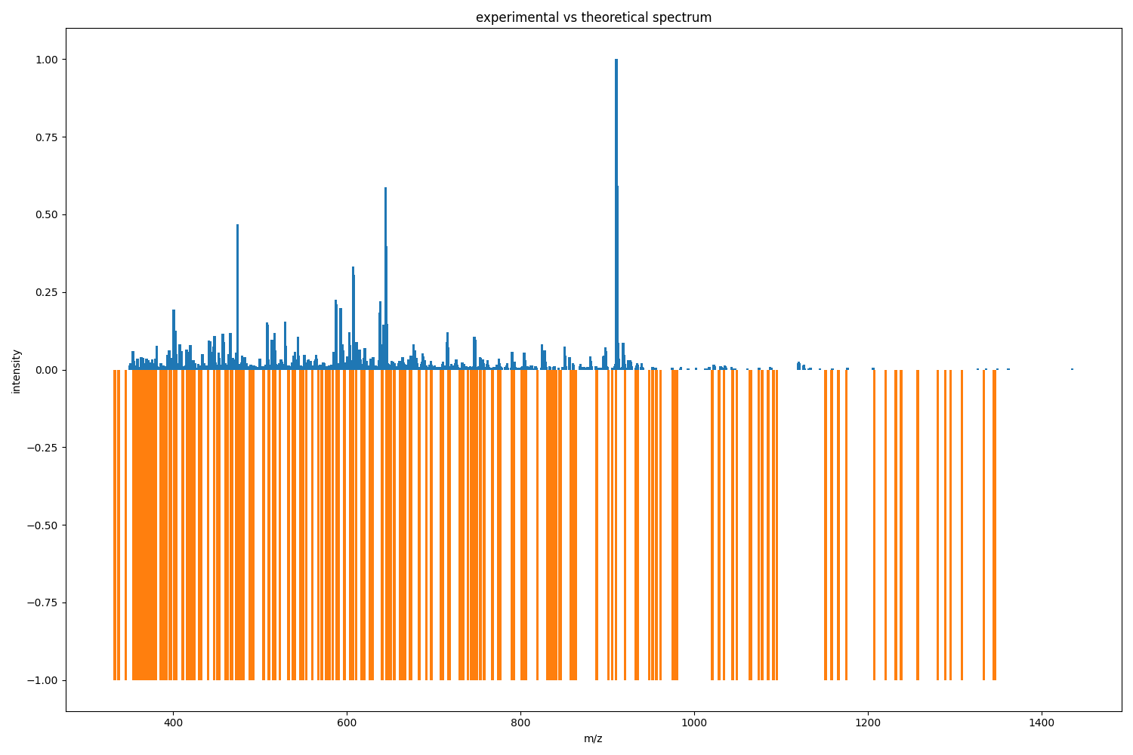

Experimental6
Before
After

Slide 23
Results6:
peptides number : 21
___________________________________
Number of matched peaks: 154
___________________________________
ion theo. m/z observed m/z
y6++ 2 354.6377686207209 354.62225341796875
y3+ 1 357.24963348757103 357.2522277832031
y6++ 2 359.220018788771 359.2281188964844
y3+ 1 361.244548487571 361.24395751953125
y3+ 1 362.203412328071 362.20733642578125
y3+ 1 363.206054153771 363.2018737792969
y6++ 2 366.719851804721 366.7193603515625
y6++ 2 367.691959645221 367.5804138183594
y7++ 2 370.168181129271 370.1693420410156
y7++ 2 372.22414739187093 372.21539306640625
y7++ 2 373.19558729617097 373.187255859375
y3+ 1 373.280933615171 373.28387451171875
y6++ 2 373.700839280221 373.747314453125
y7++ 2 375.182479732371 375.18023681640625
y3+ 1 375.23504642377105 375.2348937988281
y3+ 1 376.19391026427104 376.1943054199219
y3+ 1 377.166693232371 377.1597900390625
y7++ 2 379.71140434402093 379.7084655761719
y3+ 1 385.255781487571 385.2378234863281
y4+ 1 388.21906239187103 388.2237854003906
y7++ 2 388.729262939721 388.7398376464844
y3+ 1 390.209560328071 390.2151794433594
y3+ 1 391.21220215377105 391.22052001953125
y3+ 1 392.17106599427103 392.2141418457031
y7++ 2 396.22414739187104 396.2319030761719
y7++ 2 396.73434793972103 396.8988342285156
y3+ 1 397.255781487571 397.2072448730469
y7++ 2 401.23451492377103 401.23883056640625
y3+ 1 402.24594545567106 402.2427978515625
y7++ 2 402.73603336852096 402.7296142578125
y7++ 2 403.1641507323709 403.1648864746094
y4+ 1 403.229961423771 403.2355041503906
y6++ 2 403.74082990782097 403.7354431152344
y3+ 1 411.22381342377105 411.2188415527344
y4+ 1 416.250362519471 416.24609375
y7++ 2 417.21685385997097 417.2230529785156
y7++ 2 418.215799256871 418.21075439453125
y4+ 1 419.22487642377104 419.2331848144531
y8++ 2 419.702388272821 419.7140808105469
y8++ 2 423.2274189237709 423.22479248046875
y7++ 2 423.741315900421 423.7269287109375
y4+ 1 424.186048121871 424.2093200683594
y8++ 2 429.737619471621 429.7416076660156

Slide 24
y8++ 2 431.724511907821 431.75921630859375
y8++ 2 432.245277519471 432.2477111816406
y3+ 1 440.2364433918711 440.2392272949219
y4+ 1 447.231024423771 447.25146484375
y8++ 2 451.26241548017094 451.2725524902344
y7++ 2 453.275037051371 453.2785339355469
y4+ 1 460.258818377071 460.2529296875
y8++ 2 460.74544450352107 460.7672119140625
y4+ 1 462.29222771087103 462.2767333984375
y9++ 2 466.7434335035209 466.6048278808594
y9++ 2 468.228770384471 468.23193359375
y4+ 1 472.287810647071 472.283447265625
y8++ 2 474.757831432321 474.7525634765625
y8++ 2 474.76872206732105 474.7651062011719
y8++ 2 476.6983578759209 476.7720642089844
y4+ 1 479.203095153771 479.2414245605469
y8++ 2 481.254787980171 481.2471618652344
y9++ 2 488.266544083271 488.27410888671875
y5+ 1 489.26674161517104 489.24951171875
y4+ 1 489.27797461517105 489.27337646484375
y8++ 2 490.751061003521 490.7542724609375
y4+ 1 491.264632408971 491.26483154296875
y4+ 1 492.193637391871 492.03997802734375
y4+ 1 504.321418632271 504.286376953125
y4+ 1 510.29222771087103 510.2643127441406
y4+ 1 510.33984583847104 510.30517578125
y5+ 1 515.318776806571 515.303955078125
y5+ 1 516.314025774671 516.2978515625
y9++ 2 517.7669085992211 517.767822265625
y9++ 2 522.777276131121 522.8052368164062
y9++ 2 532.794080123721 532.6096801757812
y9++ 2 533.2403900513709 533.2535400390625
y9++ 2 537.7968201556209 537.9761352539062
y5+ 1 539.2129922813709 539.270263671875
y10++ 2 539.771136528021 539.7717895507812
y10++ 2 546.277640647071 546.28515625
y9++ 2 548.3029292108711 548.2586059570312
y5+ 1 549.324256870371 549.311767578125
y4+ 1 553.320507742771 553.2718505859375
y5+ 1 560.3150887746709 560.52783203125
y5+ 1 567.313691806571 567.3167724609375
y5+ 1 567.361309934171 567.6498413085938
y5+ 1 571.356224934171 571.4976196289062
y10++ 2 576.310094703471 576.2706298828125
y10++ 2 579.798740226821 579.8212890625
y10++ 2 583.764229663021 583.6234130859375
y10++ 2 588.320659767271 588.2948608398438
y5+ 1 590.325653838471 590.318359375
y5+ 1 597.317730600371 597.3242797851562
y11++ 2 604.292433639671 603.8357543945312

Slide 25
y5+ 1 604.3486967598709 604.6365356445312
y5+ 1 605.304189742771 605.2920532226562
y5+ 1 607.220581551371 607.310791015625
y11++ 2 610.7989377587211 610.8026733398438
y10++ 2 616.8323853225211 616.97802734375
y6+ 1 617.325319870371 617.3093872070312
y5+ 1 617.4054829831709 617.6124267578125
y11++ 2 619.8261092832211 619.8042602539062
y6+ 1 626.2450214408709 626.3115844726562
y11++ 2 629.332947370371 629.3349609375
y11++ 2 640.785693758721 640.8295288085938
y11++ 2 645.342123862971 645.32568359375
y12++ 2 648.336841331071 648.3162841796875
y5+ 1 650.373271966071 650.3381958007812
y6+ 1 654.393339093671 654.339599609375
y12++ 2 654.816273251321 654.8455810546875
y6+ 1 661.362767997971 661.349365234375
y6+ 1 662.325653838471 662.3466796875
y6+ 1 663.367185061771 662.9757080078125
y6+ 1 663.3824400617709 663.8372192382812
y6+ 1 664.366456029871 664.36962890625
y12++ 2 667.3409699341711 667.3241577148438
y6+ 1 672.403904157471 672.3546752929688
y11++ 2 673.3744174979711 673.0242919921875
y12++ 2 673.852855910821 673.7879028320312
y13++ 2 683.327005299171 683.6995849609375
y13++ 2 691.8528559108211 691.8589477539062
y12++ 2 697.327725934171 697.360107421875
y6+ 1 708.2682607746709 707.8778686523438
y12++ 2 710.864612013921 710.70263671875
y13++ 2 716.8751770777211 717.0390014648438
y6+ 1 717.4327611107709 717.303466796875
y14++ 2 718.845562378921 718.8709106445312
y6+ 1 732.4324271426709 732.3840942382812
y6+ 1 734.376642823671 734.4024658203125
y7+ 1 745.383898125571 745.3427124023438
y7+ 1 749.357682997971 749.3884887695312
y13++ 2 753.869758109621 753.8810424804688
y15++ 2 754.3641194586711 754.3711547851562
y7+ 1 758.415532221271 758.4223022460938
y13++ 2 767.8860761096211 767.8770751953125
y14++ 2 774.3886491574711 774.034423828125
y7+ 1 776.451249412671 776.3728637695312
y16++ 2 789.8826765384212 789.9083862304688
y7+ 1 791.4410183169709 791.4046020507812
y7+ 1 792.4614194126709 792.4055786132812
y7+ 1 801.461753380771 801.867919921875
y14++ 2 804.408527150071 804.3829345703125
y7+ 1 804.4647902702709 804.885009765625
y7+ 1 805.3210249979709 805.3853759765625
y6+ 1 806.474383348871 806.3994750976562
y7+ 1 833.4264312531709 833.4317016601562
y8+ 1 838.397500078871 838.69091796875
y15++ 2 861.429991245771 861.461181640625
y16++ 2 887.9521454286212 887.8878173828125
y7+ 1 905.542797635971 905.943359375
y16++ 2 909.9563733574211 909.9547729492188
y8+ 1 920.483612540271 920.46484375
y9+ 1 932.4795905402709 932.9579467773438
y9+ 1 1044.547275795471 1044.946044921875
y9+ 1 1074.586363844471 1074.9637451171875

Slide 26
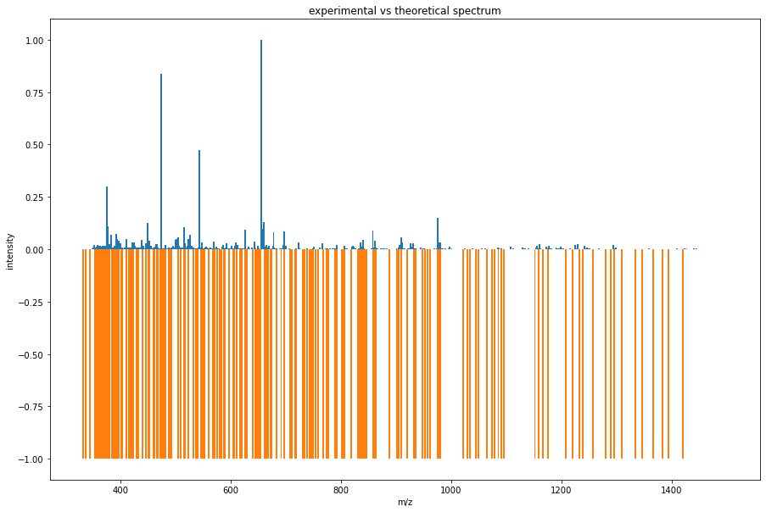
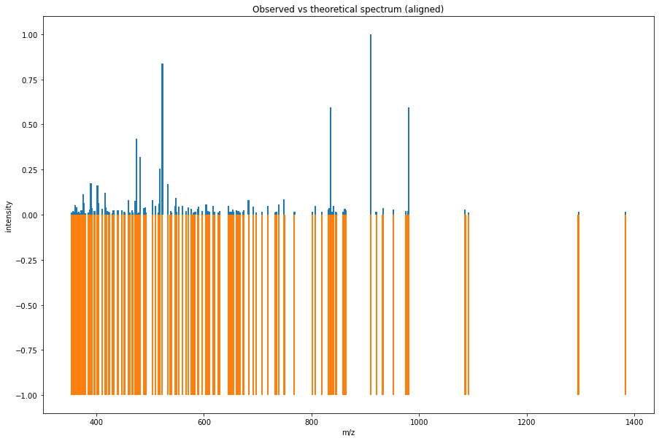
Experimental7
Before
After

Slide 27
Results7:
peptides number : 21
___________________________________
Number of matched peaks: 148
___________________________________
ion theo. m/z observed m/z
y6++ 2 354.637768620721 354.28753662109375
y3+ 1 357.24963348757103 357.24053955078125
y6++ 2 359.220018788771 359.2203063964844
y3+ 1 361.244548487571 361.24420166015625
y3+ 1 362.20341232807107 362.20086669921875
y3+ 1 363.206054153771 363.19866943359375
y6++ 2 366.719851804721 366.9688415527344
y6++ 2 367.691959645221 367.9198913574219
y7++ 2 370.168181129271 370.1583557128906
y7++ 2 372.224147391871 372.22412109375
y7++ 2 373.19558729617097 373.19927978515625
y3+ 1 373.280933615171 373.2805480957031
y6++ 2 373.700839280221 373.9764709472656
y7++ 2 375.182479732371 375.2025146484375
y3+ 1 375.23504642377105 375.23828125
y3+ 1 376.19391026427104 376.19940185546875
y3+ 1 377.166693232371 377.1694641113281
y7++ 2 379.71140434402093 379.467041015625
y3+ 1 385.255781487571 385.2604675292969
y4+ 1 388.21906239187103 388.21514892578125
y7++ 2 388.729262939721 388.4725341796875
y3+ 1 390.209560328071 390.2149658203125
y3+ 1 391.21220215377105 391.2126159667969
y3+ 1 392.17106599427103 392.1585693359375
y7++ 2 396.22414739187104 396.2256164550781
y7++ 2 396.73434793972103 396.9714660644531
y3+ 1 397.255781487571 397.2610778808594
y7++ 2 401.23451492377103 401.23138427734375
y3+ 1 402.24594545567106 402.2515563964844
y7++ 2 402.73603336852096 403.085693359375
y7++ 2 403.16415073237096 403.13720703125
y4+ 1 403.229961423771 403.2338562011719
y6++ 2 403.74082990782097 403.9754638671875
y3+ 1 411.2238134237711 411.24041748046875
y4+ 1 416.250362519471 416.2669372558594
y7++ 2 417.21685385997097 417.2130126953125
y7++ 2 418.21579925687104 418.21014404296875
y4+ 1 419.22487642377104 419.2314147949219
y8++ 2 419.702388272821 419.9379577636719
y8++ 2 423.2274189237709 423.2234191894531
y7++ 2 423.741315900421 423.3910217285156
y4+ 1 424.186048121871 424.1849365234375
y8++ 2 429.737619471621 429.9555358886719

Slide 28
y8++ 2 431.724511907821 431.28643798828125
y8++ 2 432.245277519471 432.2423095703125
y3+ 1 440.2364433918711 440.2306213378906
y4+ 1 447.231024423771 447.2451477050781
y8++ 2 451.26241548017094 451.272216796875
y7++ 2 453.275037051371 453.2539367675781
y4+ 1 460.258818377071 460.2574768066406
y8++ 2 460.74544450352107 461.0914001464844
y4+ 1 462.29222771087103 462.3000793457031
y9++ 2 466.7434335035209 466.4136962890625
y9++ 2 468.228770384471 468.2143249511719
y4+ 1 472.287810647071 472.29388427734375
y8++ 2 474.75783143232104 474.9655456542969
y8++ 2 474.76872206732105 475.0275573730469
y8++ 2 476.698357875921 477.0068664550781
y4+ 1 479.203095153771 479.1383972167969
y8++ 2 481.254787980171 481.263671875
y9++ 2 488.266544083271 488.2522277832031
y5+ 1 489.26674161517104 489.27203369140625
y4+ 1 489.27797461517105 489.28265380859375
y8++ 2 490.751061003521 490.9872741699219
y4+ 1 491.264632408971 491.2703552246094
y4+ 1 492.193637391871 492.2109069824219
y4+ 1 504.321418632271 504.3218994140625
y4+ 1 510.2922277108711 510.2960205078125
y4+ 1 510.33984583847104 510.30975341796875
y5+ 1 515.318776806571 515.308349609375
y5+ 1 516.314025774671 516.3206787109375
y9++ 2 517.7669085992211 517.9985961914062
y9++ 2 522.777276131121 522.9542236328125
y9++ 2 532.794080123721 533.0347900390625
y9++ 2 533.2403900513709 533.2098999023438
y9++ 2 537.7968201556209 538.1771850585938
y5+ 1 539.2129922813709 539.25048828125
y10++ 2 539.771136528021 539.9482421875
y10++ 2 546.277640647071 546.2955322265625
y9++ 2 548.3029292108711 548.3106079101562
y5+ 1 549.324256870371 549.3126831054688
y4+ 1 553.320507742771 553.2765502929688
y5+ 1 560.3150887746709 560.3107299804688
y5+ 1 567.313691806571 567.3008422851562
y5+ 1 571.356224934171 571.02587890625
y10++ 2 576.310094703471 576.3054809570312
y10++ 2 579.798740226821 580.0360107421875
y10++ 2 583.764229663021 584.0211791992188
y10++ 2 588.320659767271 588.3052978515625
y5+ 1 590.325653838471 590.32177734375
y5+ 1 597.317730600371 597.3027954101562
y11++ 2 604.292433639671 604.300537109375
y5+ 1 604.3486967598709 604.3375854492188

Slide 29
y6+ 1 732.4324271426709 732.422607421875
y6+ 1 734.376642823671 734.4015502929688
y7+ 1 739.3290857917709 738.9544677734375
y7+ 1 749.357682997971 748.9383544921875
y13++ 2 767.8860761096211 768.1931762695312
y7+ 1 801.461753380771 801.12890625
y6+ 1 806.474383348871 806.9107055664062
y14++ 2 819.390668554371 819.1949462890625
y15++ 2 830.9306813329212 830.9229125976562
y7+ 1 833.4264312531709 833.2105712890625
y7+ 1 835.4243220469709 835.2271118164062
y8+ 1 838.397500078871 838.16650390625
y17++ 2 841.3872689831711 841.1856689453125
y8+ 1 845.4475613807709 845.1392211914062
y7+ 1 846.475355334071 846.1897583007812
y8+ 1 858.467962476471 858.9120483398438
y15++ 2 861.429991245771 861.9263916015625
y8+ 1 862.441747348871 862.0300903320312
y8+ 1 863.483278572171 863.8916015625
y16++ 2 909.9563733574211 909.9400024414062
y8+ 1 920.483612540271 920.126953125
y9+ 1 932.4795905402709 932.8839111328125
y8+ 1 952.389439285071 951.96435546875
y9+ 1 975.525811699771 975.1439819335938
y17++ 2 978.4858294690711 978.9406127929688
y8+ 1 980.494845540271 980.0345458984375
y19++ 2 1085.551701256171 1085.2086181640625
y10+ 1 1091.548004827371 1091.88720703125
y12+ 1 1295.666406195371 1296.093505859375
y13+ 1 1382.6984353548712 1382.8956298828125
y5+ 1 605.304189742771 605.2442626953125
y5+ 1 607.220581551371 606.9979858398438
y11++ 2 610.7989377587211 610.3837280273438
y10++ 2 616.8323853225211 616.962646484375
y6+ 1 617.325319870371 617.2079467773438
y5+ 1 617.4054829831709 617.374755859375
y11++ 2 619.8261092832211 620.1408081054688
y6+ 1 626.2450214408709 626.357421875
y11++ 2 629.332947370371 629.1471557617188
y11++ 2 645.342123862971 645.3645629882812
y12++ 2 648.336841331071 648.3273315429688
y5+ 1 650.373271966071 650.3794555664062
y6+ 1 654.393339093671 653.9347534179688
y12++ 2 654.816273251321 654.3370971679688
y6+ 1 661.362767997971 661.03466796875
y6+ 1 662.325653838471 662.3429565429688
y6+ 1 664.366456029871 664.3579711914062
y12++ 2 667.3409699341711 667.155029296875
y6+ 1 672.4039041574711 672.4358520507812
y12++ 2 673.852855910821 673.9749145507812
y13++ 2 683.327005299171 682.9246826171875
y13++ 2 691.8528559108211 691.985595703125
y12++ 2 697.327725934171 697.0922241210938
y6+ 1 708.268260774671 708.3851318359375
y14++ 2 718.845562378921 718.9959716796875

Slide 30
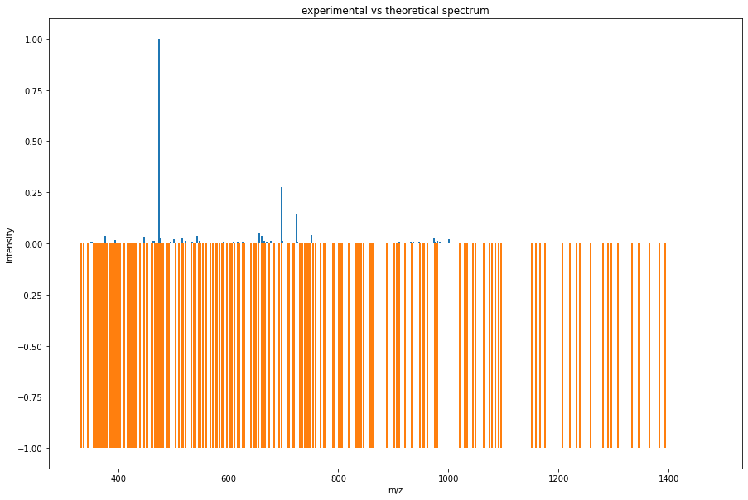
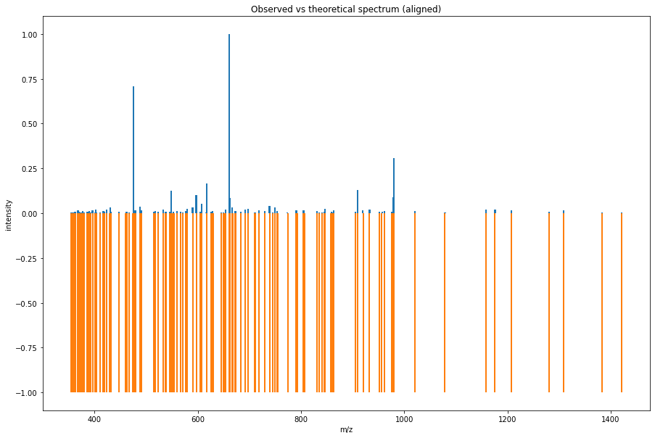
Experimental8
Before
After

Slide 31
Results8:
peptides number : 21
___________________________________
Number of matched peaks: 137
___________________________________
ion theo. m/z observed m/z
y6++ 2 354.637768620721 354.9984436035156
y3+ 1 357.24963348757103 357.20440673828125
y6++ 2 359.220018788771 359.2278137207031
y3+ 1 361.244548487571 361.16455078125
y3+ 1 362.20341232807107 362.2194519042969
y3+ 1 363.206054153771 363.19927978515625
y6++ 2 366.719851804721 366.96820068359375
y6++ 2 367.691959645221 367.917236328125
y7++ 2 370.168181129271 370.1873779296875
y7++ 2 372.224147391871 372.22119140625
y7++ 2 373.19558729617097 373.07525634765625
y3+ 1 373.280933615171 373.10076904296875
y6++ 2 373.700839280221 373.4786376953125
y7++ 2 375.182479732371 375.064697265625
y3+ 1 375.23504642377105 375.1796875
y3+ 1 376.19391026427104 376.19873046875
y3+ 1 377.166693232371 377.1591491699219
y7++ 2 379.71140434402093 379.7079162597656
y3+ 1 385.255781487571 385.23663330078125
y4+ 1 388.21906239187103 388.1982727050781
y7++ 2 388.729262939721 388.97467041015625
y3+ 1 390.209560328071 390.21429443359375
y3+ 1 391.21220215377105 391.1386413574219
y3+ 1 392.17106599427103 392.157958984375
y7++ 2 396.22414739187104 395.9779968261719
y7++ 2 396.73434793972103 396.97979736328125
y3+ 1 397.255781487571 397.1856384277344
y7++ 2 401.23451492377103 400.9765930175781
y3+ 1 402.24594545567106 402.1825256347656
y7++ 2 402.73603336852096 402.93560791015625
y7++ 2 403.16415073237096 402.94329833984375
y6++ 2 403.74082990782097 403.9413757324219
y3+ 1 411.2238134237711 411.202392578125
y4+ 1 416.250362519471 416.26605224609375
y7++ 2 417.21685385997097 416.995361328125
y7++ 2 418.21579925687104 418.1729431152344
y4+ 1 419.22487642377104 418.7327575683594
y8++ 2 419.702388272821 419.7218322753906
y8++ 2 423.2274189237709 423.2237854003906
y7++ 2 423.741315900421 423.7256164550781
y8++ 2 429.737619471621 429.9551696777344
y8++ 2 432.245277519471 432.28326416015625
y4+ 1 447.231024423771 447.1197509765625

Slide 32
y8++ 2 460.74544450352107 461.0114440917969
y4+ 1 462.29222771087103 462.1492919921875
y9++ 2 466.7434335035209 467.0586242675781
y8++ 2 474.75783143232104 474.9554138183594
y8++ 2 474.76872206732105 474.9645080566406
y8++ 2 476.698357875921 476.9712829589844
y4+ 1 479.203095153771 478.9850769042969
y9++ 2 488.266544083271 487.9760437011719
y5+ 1 489.26674161517104 488.9700012207031
y4+ 1 489.27797461517105 488.9811096191406
y8++ 2 490.751061003521 490.9866027832031
y4+ 1 491.264632408971 491.0328063964844
y5+ 1 515.318776806571 515.0338745117188
y5+ 1 516.314025774671 516.2108154296875
y9++ 2 517.7669085992211 517.9241943359375
y9++ 2 522.777276131121 522.94384765625
y9++ 2 532.794080123721 532.9974365234375
y9++ 2 533.2403900513709 533.0342407226562
y9++ 2 537.7968201556209 537.9442749023438
y5+ 1 539.2129922813709 539.0184936523438
y10++ 2 546.277640647071 546.030517578125
y9++ 2 548.3029292108711 548.0198364257812
y5+ 1 549.324256870371 549.0032958984375
y4+ 1 553.320507742771 552.9330444335938
y5+ 1 560.3150887746709 560.0078735351562
y5+ 1 567.313691806571 566.9188232421875
y5+ 1 567.361309934171 566.9435424804688
y5+ 1 571.356224934171 570.9856567382812
y10++ 2 576.310094703471 576.0147094726562
y10++ 2 579.798740226821 579.9862670898438
y5+ 1 590.325653838471 589.97119140625
y5+ 1 597.317730600371 596.9418334960938
y5+ 1 605.304189742771 604.9830322265625
y5+ 1 607.220581551371 606.9970092773438
y10++ 2 616.8323853225211 616.3698120117188
y6+ 1 617.325319870371 616.9620361328125
y5+ 1 617.4054829831709 616.981689453125
y6+ 1 626.2450214408709 626.0423583984375
y11++ 2 629.332947370371 629.052734375
y11++ 2 645.342123862971 645.3633422851562
y5+ 1 650.373271966071 650.0035400390625
y6+ 1 654.393339093671 653.9325561523438
y6+ 1 661.362767997971 661.0191650390625
y6+ 1 662.325653838471 662.022705078125
y12++ 2 667.3409699341711 666.9771728515625
y6+ 1 672.4039041574711 672.0591430664062
y12++ 2 673.852855910821 673.9730834960938
y13++ 2 683.327005299171 682.98388671875
y13++ 2 691.8528559108211 691.9848022460938
y12++ 2 697.327725934171 696.9821166992188

Slide 33
y12++ 2 710.864612013921 710.8986206054688
y14++ 2 718.845562378921 718.9126586914062
y12++ 2 730.3958815936711 729.9525756835938
y7+ 1 739.3290857917709 738.9530639648438
y7+ 1 745.383898125571 745.0211181640625
y7+ 1 749.357682997971 748.9682006835938
y13++ 2 753.869758109621 753.9044799804688
y15++ 2 754.3641194586711 753.9249267578125
y14++ 2 774.3886491574711 773.9541015625
y16++ 2 789.8826765384212 789.9854736328125
y7+ 1 791.4410183169709 790.9586181640625
y7+ 1 792.4614194126709 792.07177734375
y14++ 2 804.408527150071 804.06494140625
y7+ 1 804.4647902702709 804.8964233398438
y7+ 1 805.321024997971 804.9252319335938
y6+ 1 806.474383348871 806.0171508789062
y15++ 2 830.9306813329212 830.9227294921875
y7+ 1 835.4243220469709 835.2263793945312
y17++ 2 841.3872689831711 841.0073852539062
y8+ 1 845.4475613807709 844.9818115234375
y7+ 1 846.475355334071 846.922607421875
y8+ 1 858.467962476471 858.935546875
y15++ 2 861.429991245771 860.9397583007812
y8+ 1 862.441747348871 862.8673706054688
y8+ 1 863.483278572171 863.888916015625
y7+ 1 905.542797635971 905.8934326171875
y16++ 2 909.9563733574211 909.939208984375
y8+ 1 920.483612540271 920.0603637695312
y9+ 1 932.4795905402709 932.884521484375
y8+ 1 952.389439285071 951.990234375
y17++ 2 956.4816015402712 956.9158325195312
y8+ 1 961.502299493571 961.9478149414062
y9+ 1 975.525811699771 975.9300537109375
y17++ 2 978.4858294690711 978.9718627929688
y8+ 1 980.494845540271 980.033447265625
y18++ 2 1021.0028986519212 1020.93310546875
y10+ 1 1078.534996589271 1079.0025634765625
y10+ 1 1158.590203986871 1158.968505859375
y10+ 1 1175.634043067771 1175.9942626953125
y11+ 1 1207.577590812571 1207.9564208984375
y11+ 1 1280.564111050671 1280.960205078125
y12+ 1 1308.6252700358712 1308.9620361328125
y13+ 1 1382.6984353548712 1382.9007568359375
y12+ 1 1420.7219475610711 1421.0203857421875

Slide 34
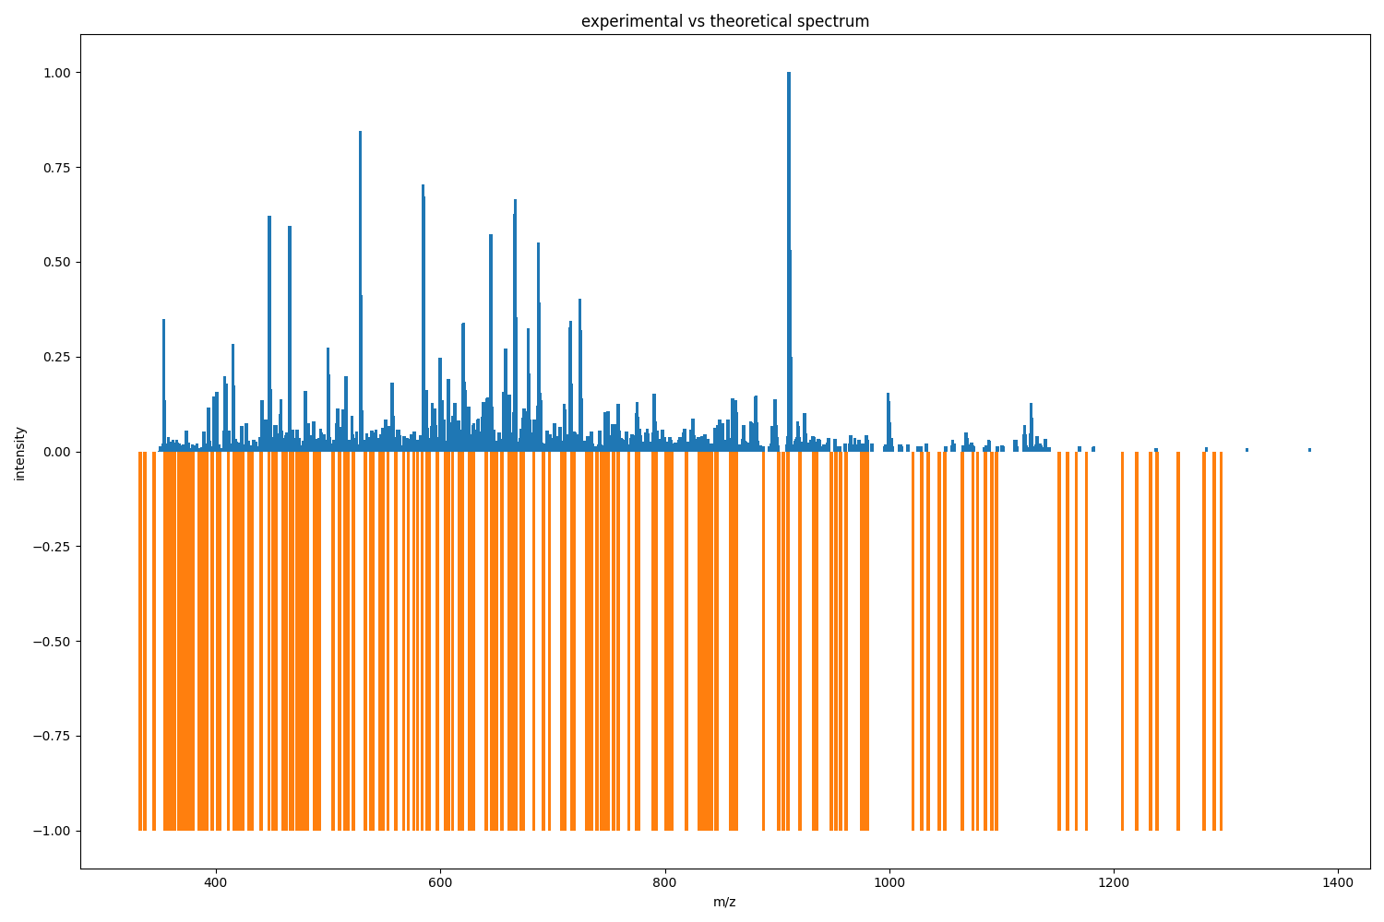
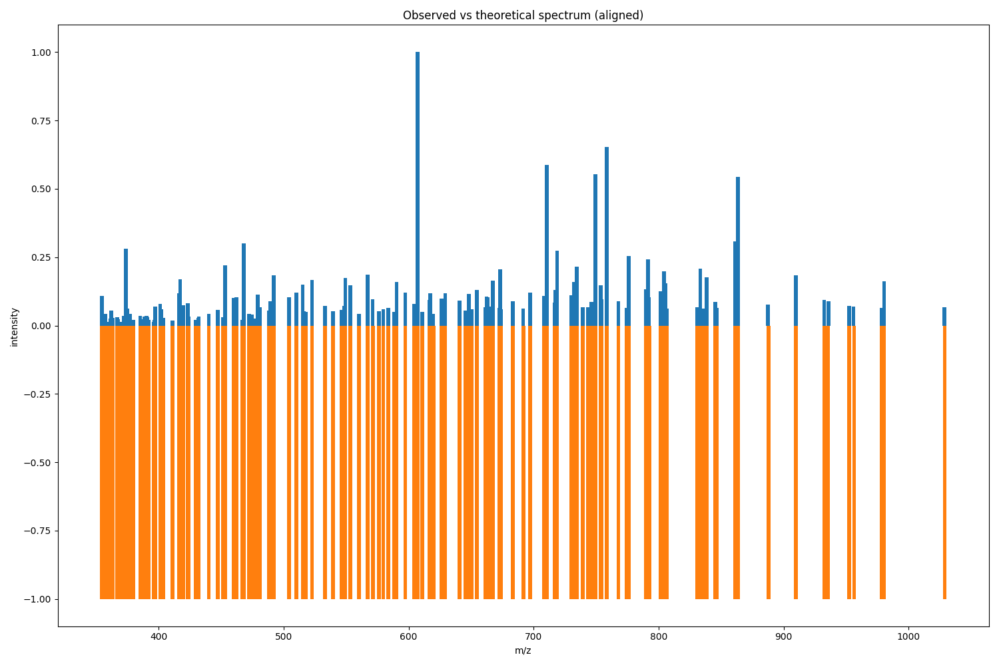
Experimental9
Before
After

Slide 35
Results9:
peptides number : 21
___________________________________
Number of matched peaks: 165
___________________________________
ion theo. m/z observed m/z
y6++ 2 354.6377686207209 354.717041015625
y3+ 1 357.24963348757103 357.25262451171875
y6++ 2 359.220018788771 359.2102355957031
y3+ 1 361.244548487571 361.216796875
y3+ 1 362.203412328071 362.207275390625
y3+ 1 363.206054153771 363.2023010253906
y6++ 2 366.719851804721 366.712646484375
y6++ 2 367.691959645221 367.6836853027344
y7++ 2 370.168181129271 370.18927001953125
y7++ 2 372.22414739187093 372.2295227050781
y7++ 2 373.19558729617097 372.73248291015625
y3+ 1 373.280933615171 373.2125549316406
y6++ 2 373.700839280221 373.9044189453125
y7++ 2 375.182479732371 375.203857421875
y3+ 1 375.23504642377105 375.2353515625
y3+ 1 376.19391026427104 376.1952209472656
y3+ 1 377.166693232371 377.1605224609375
y7++ 2 379.71140434402093 379.7189636230469
y3+ 1 385.255781487571 385.2239990234375
y4+ 1 388.21906239187103 387.8980712890625
y7++ 2 388.729262939721 388.740966796875
y3+ 1 390.209560328071 390.2159729003906
y3+ 1 391.21220215377105 391.220458984375
y3+ 1 392.17106599427103 392.2348937988281
y7++ 2 396.224147391871 395.89495849609375
y7++ 2 396.7343479397209 396.7410888671875
y3+ 1 397.255781487571 397.25238037109375
y7++ 2 401.23451492377103 401.2366027832031
y3+ 1 402.24594545567106 402.2327575683594
y7++ 2 402.73603336852096 402.7312927246094
y7++ 2 403.1641507323709 403.197265625
y4+ 1 403.229961423771 403.23004150390625
y6++ 2 403.74082990782097 403.7270812988281
y3+ 1 411.223813423771 411.2210693359375
y4+ 1 416.250362519471 416.247314453125
y7++ 2 417.21685385997097 417.22369384765625
y7++ 2 418.215799256871 418.22100830078125
y4+ 1 419.22487642377104 419.21490478515625
y8++ 2 419.702388272821 419.72320556640625
y8++ 2 423.2274189237709 423.22601318359375
y7++ 2 423.741315900421 423.7442626953125
y4+ 1 424.186048121871 424.2229919433594
y8++ 2 429.737619471621 429.7434997558594

Slide 36
y8++ 2 431.724511907821 431.7603454589844
y8++ 2 432.245277519471 432.2413330078125
y3+ 1 440.2364433918711 440.2406005859375
y4+ 1 447.231024423771 447.2529296875
y8++ 2 451.26241548017094 451.25762939453125
y7++ 2 453.275037051371 453.26983642578125
y4+ 1 460.258818377071 460.25408935546875
y8++ 2 460.74544450352096 460.7458190917969
y4+ 1 462.29222771087103 462.2785339355469
y9++ 2 466.7434335035209 466.7413635253906
y9++ 2 468.228770384471 468.2583923339844
y4+ 1 472.287810647071 472.26568603515625
y8++ 2 474.757831432321 474.64947509765625
y8++ 2 474.76872206732105 474.7386169433594
y8++ 2 476.6983578759209 476.5116882324219
y4+ 1 479.203095153771 479.24163818359375
y8++ 2 481.254787980171 481.2581787109375
y9++ 2 488.266544083271 488.27099609375
y5+ 1 489.26674161517104 489.2473449707031
y4+ 1 489.27797461517105 489.2738037109375
y8++ 2 490.75106100352093 490.78173828125
y4+ 1 491.264632408971 491.2770080566406
y4+ 1 492.193637391871 492.2569274902344
y4+ 1 504.321418632271 504.28753662109375
y4+ 1 510.292227710871 510.28204345703125
y4+ 1 510.33984583847104 510.3067626953125
y5+ 1 515.318776806571 515.304443359375
y5+ 1 516.314025774671 516.3106689453125
y9++ 2 517.766908599221 517.769775390625
y9++ 2 522.777276131121 522.8067626953125
y9++ 2 532.794080123721 532.794677734375
y9++ 2 533.2403900513709 533.2794189453125
y5+ 1 539.2129922813709 539.2901611328125
y10++ 2 539.771136528021 539.7985229492188
y10++ 2 546.2776406470709 546.5162353515625
y9++ 2 548.3029292108711 548.2835083007812
y5+ 1 549.324256870371 549.3135986328125
y4+ 1 553.320507742771 553.28076171875
y5+ 1 560.3150887746709 560.3152465820312
y5+ 1 567.3136918065709 567.2860107421875
y5+ 1 567.361309934171 567.3177490234375
y5+ 1 571.356224934171 571.2991943359375
y10++ 2 576.310094703471 576.3076171875
y10++ 2 579.798740226821 579.8131103515625
y10++ 2 583.764229663021 583.6261596679688
y10++ 2 588.320659767271 588.3233032226562
y5+ 1 590.325653838471 590.3239135742188
y5+ 1 597.317730600371 597.32373046875
y11++ 2 604.292433639671 604.306396484375
y5+ 1 604.3486967598709 604.5225830078125

Slide 37
y5+ 1 605.304189742771 605.3092041015625
y5+ 1 607.220581551371 607.313720703125
y11++ 2 610.798937758721 610.8208618164062
y10++ 2 616.8323853225211 616.8116455078125
y6+ 1 617.325319870371 617.3281860351562
y5+ 1 617.4054829831709 617.3599243164062
y11++ 2 619.8261092832211 619.805908203125
y6+ 1 626.2450214408709 626.3419189453125
y11++ 2 629.332947370371 629.3348999023438
y11++ 2 640.785693758721 640.8328857421875
y11++ 2 645.342123862971 645.3515625
y12++ 2 648.336841331071 648.3488159179688
y5+ 1 650.373271966071 650.3619995117188
y6+ 1 654.393339093671 654.3418579101562
y12++ 2 654.816273251321 654.5928344726562
y6+ 1 661.362767997971 661.3570556640625
y6+ 1 662.325653838471 662.322265625
y6+ 1 663.367185061771 663.364501953125
y6+ 1 663.3824400617709 663.6133422851562
y6+ 1 664.3664560298708 664.360595703125
y12++ 2 667.340969934171 667.3386840820312
y6+ 1 672.403904157471 672.408935546875
y11++ 2 673.3744174979711 673.3682250976562
y12++ 2 673.852855910821 673.7049560546875
y13++ 2 683.327005299171 683.3676147460938
y13++ 2 691.8528559108211 691.6283569335938
y12++ 2 697.327725934171 697.3616333007812
y6+ 1 708.2682607746709 708.3619995117188
y12++ 2 710.864612013921 710.7069702148438
y13++ 2 716.875177077721 716.9735107421875
y6+ 1 717.4327611107709 717.3721923828125
y14++ 2 718.845562378921 718.8705444335938
y12++ 2 730.3958815936711 730.3948974609375
y13++ 2 730.874320006521 730.8983154296875
y15++ 2 754.3641194586711 754.3713989257812
y7+ 1 758.415532221271 758.4258422851562
y13++ 2 767.8860761096211 767.87939453125
y14++ 2 774.388649157471 774.3848876953125
y7+ 1 776.451249412671 776.0718994140625
y16++ 2 789.8826765384212 789.912353515625
y7+ 1 791.4410183169709 791.406982421875
y7+ 1 792.4614194126709 792.40771484375
y7+ 1 801.4617533807709 801.4166259765625
y14++ 2 804.408527150071 804.38330078125
y7+ 1 804.4647902702709 804.4091186523438
y7+ 1 805.3210249979709 805.4055786132812
y6+ 1 806.474383348871 806.3856811523438
y15++ 2 830.930681332921 830.8914184570312
y7+ 1 833.4264312531709 833.4343872070312
y7+ 1 835.4243220469709 835.4437866210938
y8+ 1 838.397500078871 838.4459228515625
y8+ 1 845.4475613807709 845.4720458984375
y7+ 1 846.475355334071 846.4382934570312
y15++ 2 861.429991245771 861.4649047851562
y8+ 1 862.441747348871 861.96484375
y8+ 1 863.483278572171 863.4678344726562
y16++ 2 887.9521454286211 887.4578857421875
y16++ 2 909.9563733574211 909.9541015625
y9+ 1 932.4795905402709 932.4684448242188
y9+ 1 935.4502643021709 935.807861328125
y8+ 1 952.3894392850709 952.5145263671875
y17++ 2 956.4816015402711 955.9819946289062
y17++ 2 978.4858294690711 978.4573974609375
y8+ 1 980.494845540271 980.521484375
y18++ 2 1029.009669080721 1028.52880859375

Slide 38
Experimental10
Before
After

Slide 39
Results10:
peptides number : 21
___________________________________
Number of matched peaks: 165
___________________________________
ion theo. m/z observed m/z
y6++ 2 354.6377686207209 354.717041015625
y3+ 1 357.24963348757103 357.25262451171875
y6++ 2 359.220018788771 359.2102355957031
y3+ 1 361.244548487571 361.216796875
y3+ 1 362.203412328071 362.207275390625
y3+ 1 363.206054153771 363.2023010253906
y6++ 2 366.719851804721 366.712646484375
y6++ 2 367.691959645221 367.6836853027344
y7++ 2 370.168181129271 370.18927001953125
y7++ 2 372.22414739187093 372.2295227050781
y7++ 2 373.19558729617097 372.73248291015625
y3+ 1 373.280933615171 373.2125549316406
y6++ 2 373.700839280221 373.9044189453125
y7++ 2 375.182479732371 375.203857421875
y3+ 1 375.23504642377105 375.2353515625
y3+ 1 376.19391026427104 376.1952209472656
y3+ 1 377.166693232371 377.1605224609375
y7++ 2 379.71140434402093 379.7189636230469
y3+ 1 385.255781487571 385.2239990234375
y4+ 1 388.21906239187103 387.8980712890625
y7++ 2 388.729262939721 388.740966796875
y3+ 1 390.209560328071 390.2159729003906
y3+ 1 391.21220215377105 391.220458984375
y3+ 1 392.17106599427103 392.2348937988281
y7++ 2 396.224147391871 395.89495849609375
y7++ 2 396.7343479397209 396.7410888671875
y3+ 1 397.255781487571 397.25238037109375
y7++ 2 401.23451492377103 401.2366027832031
y3+ 1 402.24594545567106 402.2327575683594
y7++ 2 402.73603336852096 402.7312927246094
y7++ 2 403.1641507323709 403.197265625
y4+ 1 403.229961423771 403.23004150390625
y6++ 2 403.74082990782097 403.7270812988281
y3+ 1 411.223813423771 411.2210693359375
y4+ 1 416.250362519471 416.247314453125
y7++ 2 417.21685385997097 417.22369384765625
y7++ 2 418.215799256871 418.22100830078125
y4+ 1 419.22487642377104 419.21490478515625
y8++ 2 419.702388272821 419.72320556640625
y8++ 2 423.2274189237709 423.22601318359375
y7++ 2 423.741315900421 423.7442626953125
y4+ 1 424.186048121871 424.2229919433594
y8++ 2 429.737619471621 429.7434997558594
y8++ 2 431.724511907821 431.7603454589844
y8++ 2 432.245277519471 432.2413330078125
y3+ 1 440.2364433918711 440.2406005859375
y4+ 1 447.231024423771 447.2529296875
y8++ 2 451.26241548017094 451.25762939453125
y7++ 2 453.275037051371 453.26983642578125
y4+ 1 460.258818377071 460.25408935546875
y8++ 2 460.74544450352096 460.7458190917969

Slide 40
y4+ 1 462.29222771087103 462.2785339355469
y9++ 2 466.7434335035209 466.7413635253906
y9++ 2 468.228770384471 468.2583923339844
y4+ 1 472.287810647071 472.26568603515625
y8++ 2 474.757831432321 474.64947509765625
y8++ 2 474.76872206732105 474.7386169433594
y8++ 2 476.6983578759209 476.5116882324219
y4+ 1 479.203095153771 479.24163818359375
y8++ 2 481.254787980171 481.2581787109375
y9++ 2 488.266544083271 488.27099609375
y5+ 1 489.26674161517104 489.2473449707031
y4+ 1 489.27797461517105 489.2738037109375
y8++ 2 490.75106100352093 490.78173828125
y4+ 1 491.264632408971 491.2770080566406
y4+ 1 492.193637391871 492.2569274902344
y4+ 1 504.321418632271 504.28753662109375
y4+ 1 510.292227710871 510.28204345703125
y4+ 1 510.33984583847104 510.3067626953125
y5+ 1 515.318776806571 515.304443359375
y5+ 1 516.314025774671 516.3106689453125
y9++ 2 517.766908599221 517.769775390625
y9++ 2 522.777276131121 522.8067626953125
y9++ 2 532.794080123721 532.794677734375
y9++ 2 533.2403900513709 533.2794189453125
y5+ 1 539.2129922813709 539.2901611328125
y10++ 2 539.771136528021 539.7985229492188
y10++ 2 546.2776406470709 546.5162353515625
y9++ 2 548.3029292108711 548.2835083007812
y5+ 1 549.324256870371 549.3135986328125
y4+ 1 553.320507742771 553.28076171875
y5+ 1 560.3150887746709 560.3152465820312
y5+ 1 567.3136918065709 567.2860107421875
y5+ 1 567.361309934171 567.3177490234375
y5+ 1 571.356224934171 571.2991943359375
y10++ 2 576.310094703471 576.3076171875
y10++ 2 579.798740226821 579.8131103515625
y10++ 2 583.764229663021 583.6261596679688
y10++ 2 588.320659767271 588.3233032226562
y5+ 1 590.325653838471 590.3239135742188
y5+ 1 597.317730600371 597.32373046875
y11++ 2 604.292433639671 604.306396484375
y5+ 1 604.3486967598709 604.5225830078125
y5+ 1 605.304189742771 605.3092041015625
y5+ 1 607.220581551371 607.313720703125
y11++ 2 610.798937758721 610.8208618164062
y10++ 2 616.8323853225211 616.8116455078125
y6+ 1 617.325319870371 617.3281860351562
y5+ 1 617.4054829831709 617.3599243164062
y11++ 2 619.8261092832211 619.805908203125
y6+ 1 626.2450214408709 626.3419189453125
y11++ 2 629.332947370371 629.3348999023438
y11++ 2 640.785693758721 640.8328857421875
y11++ 2 645.342123862971 645.3515625
y12++ 2 648.336841331071 648.3488159179688
y5+ 1 650.373271966071 650.3619995117188
y6+ 1 654.393339093671 654.3418579101562
y12++ 2 654.816273251321 654.5928344726562
y6+ 1 661.362767997971 661.3570556640625

Slide 41
y6+ 1 662.325653838471 662.322265625
y6+ 1 663.367185061771 663.364501953125
y6+ 1 663.3824400617709 663.6133422851562
y6+ 1 664.3664560298708 664.360595703125
y12++ 2 667.340969934171 667.3386840820312
y6+ 1 672.403904157471 672.408935546875
y11++ 2 673.3744174979711 673.3682250976562
y12++ 2 673.852855910821 673.7049560546875
y13++ 2 683.327005299171 683.3676147460938
y13++ 2 691.8528559108211 691.6283569335938
y12++ 2 697.327725934171 697.3616333007812
y6+ 1 708.2682607746709 708.3619995117188
y12++ 2 710.864612013921 710.7069702148438
y13++ 2 716.875177077721 716.9735107421875
y6+ 1 717.4327611107709 717.3721923828125
y14++ 2 718.845562378921 718.8705444335938
y12++ 2 730.3958815936711 730.3948974609375
y13++ 2 730.874320006521 730.8983154296875
y6+ 1 732.4324271426709 732.41357421875
y6+ 1 734.376642823671 734.405029296875
y7+ 1 739.3290857917709 739.3927001953125
y7+ 1 743.4410183169709 743.3987426757812
y6+ 1 746.3944020936709 746.3777465820312
y7+ 1 749.357682997971 749.4149169921875
y13++ 2 753.869758109621 753.8839111328125
y15++ 2 754.3641194586711 754.3713989257812
y7+ 1 758.415532221271 758.4258422851562
y13++ 2 767.8860761096211 767.87939453125
y14++ 2 774.388649157471 774.3848876953125
y7+ 1 776.451249412671 776.0718994140625
y16++ 2 789.8826765384212 789.912353515625
y7+ 1 791.4410183169709 791.406982421875
y7+ 1 792.4614194126709 792.40771484375
y7+ 1 801.4617533807709 801.4166259765625
y14++ 2 804.408527150071 804.38330078125
y7+ 1 804.4647902702709 804.4091186523438
y7+ 1 805.3210249979709 805.4055786132812
y6+ 1 806.474383348871 806.3856811523438
y15++ 2 830.930681332921 830.8914184570312
y7+ 1 833.4264312531709 833.4343872070312
y7+ 1 835.4243220469709 835.4437866210938
y8+ 1 838.397500078871 838.4459228515625
y8+ 1 845.4475613807709 845.4720458984375
y7+ 1 846.475355334071 846.4382934570312
y15++ 2 861.429991245771 861.4649047851562
y8+ 1 862.441747348871 861.96484375
y8+ 1 863.483278572171 863.4678344726562
y16++ 2 887.9521454286211 887.4578857421875
y16++ 2 909.9563733574211 909.9541015625
y9+ 1 932.4795905402709 932.4684448242188
y9+ 1 935.4502643021709 935.807861328125
y8+ 1 952.3894392850709 952.5145263671875
y17++ 2 956.4816015402711 955.9819946289062
y17++ 2 978.4858294690711 978.4573974609375
y8+ 1 980.494845540271 980.521484375
y18++ 2 1029.009669080721 1028.52880859375

