Slide 1


Team members:
Abdulrahman Ali Mustafa
Beshoy Fayz Beshier
Khaled Karam
David Hatem Gerges
Walid Essam
Bioinformatics, Faculty of Computers and information, Assiut University

Slide 2
TMT Quantification
A tandem mass tag (TMT) is in vitro chemical label that allows quantification and identification of biological macromolecules such as proteins, peptides, and nucleic acids using mass spectrometry (MS).
TMT belongs to isobaric mass tag family of reagents, which are a collection of molecules with the same mass but yield reporter ions of varying mass following fragmentation.
Although ion suppression reduces accuracy, the relative ratio of the measured reporter ions represents the relative abundance of the tagged molecule.

Slide 3
History of TMT :
Thompson et al. pioneered the use of isobaric tags labelling for the simultaneous identification and relative quantification of peptide pairs in 2003.
Thermo Fisher Scientific created the Tandem Mass Tag (TMT) method to identify and quantify proteins in a variety of samples.
-------------------------------------------------------------------------------------------
TMT tags can improve the detection sensitivity of some very hydrophilic analytes, such as phosphopeptides, in RPLC-MS analysis, in addition to assisting in protein quantification.

Slide 4
TMT tagging reagents are made up of an
amine-reactive group spacer arm,MS/MS reporter
During labelling, the amine reactive group binds to the N-terminus of a peptide or a lysine residue.
Applications of TMT: Primary cells/tissuebased studies
Notes:
ligand having affinity for a target molecule is covalently attached to an insoluble
___
Isobaric labeling is a mass spectrometry strategy used in quantitative proteomics. Peptides or proteins are labeled with various chemical groups
spacer arm : the (usually) hydrocarbon chain interposed between the specific ligand and the supporting matrix

Slide 5
Distinct isobaric tags are employed to mark different systemic conditions in relative quantitation investigations.
Following labelling, all samples are combined and analysed in a single liquid chromatography-mass spectrometry (LC-MS) experiment.
All peptides from various TMT-labeled samples co-elute during LC separation because the isobaric tags have the same chemical characteristics.
Once the peptides enter the mass spectrometer, they are detected simultaneously as a single and indistinguishable precursor ion peak

Slide 6
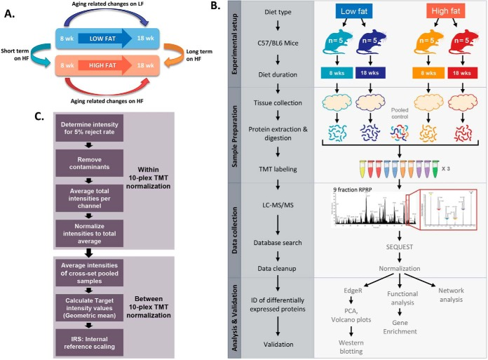
Experimental setup and workflow for comparison of diet and age related changes in epididymal adipose proteome.
Notes:
western blot is a laboratory method used to detect specific protein molecules from among a mixture of proteins.

Slide 7
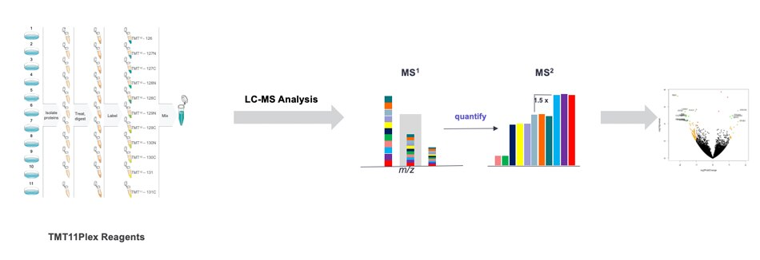
After fragmentation we could identify from the low m/z area of ms/ms
by matching the resulting ion peaks
Then we can quantify it by comparing the intensities of the reporter ions.
Notes:
precursor mass of each isobaric tagging reagent within a set is the same.

Slide 8
TMT Versions
TMT enables analysis to be multiplexed?
because isobaric labels are available in up to 11 tags and can be used to label virtually any peptide or protein sample.
It also allow technical variation to be controlled further.
TMTzero, TMTduplex, TMTsixplex, TMT10plex, and TMT11plex Reagents all have the same structure, allowing for a smooth transition from method development to multiplex quantification.
Mass Shift of Different TMT Reagents
 | Mass shift
TMT 0 | 224.152478
TMT 2 | 225.155833
TMT 6/10 | 229.162932
TMT 11 | 229.169252
TMT Pro-zero | 295.18959
TMT Pro | 304.2071
Notes:
Mas shift defined as the exact mass of the ion minus the measured mass as described i

Slide 9
Advantages
There are no particular conditions for cell growth.
It's possible to apply it on primary tissue.
Multiplexing at a higher level.
Disadvantages
It has further noise
It has the potential to be costly.
Pressure

Slide 10
References
https://www.creative-proteomics.com/services/tmt-based-proteomics-service.htm
https://www.thermofisher.com/eg/en/home/industrial/mass-spectrometry/proteomics-mass-spectrometry/quantitative-proteomics-mass-spectrometry/tmt-quantitation.html
Extended Multiplexing of Tandem Mass Tags (TMT) Labeling Reveals Age and High Fat Diet Specific Proteome Changes in Mouse Epididymal Adipose Tissue (nih.gov)

