Slide 1

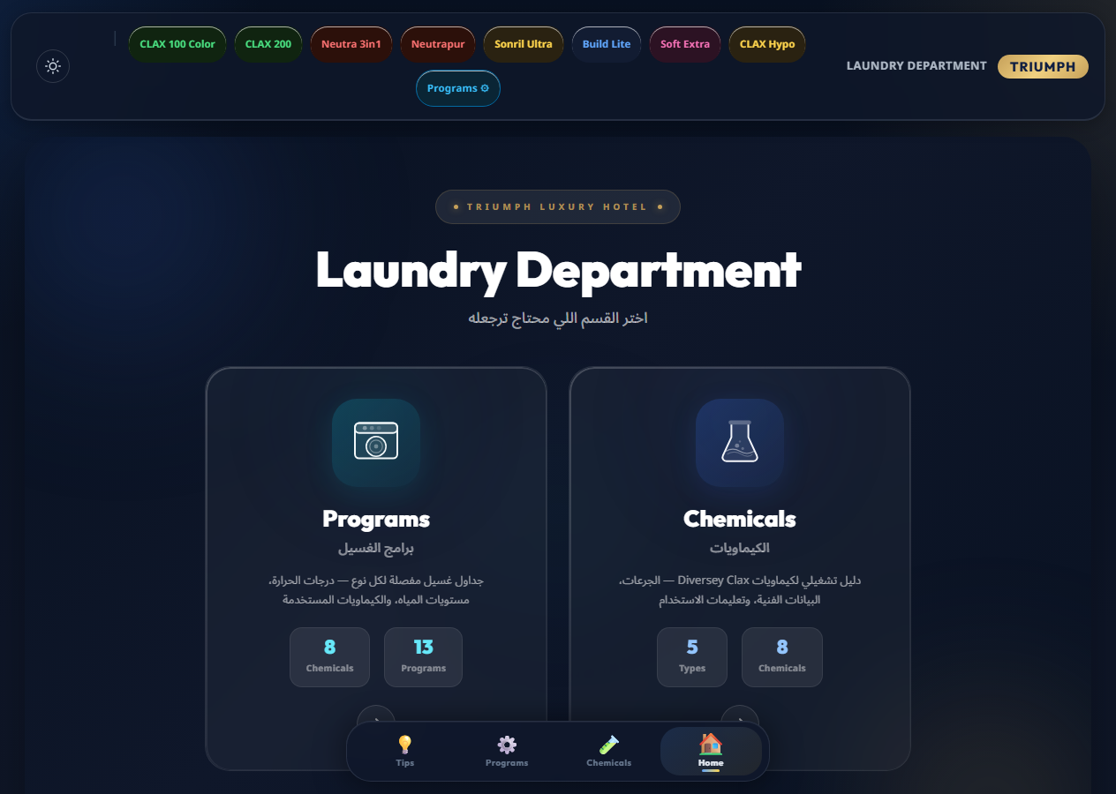
TRIUMPH LAUNDRY GUIDE
A single operations reference for chemicals, programs, and floor decisions.
A concise product presentation for the internal Triumph Luxury Hotel Laundry Department webapp. The guide brings daily chemical lookup, wash formulas, dosage tables, and team navigation into one browser-based workspace.
Home hub
8
13
5
One entry point separates chemical reference, washing programs, and tips for fast routing.
Chemicals
Programs
Types
Clax product reference
Standard wash formulas
Filtered by function
Source: local Triumph Laundry Guide webapp files
01

Slide 2
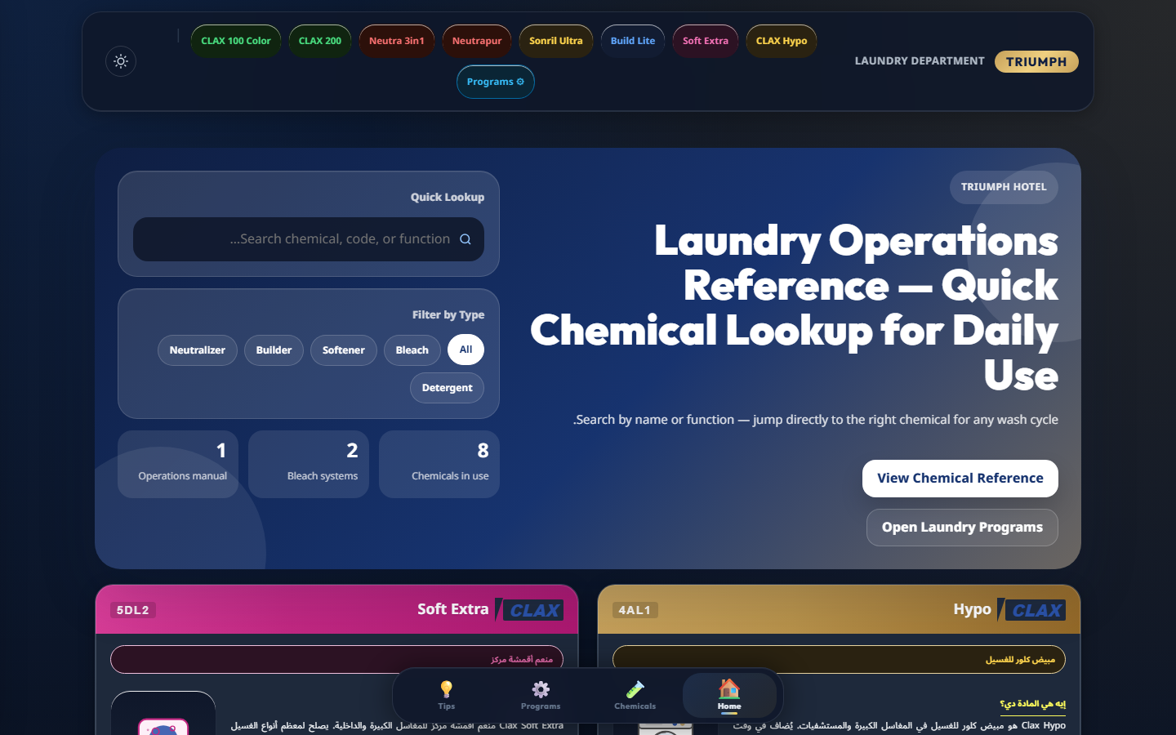
CHEMICAL LOOKUP
Chemical selection is reduced to search, filter, verify.
The chemical section is designed around the question operators ask first: what product fits this cycle, and what dosage or safety detail should be checked before use?
Reference coverage
Bleach
2
Neutralizer
2
Detergent
2
Softener
1
Lookup path
Builder
1
1
Search
2
Filter
3
Verify
name, code, or function
by chemical type
dosage, data, safety
Hypo
Soft Extra
Build Lite
CLAX 200
Source: local Triumph Laundry Guide webapp files
02

Slide 3
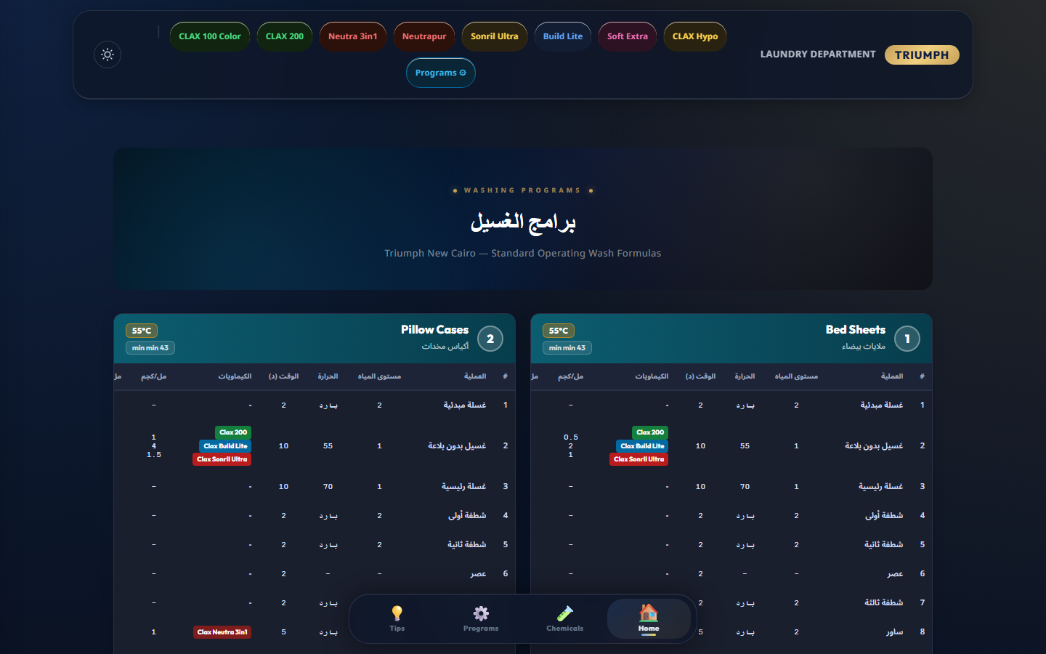
WASH FORMULAS
Thirteen wash formulas standardize linen and uniform handling.
Program cards make operating parameters visible in one place: process step, water level, temperature, time, chemical, and dosage. The result is a shared reference for repeatable handling.
Program family
Count
Examples
Room linen
2
Bed sheets, pillow cases
Towels
3
White, pool, colored towels
Table linen
2
White and colored table linen
Uniforms & colors
4
Kitchen jacket, uniforms, light colors
Operational proof
Utility cycles
2
Sour bath and rinse only
The table grammar makes every program auditable: a staff member can compare step order, time, temperature, and chemical dose without switching documents.
Source: local Triumph Laundry Guide webapp files
03

Slide 4
INFORMATION ARCHITECTURE
The structure follows the team path from question to procedure.
The app is not just a document dump. It separates decision routes so the operator can move from the type of question to the exact table or product card that resolves it.
Decision routes
Chemicals
Product card
Search or filter
Purpose, dose, safety
Question
What product?
Home hub
Choose section
Tips
Question
Operating guidance
Which program?
Programs
Formula table
Question
Select wash formula
Step, temp, time, dose
How to operate?
Source: local Triumph Laundry Guide webapp files
04

Slide 5
FLOOR EXPERIENCE
Floor use is supported by fast navigation and clear state controls.
The UI keeps repeated operational tasks close: persistent navigation, dark/light mode, section switching, and filter state all support quick checks during active laundry work.
Persistent sections
Home, Chemicals, Programs, Tips remain one click away.
Search-first lookup
The chemical search field targets name, code, and function.
Type filters
Bleach, softener, builder, neutralizer, and detergent reduce scanning.
Operational value
The app reduces the need to remember formulas, locate PDFs, or ask for routine reference details during a wash cycle.
Theme control
Dark/light mode supports different room lighting and device use.
Source: local Triumph Laundry Guide webapp files
05

Slide 6
NEXT STEP
The next version can move the guide toward an operating control layer.
Value bridge
Onboarding
Consistency
The current webapp already centralizes knowledge. A pragmatic roadmap can add offline access, printable formula views, update control, and eventually inventory or usage signals without changing the core workflow.
Safety
Less rework
Today
Near term
Next
Later
Reference guide
Floor-ready access
Controlled updates
Operating signals
Static chemical and program lookup
Offline/PWA, print views, QR entry
Manager edits, approval history
Chemical stock and usage tracking
Recommended close
Keep the current product simple, but make the next release operational: offline availability, printable formulas, and a controlled way for laundry leadership to update procedures.
Source: local Triumph Laundry Guide webapp files
06

