Slide 1

Flight delay Prediction
by
Team 3
Present on: May 7th, 2024

Slide 2
Our Team
Javier Gutierrez , title
Javier
Pawal
Rabiat

Slide 3
Our Team
Pawel Kryj, title
Pawal
Rabiat
Javier

Slide 4
Our Team
Rabiat Ibrahim, title
Rabiat
Javier
Pawal

Slide 5

Introduction
Problem statement
Agenda
Analysis and Insights
Modelling
Result and Discussion
Conclusion

Slide 6
Introduction
Problem statement
Agenda
Analysis and Insights
Modelling
Result and Discussion
Conclusion

Slide 7
Introduction
Problem statement
Agenda
Analysis and Insights
Modelling
Result and Discussion
Conclusion

Slide 8
Introduction
Problem statement
Agenda
Analysis and Insights
Modelling
Result and Discussion
Conclusion

Slide 9
Introduction
Problem statement
Agenda
Analysis and Insights
Modelling
Result and Discussion
Conclusion

Slide 10
Introduction
Problem statement
Agenda
Analysis and Insights
Modelling
Result and Discussion
Conclusion

Slide 11

Problem Statement
Flight delays not only frustrate air passengers and disturb their itineraries but also lead to:
Reduced efficiency
Elevated capital costs due to the reallocation of flight crews and aircraft
Added crew expenses
Consequently, an airline's history of flight delays can adversely affect passenger demand.

Slide 12
Project Goal
To provide airline stakeholders with analysis and prediction tool that enables them to make data-driven decisions on preventive measures to avoid flight delays.
Objective
Goal

Slide 13
Project Goal
Analyse and extract insight from the Tunisian airline delay dataset.
Develop a machine learning-based model for predicting flight delay.
Goal
Objective

Slide 14

About the dataset
Features
ID
Date of flight
Flight number
Departure point
Arrival point
Scheduled time departure
Scheduled time arrival
Flight status
Aircraft code
Target

Slide 15
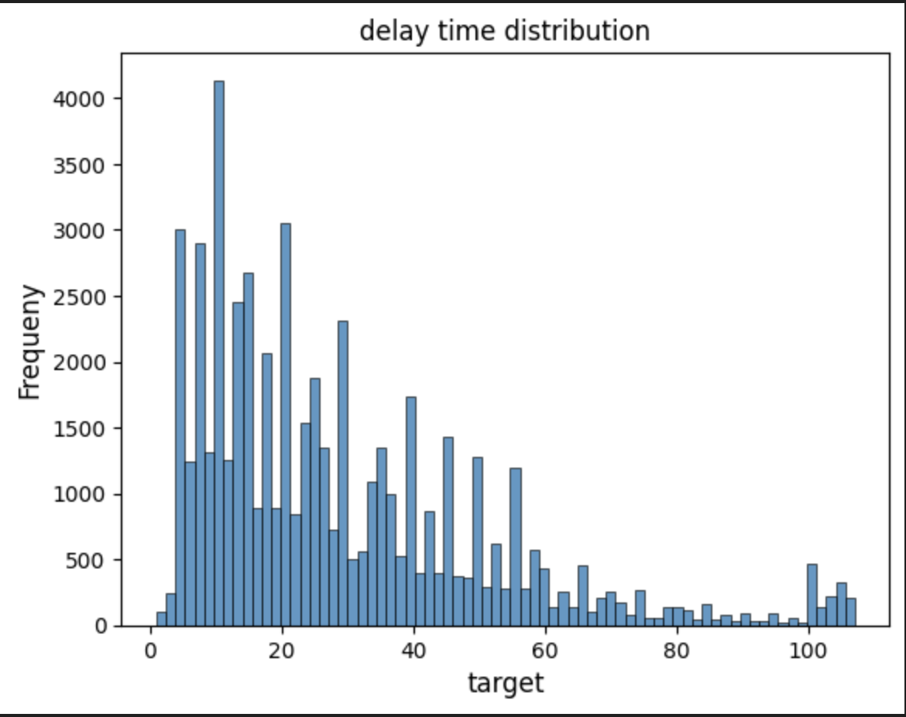
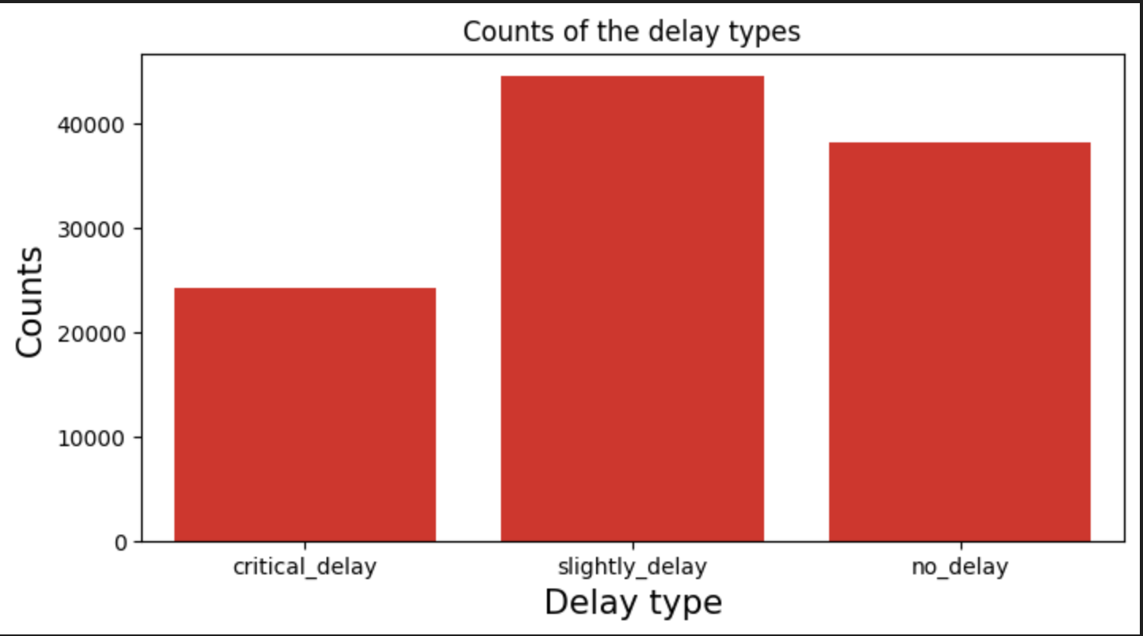
There are more frequent occurrences of delay short-time delay.
Analysis and Insights

Slide 16
There are more frequent occurrences of delay short-time delay.
Analysis and Insights

Slide 17
Baseline model
Modelling

Slide 18
Pipeline
Modelling

Slide 19
Modelling

Slide 20
Result and Discussion

Slide 21
Conclusion

Slide 22


